Slide 1


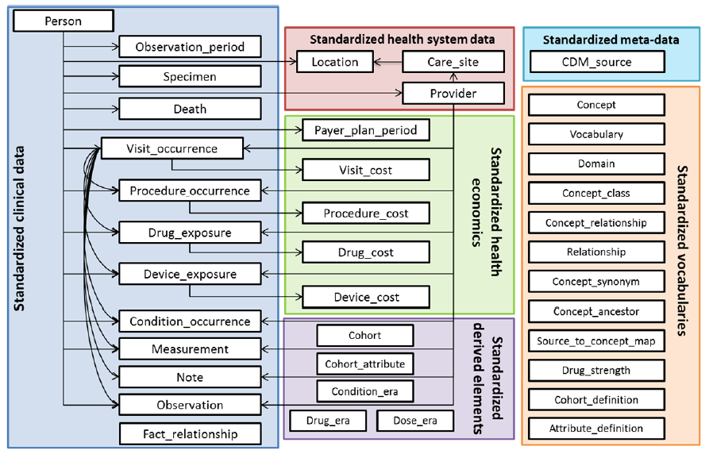


DaVINCI: DoD OMOP Overview
CDW
Outpatient
Inpatient
Fee
Labs
Vitals
Pharmacy
MDR
CAPER
SIDR
TEDNI
Ancillary
Vitals
PDTS

Slide 2
Objectives
Attendees will be able to:
Describe how key DoD Source data is mapped into OMOP
Describe similarities and differences with VA OMOP
Understand current status of DoD OMOP and the future vision for DaVINCI

Slide 3
The OMOP Common Data Model (CDM)

Slide 4
DoD OMOP table development status (v1)
# | OMOP Table | Status | Record Count
1 | Person | Complete | 8,212,896
2 | Location | Complete | 171,450
3 | Care_site | Complete | 44,984
4 | Provider | Complete | 6,924,062
5 | Visit_occurrence | Complete | 1,356,265,863
6 | Death | Complete | 461,137
7 | Procedure_occurrence | Complete | 2,720,437,944
8 | Drug_exposure | Complete | 526,696,394
9 | Condition_occurrence | Complete | 2,481,422,654
10 | Observation | In development | 356,235,664
11 | Device_exposure | In development | 84,717,236
12 | Fact_relationship | In development
13 | Measurement | In development
14 | Note | Not started
15 | Specimen | Not started
16 | Observation_period | Not started
17 | Payer_plan_period | Not started

Slide 5

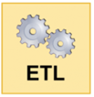
DoD Mappings to OMOP tables
DoD Source table | Source Transform / Split
DEERS | DEERS Person
 | DEERS Provider
SIDR (Inpatient) | SIDR Provider
 | SIDR Death
 | SIDR Visit_occurrence
 | SIDR Procedure_occurrence
 | SIDR Drug_exposure
 | SIDR Device_exposure
 | SIDR Condition_occurrence
 | SIDR Measurement
 | SIDR Observation
CAPER (Outpatient) | CAPER Provider
 | CAPER Visit_occurrence
 | CAPER Procedure_occurrence
 | CAPER Drug_exposure
 | CAPER Device_exposure
 | CAPER Condition_occurrence
 | CAPER Measurement
 | CAPER Observation
Source Split | OMOP table
VM6BEN Person | Person
VM6BEN Provider | Provider
SIDR Provider
CAPER Provider
TEDN Provider
PDTS Provider
TEDI Care_site | Care_site
TEDN Care_site
PDTS Care_site
Master Death | Death
SIDR Visit_occurrence | Visit_occurrence
CAPER Visit_occurrence
TEDI Visit_occurrence
TEDN Visit_occurrence
SIDR Procedure_occurrence | Procedure_occurrence
CAPER Procedure_occurrence
TEDI Procedure_occurrence
TEDN Procedure_occurrence
Ancillary Lab/Rad Procedure_occurrence

Slide 6
DoD Mappings to OMOP tables
DoD Source table | Source Transform / Split
TEDI (PC Inpatient) | TEDI Care_Site
 | TEDI Visit_occurrence
 | TEDI Procedure_occurrence
 | TEDI Drug_exposure
 | TEDI Device_exposure
 | TEDI Condition_occurrence
 | TEDI Measurement
 | TEDI Observation
TEDN (PC Professional) | TEDN Provider
 | TEDN Care_site
 | TEDN Visit_occurrence
 | TEDN Procedure_occurrence
 | TEDN Drug_exposure
 | TEDN Device_exposure
 | TEDN Condition_occurrence
 | TEDN Measurement
 | TEDN Observation
PDTS (Scripts) | PDTS Provider
 | PDTS Care_site
 | PDTS Drug_exposure
Ancillary Lab/Rad | Ancillary Lab/Rad Procedure_occurrence
 | Ancillary Lab/Rad Observation
Source Split | OMOP table
SIDR Drug_exposure | Drug_exposure
CAPER Drug_exposure
TEDI Drug_exposure
TEDN Drug_exposure
PDTS Drug_exposure
SIDR Device_exposure | Device_exposure
CAPER Device_exposure
TEDI Device_exposure
TEDN Device_exposure
SIDR Condition_occurrence | Condition_occurrence
CAPER Condition_occurrence
TEDI Condition_occurrence
TEDN Condition_occurrence
SIDR Measurement | Measurement
CAPER Measurement
TEDI Measurement
TEDN Measurement
SIDR Observation | Observation
CAPER Observation
TEDI Observation
TEDN Observation
Ancillary Lab/Rad Observation

Slide 7
DoD OMOP ETL Specification
Kennell has developed a robust ETL specification workbook and Source Mapping workbook
Describes all of the business rule logic for how source data records and fields are used to populate all of the OMOP tables
Similar to the VA OMOP database specification located on VA Pulse: https://www.vapulse.net/servlet/JiveServlet/downloadBody/60310-102-12-210474/VINCI_OMOPv5_Database_Data_Specifications_2018%2006%2026.pdf

Slide 8
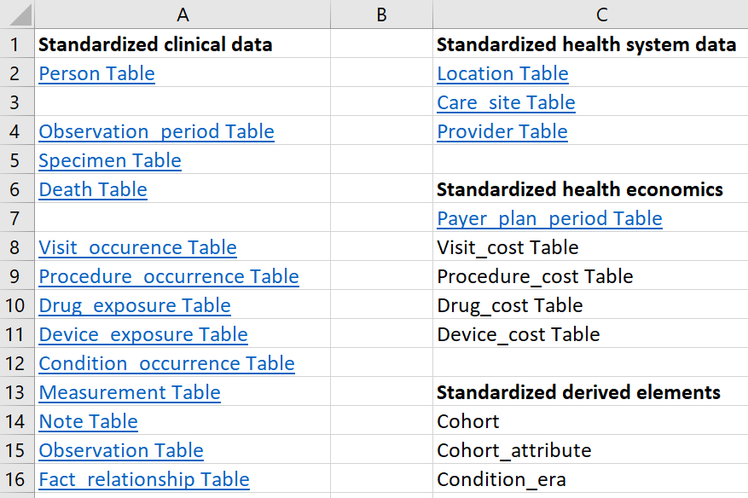
DoD OMOP ETL Specification
From the table of contents, click hyperlink for desired table to get to the business rules:

Slide 9
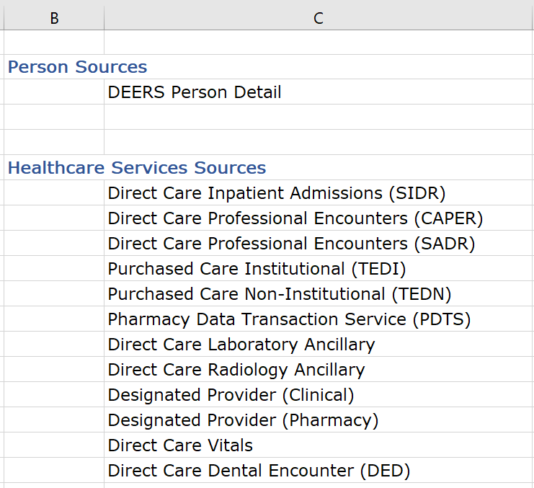
DoD Source Mappings to OMOP
Similarly, source mappings go in the other direction, from the perspective of the source tables:

Slide 10
CDM: What is it and why have one?
What is the OMOP Common Data Model (CDM)?
The OMOP Common Data Model allows for the systematic analysis of disparate databases. The concept behind this approach is to transform data contained within those databases into a common format (data model) as well as a common representation (terminologies, vocabularies, coding schemes), and then perform systematic analyses using a library of standard analytic routines that have been written based on the common format.
Why do we need a CDM?
Observational databases differ in both purpose and design. Electronic Medical Records (EMR) are aimed at supporting clinical practice at the point of care, while administrative claims data are built for the insurance reimbursement processes. Each has been collected for a different purpose, resulting in different logical organizations and physical formats, and the terminologies used to describe the medicinal products and clinical conditions vary from source to source.
Why use the OMOP CDM?
Once a database has been converted to the OMOP CDM, evidence can be generated using standardized analytics tools. OHDSI is currently developing Open Source tools for data quality and characterization, medical product safety surveillance, comparative effectiveness, quality of care, and patient-level predictive modeling.
source: https://www.ohdsi.org/data-standardization/

Slide 11
Mapping any data source to the OMOP model
VistA
CDW
OMOP
Cerner
HealthEDW
OMOP
Query using the same SQL code
AHLTA / CHCS
MDR
OMOP
Medicare Claims
CMS Data Repository
OMOP

Slide 12
Inconsistencies within source data
Table | Field Name | Definition
DEERS | person_id | DEERS Person ID of the beneficiary (EDIPN)
SIDR | Patient_Unique_ID | EDIPN of the beneficiary
CAPER | PersonID | Unique patient identifier supplied by the Defense Manpower Data Center (DMDC). The Electronic Data Interchange Person Number (EDI_PN).
TEDI | personid | DEERS Electronic Data Interchange Person ID (EDIPN)
TEDNI | PersonID | DEERS Electronic Data Interchange Person ID (EDIPN)
PDTS | PatientIdentifier | A unique identifier of a person, as assigned by DEERS. This is sometimes, under HIPAA, called the Electronic Data Interchange - Patient Identifier (EDI-PN).
Anc Lab | PersonID | DEERS Person ID (EDIPN)
Anc Rad | PersonID | DEERS Person ID (EDIPN)
DESPROV | PATID | Identifier associated with a specific patient.
Vitals | EDI_PN | Unique person identifier.
Immunizations | bnfcry_deers_id | Unique patient identifier supplied by the Defense Manpower Data Center (DMDC). The Electronic Data Interchange Person Number (EDI_PN).

Slide 13
Disparate tables in source data
50+ DoD Tables
DEERS | Designated Provider (Pharmacy) | Health Risk | Behavioral Health Screenings
PDTS | CDR Immunizations | Pathology Results | ADDP Providers
TED-I | Chemistry | Microbiology Results | TRICARE Dental Program Provider
TED-NI | Radiology Results | Medications | DEERS PITE
CAPER | Master Death | Microbiology Susceptibility | TEDPR
SADR | DEERS LVM | SO Notes | NPPES
SIDR | TMDS Encounter | Dental Encounter Data | DMHRSi-HR
DMIS ID Table | TMDS Medications | ADDP Claims | HCPR
Ancillary Procedures | Genesis Immunizations | TRICARE Dental Program Claims | Enrollment MEPRS Code File
Vitals | Casualty Death | Tricare Retiree Dental Program Claims | Contingency Tracking System
Designated Provider (Clinical) | Separatee Table | MMSO Dental Care Claims | Referral
Risk Adjustment | Address | Appointment | Reservist

Slide 14
The Case for OMOP
The OMOP project will succeed if we provide data which requires less institutional knowledge and is easier to use
Use of the data model is more straight forward compared to health care system data warehouses, but care must be taken to still understand the nature of the underlying data
The OMOP data model is optimized for carrying out comparative effectiveness analyses for medications and devices within a cohort population
How else are you going to combine DoD and VHA data???

Slide 15
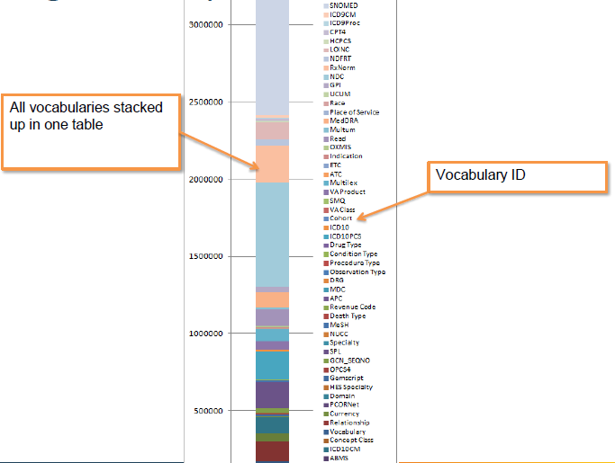
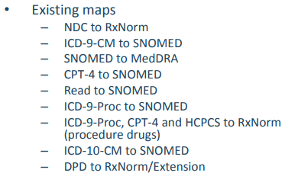
Single Concept table
For every code that exists there is a map to a Standard Concept:

Slide 16
OMOP Field naming conventions
Most OMOP tables have the following fields with these suffixes in them:
  *_SOURCE_VALUE : this is the actual text or numeric value in the source data. (ex. “401.9” – the ICD9 Dx for hypertension)
  *_SOURCE_CONCEPT_ID: the OMOP identifier from the CONCEPT table, representing the OMOP concept ID for the source value.
  *_CONCEPT_ID: this is the “standardized” vocabulary mapping of the OMOP concept (ex. 59621000, the OMOP “standard” concept id for the SNOMED value for Essential Hypertension)
  *_ID: auto-generated primary key, like a counter.

Slide 17
What is a “Concept”?
CONCEPT_ID | 45595909 |  | For use as the OMOP ID
CONCEPT_NAME | Post-traumatic stress disorder |  | English description
DOMAIN_ID | Condition |  | Domain
VOCABULARY_ID | ICD10 |  | Vocabulary
CONCEPT_CLASS_ID | ICD10 code
STANDARD_CONCEPT |  |  | ‘S’ or null – ‘S’ means the “Standard” concept
CONCEPT_CODE | F43.1 |  | This is the value of the ICD10 Dx code
CONCEPT_ID | 436676
CONCEPT_NAME | Posttraumatic stress disorder
DOMAIN_ID | Condition
VOCABULARY_ID | SNOMED
CONCEPT_CLASS_ID | Clinical Finding
STANDARD_CONCEPT | S
CONCEPT_CODE | 47505003
This is the SNOMED concept ID used as the “Standard” concept for PTSD in the Condition table

Slide 18
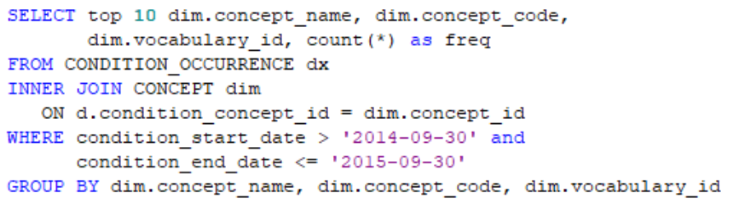
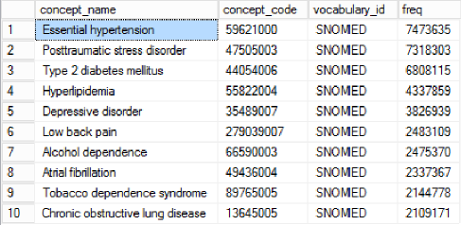
Top DoD and VA concepts for Condition_occurrence
VA
DoD
Concept_Name | CONCEPT_CODE | Vocabulary_ID | Freq
General finding of observation of pat | 118222006 | SNOMED | 34,471,286
Essential hypertension | 59621000 | SNOMED | 3,470,697
Low back pain | 279039007 | SNOMED | 2,733,862
Type 2 diabetes mellitus | 44054006 | SNOMED | 2,493,430
Hyperlipidemia | 55822004 | SNOMED | 2,205,494
Arthralgia of the lower leg | 267953003 | SNOMED | 2,025,120
Obstructive sleep apnea syndrome | 78275009 | SNOMED | 2,006,211
Shoulder joint pain | 267949000 | SNOMED | 1,612,318
Atrial fibrillation | 49436004 | SNOMED | 1,332,396
Benign essential hypertension | 1201005 | SNOMED | 1,313,711

Slide 19
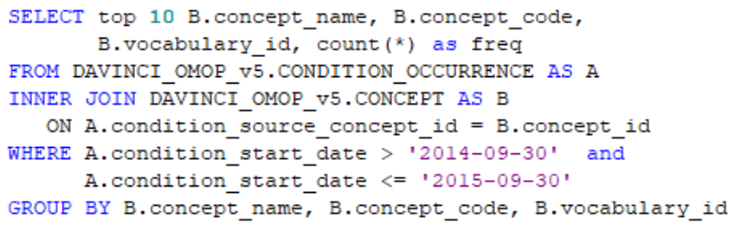
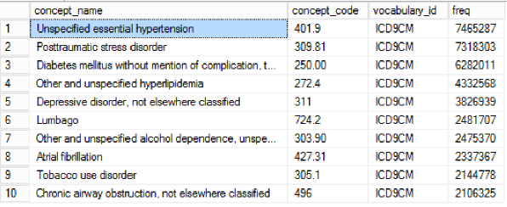
Top DoD and VA concepts for Condition_occurrence
DoD
VA
Concept_Name | CONCEPT_ CODE | Vocabulary_ ID | Freq
Other ill-defined conditions | 799.89 | ICD9CM | 34,471,280
Unspecified essential hypertension | 401.9 | ICD9CM | 3,467,033
Lumbago | 724.2 | ICD9CM | 2,733,708
Other and unspecified hyperlipidemia | 272.4 | ICD9CM | 2,203,334
Diabetes mellitus without mention of complication | 250 | ICD9CM | 2,172,795
Pain in joint, lower leg | 719.46 | ICD9CM | 2,025,120
Obstructive sleep apnea | 327.23 | ICD9CM | 2,005,932
Pain in joint, shoulder region | 719.41 | ICD9CM | 1,612,294
Atrial fibrillation | 427.31 | ICD9CM | 1,331,993
Benign essential hypertension | 401.1 | ICD9CM | 1,313,711

Slide 20
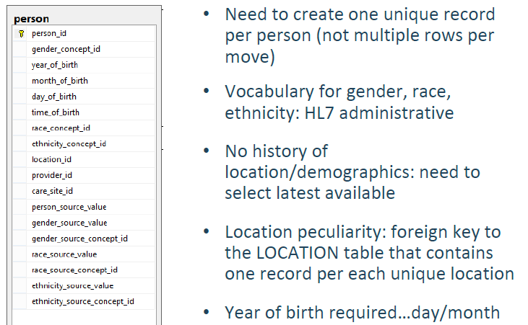
Person Table
One unique record per person
Vocabulary for gender, race, ethnicity
While it is possible for a PERSON to change genders, LOCATIONs, and PROVIDERS over time, it is the responsibility of the data holder to select the one value to use in the CDM

Slide 21
Person Table
DAVINCI Cohort:

Slide 22
Person Table Comparison DoD vs. VA
 | VA | DoD
Source Tables | SPatient | DEERS Beneficiary Detail
Source Person Field | PatientICN or PatientSID | EDIPI or PATSSN

Slide 23
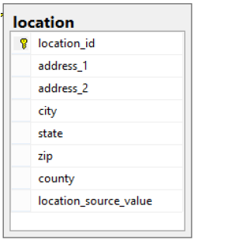
Location table
Contains one record per each unique location
Location is highly variable across sources
Table represents a generic way to capture physical location or address information.
LOCATIONS are used to define the addresses for PERSONS and CARE_SITES

Slide 24
Location table Comparison DoD vs. VA
 | VA | DoD
Source Tables | SPatientAddress and Dim.Institution | Address file, DMISID, NPPES, PC Providers
Source Location Fields | Address1-3, City, State, ZIP | Address, City, State, ZIP

Slide 25
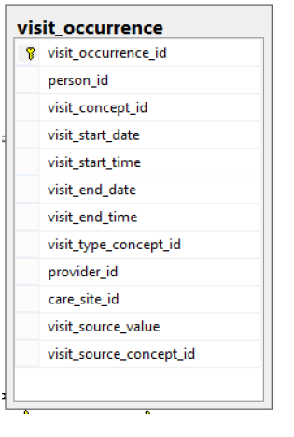
Visit_occurrence table
Visits <> ‘Encounters’:
  Claims often need to be consolidated to minimize double-counting
  Inpatient records have a lot of duplication, overlap, and contradictory data
Visit Types
  Inpatient
  Emergency room
  Outpatient
  Long-term care

Slide 26
Visit_occurrence Comparison DoD vs. VA
 | VA | DoD
Source Tables | Outpat.Visit, Dim.MASMovementType, Inpat.Inpatient, FeeBasis | SIDR, CAPER, TEDI, TEDN, Designated Provider, TMDS
Source Location Fields | Outpat.Visit.VisitSID Inpatient.InpatientSID Inpatient.StartPatientStransferSID Inpatient.EndPatientStransferSID | If CAPER, DMISID+MEPRS If TEDNI, TEDNO If SIDR, DMISID+PRN If TEDI, TEDNO If Desig, DMISID+RECID

Slide 27
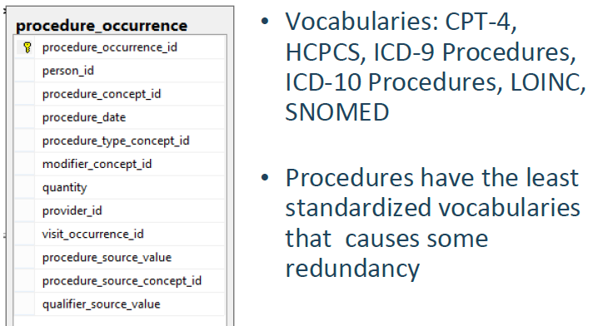
Procedure_occurrence table

Slide 28
Procedure_occurrence Comparison DoD vs. VA
 | VA | DoD
Source Tables | InpatientProcedure.ICD9ProcedureCode, InpatientProcedure.ICD10ProcedureCode, InpatientSurgicalProcedure.ICD9ProcedureCode, InpatientSurgicalProcedure.ICD10ProcedureCode, InpatientCPTProcedure.CPTCode, Outpat.VProcedure.CPTSID | SIDR CAPER TEDI TEDN Designated Provider Ancillary
Source Location Fields |  | Procedure 1 - Procedure 20; Diagnosis 1 - Diagnosis 20; Diagnosis, Admitting E&M Code 1 - E&M Code 3; Procedure 1 - Procedure 10; Diagnosis 1 - Diagnosis 10; Diagnosis, Chief Complaint Procedure 1 - Procedure 6, Diagnosis 1 - Diagnosis 12, Admission Diagnosis Procedure Code, Diagnosis 1 - Diagnosis 5 Procedure Code Procedure Code SVCPROC1 - SVCPROC6, HOSPPRCP, HOSPPRC2 - HOSPPRC6, PDX, DX2 - DX12, SVCDX1 - SVCDX6

Slide 29
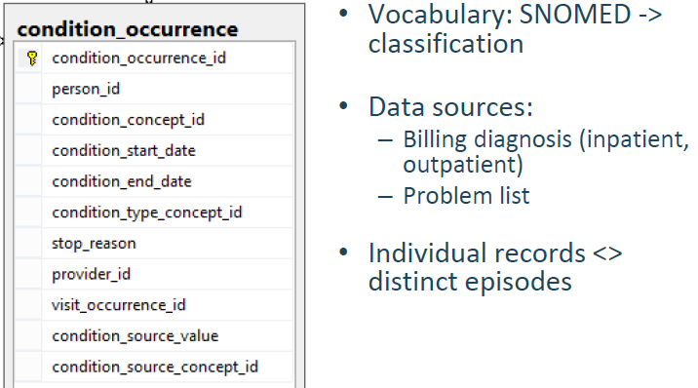
Condition_occurrence table

Slide 30
Condition_occurrence Comparison DoD vs. VA
 | VA | DoD
Source Tables | Inpat.InpatientDiagnosis. ICD9SID Inpat.InpatientDiagnosis. ICD10SID Outpat.VDiagnosis. ICD9SID Outpat.VDiagnosis. ICD10SID Inpat.InpatientFeeDiagnosis. ICD9SID Inpat.InpatientFeeDiagnosis. ICD10SID Source Dimension Tables Dim.ICD9 (ICD9SID -> ICD9Code) Dim.ICD10 (ICD10SID -> ICD10Code) | SIDR CAPER TEDI TEDN Designated Provider Ancillary
Source Location Fields |  | Diagnosis 1 - Diagnosis 20; Diagnosis, Admitting Diagnosis 1 - Diagnosis 10; Diagnosis, Chief Complaint Diagnosis 1 - Diagnosis 12, Admission Diagnosis Diagnosis 1 - Diagnosis 5 PDX, DX2 - DX12, SVCDX1 - SVCDX6

Slide 31
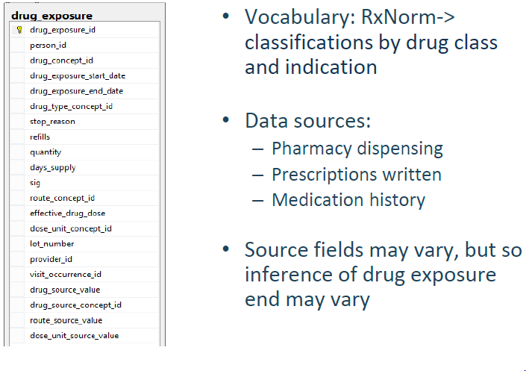
Drug_exposure table

Slide 32
Drug_exposure Comparison DoD vs. VA
 | VA | DoD
Source Tables | BCMAadditive.LocalDrugSID BCMASolution.LocalDrugSID BCMADispensed.LocalDrugSID RxOutpatientFill.LocalDrugSID CPTCodeSource.CPTCode | PDTS CAPER TEDNI CDR Medications CDR Immunizations SIDR TEDI Designated Provider (Pharmacy) Designated Provider (Clinical)
Source Location Fields |  | NDC E&M Code 1 - E&M Code 3; Procedure 1- Procedure 10 IMMUNIZATION_ID Procedure 1 - Procedure 20 SVCPROC1 - SVCPROC6, HOSPPRCP, HOSPPRC2 - HOSPPRC6

Slide 33
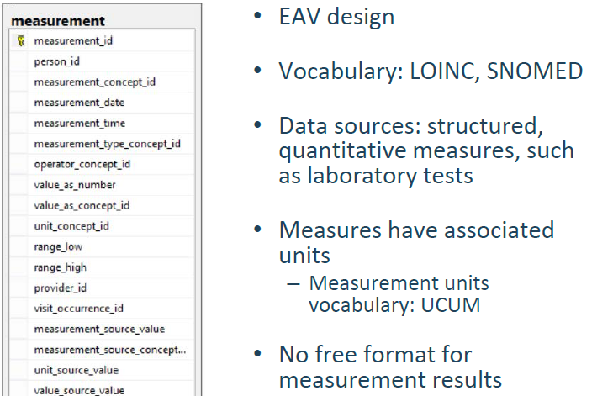
Measurement table

Slide 34
Measurement Comparison DoD vs. VA
 | VA | DoD
Source Tables | Chem.PatientLabChem Vital.VitalSign | CDR Vitals CDR Chemistry SIDR CAPER TEDI TEDN Designated Provider (Clinical)
Source Location Fields | LOINCSID VitalTypeSID | Blood Pressure (Sitting, Standing, Supine, and No Position); Heart Rate (Sitting, Standing, Supine, and No Position); Heart Rhythm (Sitting, Standing, Supine, and No Position); Height; Oxygen Saturation; Peak Flow; Respiratory Rate; Temperature; Temperature Site; Weight RESULT_LOINC Diagnosis 1 - Diagnosis 20; Diagnosis, Admitting

Slide 35
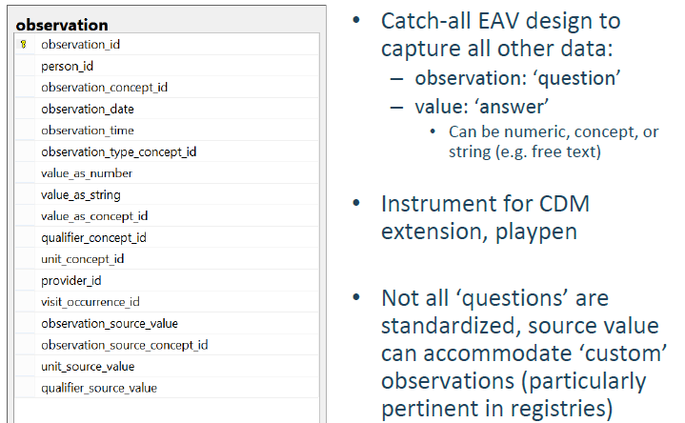
Observation table

Slide 36
Observation table Comparison DoD vs. VA
DESCRIPTION:
The OBSERVATION domain captures any clinical facts about a PERSON obtained in the context of examination, questioning or a PROCEDURE. The OBSERVATION table supports capture of data not represented by other DOMAINs, including social and lifestyle facts, medical history, family history, etc. are recorded here.
 | VA | DoD
Source Tables | Inpatient.PlaceofDisposition Inpatient.DispositionType Inpatient.DRG Inpatient.AdmitSourceName | SIDR CAPER TEDI TEDN Designated Provider (Clinical) CDR Vitals CTS Separatee Referrals Health Risk Risk Adjustment
Source Location Fields |  | MS-DRG; Disposition Status Code; Admission Source; MDC Alcohol Annoy, Alcohol Cut Down, Alcohol Eye Opener, Alcohol Guilt, Alcohol Use, Pain Scale, Tobacco Amount Used, Tobacco Desire to Quit, Tobacco Type Used, Tobacco User GRADE, SEPARATION

Slide 37
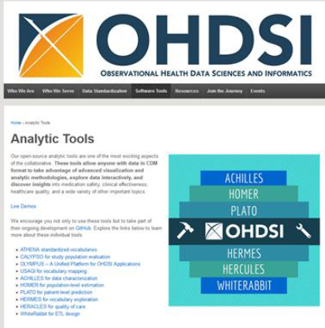
OHDSI tools to help with OMOP data

Slide 38
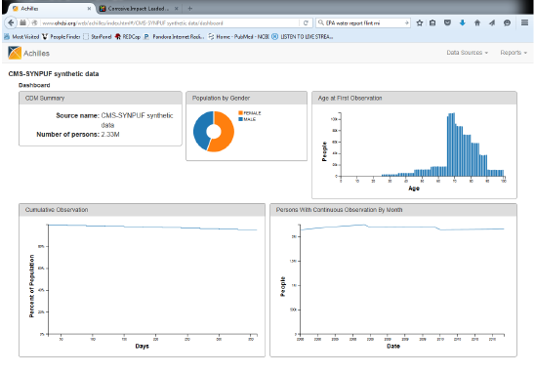
Visualizing data with Achilles

Slide 39
OMOP Table Locations in DaVINCI
DoD OMOP tables are currently being transferred to VINCI (as of 10/2018)

Slide 40
Questions

