Slide 1
R&D CONTRACTING BASICS
Submitting a Procurement Package
December 15, 2022
SETH CUSTER
Division Chief
VHA R&D Contracting Division

Slide 2
Webinar Housekeeping
Recording - This session is being recorded and the associated handouts will be available on ORPP&E’s Education and Training website within one-week post-webinar.
Close Captioning - Now available in the new Webex platform. Click the “CC” button at the bottom left of the Webex screen.
Experiencing Sound Issues? – Call in using the number in your Webex chat box or in your registration confirmation email.
Q&A - Please use the Q&A feature to submit questions.
Be sure to send questions to “All panelists”.
Questions will be addressed at the end of the webinar.
Webinar Archive - Most ORPP&E webinars can be found here: https://www.research.va.gov/programs/orppe/education/webinars/archives.cfm
Post-Webinar Evaluation Survey - We are grateful to all that complete the post-webinar evaluation survey. It will automatically pop up once the webinar is exited.
For questions, please use Q&A box and address to “All Panelists.”
All Webinars will be recorded and posted within one week.

Slide 3
R&D Contracting Division
Who are we?
1 team, 9 total staff – all East Time Zone
Seth Custer – Division Chief/Supervisor
Contracting Officers/Contract Specialists:
Michael Haydo
Lynn Portman
Ann Marie Stewart
Millicent “Mel” Covert
Robin Simmons
Rachael Talbott
Shannon Hukriede
Jaclyn Ferreira – Procurement Technician

Slide 4
R&D Contracting Division
Where to find us?
R&D Contracting Customer Center
Home - R&D Contracting Division - Customer Center (sharepoint.com)

Slide 5
Objectives – for today’s training
Training Section: | By the end of this section, you will:
Section 1: Resources for Procurement Package Guidance | Know where to go to find what I need Know what checklist(s) to utilize for guidance Know who I can reach out to for help
Section 2: Documents Required for a Complete Procurement Package | Know which documents are required in a procurement package Understand why documents are to be included
Section 3: How to Submit and What to Expect Next | Tips for a good FORCE submission Know standard PALT expectations for research requirements Know where to look for status updates on procurement actions
Q&A
Notes:
Jason -Section 1; John- Section 2; Kari- Section 2 and 3

Slide 6
Let’s Get Started!
Notes:
Jason -Section 1; John- Section 2; Kari- Section 2 and 3

Slide 7
Resources for Procurement Package Guidance
Where do I begin?
Determine type of procurement – Supply, Service, or Affiliate
R&D Contracting Customer Center: Home - R&D Contracting Division - Customer Center (sharepoint.com)
Set Up for your convenience… use this!
Continuing to remake and update
VHA Customer Reference Guide: CRG - Customer Procedures (sharepoint.com)
What if I need help?
R&D Customer Center / Submission Instructions: R&D Contracting Division - Customer Center - How to Submit (sharepoint.com)
Procurement Technician: Jaclyn Ferriera
Division Chief/Supervisor: Seth Custer
Contract Specialist/Contracting Officer
Notes:
CLICK/SHOW R&D Contracting Customer Center Site

Slide 8
Procurement Package – What to Include
What is standard?
Procurement Checklist
Requirement Document – SOW, PWS, SON
Market Research
Independent Government Cost Estimate (IGCE)
6500.6
Other documents
Acquisition Plan
Justification & Approvals (J&A) / Limited Sources Justification (LSJ)
COR Nomination Letter
FITARA/BTT/ARM Approval
Site-Specific Information (Memo to File)

Slide 9
Procurement Package – What to Include

Slide 10
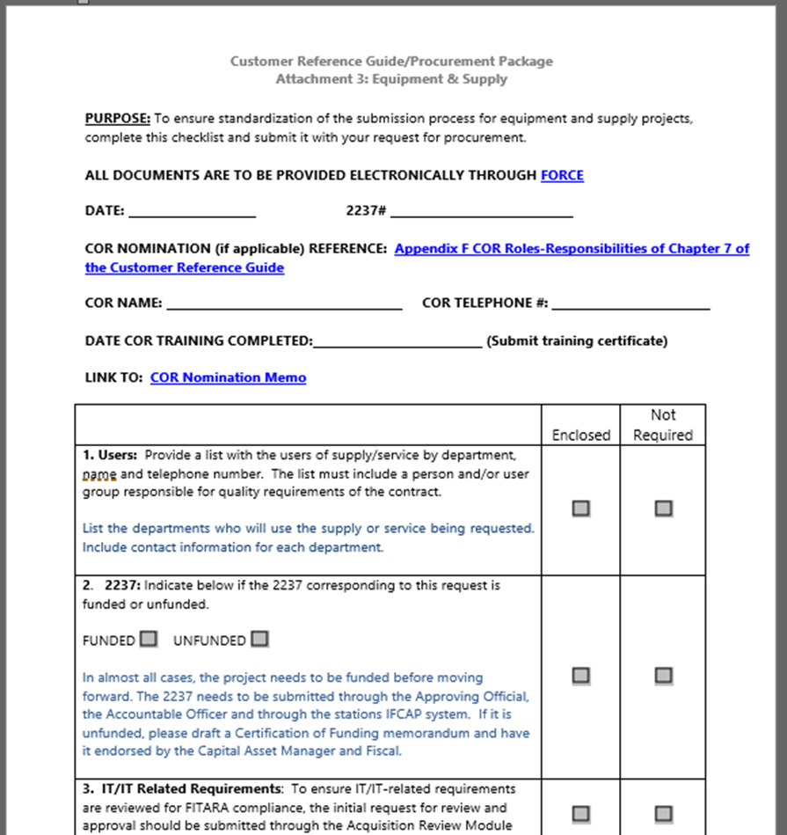
Procurement Package – Notes
Procurement Checklist
You tell us what goes in the package!
Pick most appropriate for type of procurement
Take this seriously, answer honestly
At a minimum, we should always see:
SOW/PWS/SON
Market Research
IGCE
6500.6
Funding/2237
Procurement Checklists: CRG - Customer Procedures (sharepoint.com)

Slide 11
Procurement Package – Notes
Requirements Document – SOW, PWS, SON
Foundation of the requirement
Start early
Use clear, direct language… layman’s terms
Be consistent – tense, tone, terminology
Be thorough
Include deliverables/schedule
Make no assumptions - if it’s not in, it’s not required!
Templates available
VABIT: Home - VHA Acquisition Business Intelligence Tool (VABIT) (sharepoint.com)
SOW Guidance: CRG - SOW PWS SOO (sharepoint.com)
SOW Writing Guide: CRG - Appendix A SOW Writing Guide (sharepoint.com)

Slide 12
Procurement Package – Notes
Market Research
Critical piece to drive the acquisition
Collaborative effort…you know the market!
The more, the better – be thorough
SAM registration! ***
Contracting contributions
Sources Sought Notice
Past procurements
Web/Database searches
Small Business size determination
Set-aside strategy
Market Research Guidance: CRG - Market Research (sharepoint.com)

Slide 13
Procurement Package – Notes
Independent Government Cost Estimate (IGCE)
Should be developed from multiple sources of information (independent)
Good market research drives good IGCE
Sets pricing structure for contract
Line items should relate to tasks or deliverables in SOW/PWS/SON
Commercial standard
Include options/out-years, if required
Drives review requirements and contributes to lead time
IGCE: CRG - Independent Gov Cost Estimate (sharepoint.com)
Guidelines for Developing IGCE: CRG - Appendix B IGCE Guide (sharepoint.com)

Slide 14
Procurement Package – Notes
Security Checklist – 6500.6
Required for all acquisitions
Purpose is to determine if contract requires access to VA systems or sensitive information
Joint review by CO, PO, ISSO, COR/POC/PM
If security considerations are not applicable, must be signed by the COR/POC
Complete Appendix A Checklist:
6500.6 Guidance: Contract Requirements for Security (sharepoint.com)
Hyperlinks throughout to take to the pdf version for checklist

Slide 15
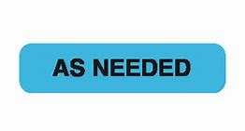
Procurement Package – What to Include

Slide 16
Procurement Package – Notes
Acquisition Plan
Required $7M and above
IPT required $7M and above – requires charter and formal documentation
Purpose is to document the agreement between the COR/POC/Requestor and the Contracting Officer
Provides clear documentation and guidance regarding program objectives
Formally captures everything covered previously to ensure agreement and direction
Engage early, can work on some of this before submitting to FORCE
Acquisition Planning: Acquisition Planning (sharepoint.com)

Slide 17
Procurement Package – Notes
Justification & Approvals (J&A) / Limited Sources Justification (LSJ)
J&A if open market; LSJ if FAR 8 (GSA/FSS)
Be sure to use right template based on size and source
Links available on R&D Customer Center
Only use if there is truly only ONE viable source or affiliate
Most critical sections are the justification and market research portions
Sole source is verified by sources sought announcement
J&A/LSJ Info/Templates: Other than Full and Open Competition (OFOC) (sharepoint.com)

Slide 18
Procurement Package – Notes
COR Nomination Letter
COR vs Technical POC
CORs are now RECOMMENDED, not required
POCs should do almost all of same tasks (overseeing performance, certifying invoices, etc), just without formal delegation
We will look to utilize CORs for more complex actions
COR Guidance/Templates: COR Guidelines (sharepoint.com)

Slide 19
Procurement Package – Notes
FITARA/BTT/ARM Approval
Federal Information Technology Acquisition Reform Act (FITARA)
Applicable to all VA IT/IT-Related Requirements
Driven by the Product/Service Code Selected: Product Service Codes (PSCs), Federal Supply Codes (FSCs), Federal Supply Groups (FSGs) (outreachsystems.com)
PSC/FSC starting with D### (Services) and 7@## (Supplies) – IT and Telecom
Link below includes overview and link to great SOP (see Policies on right of page)
What is required?
Must process approval to ensure item/service procured can access the network/VA information
Initiated/Driven by COR/POC, Contracting Officer is one step in approval process
FITARA Information: FITARA | Office of Information and Technology (va.gov)

Slide 20
Procurement Package – Notes
Local Site-Specific Information (Memo to File)
Notes for the Contracting Office
Narrative summary
Desired evaluation factors/methodology
Specify date requirements
POCs for the action
Distribution of Contract

Slide 21
FORCE Submission
Notes:
Jason -Section 1; John- Section 2; Kari- Section 2 and 3

Slide 22
FORCE Submission – Notes
FORCE Tips
Select the correct site when submitting (RPO East R&D)
Two fields for amounts
Estimated Action Amount (or IGCE) = base year total only
Estimated Total Amount (or IGCE Total) = total contract value
IGCE should include pricing estimates for total contract value
Approve 2237 after FORCE status changes to “Planning” (sends 2237 to R&D rather than NCO)
Submit appropriate request type (New Requirement, Modification, TO, Option)
If Mod, TO, Option, then include contract number in title

Slide 23
FORCE Submission – Notes
FORCE Tips (continued)
Use R&D documents/templates rather than local NCO
Title/Description should be clear to state what we’re buying
(no vendor name, person’s name, abbreviations, etc)
Need Dates should be realistic
Urgent/short timelines – reach out to Seth/Jaclyn to discuss
Do not populate CO name in new submissions
Do not sign where CO is supposed to sign (especially J&A/LSJ)
Do not submit 2237s for modifications, unless CO requests
Return vs Cancel 2237

Slide 24
FORCE Submission – Notes
FORCE Tips (continued)
To upload additional documents after initial submission and action is assigned (action in Planning status), click the icon on the new document to “upload to AAMS”; we will not get the document without this step; checkmark will display if done correctly; confirm with Contracting to ensure upload complete (Details tab).

Slide 25
What to Expect - PALT
PALT – Procurement Action Lead Times
Standard requirements less than $250k 60-90 days
Actions between $250k and $500k 120 days
Actions between $500k and $7M 150 days
Actions greater than $7M 180 days
Procurement Cutoff Dates for End of Year Execution
Standard requirements less than $250k June 30
Actions between $250k and $500k June 15
Actions between $500k and $7M May 1
Actions greater than $7M April 1

Slide 26
Communication Throughout
Assignment Message
Automated email for each FORCE action assignment
Status Updates
Working to post spreadsheet for open workload
Tony sends out Open Workload
Communication with Contracting
Know who is working your action
Stay in touch!

Slide 27
Questions

