Slide 1


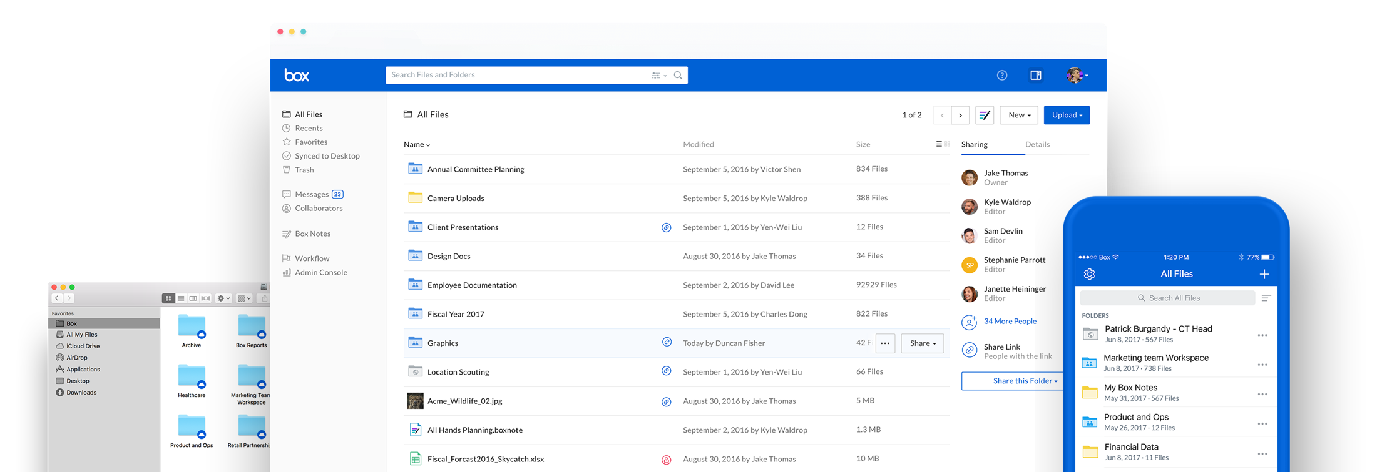
Qualtrics and Box

Slide 2






Today’s
Session
What is Box?
Navigating Box
Qualtrics Integration
Qualtrics and Box How-To
Box Features
Next Steps

Slide 3
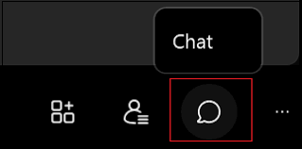
Chat Pod
Say hi in the chat!

Slide 4
/ Benefits of Box
What is Box?
What is Box?

Slide 5







What is Box?

Slide 6
What is Box?
One platform for secure content management, workflow, and collaboration; used to securely house Qualtrics survey data

Slide 7

How do you benefit from Box?
Unlimited storage of files up to 150 GB

Slide 8
How do you benefit from Box?
Unlimited storage of files up to 150 GB
Share internally & externally securely

Slide 9

How do you benefit from Box?
Unlimited storage of files up to 150 GB
Share internally & externally securely
Seamless Integrations

Slide 10

How do you benefit from Box?
Unlimited storage of files up to 150 GB
Share internally & externally securely
Seamless Integrations
Access anywhere on your device

Slide 11
/Understanding Box Structure and Purpose
Navigating Box
Navigating Box

Slide 12
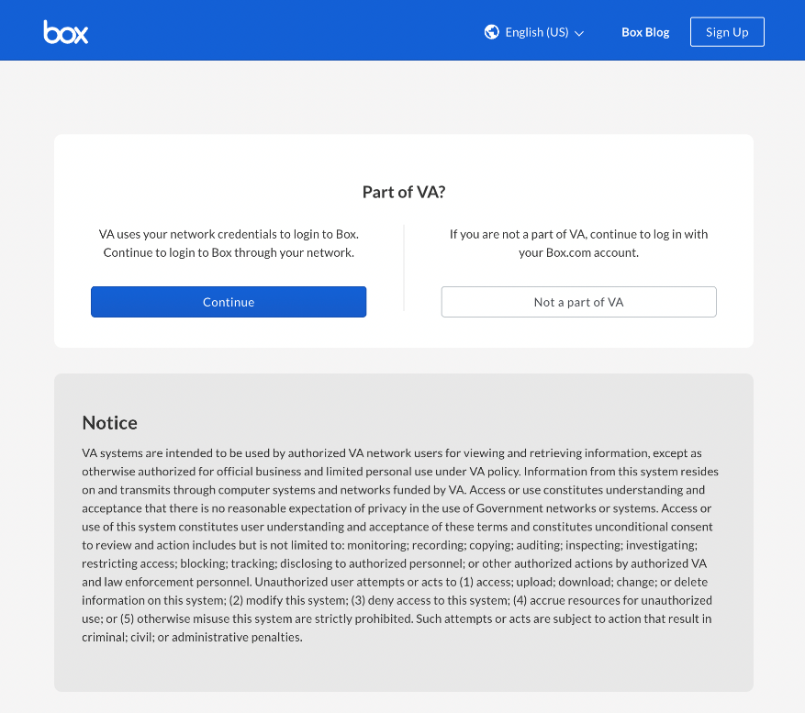
Logging into Box
From a VA-approved device, navigate to veteransaffairs.box.com, click continue, and enter your credentials

Slide 13
/ Survey Reporting
/ Relationship to Box
Qualtrics Integration
Qualtrics Integration

Slide 14
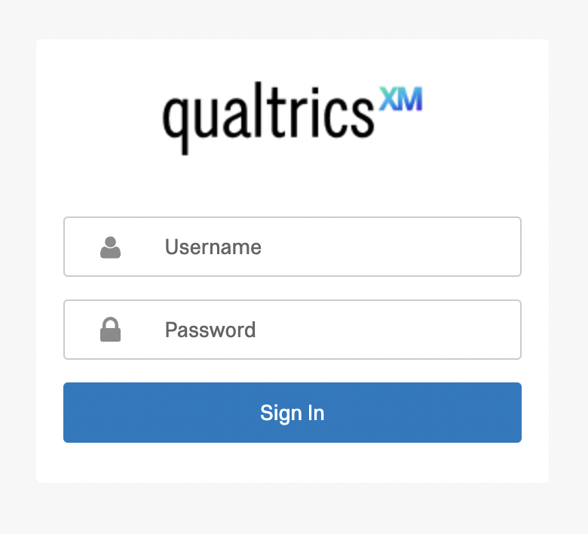
Logging into Qualtrics
Navigate to Qualtrics.com, click “Login,” and enter your credentials

Slide 15
Qualtrics and Box How-To
/How to automatically copy survey responses to your Box account
Qualtrics and Box How-To

Slide 16
What do I need to do first?
Survey owner is provisioned in VA Box, for internal VA users
Survey owner has permission in Qualtrics to “Collaborate” (granted by Qualtrics Administrator)

Slide 17
Setting your Survey to “Collaborate”
Remember to do the following steps BEFORE launching your survey!

Slide 18
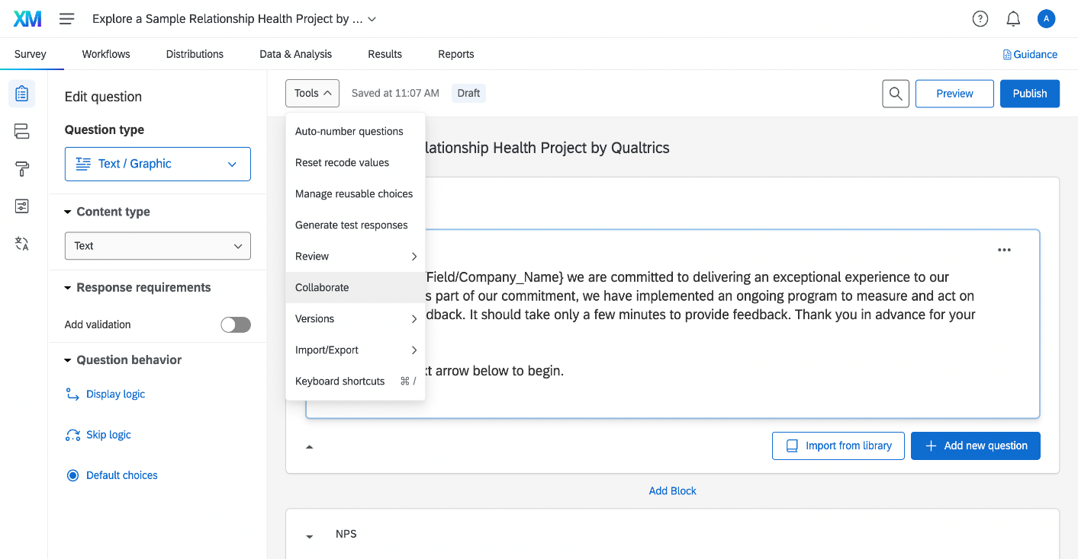
Setting your Survey to “Collaborate”
In Qualtrics, navigate to your survey, and from the project Survey tab, click Tools to view the sub-menu
Select Collaborate

Slide 19
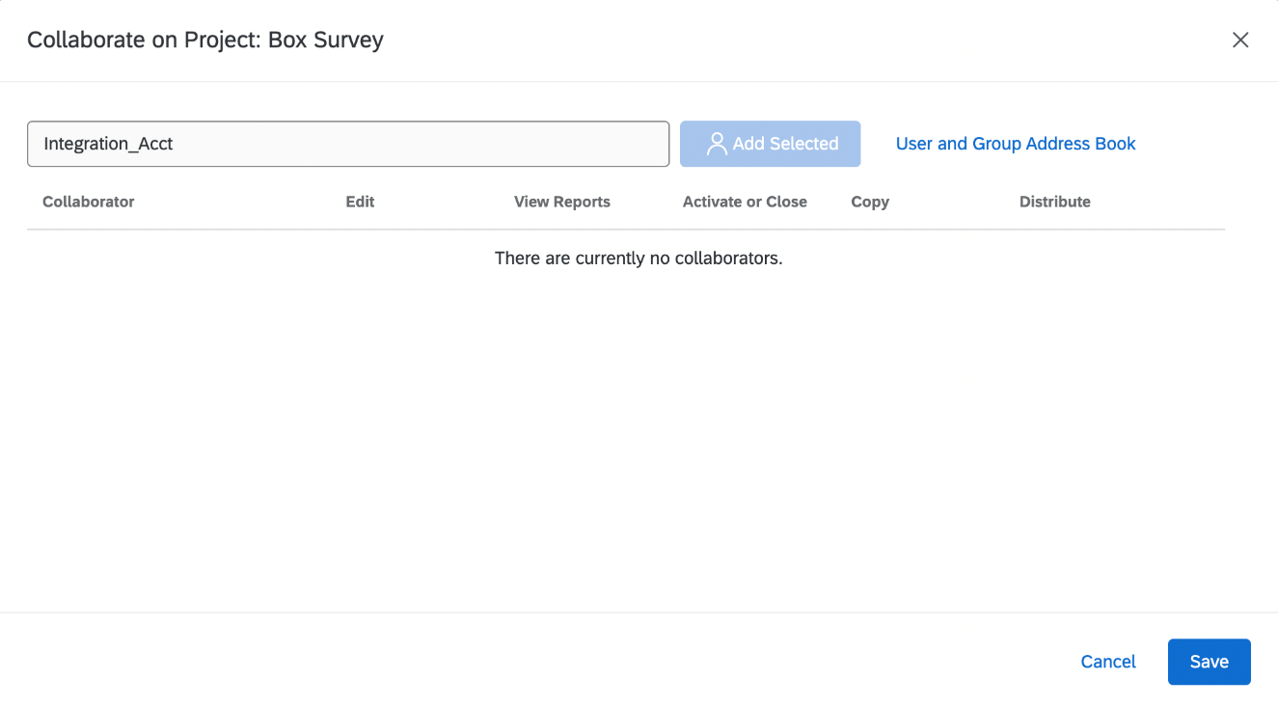
Select Integration_Acct as a Collaborator
The Collaborate on Project page will open
Type “Integration_Acct” in the text field or click the “User and Group Address Book” option and enter “Integration_Acct” in the Search field.

Slide 20
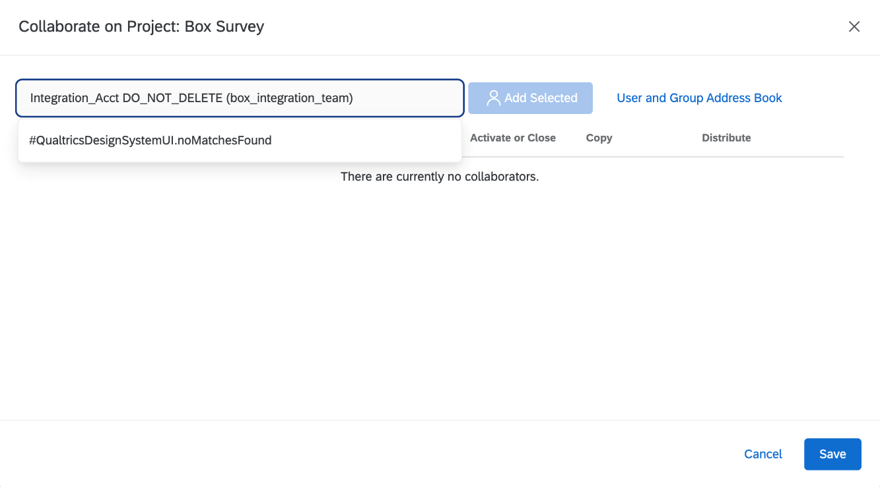
Select Integration_Acct as a Collaborator
  Select “Integration_Acct Do_NOT_Delete (box_integration_team)” from results
  Click the “Add Selected” button
  Click the “Save” button

Slide 21
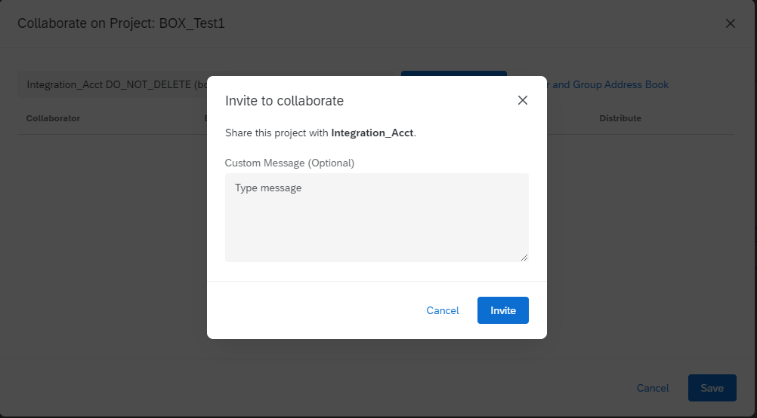
Select Integration_Acct as a Collaborator
The Invite to collaborate page opens
Select the “Invite” button. (No custom message is needed)

Slide 22
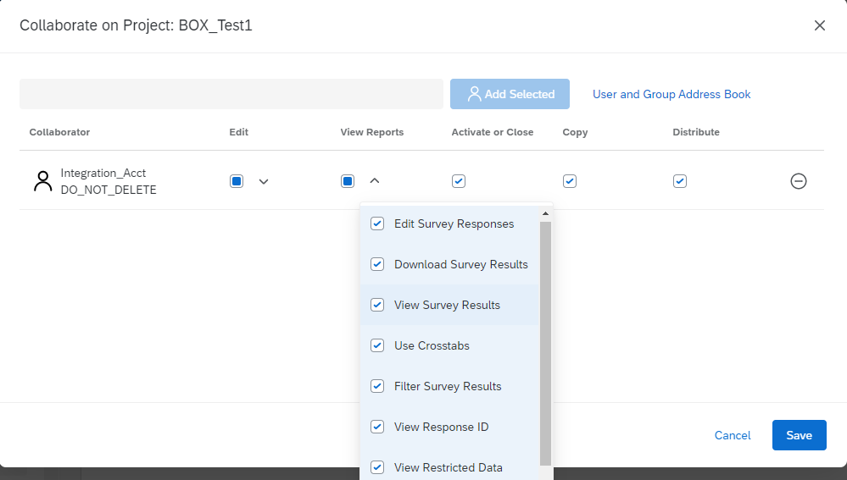
Set Integration_Acct API Settings
All collaboration permissions are automatically checked for the Integration_Acct and no changes should be made
Click the “Save” button

Slide 23
Box Features
/Now that our information is in Box, how do we share and organize our content?
Box Features

Slide 24
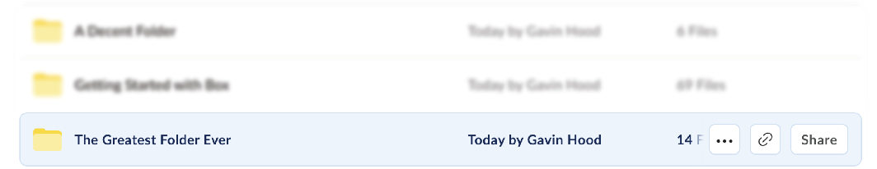


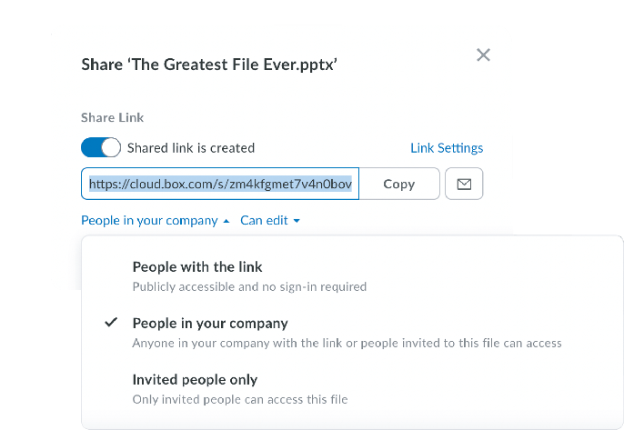
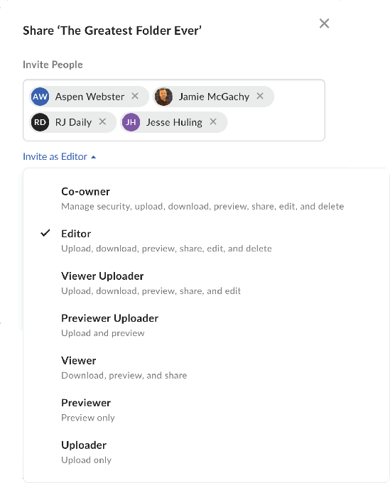
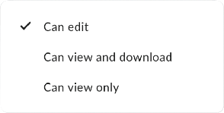
Shared Link
Inviting Collaborators
A shared link is a unique URL that gives the recipient access to a specific file or folder.
A collaborator is an individual who has been invited to a file or folder

Slide 25


Waterfall permissions
Access trickles down
Qualtrics Reports
Maya’s Customer + VA Survey
Aspen’s Box + VA Survey
Survey Results
Survey Results

Slide 26

Waterfall permissions
Access trickles down
Qualtrics Reports
Maya’s Customer + VA Survey
Aspen’s Box + VA Survey
Survey Results
Survey Results

Slide 27
Waterfall permissions
Access trickles down
Qualtrics Reports
Maya’s Customer + VA Survey
Aspen’s Box + VA Survey
Survey Results
Survey Results

Slide 28
Waterfall permissions
Access trickles down
Qualtrics Reports
Maya’s Customer + VA Survey
Aspen’s Box + VA Survey
Survey Results
Survey Results

Slide 29
Waterfall permissions
Access trickles down
Qualtrics Reports
Maya’s Customer + VA Survey
Aspen’s Box + VA Survey
Survey Results
Survey Results

Slide 30
Waterfall permissions
Access trickles down
Qualtrics Reports
Maya’s Customer + VA Survey
Aspen’s Box + VA Survey
Survey Results
Survey Results

Slide 31
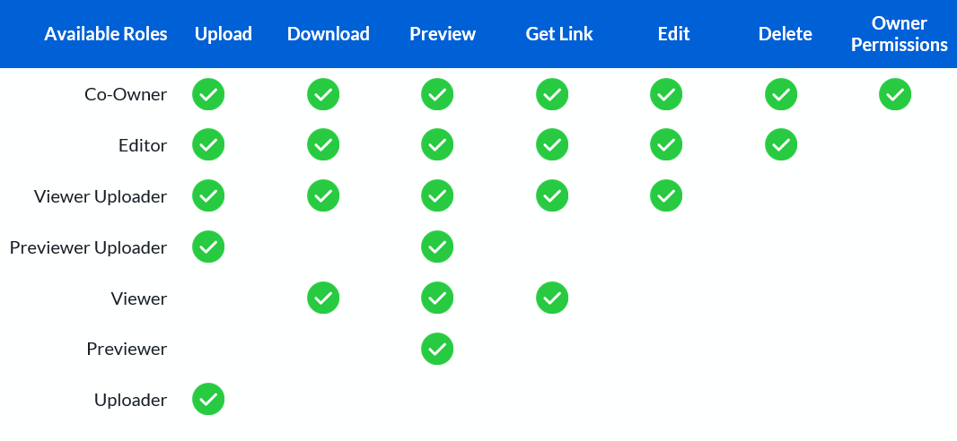
Collaboration access levels
What permissions should you give your collaborators?

Slide 32
Next Steps
/Help and Additional Resources
/Q&A
Next Steps

Slide 33
Next Steps
Take part in any Qualtrics specific Trainings
Take Box Trainings provided by VA

Slide 34
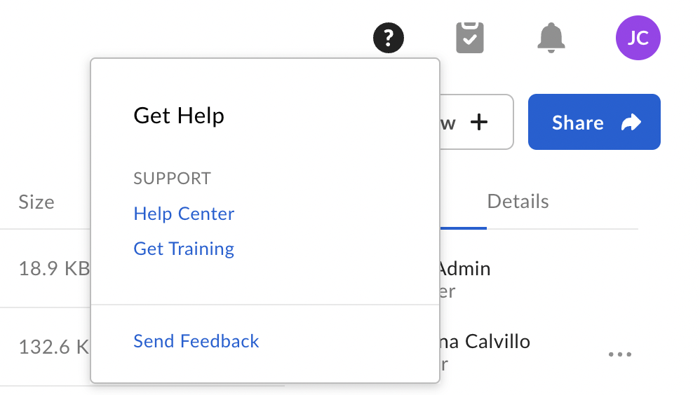
Learn More
For more tutorials, videos, and guides on Box, visit us at community.box.com

Slide 35
Need Help?
Contact: Ahmed_Asdique@bah.com

Slide 36
Congratulations!
What is Box?
Navigating Box
Qualtrics Integrations
Qualtrics and Box How-To
Box Features
Next Steps

Slide 37

Q & A

