Slide 1
Understanding the Flow of Funding, Obligations, and Common Financial Reports
January 18, 2023
Diane Murphy, Budget Analyst, Finance
Kari Points, AO-Research, Iowa City VAMC
Jason Berlow, Management Analyst, Finance

Slide 2
Housekeeping
Webinar Housekeeping
Recording - This session is being recorded and the associated handouts will be available on ORPP&E’s Education and Training website within one-week post-webinar.
Close Captioning - Now available in the new Webex platform. Click the “CC” button at the bottom left of the Webex screen.
Experiencing Sound Issues? – Call in using the number in your Webex chat box or in your registration confirmation email.
Q&A - Please use the Q&A feature to submit questions.
Be sure to send questions to “All panelists”.
Questions will be addressed at the end of the webinar.
Webinar Archive - Most ORPP&E webinars can be found here: https://www.research.va.gov/programs/orppe/education/webinars/archives.cfm
Post-Webinar Evaluation Survey - We are grateful to all that complete the post-webinar evaluation survey. It will automatically pop up once the webinar is exited.
For questions, please use Q&A box and address to “All Panelists.”
All Webinars will be recorded and posted within one week.

Slide 3
Objectives – for today’s training
Training Section: | By the end of this section, you will:
Section 1: Understanding the flow of funding/obligations/transactions | Obligation policy
Section 2: Common Obligation Types | Understand 2237, 1358, and Purchase Card Obligations
Section 3: Common Financial Reports | Listing of several financial reports
Section 4: Understanding the tracking requirements of open obligations | Understand UDO Reports 850/851
Section 5: UDO Helpful Information | VISTA screenshots and information
Q&A
Notes:
John

Slide 4
Section 1: Understanding the flow of funding/obligations

Slide 5
Section 1: Understanding the flow of funding/obligations
The Financial Policy manual states (Volume II-Chapter 5), Obligations Policy states that Appropriated funds will be obligated consistent with fiscal restrictions on federal spending. VA may obligate and expend appropriations only for the specific purpose for which the appropriation was made and within the time limits applicable to the appropriation.
We must ensure that funds are available to cover the obligation and expenditure prior to entering into an agreement. The amount of an obligation may be estimated when the exact amount cannot be determined at the time the obligation is incurred. Appropriate obligation adjustments must be recorded in the financial system as information becomes available.
Obligations must contain a separation of duties of the following:
Purchases of goods or services are to be initiated by a requestor who is authorized to request the purchase of goods or services
The approval of the necessity for goods or services will be made by a person who has been authorized for this responsibility
The Anti-Deficiency Act requires federal agencies to use appropriated funds in the manner intended by Congress. See VA Financial Policy Volume II, Chapter 3 – VA Fund Control and VA Financial Policy Volume II, Chapter 7, Various Appropriations Law Related Topics for detailed information on the ADA and ADA Violations.
Notes:
Timing – 1 day for purchase card (GPC) and five days for 1358s.

Slide 6
Section 1: Understanding the flow of funding (obligation)
Understanding the key accounting elements of financial transactions is critical.
Station Number | Budget Fiscal Year | Fund | ACC | Cost Center | BOC
127 | 2324 | 0161A1 | 810010100 | 810300 | 2660
Records what station the transaction occurred at
First 2 Digits: Beginning FY of availability
Last 2 Digits: Ending FY of availability
Records fund within appropriation (A is direct and R is reimbursable)
Denotes the FCP or ACC where funds will be utilized from
Denotes who is purchasing the goods or services
Denotes the type of good/service purchased for reporting purposes

Slide 7
Section 2: Common Obligation Types
The table below displays the different types obligation documents that are linked to an IFCAP/VISTA transaction number which is reflected on the Running Balance:
Obligation Type | Uses | Description
2237 | Contracts that go through Contracting Officer | Must be processed by PBD/Contracting and have an obligation number assigned prior to the beginning of service(s) or receipt of good(s). Be recorded (committed) in VISTA/IFCAP within 1 business day of the agreement being made with a vendor for the item(s) or service(s). Reference: Volume II, Chapter 5A - Purchase Request Policy (va.gov)
1358 | Interpersonal Agreements (IPA), Subject Reimbursements, transactions between appropriations (IAA) | Must be submitted to Fiscal Service within the first 5 days of the month for service(s) being received (for 1358’s established on a quarterly/yearly basis the document must be sent to Fiscal w/in first 5 days of quarter or year). Reference: Vol II Ch 6 1358 Obligations (va.gov)
Government Purchase Card | Purchase of supplies/services below micro purchase threshold | Reference: Volume XVI Chapter 1B - Government Purchase Card for Micro-purchase.pdf (va.gov)
Notes:
Timing – 1 day for purchase card (GPC) and five days for 1358s.

Slide 8
Section 2: Managing Obligations: 2237 (Contracts that go through Contracting Officer)
2237 Purchase Order (PO): A 2237 is the document initiated by the service line to set aside (reserve) funds from a Fund Control Point (FCP). When the 2237 is processed by either Fiscal, PBD, or both, it is assigned an obligation number and becomes a purchase order. At this time, the total dollar amount is immediately withdrawn from the FCP. These dollars are then used to process invoice payments for the good(s)/service(s) outlined on the document.
Below are the required steps:
Established by a FCP Clerk and approved by a FCP Official.
Most common type of obligation and can be used for: materials, services, contracts, etc.
Obligation numbers begin with a letter (example: D35555).
The letter identifies what the obligation is for (e.g., C=Services, D= Research, A=Goods, B=Federal, NC=No Charge, U=Ratification, F=Bill of Lading, T=Travel, IX=Convenience Checks).
The 3 represents the FY of the obligation (2023).

Slide 9
Section 2: Managing Obligations: 2237 (Contracts that go through Contracting Officer)
2237 Purchase Order (PO) (Step-by-Step Instructions) Each document must be:
Requirements | Description
Entered TIMELY | End user must allow adequate time for the procurement process (timeframe varies depending on type & priority of need)
Requested in the CORRECT FY & QTR | The Fiscal Year and Quarter on the document need to reflect the desired delivery date of the good(s) or beginning date of service(s) being requested
Regularly MONITORED | End user should monitor all transactions within the Running Balance to endure the transaction is completed and/or perform follow-up, as necessary
Promptly CANCELLED | If a transaction is not needed (i.e., entered incorrectly or duplicated) it must be cancelled; otherwise, this ties up funds which can be used for other purchases/services. To cancel, use the IFCAP/VistA menu option: Cancel Transaction with a Permanent Number. This can only be completed when the “*” is showing in the COMM AMT and OBLIG AMT columns

Slide 10
Section 2: 1358 Obligation (Interpersonal Agreements (IPA), Subject Reimbursements, transactions between appropriations (IAA)
Steps | Description
Entered TIMELY | New 1358 and Increase/Decrease requests (remove comment) must be entered within 5 days of the beginning date of service (year, quarter, or month as applicable)
Requested in the CORRECT FY & QTR | The Fiscal Year and Quarter on the document need to reflect the beginning date of the services being requested. If a prior year increase/decrease is being requested, it should be requested in the 4th quarter of the applicable year. For example, if you need an increase on a FY20 PO in FY21, enter the request in VISTA on a FY20 Q4 Transaction.
Regularly MONITORED | End user should be reviewing obligations vs. expenditures (payments) to ensure estimated costs on the 1358 are appropriately aligned with the actual payments processed. For example, if an IPA terminates early, decrease the obligation to return that amount of funding back to the investigator.
Promptly MODIFIED | When/If a significant surplus or deficit is identified, the increase/decrease request (as appropriate) needs to be entered immediately. If a transaction is not needed (i.e., entered incorrectly or duplicated) it must be cancelled.
Promptly CANCELLED | To cancel, use the IFCAP/VistA menu option: Cancel Transaction with a Permanent Number. This can only be completed when the “*” is showing in the COMM AMT and OBLIG AMT columns.

Slide 11
Section 2: Managing Obligations: 1358
1358 Estimated Obligation
An obligation document used to allocate funds from a Fund Control Point (FCP) for an estimated expense. When the 1358 document has been obligated, the total dollar amount is immediately withdrawn from the FCP. These dollars are then used to process invoice payments for the service(s) outlined on the document. 1358s can only be used for approved uses listed in Financial Policy, Volume II, Chapter 6-1358 Obligations, Appendix A.
Established by the FCP Clerk and approved by the FCP Official. Most restrictive type of obligation can be used for: 1 - Service(s) ONLY when a specific authorization exists for this type of obligation
Obligation # or PO#: D represent orders for Research, the “3” represents the fiscal year (example: D3---- or 3D----, exception Prime Vendor)
Per VACO regulations regarding Separation of Duties, four separate individuals must be involved in the 1358 process. Each of the following must be completed by a different employee: ENTERING the request (service) APPROVING the request (service) OBLIGATING the funds (accounting) CERTIFYING the invoice for payment (service)

Slide 12
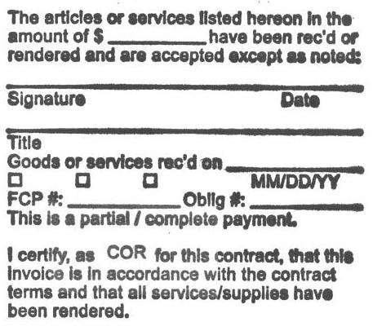
Section 2: Managing Obligations: Invoices
Certifying Officials are responsible for tracking the invoices he/she certifies:
This must be done in order to ensure funding levels are adequate for the entire time period covered by the obligation.
If/When a deficit or surplus is identified, a request must be made to increase/decrease funding.
Increase/Decrease requests for 2237s: are entered in FORCE; process may vary by contracting office 1358s: are entered in IFCAP/VistA

Slide 13
Section 2: Government Purchase Card
A purchasing tool which functions in a capacity similar to a personal credit card.
Government Purchase Card (GPC )
It is used to commit funds from a Fund Control Point (FCP) for an estimated expense. When the card holder makes a purchase, the cost is committed in the FCP in VISTA/IFCAP only. The order is considered Committed, Not Obligated. Once the vendor charges for the good(s)/service(s) the monies are withdrawn from the FCP in FMS.
Orders are established by a purchase card holder (or a designated surrogate) and approved by the purchase card Approving Official or Alternate Approving Official.
Most flexible type of obligation and can be used for: 1 - Material(s), 2 - Service(s)
Once a cardholder enters & applies their electronic signature to a purchase card order in IFCAP/VistA, it remains in a committed status until the charge from the vendor is received and reconciled (tied/matched) to the order.
Obligation numbers contain letters including, but not limited to D,P, Q, R, or Y (example: D65555). In any of these cases, the number 6 represents the FY of the obligation. The letter identifies that the obligation is a purchase card order and what section made the procurement (P6XXXX=Logistics/Contracting, D6XXXX=Research). Not all stations use the “D” for purchase card orders.

Slide 14
Section 2: Managing Obligations: GPC
Each GPC order must be:
Steps | Description
Entered TIMELY | Purchase Cardholder must enter a New Detailed Purchase Card Order and apply their electronic signature code to the transaction within 1 business day of the procurement. Ensure funds are available to make purchase BEFORE contacting vendor. Orders placed without available funds go against the Anti-Deficiency Act rule.
Regularly MONITORED | VHA Handbook 1730.01 requires all GPC orders be completed/closed within 30 days of the delivery date. Appropriate follow-up should be completed to ensure this timeline is achieved.
Promptly CANCELLED | If a transaction is not needed it must be cancelled. Otherwise, this can tie up funds which could be used to purchase other items or services on the Running Balance/FCP.
NOTE: | To cancel, use the IFCAP/VISTA option: Amendment to Purchase Card Order, Authority E. This can only be completed when no Receiving Reports are tied to the order.

Slide 15
Section 2: Managing Obligations: GPC TOOLS
Government Purchase Card (GPC )
In order to increase the limit:
Request an increase from the original $3500 supply/$2500 services to the $10,000 limit allowed by law. Services limits cannot be increased. However, if the services qualify for the Professional Exemption under the Fair Labor Standards Act (FLSA), they can go up to the $10,000 limit. Fact Sheet #17A: Exemption for Executive, Administrative, Professional, Computer & Outside Sales Employees Under the Fair Labor Standards Act (FLSA) | U.S. Department of Labor (dol.gov)
You can request a memo from the GPC program which includes a justification of the higher costs of research supplies and equipment.
Memo signatories are your service chief, logistics, station CFO.
Once the memo is approved by all parties and returned to the purchase card coordinator, they will process the increased limit for your cardholder.

Slide 16
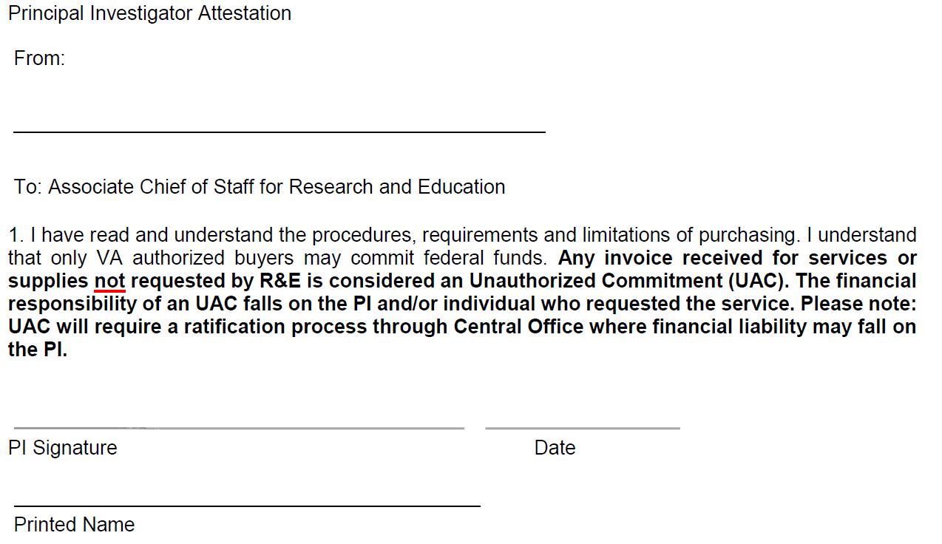
Section 2: Delinquent/Unauthorized Commitments
Delinquent Obligation (DO): When an individual who has the purchasing authority procures goods or services but does not record the expense (establish GPC PO in IFCAP/VISTA) within 1 business day.
Delinquent obligations require approval from fiscal, logistics, and medical center director documented in a memo prior to the obligation.
Unauthorized Commitment (UAC): When an individual places an order with a vendor for goods or services but exceeds their purchasing authority (authorized based on dollar amount and/or type of good(s)/service(s) being procured) or does NOT have the purchasing authority to spend government funds.
Unauthorized commitments require ratification for consideration of payment. If a ratification is not completed (or the request for ratification is denied) the individual who made the procurement is liable for the cost to the government.
Sample tool for helping with PI education on VA fiscal regulations
Notes:
When an obligation is not established in accordance with regulations the procurement is considered either a(n): Delinquent Obligation or an Unauthorized Commitment. Uh OH!
Example: freezer breaks and PI calls in to get a repair. The purchase card holder can do that, not the PI. timeframe and resource drain to process UAC. It is your discretion to process, if not approved the requestor is liable for costs. Too bad!

Slide 17
Section 3: Common FISCAL Reports
We have to figure this out now that Clippy is gone!

Slide 18
Section 3: Common Reports from Fiscal/VSSC
Report | Description
VSSC-VHA Support Service Center VSSC - VHA Support Service Center (va.gov) | Another tool to pull reports to review activity and funds: Undistributed, Distributed, Committed, Expensed, and All Transactions.​
PAID Reports (Local Finance/Budget) | Payroll and FTEE report
F850/F851 | UDO (undelivered orders) Report-provided by Fiscal
FMS OBLL-Open Documents Only OBLL_OpenDocuments - Report Viewer (va.gov) | Identifies purchase orders with an available balance (open orders) from FMS.
FMS OBLL Residual Balance Report ResidualBalance - Report Viewer (va.gov) | Identifies purchase orders with a residual balance-balance of less than $500 and less than 10% of the obligation amt.
Obligation and Accrual Review Obligation and Accrual Review - Report Viewer (va.gov) | Identifies purchase orders with large discrepancies between percent of service period versus percent paid.
Notes:
TDA Listings: http://vhaarcweb108.vha.med.va.gov/ReportServer_ARC/Pages/Reportviewer.aspx?%2fPgmOffRep%2fTDAList&rs:Command=Render
F20D: https://reports.vssc.med.va.gov/ReportServer/Pages/ReportViewer.aspx?%2fFinance%2fSOA%2fF20D_Daily_Activity_SOA&rs:Command=Render&BFYMAC=21&FUNDMAC=0161A1&ACCMAC=820010119&FACMAC=660

Slide 19
Section 3: Common Reports from Fiscal/VSSC
Report | Description
F827-Monthly Detailed Accounting Transactions F827 VSSC Link | Shows all transactions for a specific month by general ledger. G/L 425P can provide Reimbursables information, when reviewed monthly. Fiscal/Accounting can provide.
F20D-Daily Activity by Account Classification Code F20 VSSC Link | Shows all FMS transactions by Account Classification Code (ACC). You can pull from VSSC.
F830-Expenditure Report F830 VSSC Link | Shows all expenses/payments which have been processed in FMS.
F887-Obligation Report F887 VSSC Link | Shows all obligations which have been processed in FMS.
Notes:
Add this to table of contents

Slide 20
Section 3: F20 Report
VSSC-F20D Daily Activity by Account Classification Code
Review actions processed in FMS affecting your FCPs/ACCs

Slide 21
Section 3: Common Reports from Fiscal-VSSC View

Slide 22
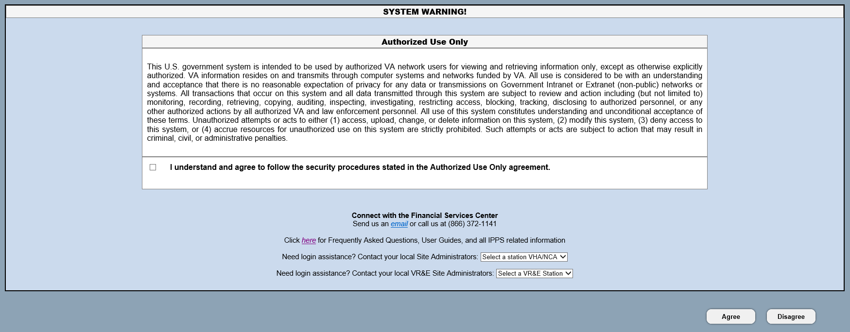
Section 3: IPPS Homepage
TRAINING!!

Slide 23
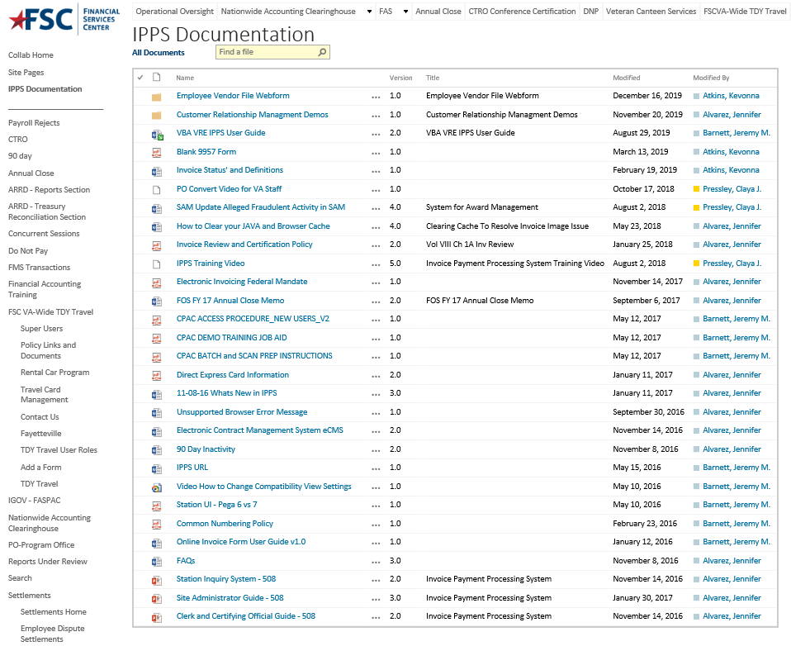
Section 3: IPPS Trainings
TRAINING!!!
TRAINING!!!

Slide 24
Section 4: Understanding the tracking requirements of open obligations

Slide 25
Section 4: Reviewing Open Obligations
Open obligations include those obligations that are not considered closed or complete and have a balance associated with them, whether undelivered or unpaid.
Research Offices are responsible for reviewing open obligations and will perform monthly reviews and reconciliations to ensure that their obligations, to include undelivered orders (UDOs) and delivered unpaid obligations, are valid (as required by the VA Financial Policy Manual, Volume II, Chapter 5, Obligations Policy).

Slide 26
Section 4: Review and Reconciliation of Open Obligations
Your fiscal office will ask you monthly to review data contained in the F850 and F851 reports monthly.
The purpose of the review is to reconcile the outstanding and/or undelivered balance column to the anticipated cost of unpaid posted authorizations or the amount unpaid according to the Integrated Funds Distribution, Control Point Activity, Accounting and Procurement (IFCAP) system.
As part of the review, the finance office will identify open obligations in VA’s accounting system with an end date that is greater than 90 days past and/or last activity date greater than 90 days (as required by Appendix F of the Obligations Policy Chapter).

Slide 27
Section 4: Review and Reconciliation of Open Obligations
FMS 850 (Verification of General Ledger Balances): This report lists each open document and its remaining balance, a total Standard General Ledger (SGL) balances (GL4801), and a difference line. The F850 should be reviewed against supporting documentation monthly to ensure reports, subsidiary records and systems reflect proper costing, accurate delivery date/end date, and correctly calculated unliquidated balance.
FMS 851 (Verification of General Ledger Balances): This report lists each accrued payable and the vendor, SGL balance (GL4901), and the total outstanding accrued amount. The F851 should be reviewed against supporting documentation monthly to ensure reports, subsidiary records and systems reflect proper vendors and correctly calculated delivered/unpaid balances.

Slide 28
Section 4: Example of the “UDO” report from VSSC
Obligation and Accrual Review-VSSC report pulled 11-17-22

Slide 29
Section 4: UDO Example
TC | Document ID | FCP | Fund | BFY | ACC No | BOC | Cost Ctr | P.O. Open AMT | Vendor name | Begin Date | End Date | Days Open | Last Activity Date
MO | XXXB72009 | 7132 | 0161A1 | 17 | 810010100 | 2580 | 855100 | $9,087.00 | DEPARTMENT OF VETERANS AFFAIRS | 09/25/2017 | 09/30/2020 | 488 | 08/27/2021
SO | XXXB11021 | 1132 | 0161A1 | 21 | 810010100 | 2580 | 856400 | $50,330.25 | DEPARTMENT OF VETERANS AFFAIRS | 10/01/2020 | 09/30/2021 | 123 | 09/14/2021
SO | XXXTB1017 | 1132 | 0161A1 | 21 | 810010100 | 1285 | 810100 | $823.20 | DEPT OF HEALTH & HUMAN SVCS | 10/01/2020 | 09/30/2021 | 123 | 09/15/2021
SO | XXXD15002 | 1532 | 0161A1 | 21 | 850010100 | 2580 | 815000 | $2,057.84 | MISC COMMERCIAL VENDOR | 07/01/2021 | 12/31/2021 | 31 | 09/13/2021
MO | XXX2A6269 | 2532 | 0161A1 | 22 | 850010100 | 2660 | 856400 | $756.05 | MEDLINE INDUSTRIES INC | 01/10/2022 | 01/20/2022 | 11 | 01/18/2022
MO | XXX2A6299 | 2532 | 0161A1 | 22 | 850010100 | 2660 | 856400 | $429.24 | MEDLINE INDUSTRIES INC | 01/18/2022 | 01/28/2022 | 3 | 01/19/2022
MO | XXXB12004 | 1532 | 0161A1 | 21 | 850010100 | 2580 | 854100 | $251,576.00 | DEPARTMENT OF VETERANS AFFAIRS | 02/18/2021 | 02/18/2022 | 0
SO | XXXTB2017 | 1132 | 0161A1 | 21 | 810010100 | 1285 | 810100 | $1,500.00 | DEPT OF HEALTH & HUMAN SVCS | 10/01/2021 | 09/30/2022 | 0
SO | XXXD17109 | 1132 | 0161A1 | 21 | 810010100 | 2520 | 810300 | $9,132.00 | AGILENT TECHNOLOGIES INC | 09/30/2021 | 03/31/2022 | 0
SO | XXXD17102 | 132 | 0161A1 | 20 | 810010100 | 2580 | 810100 | $15,159.00 | MEDICAL UNIVERSITY OF SOUTH CA | 04/01/2021 | 03/31/2022 | 0
SO | XXXC25108 | 1132 | 0161A1 | 21 | 810010100 | 2520 | 810300 | $17,967.24 | AGILENT TECHNOLOGIES INC | 01/04/2022 | 03/31/2023 | 0
SO | XXXD17104 | 1132 | 0161A1 | 21 | 810010100 | 2580 | 810100 | $28,760.30 | NANCY A RODRIGUEZ | 06/19/2021 | 06/18/2022 | 0 | 01/24/2022
SO | XXXD15001 | 132 | 0161A1 | 20 | 810010100 | 2560 | 810100 | $32,830.75 | BIOMED RESEARCH CORP | 02/01/2021 | 02/02/2022 | 0 | 11/09/2021
SO | XXXD17108 | 532 | 0161A1 | 20 | 850010100 | 2580 | 815000 | $61,486.85 | UNIVERSITY | 08/04/2021 | 08/12/2022 | 0 | 01/24/2022
SO | XXXD17100 | 1532 | 0161A1 | 21 | 850010100 | 2560 | 815000 | $66,592.78 | UNIVERSITY | 02/07/2021 | 02/06/2022 | 0 | 01/21/2022
SO | XXXD25001 | 1132 | 0161A1 | 21 | 810010100 | 2580 | 810100 | $70,070.00 | UNIV OF | 10/01/2021 | 09/30/2022 | 0
SO | XXXD17101 | 1132 | 0161A1 | 21 | 810010100 | 2580 | 810500 | $103,212.98 | UNIVERSITY | 02/07/2021 | 02/06/2022 | 0 | 01/21/2022
SO | XXXD17107 | 1532 | 0161A1 | 21 | 850010100 | 2560 | 815000 | $182,181.86 | UNIVERSITY | 08/04/2021 | 08/12/2022 | 0
SO | XXXD17106 | 132 | 0161A1 | 20 | 810010100 | 2560 | 810300 | $271,516.07 | UNIVERSITY | 08/13/2021 | 08/12/2022 | 0 | 01/31/2022
SO | XXXD17105 | 1132 | 0161A1 | 21 | 810010100 | 2560 | 810300 | $504,636.43 | UNIVERSITY | 08/13/2021 | 08/12/2022 | 0 | 12/20/2021

Slide 30
Section 4: UDO Example
You should review all orders on the UDO report, but these factors should get close attention:
End Date: Orders within 30-60 days of their End date. Are invoices being paid properly and timely? Have receiving reports been submitted? Will the order be completed by the end date? If not, do you need to request an End Date extension? Review your activity before the end date to ensure order doesn’t become delinquent.
Days Open: Identifies how many days this order has gone past its End Date. Any order open more than 90 days past the End Date is considered delinquent and affects the financial indicators.
Last Activity Date: Identifies when the last time there was activity on the order, i.e., obligation, payments, receiving reports. Even if order hasn’t reached the End Date, this is important.
Example: if you have an order which began on 10/1/21 but there hasn’t been any activity since the order began. You should review to see if the vendor isn’t submitting invoices or submitting incorrectly (wrong PO#). Do you need to notify the warehouse to submit receiving reports? Have services/deliveries been delayed? This may require an End Date extension.

Slide 31
Section 4: UDO Helpful Information
We are here to help!

Slide 32
Section 4: UDO Helpful Information
Helpful information for UDO and IPPS
MO-Miscellaneous Orders (VISTA Method of Payment: Invoice/Receiving Report): Warehouse must process receiving reports. If items didn’t come through the warehouse, service needs to notify the warehouse staff to process a receiving report. IPPS matches invoices to receiving report to process payment.
SO-Service Orders (1358s and VISTA Method of Payment: Certified Invoice on 2237s): Vendor submits invoice(s) into IPPS. Invoices over $2,500 MUST be certified by Certifying Official. IPPS will process invoices $2500 and under if funds are available on order. Recommend you review invoices anyway to verify Vendor is invoicing correctly.
RR/RT-Receiving Reports: Processed against Invoice/Receiving Report (VISTA); MO orders (FMS)
AR-Accrual: Occurs in FMS if there are outstanding funds after the end date on SO orders. Funds are available to use for payments. It is possible to have one purchase order with an SO amount and an AR amount.

Slide 33
Section 5: What is my Purchase order #/Obligation #
Use this option to review your FCP activity
Control Point Clerk’s (or Official’s) Menu→
Display Control Point Activity Menu→
Running Balances
Select Display Control Point Activity Menu Option: Running Balances
Select FISCAL YEAR: 22//
Select QUARTER: 3//
Select CONTROL POINT: 2132 Research Supplies 0161A1 10 8100 810010101
Summary Balances Report Only? No//
NOTE: Summary Balances Report Only? No = Detailed listing of activity for FCP in designated fiscal year and quarter.
Summary Balances Report Only? Yes = Current balance only for FCP in designated fiscal year.

Slide 34
Section 5: What is my Purchase order #/Obligation #
CONTROL POINT BALANCE - XXX-22-3-2132- RESEARCH SUPPLIES MAY 07, 2019@10:41:15 PAGE 1
FISCAL
FYQSeq# TXN OBL # AP/OB DT COMM $AMT CP $BAL OBL $AMT UNOBL $BAL
--------------------------------------------------------------------------------
2210009 OBL D27200 03/21/22 1096926.84 -1096926.84 0.00* 0.00
2210010 OBL D20424 04/24/22 440.00 -1097366.84 440.00 -440.00
2230015 CEI 509FC3560 12/20/21 15000.00 -1082366.84 15000.00 14560.00
2220020 OBL 0.00*-1082366.84 0.00* 14560.00
2220022 OBL D22003 02/04/22 2844343.26 -3926710.10 0.00* 14560.00
2220027 CAN 0.00#-3926710.10 0.00# 14560.00
2230034 CEI FROM 19-2 4100269.40 173559.30 4100269.40 4114829.40
2230036 ADJ QTRADJ 0.00 173559.30 4114829.40
2230037 ADJ D21064 04/02/22 250000.00 -76440.70 250000.00 3864829.40
2230038 ADJ D21064 04/05/22 250000.00 -326440.70 250000.00 3614829.40
2230039 CEI 509FC3601 04/05/22 650000.00 323559.30 650000.00 4264829.40
Press return to continue, uparrow (^) to exit:
FYQSeq#: 2210009-Fiscal Year 22, Quarter 1, Seq#-Last 4 numbers of transaction number
(509-22-1-2132-0009)
TXN: OBL-obligation, CEI-budget function (deposit or withdrawal), CAN-cancelled transaction, ADJ-adjustment to an obligation or adjustment done by Budget
OBL #: Obligation/Document ID/Purchase Order# (PO#)
AP/OB DT: Date transaction submitted in FCP
COMM $AMT: Amount of transaction Note: If * is next to dollar amount in COMM $AMT column, transaction is pending action from service
CP $Bal: Running Control Point Balance
OBL $AMT: Amount of transaction after obligated. Note: If * is next to dollar amount in Obl $Amt column but there is no * in the COMM $AMT, transaction is pending action by Contracting or CAO
FISCAL UNOBL $BAL: Running Fiscal Balance

Slide 35
Section 5: How to review my Purchase Order in VISTA
Control Point Clerk’s (or Official’s) Menu→
Display Control Point Activity Menu→
Purchase Order Status
Select CONTROL POINT: 2132 RESEARCH SUPPLIES 0161A1 810010100
Select PURCHASE ORDER NUMBER: D20001 XXX-D20001 04-22-22 ST Partial Order Received
FCP: 2132 $40658.62
Purchase Order Status: Partial Order Received
Would you like the purchase order display? No// Y (Yes)

Slide 36
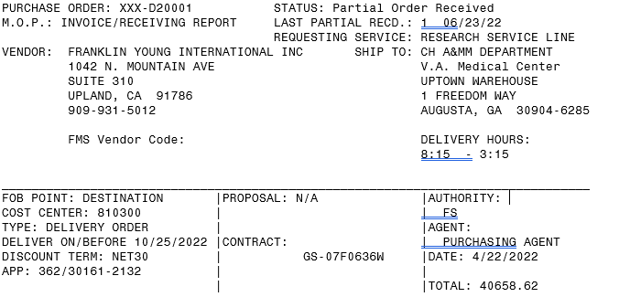
Section 5: VISTA Examples-MO (Miscellaneous Order)
Purchase order# Obligation#
VISTA Status of Order
VISTA Method of Payment=MO (FMS)
# of Receiving Reports and date of last one processed.
Name of Contracting Purchasing Agent
Shows BFYs (2022/2023) and FCP
Total amount of order (includes any amendment amounts)
Notes:
F830 Report: Diane-Notes
- BOC Codes : Monthly spending, using correct codes
- Monthly Report, Download from RSD
- Cost that occurred up to that point by fund and cost center (No breakout by fund control point)
Training: Induction into budgeting, different appropriations, VIST menu to submit, how to read running balance, reports that can be pulled - 1358

Slide 37
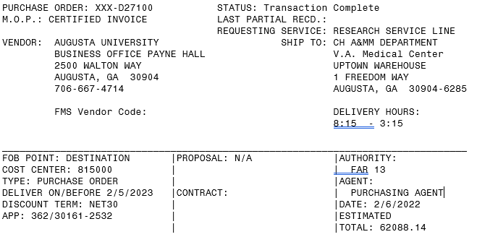
Section 5: VISTA Examples-SO (Service Order)
Status is Transaction Complete immediately after order is obligated. Doesn’t mean order is completed only that receiving reports aren’t required.
Purchase Order # Obligation #
VISTA Method Of Payment=SO (FMS)
No Receiving Reports
Name of Contracting Purchasing Agent
Shows BFYs (2022/2023) and FCP
Total amount of order (includes any amendment amounts)
Notes:
Jason: Slide on IAAs and allocating

Slide 38
Questions

Slide 39
Appendix A: Additional Acronyms & Abbreviations
BOC Budget Object Codes
CC Cost Center
CPC Control Point Clerk
CPO Control Point Official
eCMS Electronic Contracting Management System
FCP Fund Control Point
FMS Financial Management System
IFCAP Integrated Funds Control Distribution, Accounting Activity and Procurement
MO Miscellaneous Order
IPPS Invoice Payment Processing System
PC Purchase Card
PO Purchase Order
RR Receiving Report
SA Suballowance (Budget depositing or withdrawing funds)
ST Suballowance Transfer (Budget transferring funds between FCPs)
SO Service Order
TDA Transfer of Disbursing Authority
VISN Veteran Integrated Service Network
VISTA Veteran Health Information System and Technology Architecture
1358 1358 Obligation
2237 Request, Turn-In, Receipt for Goods or Services (Purchase Order/Contracts)

Slide 40
Resources
VSSC: VSSC - VHA Support Service Center (va.gov)
IPPS: https://vaww.ipps.fsc.va.gov/prweb/PRWebLDAP1/ZAAnDJR28qcDKrEgu_hmcUyQ4QJoIZMB*/!STANDARD (works best using Google)
Cost Centers and BOCs: Volume XIII - Cost Accounting - Office of Finance (va.gov)
1358 Obligations Policy: VA-FinancialPolicyVolumeIIChapter06.pdf
IFCAP Control Point Clerk User’s Guide: ifcp5_1cp_clerk.pdf (va.gov)
IFCAP Control Point Official User’s Guide: ifcp5_1cp_official.pdf (va.gov)

Slide 41
Resources
VA Financial Policy Volumes
Volume I - General Accounting - Office of Finance (va.gov)
VA’s Accounting Classification Structure
Volume II - Appropriations, Funds and Related Information (VA Financial Policy Manual)
Obligations Policy

