Slide 1
Research Support division (RSD)
Research Cybersecurity AWARENESS
March 26, 2020
This Briefing is: UNCLASSIFIED//FOR OFFICIAL USE ONLY

Slide 2
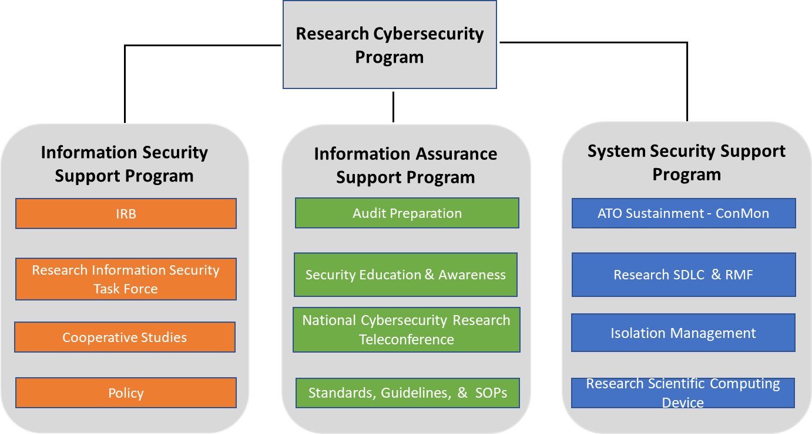
RSD Mission
Consult with stakeholders across the VA enterprise participating in research programs providing guidance in complying with research information security policy. Respond to research security needs by using a risk management approach to develop and implement enterprise information security standards, guidelines, and procedures that address security objectives that are in alignment with the customer’s business considerations and objectives.

Slide 3
Discussion Topics
Research Cybersecurity Administration Program (RCAP) Overview-Carol Johnson
Administrative Officer (AO)/Associated Chief of Staff (ACOS) RCAP Impacts/Resource Utilization -Carol Johnson
Common Office of Research & Oversight (ORO) Cybersecurity Findings- Carol Johnson
Research Protocol Data Management/Enterprise Research Data Security Plan (ERSDP)-Terry Peters
Research Systems i.e. Research Scientific Computing Devices, Authority to Operation (ATO)- Terry Taylor

Slide 4
Research Cybersecurity Administration
Program (RCAP)
Overview

Slide 5
Research Cybersecurity Administration Program (RCAP) Overview
RSD objective is to provide assistance and guidance to local facilities conducting research, with adhering to research information security policy. Note some of the following outlets used for this purpose:
  Webinars
  Monthly National Cybersecurity Research Teleconference (NCRT)
  Formalized ITWD Training
  Research Cybersecurity Administration Program (RCAP)

Slide 6
Research Cybersecurity Administration Program (RCAP) Overview (cont.)
The Research Cybersecurity Administration Program (RCAP) includes the following components:
  On-site/Remote visits that assist with training and awareness and assessment of existing research security posture.
  Before site visits are conducted, RSD as part of RCAP, will engage the facilities research stakeholders requesting various research information security documentation for review and leverage the following artifacts ahead of the scheduled visit:
    Letter of Notification
    Control Assessment Questionnaire (Assesses research programs implementation of critical controls)
    Self-Assessment Questionnaire (Assesses individual understanding of critical controls as it applies to research)
    Control Assessment Matrix (Evidence of control implementation)
  During site visits RSD will provide overview of any compliance gaps and assist facility with closing compliance gaps while also engaging facility for training and awareness related to those identified gaps
  Following site visits, RSD as part of RCAP will continue remediation efforts to assist facilities with becoming compliant on all identified compliance gaps.

Slide 7
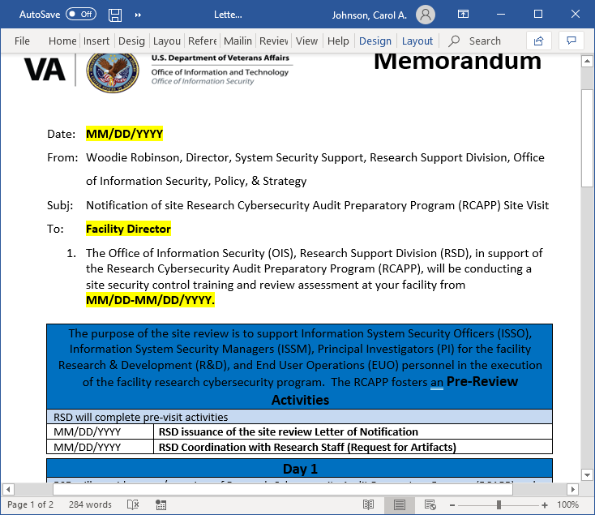
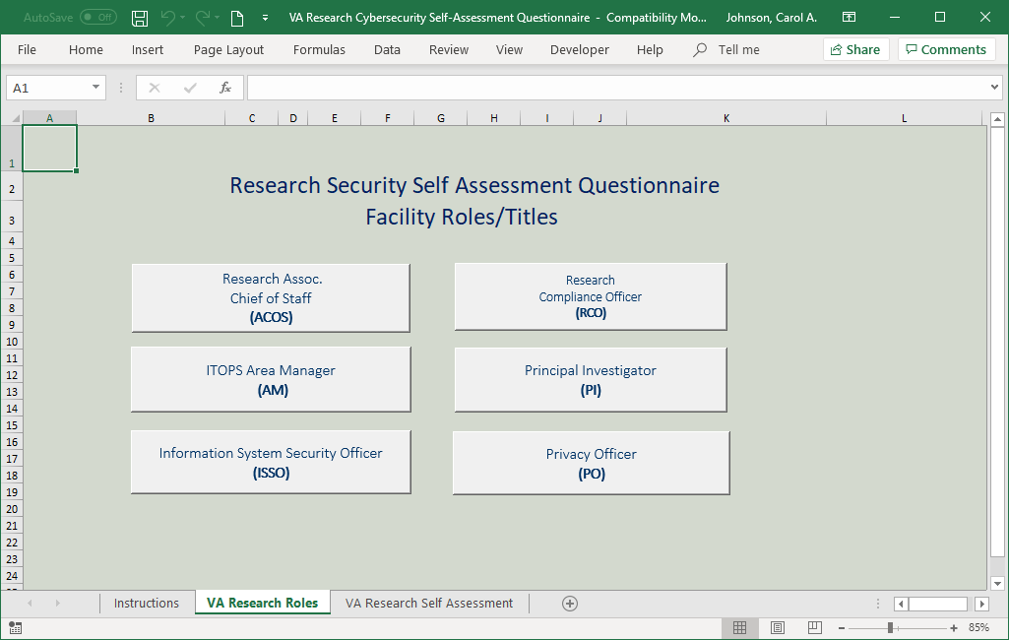
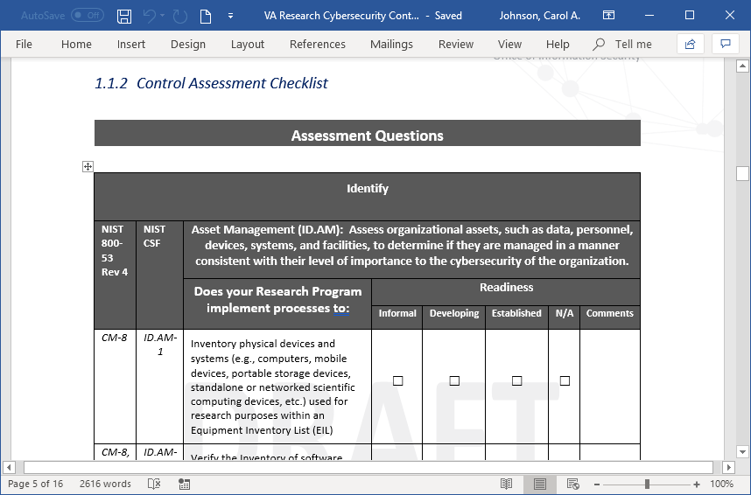
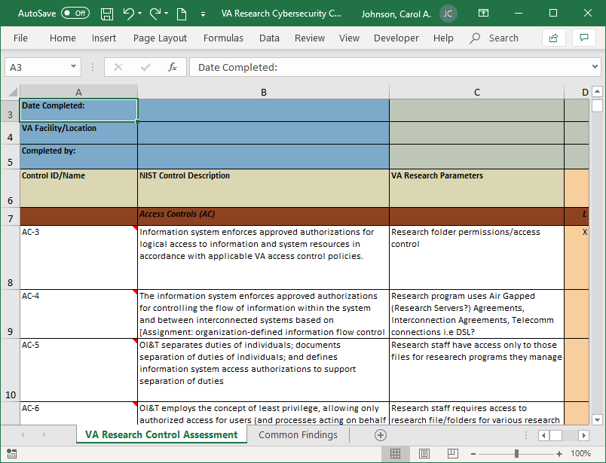
Sample Artifacts
Letter of Notification
Self-Assessment Questionnaire
Control Assessment Questionnaire
Control Assessment Matrix

Slide 8
AO/ACOS RCAP Impacts/Resource Utilization

Slide 9
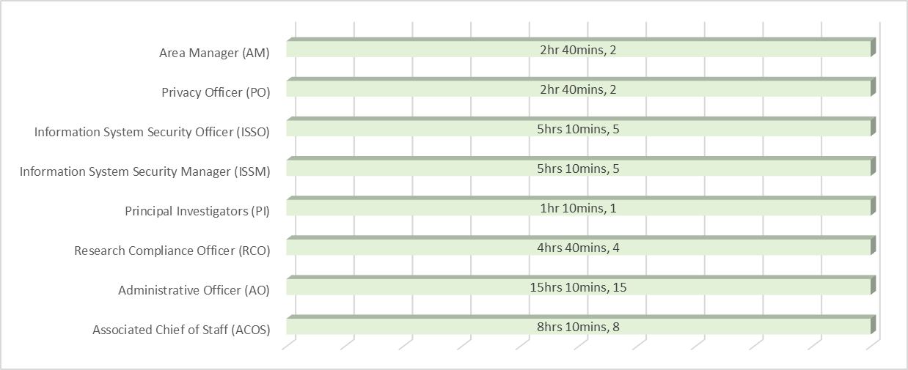
AO/ACOS RCAP Impacts/Resource Utilization
During RCAP site visits, the role of the AO and ACOS are critical to the success of the program. Outlined below is the total time commitment by role requested for the duration (1week) of the site visit:
  Self -Assessment Questionnaire
  Entrance Brief
  Administrative (Protocol selection, access to protocol system, conference rooms, scheduling of PI interviews, access to PI folders, evidence submission etc.)
  Interviews/Training & Awareness
  Research Lab, Server Room, Network Closet Tour
  Exit Brief

Slide 10
Common ORO Cybersecurity Findings

Slide 11
Common ORO Information Security Related Findings
Common information security findings noted by Office of Research & Oversight (ORO) include the following:
Documentation of System Interconnections
Documentation of air-gapped networks (Externally hosted VASI within VA physical boundary)
External storage of sensitive information
Inventory of externally owned equipment
Internal Storage of sensitive information
Encryption of sensitive information during transmission
Authorization to transport sensitive information
Authorized use of mobile systems
Encryption of mobile systems
Encryption of removable media containing sensitive information
Authorized use of personal equipment
ISSO Review
Privacy Related Requirements
Training
Proper reporting of research-related information security incidents
Report Reference: https://www.sciencedirect.com/science/article/pii/S2352340918313957

Slide 12
Research Protocol Data Management/Enterprise Research Data Security Plan (ERSDP)
Terry Peters
March 26, 2020
This Briefing is: UNCLASSIFIED//FOR OFFICIAL USE ONLY

Slide 13
Objectives
  Provide VHA Research stakeholders an overview of the Enterprise Research Data Security Plan (ERDSP) that will be implemented within the VA Innovation and Research Review System (VAIRRS)
  Communicate key benefits of the ERDSP
  Identify training resources available to VHA Research stakeholders
  Communicate Research Support Division (RSD) efforts to support the Office of Research and Development (ORD) with the VAIRRS implementation

Slide 14
Enterprise Research Data Security Plan Development (1 of 2)
The ERDSP is a collaborative effort between VHA Data Owners (ORD, ORO, OIS, ESO) to balance security needs and security control requirements against the following factors:
  The Mission of VHA Research
  Operational Use of the Data within the Environment
  Identified Risks
  Available Resources

Slide 15
Enterprise Research Data Security Plan Development (2 of 2)
The ERDSP was developed in response to the Enterprise Cybersecurity Risk Assessment for Research Protocol Data Management.
The ERDSP is a central element of the selection of administrative, technical, and operational safeguards and implementation of research protocol data risk management.

Slide 16
Enterprise Research Data Security Plan (ERDSP) Overview (1 of 3)
The ERDSP provides a mechanism to account for the security of research protocol data during each stage of the data management life cycle and is a reliable way to ensure the consistent evaluation of a research protocol’s data usage, storage, sharing, and transmission requirements by:
  Implementing a standardized template and plan designed to provide research principal investigators (PIs) with a tool to aide in documenting the safeguards used to protect research data, information, and systems.
  Providing a mechanism for PI’s to document their plan for managing risks to protect research data within a research protocol, and promoting the standardization of the ISSO review during the IRB/R&DC review process per policy.

Slide 17
Enterprise Research Data Security Plan (ERDSP) Overview (2 of 3)
The ERDSP enables the following objectives:
  Assisting PI’s with documenting how research data (human subject, basic science, animal) will be protected.
  Assisting ISSOs with employing consistent security review checks.
  Simplifying the process of completing and submitting an Enterprise Research Data Security Plan (ERDSP).
  Increasing the consistency of the information submitted in the form.
  Clarifying whether or not ISSO approval is required for an ERDSP.

Slide 18
Enterprise Research Data Security Plan (ERDSP) Overview (3 of 3)
The ERDSP form utilizes branching logic.
  Branching logic forms are basically intelligent forms that place relevant questions in front of the users.
  Each of the questions takes respondents to a designated question.. If the next question does not align with the user’s current answer, that question is skipped and the user is taken to a more relevant question. A branching logic form allows the users to follow a certain flow based on their answers.
  In short, the path of the user takes can be reconstructed with every answer. The path can keep branching out until all questions have been addressed. The path through the form can vary for each user or respondent.

Slide 19
Key Personnel Responsibilities
Complete the ERDSP for each new research study and new amendments as required
Work with the ISSO to resolve research study information security issues in a timely manner
Principle Investigators
Review research studies that require an ISSO review
Assist the PI in resolving research study information security issues in a timely manner
Facility ISSOs
Research Support Division
Provide ERDSP guidance as needed
Maintain ERDSP template and User Guide documentation

Slide 20
ERDSP Implementation
The ERDSP will be implemented in conjunction with the VA Innovation and Research Review System (VAIRRS) tier schedule deployment.
The ERDSP will be required for new Human, Basic Science and Animal studies and most study amendments.
Currently, only the VAIRRS Tier 1 sites are required to complete the ERDSP.
VAIRRS Tier 2 and Tier 3 sites will be required to complete the ERDSP when the VAIRRS implementation is expanded to those sites.

Slide 21
ERDSP Soft Pilot Release
The Research Support Division is conducting a soft pilot release (test) of the ERDSP from 3/20/2020 to 4/20/20 with the VAIRRS Tier 1 sites. The purpose of the test:
Ensure the ERDSP functions as intended, the questions presented to the user are relevant, and concise.
Collect metrics and user feedback.

Slide 22
VAIRRS Tier 1 Sites
VAIRRS Tier 1 Sites
Facility Name | Location | Facility Name | Location
Samual S. Stratton VAMC | Albany, NY | Memphis VAMC | Memphis, TN
New Mexico VA HCS | Albuquerque, NM | Miami VAMC | Miami, FL
Atlanta VAMC | Atlanta, GA | VA Tennessee Valley HCS | Nashville, TN
Rocky Mountain Regional VAMC | Aurora, CO | VA New York Harbor HCS | New York, NY
Bay Pines VAMC | Bay Pines, FL | Northport VAMC | Northport, NY
Birmingham VAMC | Birmingham, AL | Orlando VAMC | Orlando, FL
VA Boston HCS | Boston MA | Corporal Michael J. Crescenz VAMC | Philadelphia, PA
James J. Peters VAMC | Bronx, NY | VA Pittsburgh HCS | Pittsburgh, PA
VA Western New York HCS | Buffalo, NY | Hunter Holmes McGuire VAMC | Richmond, VA
Jesse Brown VAMC | Chicago, IL | Salem VAMC | Salem, VA
VA Northeast Ohio HCS | Cleveland, OH | W.G. (Bill) Hefner VAMC | Salisbury, NC
William Jennings Bryan Dorn VAMC | Columbia, SC | VA Caribbean HCS | San Juan, PR
John D. Dingell VAMC | Detroit, MI | VA Puget Sound HCS | Seattle, WA
VA New Jersey HCS | East Orange, NJ | Syracuse VAMC | Syracuse, NY
Edward Hines Jr. VAMC | Hines, IL | James A. Haley VAMC | Tampa, FL
G.V. Montgomery VAMC | Jackson, MS | Tuscaloosa VAMC | Tuscaloosa, AL
Kansas City VAMC | Kansas City, MO | Washington DC, VAMC | Washington, DC
Central Ark. Veterans HCS | Little Rock, AR | VA Connecticut HCS | West Haven, CT
Robley Rex VAMC | Louisville, KY | White River Junction VAMC | White River Junction, VT
VA Northern California HCS | Mather, CA

Slide 23
ERDSP Benefits
The ERDSP assists PIs with documenting how research data (human subject, basic science, animal) will be protected .
The ERDSP assists ISSOs with employing consistent security review checks.
The ERDSP removes the requirement for an ISSO review of Low Risk studies.

Slide 24
RESEARCH SYSTEMS
Research Support Division (RSD)
March 26, 2020
Terry M. Taylor
This Briefing is: UNCLASSIFIED//FOR OFFICIAL USE ONLY

Slide 25

Research System Support Overview
Research Support Division (RSD) provides ISSO support for national research systems.
In 2018, Research Support Division (RSD) started with supporting two research systems for ATO (Authority to Operate).
Today, RSD supports 22 systems, 13 systems with ATO and 9 systems pursuing an ATO. More systems are planned.
Systems with an ATO are authorized to store and process VA data.
This presentation is an overview of ATO systems.

Slide 26
Research Systems
System | ISSO | System Owner | ATO STATUS | Research Use
CSP - Cooperative Studies Program | Tristan Carroll | Doug Smith | ATO Granted | Multi-site clinical trials and observational studies
GENISIS | Terry Taylor | Vanessa Davis | ATO Granted | Genomic (DNA) analysis
MVP-Mail Print Scan IPSOS | Kevin Essary | Edmund Peirce | ATO Pending | Mail surveys and scan in returned surveys for MVP
IRBManager | Tristan Carroll | Terrill Harrison | ATO Granted | Management and documentation of IRB processes.
IRBNet | George Quintela | James Breeling | ATO Granted | Management and documentation of IRB processes.
iRIS | Tristan Carroll | James Breeling | ATO Granted | Management and documentation of IRB processes.
Maveric - Data Labs | Terry Taylor | Michael Wynn | ATO Granted | Data Analysis

Slide 27
Research Systems (cont.)
MVP DOE Argonne ABLE | Terry Taylor | Jack Bates | ATO Pending | Genomic (DNA) analysis
MVP DOE ORNL KDI CHAMP | Terry Taylor | Jack Bates | ATO Granted | Genomic (DNA) analysis
ORO-CATS | George Quintela | Doug Smith | ATO Pending | ORO program oversight and compliance review system
Prospect | Terry Taylor | Siamack Ayandeh | ATO Pending | Surveys and survey result analysis.
Qualtrics | Stuart Chase | Cameron Cotten | ATO Granted | Management and documentation of IRB processes.
RedCap (VA) | Stuart Chase | James Breeling | ATO Granted | Surveys and survey result analysis.
MVP REEF | George Quintela | Edmund Peirce | ATO Granted | Recruitment/Management of veteran MVP volunteers (new)

Slide 28
Research Systems (cont.)
Tissue Metrix 2 | Tristan Carroll | James Averill | ATO Granted | Database for brain and spinal cord donors
Data Commons | George Quintela | Scott Duval | ATO Pending | Genomic (DNA) analysis
TDE - VAEDA | George Quintela | Mary Klote | ATO Pending | Automated research review system
VAIRRS | George Quintela | Doug Smith | ATO Pending | Management and documentation of IRB processes.
Westat | Terry Taylor | James Breeling | ATO Granted | Surveys and survey result analysis.
RESEARCH SYSTEMS NOT MANAGED BY RSD
VINCI |  | Scott Duvall
More systems to be identified…

Slide 29
Research Systems (cont.)
Researchers may use or encounter these systems in their research projects.
This list is a quick way to determine if the system proposed for use has a valid VA ATO (Authority to Operate).
Having an ATO shows that the system is approved for storing and processing VA data, but some are for non-sensitive information.
RSD ISSOs can provide guidance to local ISSOs as needed.

Slide 30
Research Scientific Computing Devices (RSCD)

Slide 31

What is a RSCD?
Overview
A standalone or network capable system or device that cannot obtain VA approved baseline configuration settings, and/or interfaces with scientific/clinical instrumentation(s) in direct support of research activities and scientific studies. These systems have the purpose of ultimately contributing to healthcare services and the well-being of Veterans.
  A RSCD includes instrument(s) that have an internal operating system and central processing unit used to acquire/ analyze data and for indicating, measuring and recording physical quantities, attributes, and other formulas.
  A RSCD system is a suite of hardware, software, and scientific applications, to include databases and webservers that are physically part of and dedicated to the mission of research and/or scientific studies.

Slide 32
Why Conduct an Enterprise Risk Assessment on RSCD?
Drivers
Enhance enterprise security posture for devices used within research and within research labs requiring VA Network connectivity
Introduce a standard process for reviewing and isolating RSCDs to ensure continuous monitoring of security, and mitigation of risk
Recommend information security standards to guide RSCD risk assessment process to ensure confidentiality, integrity, and availability
Lack of security standardization, guidance, and policies increases the VAs material weakness and vulnerabilities due to unsupported scientific device operating systems and creation of unsecure environments
  Impact is possible loss of records and valuable research data and regulatory fines and a possible compromise of PHI, PII, intellectual property and/or VA sensitive information.

Slide 33

Drivers for SNOW Consolidation of Specialized Devices
Mission/Business Drivers
Security Drivers
Collaborative effort between OIS, DevSecOps, ITOPS to create a seamless, one-stop shop for our customers and to reduce the number of manual hand-offs and multiple portals for duplicate data entry.
Consolidate intake request process for Medical, Special Purpose, and Research Scientific Computing Devices to provide consistent guidance to the field
The need to establish clear guidance and efficient processes to support business owners and research principal investigators with requirements for securely connecting a RSCD to the VA network
The need to properly secure RSCDs that store sensitive veteran research subject information.
Inconsistencies in the implementation of security review processes across Medical Facilities for Research devices

Slide 34
Research Scientific Computing Devices (RSCD)
Many researchers want their RSCDs connected to the VA network so that they can:
  Electronically transmit data from the RSCD to their researchers or other computer systems for processing and analysis.
  Backup their important research data
Some sites have had difficulty getting approval for connecting Research Scientific Computing Devices (RSCD) to the VA Network.
RSD is working with other VA security groups and OIT to create a evaluation and approval process for allowing RSCDs to securely and safely connect to the VA network.

Slide 35
Research Scientific Computing Devices (RSCD) (cont.)
In April of 2020 a new process will rollout for submitting RSCDs to OIT and RSD for evaluation and connection to the VA network.
The process will utilize the SNOW ticket system for submission, it will mirror a similar system for connecting Medical Devices and Special Purpose Systems.
Guidance and training will be made available soon.
Be watching for announcements about the new system.
It is recommended that sites pick some RSCDs for prioritization for submission.

Slide 36
Research Scientific Computing Devices (RSCD) (cont.)
RSCDs that are already connected to the VA network are currently grandfathered and do not need to be submitted at this time.
Existing systems that are not connected to the VA network but need connection and newly acquired systems that need to be connected to the VA network will need to be submitted in the new process.
Similar to the existing process used for connecting Medical Devices to the VA network, the submission will require considerable coordination with vendors to obtain technical documentation regarding the computer characteristics and security features of the RSCDs.
Approved RSCDs will be required to utilize built in available security features and will be placed in secure Virtual LANS (VLANS) with Access Control Lists (ACLS) to help protect these important systems from security threats. RSD will provide expertise and guidance.

Slide 37
Contact Information
Research Support Division (RSD) SharePoint
https://vaww.portal2.va.gov/sites/infosecurity/fieldsecurity/rs/default.aspx
RSD FAQs (General)
https://vaww.portal2.va.gov/sites/infosecurity/fieldsecurity/rs/Lists/RSD%20FAQ/AllItems.aspx
RSD FAQs for PIs
https://vaww.portal2.va.gov/sites/infosecurity/fieldsecurity/rs/Lists/RSD%20FAQ%20%20Principle%20Investigator%20PI/AllItems.aspx
RSD E-Mail Distribution List
OITITOPSSOESOResearchSupportDivision@va.gov

Slide 38
RSD Resources
For support contact RSD team at:
OITITOPSSOESOResearchSupportDivision@va.gov
RSD Group | Name | Email
Research Support Division – Supervisory Program Manager | DuJuan Williams | DuJuan.Williams@va.gov
Information Assurance Support, SME | Carol Johnson | Carol.Johnson31@va.gov
Information Assurance Support | Roland Sasaki | Roland.Sasaki@va.gov
Information Security Support, SME | Terry Peters | Terry.Peters@va.gov
Information Security Support | Kenneth Blagg | KENNETH.BLAGG@va.gov
Research System Security Support, SME | Terry M. Taylor | Terry.Taylor@va.gov
Research System Security Support | George Quintela | George.Quintela@va.gov
Research System Security Support | Stuart Chase | Stuart.Chase@va.gov
Research System Security Support | Kevin Essary, | Kevin.Essary@va.gov
Research System Security Support | Tristan Carroll | Tristan.Carroll@va.gov

Slide 39

Questions?

