Slide 1
VA Innovation and Research Review System (VAIRRS)
Monthly Webinar
September 20, 2022

Slide 2
Webinar Housekeeping
Recording - This session is being recorded and the associated handouts will be available on ORPP&E’s Education and Training website within one-week post-webinar.
Close Captioning - Now available in the new Webex platform. Click the “CC” button at the bottom left of the Webex screen.
Experiencing Sound Issues? – Call in using the number in your Webex chat box or in your registration confirmation email.
Q&A - Please use the Q&A feature to submit questions.
Be sure to send questions to “All panelists”.
Questions will be addressed at the end of the webinar.
Webinar Archive - Most ORPP&E webinars can be found here: https://www.research.va.gov/programs/orppe/education/webinars/archives.cfm
Post-Webinar Evaluation Survey - We are grateful to all that complete the post-webinar evaluation survey. It will automatically pop up once the webinar is exited.
For questions, please use Q&A box and address to “All Panelists.”
All Webinars will be recorded and posted within one week.

Slide 3
Contents
Welcome
Announcements
IRBNet Basics for Investigators Presented by Angela Foster, Program Manager, Enterprise Research Data Systems, Office of Research Protections, Policy, and Education (ORPP&E)

Slide 4
Important Announcements
COVID-19 Research Dashboard
VAIRRS Change Control Board (CCB)
VAEDA Webinar
ORD developed a dashboard of COVID-19 research activities occurring across the VA. You can access the COVID-19 Research dashboard on the VA network. Additionally, ORD also provides a slightly limited version of the dashboard for non-VA audiences on https://www.research.va.gov/covid-19-research-dashboard.cfm.
Effective on September 6, 2022, the VAIRRS Change Control Board (CCB) intake process has been updated. All change requests must be submitted through the VAIRRS CCB Request Form.
The VA Electronic Determination Aid (VAEDA) has completed the "soft launch" phase, and we are gearing up for the official launch on September 21, 2022. CLICK HERE TO REGISTER!
Subscribe to the VAIRRS Newsletter and Program Update to keep up with important announcements and program updates: https://public.govdelivery.com/accounts/USVHA/subscriber/new?topic_id=USVHA_1952

Slide 5
IRBNet Basics for Investigators
Angela Foster
Program Manager, Enterprise Research Data Systems
Office of Research Protections, Policy, and Education (ORPP&E)

Slide 6
IRBNet Basics for Investigators
Accessing and Enrolling in IRBNet
User Profile
My Projects
Project vs Package
Creating a New Project/Package
Revising a Package/Response Package

Slide 7
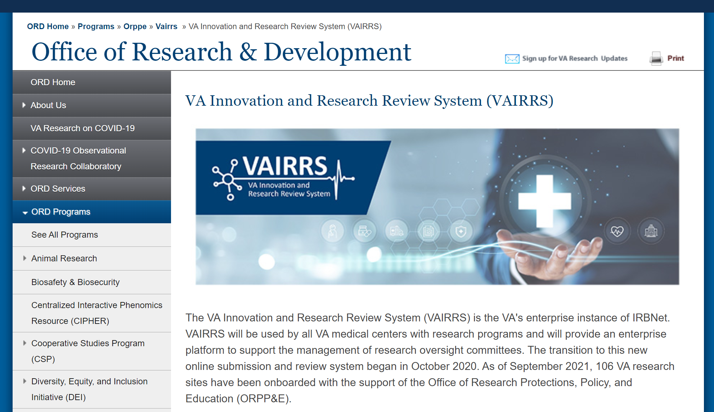
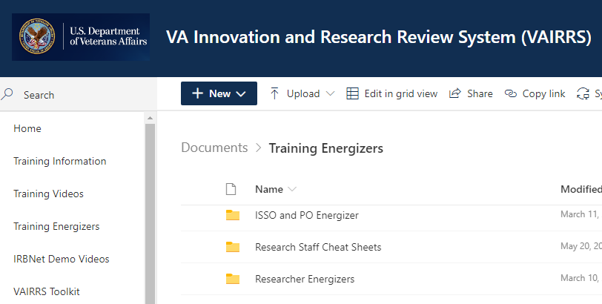
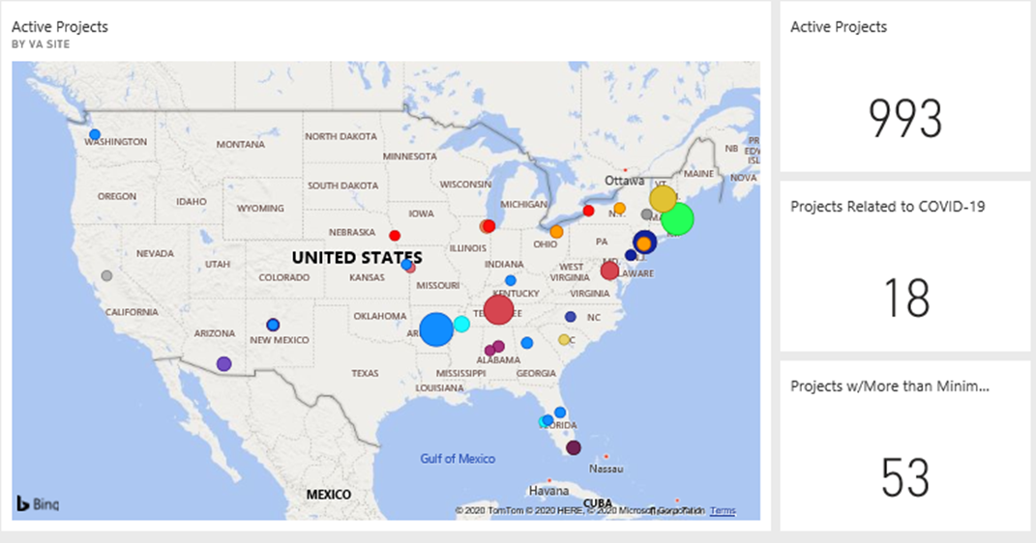
What is VAIRRS?
VA Innovation Research Review System
IRBNet: https://gov.irbnet.org/release/index.html
VAIRRS Website: https://www.research.va.gov/programs/orppe/vairrs/default.cfm
VAIRRS SharePoint Portal: https://dvagov.sharepoint.com/sites/VHAORPPE/VAIRRS
Power BI Dashboards

Slide 8
IRBNet Basics for Investigators
Accessing and Enrolling in IRBNet

Slide 9
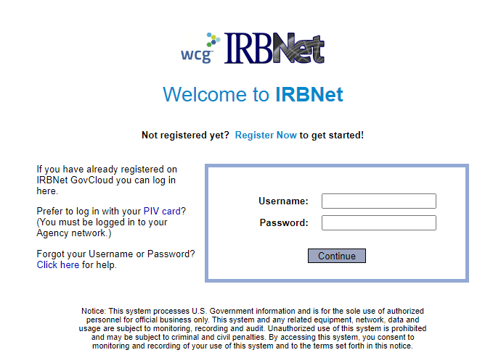
Accessing IRBNet
Website address: gov.irbnet.org
PIV log-in
Accessible from outside the VA network

Slide 10
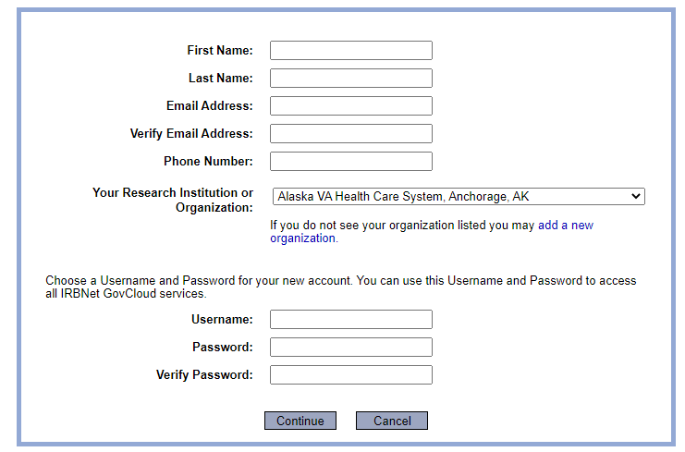
Enrolling in IRBNet
All VA facilities are listed in affiliation section

Slide 11
IRBNet Basics for Investigators
Accessing and Enrolling in IRBNet
User Profile

Slide 12
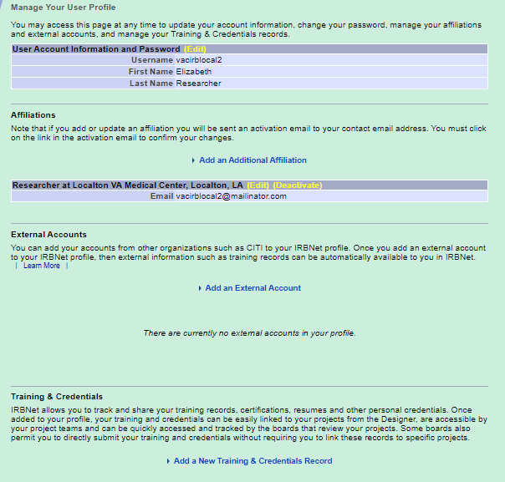
User Profile – Add Affiliations
IRBNet supports multiple VAMC affiliations

Slide 13
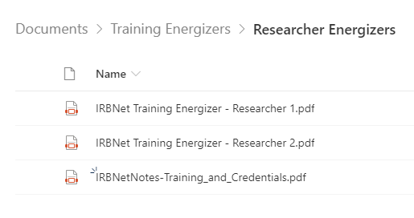
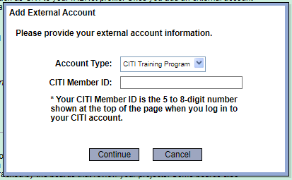
User Profile – External Accounts
VAIRRS SharePoint – Researcher Energizers

Slide 14
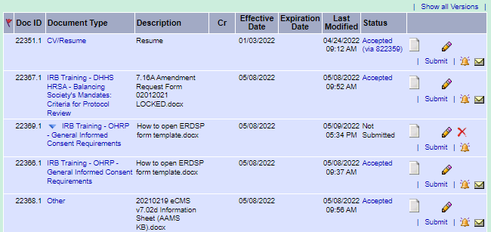
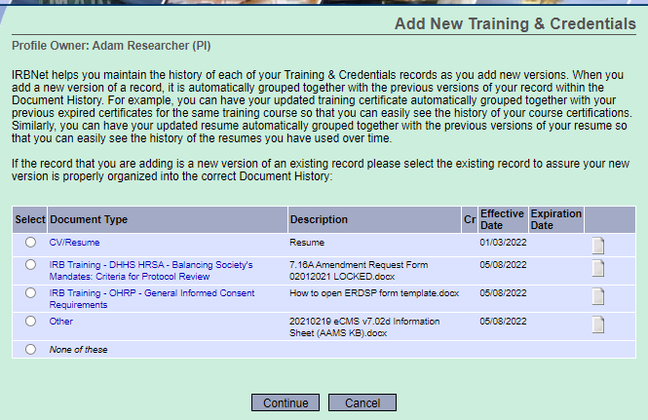
User Profile – Training and Credentials
You must select
‘Submit’ to notify the administrator!

Slide 15
IRBNet Basics for Investigators
Accessing and Enrolling in IRBNet
User Profile
My Projects

Slide 16
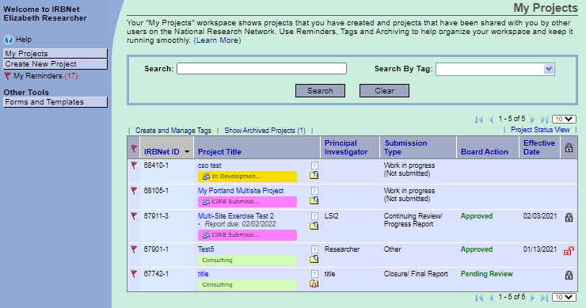
My Projects
Notifications
Search Options
Access Libraries
Project List

Slide 17
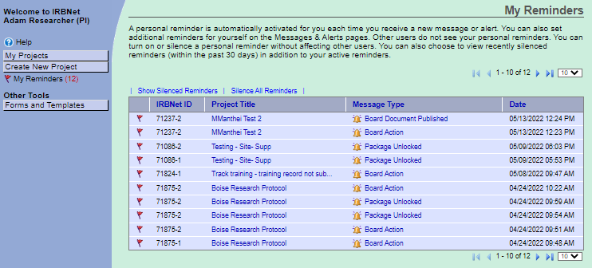
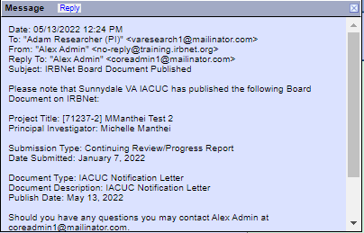
My Projects – Notifications and Reminders

Slide 18
My Projects – Search Options
Search and Filter

Slide 19
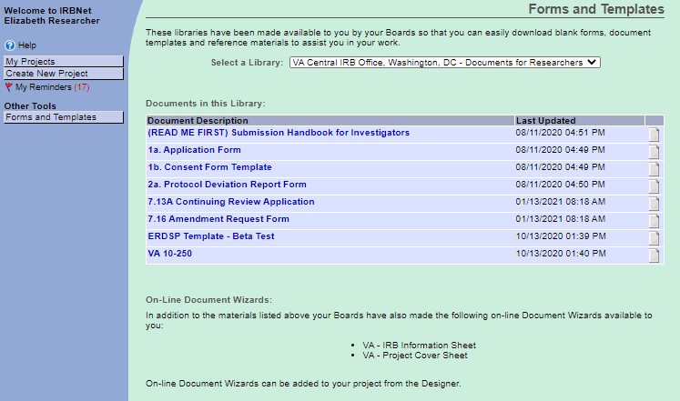
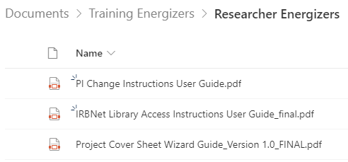
My Projects – Forms and Templates
Select the correct library
Electronic Wizards

Slide 20
My Projects - Tags
Use Tags to organize your workspace

Slide 21
IRBNet Basics for Investigators
Accessing and Enrolling in IRBNet
User Profile
My Projects
Project vs Package

Slide 22
Projects vs. Packages
Approved Project
(Package –1)
Amendment
(Package -2)
CR/Progress Report
(Package -3)
Amendment
(Package -4)

Slide 23
Projects vs. Packages Multi-site Projects
PI Project
Approved PI Project
(Package – 1)
Amendment
(Package -2)
CR/Progress Report
(Package -3)
Amendment
(Package -4)
LSI Project
LSI Project
Approved LSI Project
(Package – 1)
Approved LSI Project
(Package – 1)
Amendment
(Package -2)
CR/Progress Report
(Package -3)
Amendment
(Package -4)
Amendment
(Package -2)
CR/Progress Report
(Package -3)
Amendment
(Package -4)

Slide 24
Projects vs. Packages
When submitting a … | Create a new …
New Study Application | Project
New Study Action | Package
Revised submission | Package (per local guidance)
New LSI Application | New project created by PI site

Slide 25
IRBNet Basics for Investigators
Accessing and Enrolling in IRBNet
User Profile
My Projects
Project vs Package
Creating a New Project/Package

Slide 26
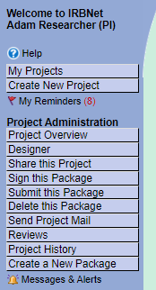
Creating a New Project
Select Create New Project to create a new study application

Slide 27
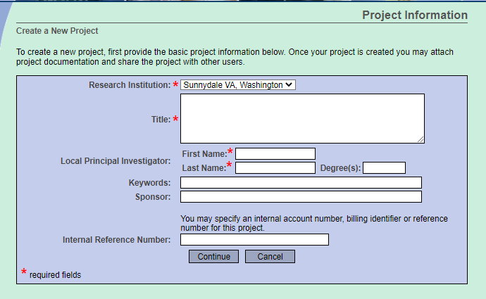
New Project Details

Slide 28
Creating a New Package
Select Create a New Package to create a new study action within an IRBNet project

Slide 29
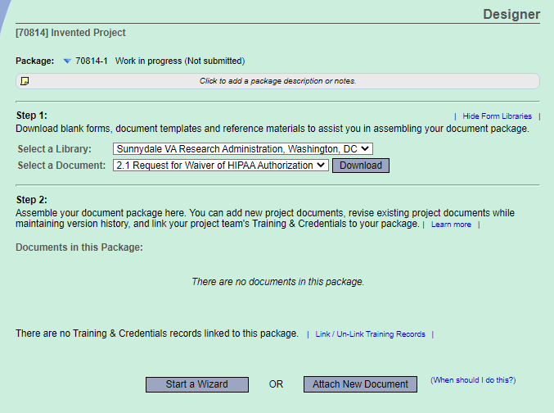
Designer

Slide 30
Completing and Submitting a Package
Step 1: Upload completed study documents
Step 2: Complete applicable wizards
Step 3: Link Training Records
Step 4: Share Package with study team members
Step 5: Sign Package
Step 6: Submit Package

Slide 31
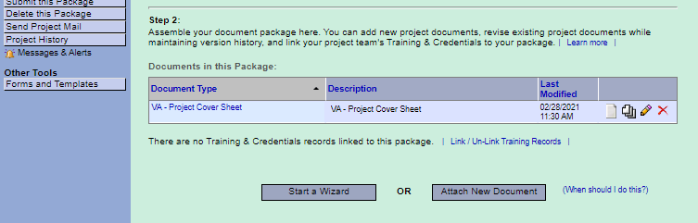
Step 1: Upload Study Documents

Slide 32
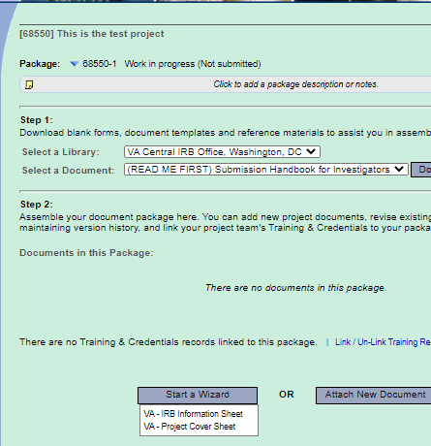
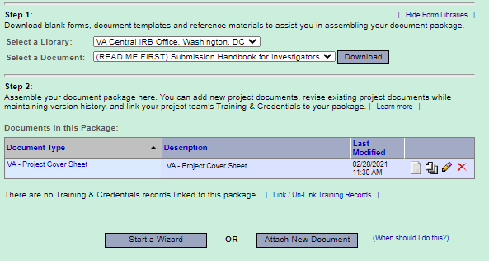
Step 2: Complete Applicable Wizards
2
1
3

Slide 33
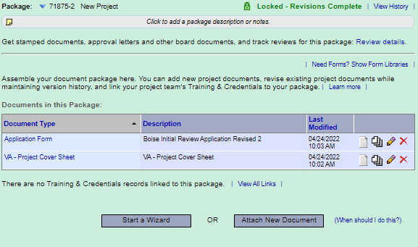
Step 2: Document Upload Complete

Slide 34
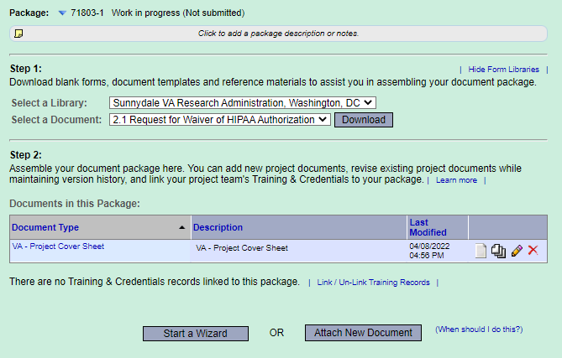
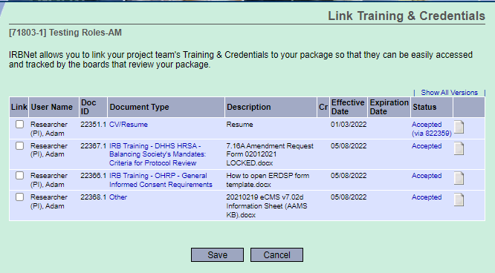
Step 3: Link Training Records

Slide 35
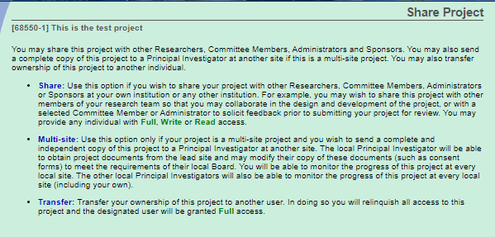
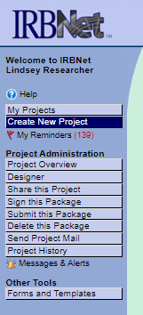
Step 4: Share Package
Share package with study team members
Multi-site share with local site/non-lead site investigator
Transfer ownership of project to another investigator

Slide 36
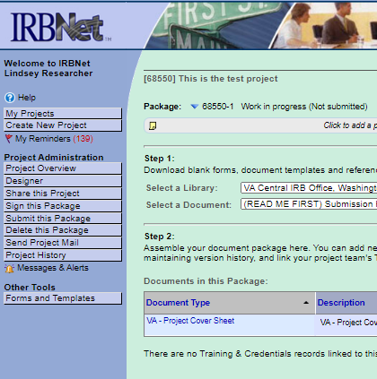
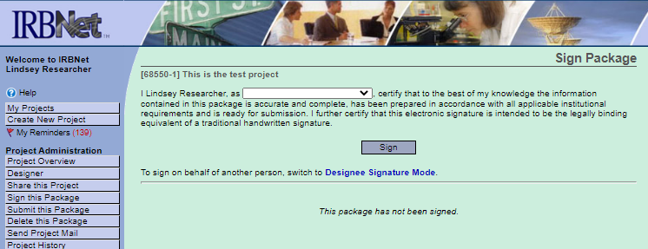
Step 5: Sign Package

Slide 37
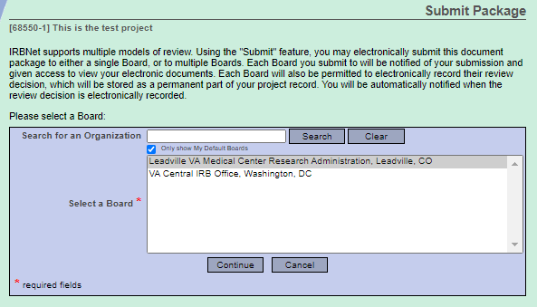
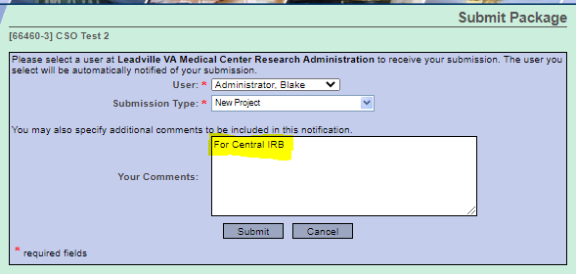
Step 6: Submit Package

Slide 38
IRBNet Basics for Investigators
Accessing and Enrolling in IRBNet
User Profile
My Projects
Project vs Package
Creating a New Project/Package
Revising a Package/Response Package

Slide 39
Revised and Response Packages
All packages are ‘locked’ upon submission to preserve the audit trail
Package may be ‘unlocked’ by administrator and returned to study team if required forms are missing
Package may receive a board action of ‘Information Required’ or ‘Modifications Required’ if additional information or modifications are necessary. A response package is used to respond to the request for more information or modifications

Slide 40
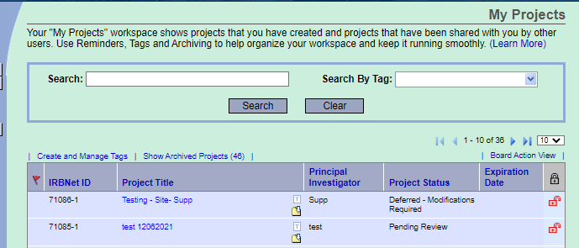
Unlocked Package
Reference unlock message for details and instructions from administrator
Follow instructions to revise documents or upload missing documents to package
Mark Revisions Complete

Slide 41
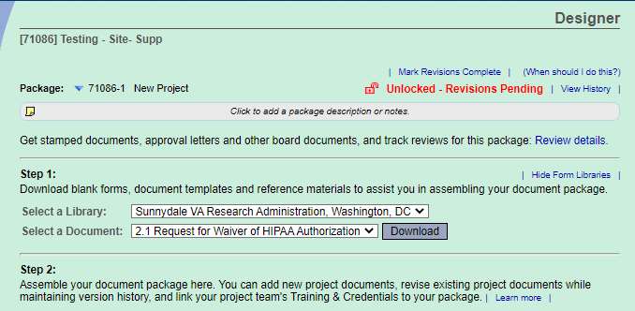
Revising Unlocked Package

Slide 42
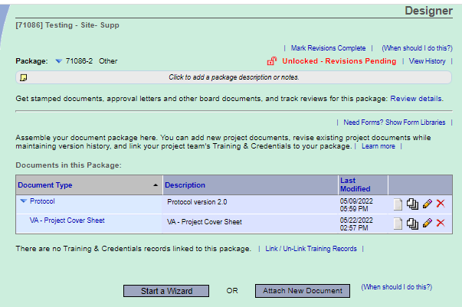
Revising Unlocked Package
Select to replace an uploaded document or edit a wizard.
Select to delete document from package.

Slide 43
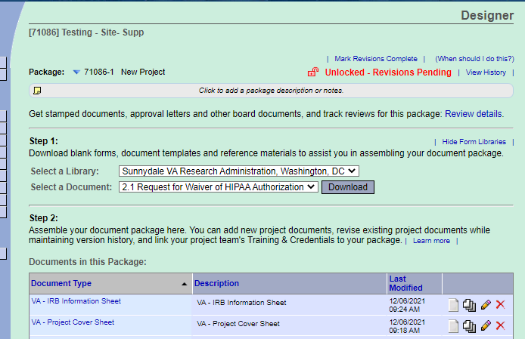
Revising Unlocked Package
You must select
“Mark Revisions Complete” to notify the administrator!

Slide 44
Response Package
Reference board document for details on additional required information or modifications
Create new package within project
Follow instructions to update documents or upload additional information to package
Submit the new package

Slide 45
Response Package Documents
Updates made to documents from previous packages (using pencil icon) are tracked using version control.

Slide 46
VAIRRS Resources
Recorded training videos are available on the VAIRRS SharePoint portal. The training videos are categorized by role (e.g., researcher, administrator, committee member perspectives).
Training energizers are available on the VAIRRS SharePoint portal. The energizers, which serve as guides for the end-user, are also categorized by role.
Answers to Frequently Asked Questions (FAQs) about VAIRRS are available on the VAIRRS website.
The VAIRRS Newsletter is published bi-monthly. A VAIRRS Program Update is published on the alternative months. Any user can subscribe to the publications. Subscribe here:
Contact the VAIRRS Support Team at VAIRRS@VA.gov

Slide 47
QUESTIONS
&
COMMENTS

Slide 48
Contacts
VAIRRS Support Team
IRBNet
VAIRRS@va.gov
govsupport@irbnet.org
Questions related to VAIRRS program, resources, training, and VA processes
Technical assistance, account issues

Slide 49
References
VAIRRS Website: https://www.research.va.gov/programs/orppe/vairrs/default.cfm
VAIRRS SharePoint: https://dvagov.sharepoint.com/sites/VHAORPPE/VAIRRS
VAIRRS Webinar Archive: https://www.research.va.gov/programs/orppe/education/webinars/archives.cfm
VAIRRS Support Team: VAIRRS@va.gov
VAIRRS Newsletter Subscription: https://public.govdelivery.com/accounts/USVHA/subscriber/new?topic_id=USVHA_1952

