Slide 1

Tracking Open Obligations:
UDO-Undelivered Orders
November 14, 2024
Diane Murphy, ORD Finance
Vanessa Smith, ORD Finance
Kari Points, Advisor, Field Operations

Slide 2
Objectives for today’s training
Training Section: | By the end of this section, you will:
Section 1: Introduction | Why is this important?
Section 2: How to understand and utilize the UDO Reports | Know what is a UDO report.
Section 3: How to locate and view purchase orders and obligation numbers in VISTA | Be able to utilize VISTA/IFCAP to identify and review purchase orders
Section 4: Navigating IPPS and certifying payments | How to review invoices and purchase orders in IPPS
Section 5: Utilizing the Open Documents report in the VSSC | How to pull your own UDO/Open orders report from VSSC
Q&A

Slide 3
Section 1: Why is this important?
VA Financial Policy requires Fiscal to review open orders monthly. Obligations aged beyond 90 days of the period of performance end date or without activity in the past 90 days are considered stale obligations and must be reviewed.
  These reports (F850 and F851) should be sent to the Research Office each month so that you can respond to the status of the open obligations.
If your Fiscal is already sending you these reports, why are you also being contacted by ORD Finance?
  Open orders that are not de-obligated by the funding expiration date, are missed opportunities to spend those funds. Funds on orders from expired years can no longer be used for new requirements. This adds up when you look at the data.

Slide 4
Section 1: Why is this important?
Currently, $40.4 Million in Open Orders exist in the Research Appropriation that is in expired funding.
There is $58M in funds that were de-obligated after the funds had expired and are no longer available for use. This amount will continue to grow as there are de-obligations to the $40.4 Million in open orders.
What is the impact? That is 72 merit reviews that could have been funded (calculating a merit review at $800K over 4 years).
Fiscal Year | # of Purchase Orders | Amount in Open Orders | Expired Balances no longer available for use.
19/20 | 10 | $230,704.46 | $12,865,452.19
20/21 | 30 | $395,361.57 | $15,564,165.68
21/22 | 92 | $3,666,386.37 | $19,648,287.31
22/23 | 322 | $7,329,540.11 | $8,279,081.78
23/24 | 1057 | $28,763,837.08 | $1,659,937.43
Grand Total | 1511 | $40,385,829.59 | $58,016,924.39

Slide 5
Section 1: Things to Consider
When creating an obligation (2237/1358), ensure these obligations do NOT exceed the estimate of good/services required.
  Do NOT over obligate just to help get your facility to 2%. ORD Finance is paying attention to large de-obligations that occur throughout the year.
Pay attention to start and end dates. Try to avoid end dates late in the fiscal year when it is the last year of funding.
  For example, if end date is Aug 31, 2025 and the obligation is a FY24/25 transaction, it is difficult to get the invoice and de-obligation completed prior to Sept 30, 2025 when the funds expire. If it is a contract that requires a modification to de-obligate, it is even more challenging.

Slide 6
Section 1: Known Challenges
ORD Finance understands that there are challenges that come with the Open Obligation - UDO report. The two main issues we hear are:
  Contracting is slow to process modifications to de-obligate/close-out a contract.
  Affiliates not invoicing timely.
While both situations can be frustrating and feel that they are out of your hands, stay on top of it and be persistent.
  Don’t just enter the FORCE transaction and not follow-up. Reach out to the Contracting Officer and ask for status updates.
  Talk to your leadership about the affiliate not invoicing. See if you can get a meeting scheduled and work through the issue. Explain the problem with late invoices and the expiration of funds.

Slide 7
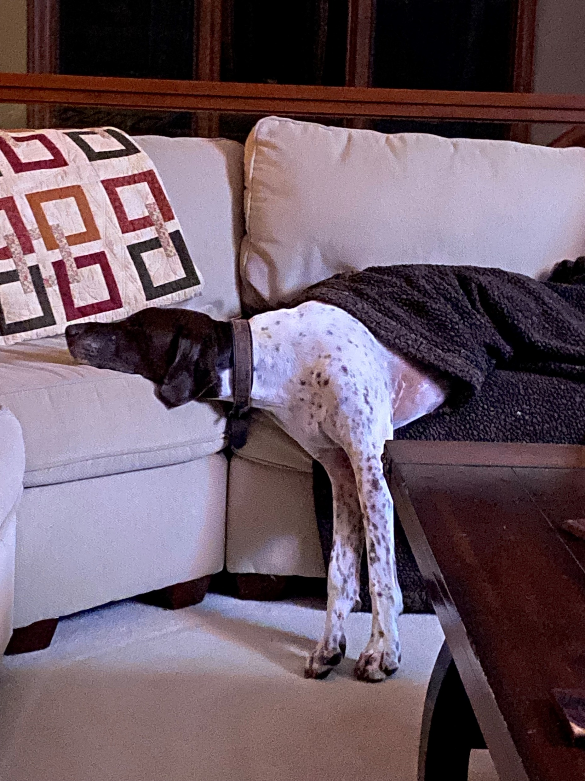
Section 2: How to understand and utilize the UDO Reports
UDO Reports are exhausting…..

Slide 8
Section 2: UDO Report
What is the UDO (Undelivered Orders) report?
  All open obligated purchase orders (2237s and 1358s): orders which have been processed/obligated by Fiscal/Accounting and have outstanding balances in FMS.
  May also be called: F850 and F851 reports
  It is required to review and respond monthly to Fiscal on the status of the open obligations.
  You can also view the reports at anytime through the VSSC: OBLL_OpenDocuments - Report Viewer (va.gov)

Slide 9
Section 2: UDO Helpful Information
Helpful information for UDO and IPPS
MO-Miscellaneous Orders (VISTA Method of Payment: Invoice/Receiving Report): Warehouse must process receiving reports. If items didn’t come through the warehouse, service needs to notify the warehouse staff to process a receiving report. IPPS matches invoices to receiving report to process payment(s).
SO-Service Orders (1358s and VISTA Method of Payment: Certified Invoice on 2237s): Vendor submits invoice(s) into IPPS. Certifying official must sign into IPPS to certify invoices for payment to process.
RR/RT-Receiving Reports: Processed against Invoice/Receiving Report (VISTA); MO orders (FMS)
AR-Accrual: Occurs in FMS if there are outstanding funds after the end date on SO orders. Funds are available to use for payments. It is possible to have one purchase with an SO amount and an AR amount.
Notes:
F830 Report: Diane-Notes
- BOC Codes : Monthly spending, using correct codes
- Monthly Report, Download from RSD
- Cost that occurred up to that point by fund and cost center (No breakout by fund control point)
Training: Induction into budgeting, different appropriations, VIST menu to submit, how to read running balance, reports that can be pulled - 1358

Slide 10
Section 2: UDO Helpful Information
You should review all orders on the UDO report, but these factors should get close attention:
End Date: Orders still open after the End Date and orders within 30-60 days of their End Date. Are invoices being paid properly and timely? Have receiving reports been submitted? Will the order be completed by the end date? If not, do you need to request an End Date extension? Review your activity before the End Date to ensure order doesn’t become delinquent.
Days Open: Identifies how many days this order has gone past its End Date. Any order open more than 90 days is considered delinquent and affects the financial indicators.
Last Activity Date: Identifies when the last time there was activity on the order, i.e. obligation, payments, receiving reports. Even if order hasn’t reached the End Date, this is important. Example: if you have an order which began on 10/1/24 but there hasn’t been any activity since the order began. You should review to see if the vendor isn’t submitting invoices or submitting incorrectly (wrong PO#). Do you need to notify the warehouse to submit receiving reports? Have services/deliveries been delayed? This may require an End Date extension.

Slide 11
UDO Example
TC | Document ID | FCP | Fund | BFY | ACC No | BOC | Cost Ctr | P.O. Open AMT | Vendor name | Begin Date | End Date | Days Open | Last Activity Date
MO | XXXB72009 | 7132 | 0161A1 | 17 | 810010100 | 2580 | 855100 | $9,087.00 | DEPARTMENT OF VETERANS AFFAIRS | 09/25/2017 | 09/30/2020 | 488 | 08/27/2021
SO | XXXB11021 | 1132 | 0161A1 | 21 | 810010100 | 2580 | 856400 | $50,330.25 | DEPARTMENT OF VETERANS AFFAIRS | 10/01/2020 | 09/30/2021 | 123 | 09/14/2021
SO | XXXTB1017 | 1132 | 0161A1 | 21 | 810010100 | 1285 | 810100 | $823.20 | DEPT OF HEALTH & HUMAN SVCS | 10/01/2020 | 09/30/2021 | 123 | 09/15/2021
SO | XXXD15002 | 1532 | 0161A1 | 21 | 850010100 | 2580 | 815000 | $2,057.84 | MISC COMMERCIAL VENDOR | 07/01/2021 | 12/31/2021 | 31 | 09/13/2021
MO | XXX2A6269 | 2532 | 0161A1 | 22 | 850010100 | 2660 | 856400 | $756.05 | MEDLINE INDUSTRIES INC | 01/10/2022 | 01/20/2022 | 11 | 01/18/2022
MO | XXX2A6299 | 2532 | 0161A1 | 22 | 850010100 | 2660 | 856400 | $429.24 | MEDLINE INDUSTRIES INC | 01/18/2022 | 01/28/2022 | 3 | 01/19/2022
MO | XXXB12004 | 1532 | 0161A1 | 21 | 850010100 | 2580 | 854100 | $251,576.00 | DEPARTMENT OF VETERANS AFFAIRS | 02/18/2021 | 02/18/2022 | 0
SO | XXXTB2017 | 1132 | 0161A1 | 21 | 810010100 | 1285 | 810100 | $1,500.00 | DEPT OF HEALTH & HUMAN SVCS | 10/01/2021 | 09/30/2022 | 0
SO | XXXD17109 | 1132 | 0161A1 | 21 | 810010100 | 2520 | 810300 | $9,132.00 | AGILENT TECHNOLOGIES INC | 09/30/2021 | 03/31/2022 | 0
SO | XXXD17102 | 132 | 0161A1 | 20 | 810010100 | 2580 | 810100 | $15,159.00 | MEDICAL UNIVERSITY OF SOUTH CA | 04/01/2021 | 03/31/2022 | 0
SO | XXXC25108 | 1132 | 0161A1 | 21 | 810010100 | 2520 | 810300 | $17,967.24 | AGILENT TECHNOLOGIES INC | 01/04/2022 | 03/31/2023 | 0
SO | XXXD17104 | 1132 | 0161A1 | 21 | 810010100 | 2580 | 810100 | $28,760.30 | NANCY A RODRIGUEZ | 06/19/2021 | 06/18/2022 | 0 | 01/24/2022
SO | XXXD15001 | 132 | 0161A1 | 20 | 810010100 | 2560 | 810100 | $32,830.75 | BIOMED RESEARCH CORP | 02/01/2021 | 02/02/2022 | 0 | 11/09/2021
SO | XXXD17108 | 532 | 0161A1 | 20 | 850010100 | 2580 | 815000 | $61,486.85 | UNIVERSITY | 08/04/2021 | 08/12/2022 | 0 | 01/24/2022
SO | XXXD17100 | 1532 | 0161A1 | 21 | 850010100 | 2560 | 815000 | $66,592.78 | UNIVERSITY | 02/07/2021 | 02/06/2022 | 0 | 01/21/2022
SO | XXXD25001 | 1132 | 0161A1 | 21 | 810010100 | 2580 | 810100 | $70,070.00 | UNIV OF | 10/01/2021 | 09/30/2022 | 0
SO | XXXD17101 | 1132 | 0161A1 | 21 | 810010100 | 2580 | 810500 | $103,212.98 | UNIVERSITY | 02/07/2021 | 02/06/2022 | 0 | 01/21/2022
SO | XXXD17107 | 1532 | 0161A1 | 21 | 850010100 | 2560 | 815000 | $182,181.86 | UNIVERSITY | 08/04/2021 | 08/12/2022 | 0
SO | XXXD17106 | 132 | 0161A1 | 20 | 810010100 | 2560 | 810300 | $271,516.07 | UNIVERSITY | 08/13/2021 | 08/12/2022 | 0 | 01/31/2022
SO | XXXD17105 | 1132 | 0161A1 | 21 | 810010100 | 2560 | 810300 | $504,636.43 | UNIVERSITY | 08/13/2021 | 08/12/2022 | 0 | 12/20/2021

Slide 12

Section 3: How to locate and view purchase orders and obligation numbers in VISTA
The smile you get when open orders are closed out before the funds expire.

Slide 13
Section 3: What is my Purchase order # or Obligation #
Use the Running Balance option in VISTA to review your FCP activity
Control Point Clerk’s (or Official’s) Menu→
Display Control Point Activity Menu→
Running Balances
  Select Display Control Point Activity Menu Option: Running Balances
  Select FISCAL YEAR: 22//
  Select QUARTER: 1//
  Select CONTROL POINT: 2132 Research Supplies 0161A1 10 8100 810010101
  Summary Balances Report Only? No//
  NOTE: Summary Balances Report Only? No = Detailed listing of activity for FCP in designated fiscal year and quarter.
  Summary Balances Report Only? Yes = Current balance only for FCP in designated fiscal year.

Slide 14
Section 3: What is my Purchase order # or Obligation #
CONTROL POINT BALANCE - XXX-22-3-2132- RESEARCH SUPPLIES MAY 07, 2019@10:41:15 PAGE 1
FISCAL
FYQSeq# TXN OBL # AP/OB DT COMM $AMT CP $BAL OBL $AMT UNOBL $BAL
--------------------------------------------------------------------------------
2210009 OBL D27200 03/21/22 1096926.84 -1096926.84 0.00* 0.00
2210010 OBL D20424 04/24/22 440.00 -1097366.84 440.00 -440.00
2230015 CEI 509FC3560 12/20/21 15000.00 -1082366.84 15000.00 14560.00
2220020 OBL 0.00* 1082366.84 0.00* 14560.00
2220022 OBL D22003 02/04/22 2844343.26 -3926710.10 0.00* 14560.00
2220027 CAN 0.00#-3926710.10 0.00# 14560.00
2230034 CEI FROM 19-2 4100269.40 173559.30 4100269.40 4114829.40
2230036 ADJ QTRADJ 0.00 173559.30 0.00 4114829.40
2230037 ADJ D21064 04/02/22 250000.00 -76440.70 250000.00 3864829.40
2230038 ADJ D21064 04/05/22 250000.00 -326440.70 250000.00 3614829.40
2230039 CEI 509FC3601 04/05/22 650000.00 323559.30 650000.00 4264829.40
Press return to continue, uparrow (^) to exit:
FYQSeq#: 2210009-Fiscal Year 22, Quarter 1, Seq#-Last 4 numbers of transaction number
(XXX-22-1-2132-0009)
TXN: OBL-obligation, CEI-budget function (deposit or withdrawal), CAN-cancelled transaction, ADJ-adjustment to an obligation or adjustment done by Budget
OBL #: Obligation/Document ID/Purchase Order# (PO#), this is for 1358s, 2237s and Purchase Card Orders
AP/OB DT: Date transaction submitted in FCP
COMM $AMT: Amount of transaction Note: If * is next to dollar amount in COMM $AMT column, transaction is pending action from service
CP $Bal: Running Control Point Balance
OBL $AMT: Amount of transaction after obligated. Note: If * is next to dollar amount in Obl $Amt column and there is no * in the COMM $AMT, transaction is pending action by Contracting or Accounting/Fiscal
FISCAL UNOBL $BAL: Running Fiscal Balance

Slide 15
Section 3: How to review my Purchase Order in VISTA
Control Point Clerk’s (or Official’s) Menu→
Display Control Point Activity Menu→
Purchase Order Status
  Select CONTROL POINT: 2132 RESEARCH SUPPLIES 0161A1 810010100
Select PURCHASE ORDER NUMBER: D20001 XXX-D20001 04-22-22 ST Partial Order Received
FCP: 2132 $40658.62
Purchase Order Status: Partial Order Received
Would you like the purchase order display? No// Y (Yes)

Slide 16
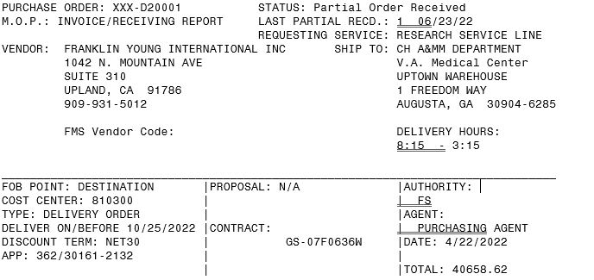
Section 3: VISTA Examples-MO (Miscellaneous Order)
Purchase order# Obligation#
VISTA Status of Order
VISTA Method of Payment=MO (FMS)
# of Receiving Reports and date of last one processed.
Name of Contracting Purchasing Agent
Shows BFYs (2022/2023) and FCP
Total amount of order (includes any amendment amounts)
Notes:
F830 Report: Diane-Notes
- BOC Codes : Monthly spending, using correct codes
- Monthly Report, Download from RSD
- Cost that occurred up to that point by fund and cost center (No breakout by fund control point)
Training: Induction into budgeting, different appropriations, VIST menu to submit, how to read running balance, reports that can be pulled - 1358

Slide 17
VISTA Examples-MO (Miscellaneous Order)
Section 3: VISTA Examples-MO (Miscellaneous Order) –Continued.
Have all items on your MO-Miscellaneous Order been received in through the Warehouse in VISTA/IFCAP?
Line 1: Two items ordered but only one has been received in.
Line 2: One item ordered, and it has been received in.
Line 3: One item ordered, and it hasn’t been received in.
Notes:
F830 Report: Diane-Notes
- BOC Codes : Monthly spending, using correct codes
- Monthly Report, Download from RSD
- Cost that occurred up to that point by fund and cost center (No breakout by fund control point)
Training: Induction into budgeting, different appropriations, VIST menu to submit, how to read running balance, reports that can be pulled - 1358

Slide 18
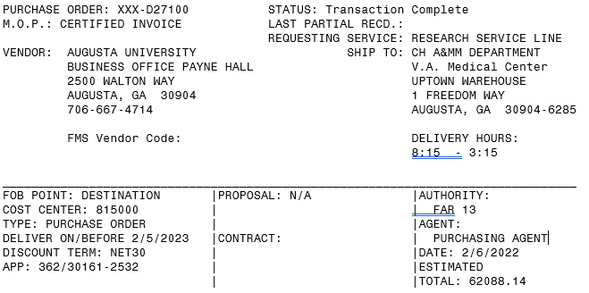
Section 3: VISTA Examples-SO (Service Order)
Status is Transaction Complete immediately after order is obligated. Doesn’t mean order is completed only that receiving reports aren’t required.
Purchase Order # Obligation #
VISTA Method Of Payment=SO (FMS)
No Receiving Reports
Name of Contracting Purchasing Agent
Shows BFYs (2022/2023) and FCP
Total amount of order (includes any amendment amounts)
Notes:
Jason: Slide on IAAs and allocating

Slide 19
Section 3: How to review my 1358 in VISTA
Display/Print 1358
  Select 1358 Print Menu Option: display/Print 1358
  Brief or Standard output? (B/S): B// S
  Select OBLIGATION NUMBER: D35005 509-23-4-3132-0445 OBL ABRC D35005
  Would you like to print the Description field for each 1358 Daily Record entry? No// (No)
  Would you like to print the daily records for each authorization? NO// (No)

Slide 20
Section 3: VISTA Examples-SO (1358-Service Order)
Original transaction #
509-23-1-3132-0003 PAGE 1
________________________________________________________________________________
1358 OBLIGATION OR CHANGE:NON-PROCUREMENT OBLIGATIONS
INTERGOVERNMENTAL PERSONNEL AGREEMENTS AND SERVICES,INCLUDING CASUS
________________________________________________________________________________
Originator of Request: FCP Clerk Name
Requestor: |Date Requested: |Obligation No.:
FCP Clerk Name |Oct 31, 2022 | 509-D35005
________________________________________________________________________________
Vendor: |Contract Number:
ABRC |
________________________________________________________________________________
Name and Title Approving Off.: |Signature: |Date Signed:
FCP Approving Official Name |/ES/FCP Approving |OCT 31, 2022
@11:37:30 Official Name
ADMINISTRATIVE OFFICER | |
________________________________________________________________________________
FUND CERTIFICATION: The supplies and services listed on this request are
properly chargeable to the following allotments, the available balances of
which are sufficient to cover the cost thereof, and funds have been obligated.
Appropriation & Acct. Symbols: |Obligated By: |Date Obligated:
509-363/40161-3132-810100-2580 810010100 |/ES/JOSEPH KITENGE |SEP 1, 2022
________________________________________________________________________________
AUTHORITY: 20 SUB: J
SERVICE START DATE: 10/01/22 SERVICE END DATE: 09/30/23
________________________________________________________________________________
Purchase Order #
Notes:
Jason: Slide on IAAs and allocating

Slide 21
Section 3: VISTA Examples-SO (1358-Service Order)
Purpose:
PURPOSE: INTERGOVERNMENTAL PERSONNEL ACT TO COVER SALARY, FRINGE AND ADJUSTMENTS
IN ACCORDANCE WITH SIGNED CONTRACT FOR PEARSON, LAURA
JUSTIFICATION: DUTIES WILL INCLUDE: PROVIDE WATER AND PROPER DIET TO ANIMALS IN
ASSIGNED AREA, MAINTAIN PROPER SPACE REQUIREMENTS IN EACH ANIMAL CAGE AS
SPECIFIED BY ACCEPTED STANDARDS, IDENTIFY EACH ANIMAL APPROPRIATE METHOD IE
CLEAN CAGE AND CHANGE BEDDING, ASSIST WITH MEDICAITON TO ANIMALS AS DIRECTED,
PROVIDE SPECIAL DIETARY SUPPLEMENTATION TO THE ANIMALS AS DIRECTED BY THE
INVESTIGATORS.
________________________________________________________________________________
APPROPRIATE REF: OF-69 ASSIGNMENT AGREEMENT, TITLE IV INTERGOVERNMENTAL
________________________________________________________________________________
ESTIMATED OBLIGATION RECAP
DATE REF# CPA# AMOUNT BALANCE
10/31 0001 509-23-1-3132-0003 $ 63024.00 $ 63024.00
06/01 0050 509-23-2-3132-0026 $ 2500.00 $ 65524.00
09/23 0076 509-23-4-3132-0053 $ -325.25 $ 65198.75
________________________________________________________________________________
Notes:
Jason: Slide on IAAs and allocating

Slide 22

Section 4: Navigating IPPS and certifying payments

Slide 23
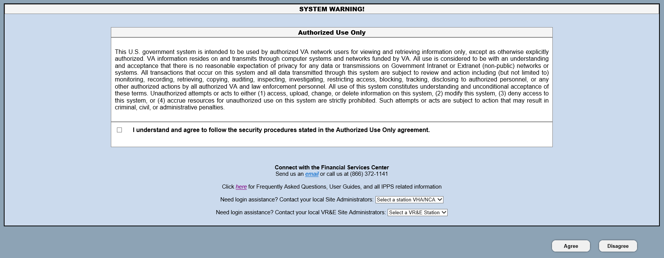
Section 4: IPPS Homepage
TRAINING!!

Slide 24
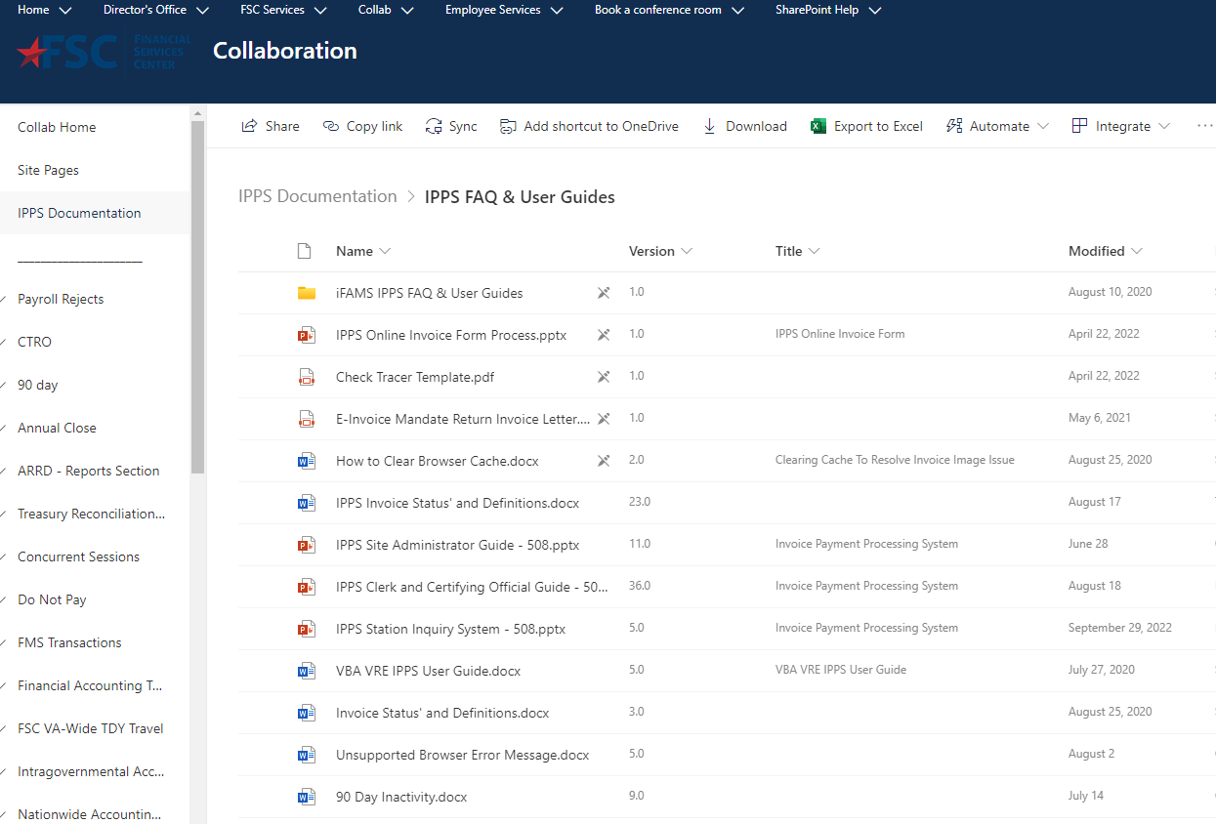
Section 4: IPPS Trainings
Additional Trainings
Training

Slide 25
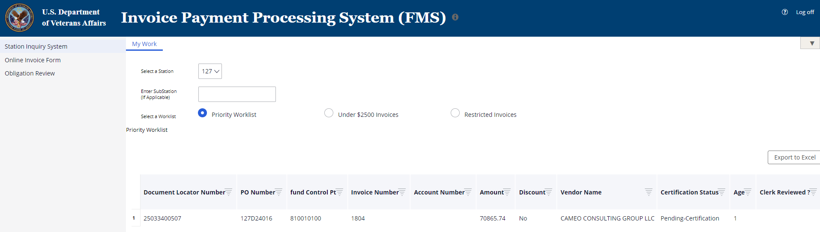
Section 4: IPPS Example – SO Orders (Services)
My Work tab-list invoices which are pending review for payment. Take note of the age of the invoice. If invoice is accurate, you will certify for payment. If invoice is inaccurate, reject the invoice with reason for why it is incorrect.

Slide 26
Section 4: Reviewing 1358s and Certified Invoice Orders (SO)
1358s/IPAs
  If the end date has past, have all services/invoices been paid for the period of performance established on the obligation. (Example:10/1/23-9/30/24)
  If all services have been paid for and there is funds on the order, submit a 1358 decrease adjustment to decrease the remaining amount to close the 1358.
  If all services have not been paid for, does the vendor need to submit invoices? Does the 1358 need an increase adjustment to provide funds to process final payments.
Certified Invoice/Service Orders
  If the end date has past, have all services/invoices been paid for the period of performance established on the obligation. (Example:10/1/23-9/30/24)
  If all services have been paid for and there is funds on the order, submit a de-obligation memo to Contracting to decrease the remaining amount to close the order.
  If all services have not been paid for, does the vendor need to submit invoices? Does the order need a modification to increase funds (this needs to be done prior to end of contract period and need).

Slide 27
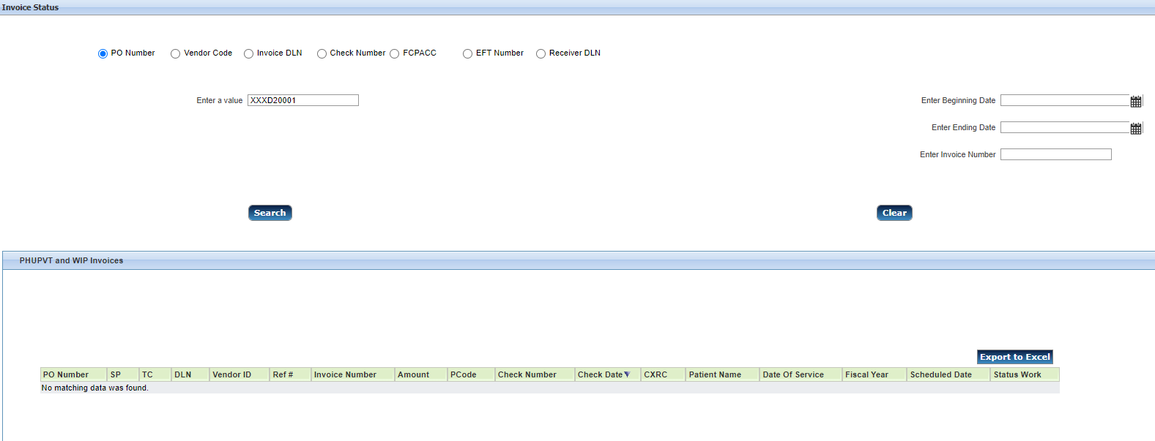
Section 4: IPPS Example – MO
IPPS/Station Inquiry System/Invoice Status menu options: Middle section (PHUPVT and WIP Invoices) shows that the vendor hasn’t submitted any invoices for this PO. Bottom section (Receiving Reports) shows a receiving report was processed on 6/23/22. Purchase Order Method of Payment is Invoice/Receiving Report (VISTA) and MO (FMS). Contact Vendor to inquire as to why an invoice hasn’t been submitted. You don’t have to certify invoices against MO orders. IPPS matches invoices against Receiving Reports.

Slide 28
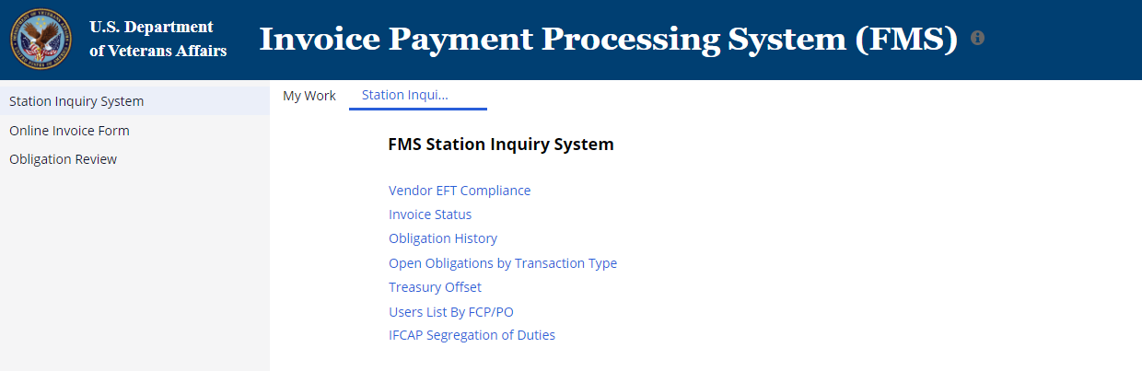
Section 4: IPPS-Station Inquiry System
Select Station Inquiry System, then Invoice Status to get detailed history of invoices, payments and receiving reports (if appropriate). Obligation History is also useful to see the amount of funds paid and remaining on the order.

Slide 29
Section 4: Reviewing Invoice/Receiving Report Orders (MO)
Review the purchase order in VISTA/IFCAP.
  Have all items been received?
  Has a Receiving Report been processed for all line items?
  If all items have been received, have invoices been submitted for all items. Note: you do not certify invoices in IPPS for MO orders. The invoices are automatically matched to receiving reports in IPPS.
  Review the invoices to confirm the vendor is billing at the correct amount as reflected on your purchase order/contract.
  If invoice and receiving report do not match, compare to line items in contract and consult with Contracting Officer.

Slide 30

Section 5: Utilizing the Open Documents report in the VSSC

Slide 31
Section 5: VSSC – Open Documents Report
You can track your open obligations through the VSSC:
OBLL_OpenDocuments - Report Viewer (va.gov)
The VSSC report shows all open obligations by fiscal year.
Recommend each of you to open this report and see what open obligations you have in previous fiscal years. You need to work to close these out even if the funds have now expired. The vendor needs to submit invoices or if they have been paid in full, the 1358 or 2237 need to be de-obligated.
  1358 – Adjustment in VISTA
  2237 – Modification request to Contracting
This report is really important to monitor especially towards the end of the fiscal year. The prior year open obligations should be monitored to ensure all decreases are completed before the funds expire.

Slide 32
Section 5: VSSC – Open Documents Report
Select your VISN and Facility
Select Fund – 0161A1
Select BOC Series – Select All
Select Budget Fiscal Year – This will show you all the fiscal years that you have open obligations remaining. Select which fiscal year, you want to view or select all to review all open obligations.
Select Cost Ctr – Select All
Select ACC No – Select All
Click View Report
The report allows you to export to excel.

Slide 33
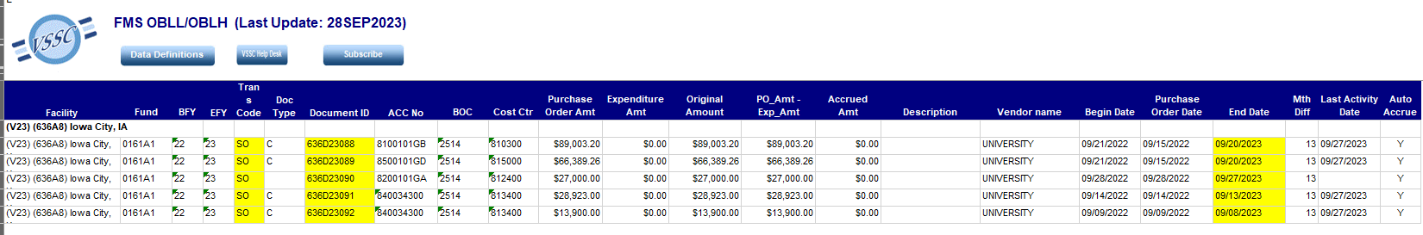
Section 5: Example Open Documents Report

Slide 34
Questions?

