Slide 1
FY 25 Start of the Year Guidance
October 9, 2024
Jason Berlow, Management Analyst, Finance
Kari Points, Advisor, ORD Field Operations
Tony Laracuente, Director of Field Operations
Seth Custer, Division Chief, VHA R&D Contracting Division

Slide 2
Objectives – for today’s training
Training Section: | By the end of this section, you will:
Section 1: FY 25 Appropriations Status Presenter: Jason Berlow | Understand the status on FY 25 Appropriations
Section 2: What do I need to know about continuing resolutions? Presenter: Jason Berlow | Understand a CR Understanding obligations by type during a CR Understanding what is not impacted by a CR
Section 3: How do I handle contracts/IPA in a CR? Presenter: Seth Custer/Kari Points | Understanding acquisitions/contracts/IPAs during a CR
Section 4: FY 25 Start-of-Year Carryover Guidance Presenter: Tony Laracuente | Carryover Guidance, 2% and Cost Center 101 Obligating CC 101 throughout FY 25 Possible CC 101 Scenarios and Carryover Limited Exceptions to 2% Carryover
Q&A
Notes:
John

Slide 3
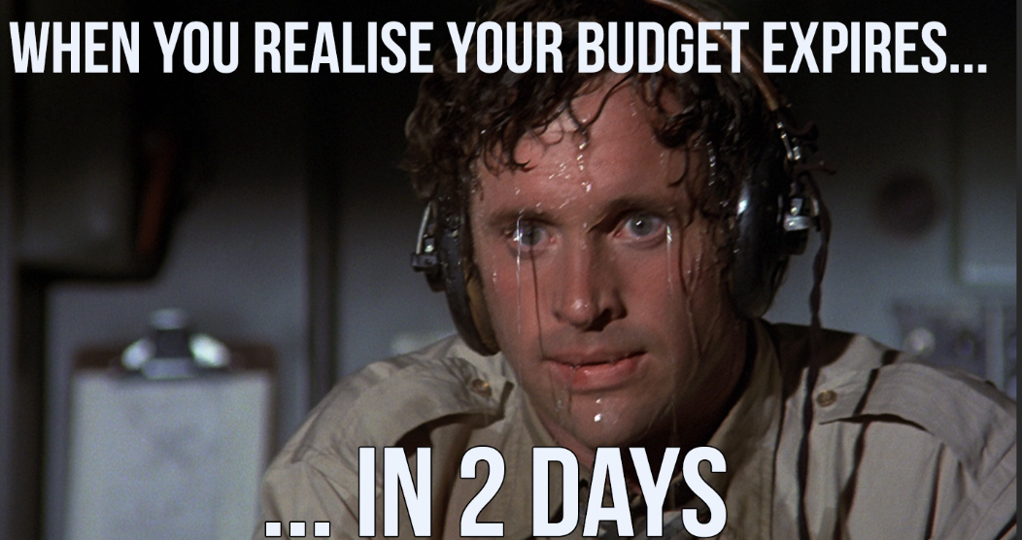
Section 1: FY 25 Appropriations Status

Slide 4
Section 2:How do we operate under a continuing resolution?
Yes, this will be on the exam!
ORD Finance Full FY 25 CR Guidance

Slide 5
Section 1: FY 25 Appropriations Status
For FY 25, a Continuing Resolution (CR), providing funding through December 20 at the FY 24 level rate of operations ($943 Million).
Congress will now continue to work to pass full-year appropriations after the election.
The FY 25 full year request is:
$868 million (a reduction of $75 Million) for Medical and Prosthetics Research.
An additional $59 million is also available from the Toxic Exposure Fund (TEF), previously appropriated in the Fiscal Responsibility Act.

Slide 6
Section 2: What do I need to know about Continuing Resolutions (CR)?
What do I need to know? | Answer
What is a CR? | CRs are short-term appropriations that bridge the gaps that arise between the end of appropriations for one fiscal year and the start of appropriations for the next.
What is the funding rate of CR? | CRs are funded at the rate of operations of the previous Fiscal Year.
What activities can be funded during a CR? | All Research activities (with limited exceptions for new major programs that are listed in the President’s Budget Request) should continue uninterrupted during a CR.
For further details consult our guidance, FY 2025 Guidance on Budget Execution during a Continuing Resolution (Appendix B)
Notes:
-Jason

Slide 7
How many CRs did we have the last few years?
Fiscal Year | # of separate CR bills | Date we received final bill
2025 | 1 or more | No earlier than December 20, 2024 (but probably later)
2024 | 4 | 3/9/2024
2023 | 3 | 12/29/2022
2022 | 4 | 3/15/2022
2021 | 5 | 12/27/2020
2020 | 2 | 12/20/2019
2019 | 0 | 9/21/2018
2018 | 5 | 3/23/2018
FY 25 is looking again like we will have multiple CRs….

Slide 8
Funding not impacted by CR
The Medical Care appropriations (Medical Services, Medical Support & Compliance, and Medical Facilities) are not subject to CRs, as they are financed with advance appropriations.
The activities which fall under this category are:
VA-paid time for certain members of the clinical staff who are conducting research.
Other Clinical costs (CSP 870 Funds)
Administration costs related to research activities (paid by medical center funds)
QUERI
The Toxic Exposure Fund (TEF) is also not affected as it was previously appropriated $59 million in the Fiscal Responsibility Act.

Slide 9
Obligating funding before funds arrive Station
Question | Answer
Where are my funds? | Funding for the CR like all VHA funding is not yet loaded in the automated allocation control system (AACS) until early November. The means obligated balances by program and station will appear negative in the Status of Allowance (SOA) because the funding is not yet at the Station. This factor should not prevent obligations from taking place.
How do I document to my fiscal that I have funding? | The Initial Target Allowance (ITA) is the funding available for FY 25 and is located in the Research Allocation Forecasting Tool (RAFT). Use RAFT to pull the ITA report, other budget reports, or bulk download pink sheets for your station. Provide this to your fiscal.
FCAP Overcommit Guidance for local fiscal | Research Stations should provide this guidance and the bulk downloaded pink sheets from RAFT to their station fiscal. This will inform the station fiscal of the FY 25 funding allocations and shall serve as documentation to support activation of the IFCAP overcommit function for current year funding (0161A1 25-26). VISN CFOs/Station CFOs have received this guidance also. Please reach out to ORD Finance (ORDFinanceAction@va.gov) if your station encounters any challenges.

Slide 10
Details on CR by Obligation Type
Obligation Type | Key Details
Payroll | Continue hiring actions initiated prior to October 1st and for projects listed in the ITA.
Travel | Planned travel should utilize current year (0161A1 25-26) funding and not extend beyond the CR end- date of December 20, 2024.
Purchase Card | Execute required purchases to cover needs through the CR end date. All Purchase Card Orders must be charged to current year (0161A1 25-26).
IPAs/Subject Remboursements | Research Stations should not obligate past the CR date. Incrementally fund the IPA amount at the % of the CR rate of operations. If needed, the following language can be added to the agreement: “Funds are not presently available to fund the agreement for the entire fiscal year. The Government’s obligation under this IPA is contingent upon the availability of appropriated funds from which payment for this IPA can be made.”

Slide 11
What do I need to know about budget execution during a CR?
Research Stations should obligate funding as if it were a normal year with the understanding that limitations will exist regarding funds available due to the CR length. Projects that have cleared Just-in-Time (JIT) and have an approved start date should be implemented early in the fiscal year by hiring staff, purchasing supplies, and buying equipment.
During this time, stations should continue to obligate current year (0161A1 25-26) for all necessary payroll, purchase cards, intergovernmental personnel agreements (IPAs), and other obligations. Prior Year (0161A1 24-25) should only be used for transactions tied to the 2% remaining on station and will be closely monitored (see section 3).

Slide 12
Section 3: What does the field need to know about IPA/contracts to the CR?

Slide 13
What does the field need to know about contracts during a CR?
Key Points | Contract | IPAs
Can a transaction be obligated past the CR deadline? | Yes, if funds are available during the CR to cover the entire obligation it can be obligated past the CR date. Review overall funding at the Station/Program level to determine if funds are available to make this obligation. You may need to look beyond the PI’s Pink Sheet. Definitive Contracts are properly awarded in full Indefinite delivery contracts can be more easily funded over time (through task orders). | No, Research Stations should not obligate past the CR date. Incrementally fund the IPA amount at the % of the CR rate of operations.

Slide 14
What else do I need to know about obligating contracts during a CR?
Definitive Contracts | Indefinite Delivery Contracts
These contracts are more difficult to fund periodically. Has specific terms, set period ,and value Most appropriately funded in full. These are contract with a C,P,F in the middle of the contract number. If you are going to obligate a definitive contract during the CR you must have all funds to do it in full. Examples include: preventive maintenance contract or software subscription These are typically non-severable contracts. | These contracts are funded periodically verses the full amount. Able to fund by current need, which is helpful during a CR. These are contracts with D in the model of the contracts and is task-order. Has ability to purchase for only immediate with funds available. Examples include: Core facility contracts, personnel contracts. These are typically severable contracts.

Slide 15
Section 4: Carryover Guidance

Slide 16
FY 25 Guidance
For prior year funds being used for CC101, no new transactions (contracts, 1358s, purchase cards, travel) in FY 24/25 funding should be obligated. Salary cost transfers need to be done to spend the prior year funds.
For prior year funds within your 2%, you do have flexibility but make informed decisions on when to obligate funds vs. executing cost transfers. Which option will spend your prior year funds first?
Example – A contract will not be executed until April 1, 2025. Instead of using FY24/25 funds, conduct a salary cost transfer from FY25/26 to FY24/25. This will free-up funds in FY25/26 to be used for the contract.

Slide 17
FY 25 Start-of-Year Carryover Guidance
As previously detailed in the Budget Execution guidance memo for FY 2024 Close Out (issued on May 6, 2024), ORD will not sweep Prior-Year funding (0161A1 24-25) that exceed the allowable 2% carryover for the Research appropriation/allocation allowance.
Funds exceeding 2% will remain on-station as part of the FY 25 Cost Center (CC) 101 allocation reducing the amount of the current year (0161A1 25-26) Cost Center (CC) 101 that will be distributed to the research sites.

Slide 18
Process after October 1, 2024
Carryover as of October 1, 2024 (FY 25) accounts for all obligations, payroll accruals and credit card accruals and will be the basis for the carryover percentage.
CC 101 will be calculated from data submitted through the CC 101 Utilization Annual Report (due October 15, 2024). The CC 101 Allocation will not be in the Initial Target Allowance (ITA) but plan for at least the same amount as FY 24 for each Research site.
Once carryover is determined, each station will be provided the total CC-101 broken into Current Year (CY) and Prior Year (PY) amounts by mid-October.

Slide 19
Exceptions to 2% carryover
The only exception to the 2% carryover requirement will be for Stations who submitted acquisition packages that could not be completed in FY 24, the 2237 returned and the station was asked to resubmit with a first quarter FY 25 transaction number using the same FCP.
Any request for exception must have been submitted previously through the link provided in FY 25 Start Year of Guidance (the deadline has passed).
All requests will now be reviewed and if approved the carryover allocation will be adjusted accordingly. We will notify individual stations if they were approved.
We will no longer can except new request as the deadline has passed.

Slide 20
Obligating CC 101 throughout FY 25
FY 25 CC 101 Allocation will be split between CY and PY (as applicable).
Research Sites should work with their Station Fiscal to execute all PY amounts above the 2% with a balance regardless of program for use of CC101. ORD permits utilization of these funds through cost transfers of salaries from program 81 Current Year FCP to Programs 81, 82, 84, 85 or 86 in Prior Year (0161A1 24-25).
ORD will closely monitor these balances to ensure timely expenditure transfers.

Slide 21
Possible CC 101 Scenarios

Slide 22
The 2% carryover and the Toxic Exposure Fund (TEF)
ORD’s expectation is to execute TEF to 2% of the FY 25 allocation; however, ORD Finance is aware that expenditure transfers cannot be executed until pay periods end, purchase cards are reconciled, and contracts are expended.
It is expected that cost transfers will be completed by October 15th for all FY24 transactions. If there are funds remaining, reach out to VHAORDFinanceAction@va.gov about returning funds.
TEF carryover in the appropriation 1126R5 above 2% will not impact CC 101 and will not be counted toward carryover amounts. Sites must follow the ORD TEF policy regarding redistribution or pullback requests.

Slide 23
Questions

Slide 24
Appendix: OGC Guidance on Contracting and CRs

Slide 25
What do I need to know about obligating contracts/IPA during a CR?
CRs pose significant challenges to obligating contracts/IPAs due to the incremental nature of how funds are allocated to sites.
Funding provided during CR are available to cover obligations or expenditures incurred during the CR period must comply with this three- step rule:
Funds must be available during the CR to cover the entire obligation (at the CR pro-rated level).
For Severable contracts, obligations for contracts needed to be prorated (to the CR length) in the absence of sufficient funding during the CR. This includes IDIQ Task Order Contracts.
For Nonseverable contracts, it not permissible to obligate less than the entire amount for a contract for nonseverable services. For nonseverable contracts, the government must fund the entire effort with dollars available for obligation at the time the contract is executed (thus you will likely have to wait for full-year enactment).
OGC Appropriations Law provided a White Paper on Acquisitions During a CR, with additional information: Acquisitions with CRs

Slide 26
What is severable and nonseverable?
Severable and Non-Severable Tasks are defined by the Federal Acquisition Regulation 532.703:
Contract Type | Definition | Can be incremental funded during a CR?
Severable | Tasks are defined by and typically refer to services that can be divided into components, each of which can be independently performed to meet a separate need of the government. | Yes, typically are funded through the CR end date.
Non-severable tasks | Cannot be separated into components; must be performed as a single task to meet a need of the government. As in the conduct of Research non-severable tasks represent a single undertaking, that is not separated into tasks, and produces a single unified outcome, report, or product. | No, the Adequacy of Appropriations Act (41 U.S.C. § 6301(a) prohibits incremental funding of a nonseverable task with annual funds.

Slide 27
Contracting during a CR (the specific actions required)
Details on CR by Obligation Type | Details
Contracts | If funding is not available to fully award a contract, continue preparing your contract packages for FORCE so that 2237s can be entered as soon as funds are available. This includes: Submitting your acquisition packages into RPO East as early as possible. Enter FY 25 equipment purchases or service contracts into IFCAP and FORCE and request approval from Fiscal to allow overcommitment (VISTA) by showing them the ITA or funding sheets. This is critical to help the Contracting Office to execute actions as soon as possible. If applicable, incrementally fund contract actions for severable services. This is permissible for any contract type (to the continuing resolution TDA level).
Interagency Agreements/Interagency Agreements (IAAs) | Interagency Agreements (IAA) can be processed to the full amount on the Order (7600B) as the Servicing Agency. The actual 1358 obligations can be pro-rated to the amount afforded by the CR.

Slide 28
Main considerations impacting CR and Contracting (Option Years)
Main Considerations | Key Details
Exercising Option Years | There are no appropriations law prohibitions against exercising options for which an agency has a current FY bona fide need during a CR, assuming that the options comply with any applicable acquisition law requirements (but the considerations in previous slides must be met).
Exercising Options that exceed beyond CR period (12 months) | Fund severable service contracts incrementally during the CR period. Do not incrementally fund nonseverable services options with annual funds during a CR. Prioritize exercising option years on existing contracts vs establishing new contracts during a CR.
If you have specific challenges with a current contract during a CR send a note to ORD Finance, Tony Laracuente, and Seth Custer.

