Slide 1
FCOI Administrator Review of the Alt-450
Joan Liguoro
Alex Miller
VA Office of General Counsel
Ethics Specialty Team – August 2024

Slide 2
Training Objectives
Understand the purpose of the Alt-450
Understand how to conduct a technical review
Understand how to conduct a conflicts review
Notes:
Here are the three objectives for this class.
The first objective is to understand why the Alt-450 exists and why it’s important.
The second and third objectives are to understand how to conduct a complete review of the form. This review is done in two parts. The first part is the technical review, which addresses whether the form is complete and accurate, and the second part is the conflicts review, which addresses whether there is a potential conflict and what to do about it.

Slide 3
What is the Alt-450?
We call it the “Alt-450” because it is an alternative version of the OGE Form 450.
The OGE Form 450 is the confidential financial disclosure report, submitted by GS-15s and below based upon the likelihood that their duties could result in a conflict.
The purpose of the 450 is to help the employee avoid conflicts of interest.
Notes:
On the EST, we refer to the form as the Alt-450. I know some of you refer to it as an “FCOI,” which stands for financial conflict of interest, but we prefer to say Alt-450. The Alt is short for “alternative,” because the Alt-450 is an alternative version of the OGE Form 450.
There are two primary financial disclosure reports in the executive branch. The public report is called the OGE Form 278e and is used by political appointees, SES, and others above GS-15. The confidential report is the OGE Form 450. This report is for GS-15s and below who are required to submit the report because their duties put them at risk of committing a conflict of interest violation. At VA we have about 12,000 450 filers.
The purpose of the regular 450, and of the 278e, is to help the employee avoid conflict of interest violations. The employee reveals certain assets and relationships, and the reviewer compares that data with the employee’s duties to determine if there is a potential conflict of interest. Our goal is to help the employee comply with the law and to protect the integrity of the federal government’s operations.

Slide 4
What is the Alt-450?
But the OGE Form 450 does not ask for the kinds of information helpful to an Investigator.
VA requested that OGE approve an alternative version of the 450, to be used specifically for VA researchers.
VHA Directive 1200.13 requires submission of the Alt-450 through IRBNet.
Notes:
Researchers, however, have different potential conflicts that are not captured in the 450. The ethics regulations permit an agency to request that the Office of Government Ethics approve an alternative version of the 450. Several years ago VA worked with OGE to develop an Alt-450 that would gather the necessary data to determine if a researcher has a potential conflict of interest.
So the purpose of the Alt-450 is to help the researcher avoid ethics violations and also to uphold the integrity of VA’s research operations.
For years, facilities have submitted the Alt-450 to the EST via email. But when VHA Directive 1200.13 is published, researchers will be required to submit Alt-450s through IRBNet.

Slide 5
Who Submits an Alt-450?
Only those who serve, or will serve, as an Investigator on a VA study.
For other employees who believe they have a conflicts issue, they should contact the EST for advice.
Notes:
The top of the first page of the Alt-450 tells you which employees must submit the form. The form is for investigators only. This includes principal investigators, co-principal investigators, investigators, study chairs, and site principal investigators. Currently, until the VHA policy mandating the use of the form is published, there is no VHA-wide requirement to use the form. However, it is strongly encouraged for all investigators to submit an Alt-450 when required, and many VHA facilities have local policies or practices that require submission of the form.
Anyone working on or supporting a study; i.e. study co-Ordinator, who is not an investigator should not submit an Alt-450. If a VA employee seeks to work on a study, but not as an investigator, and believes that they have an ethics issue, instead of submitting an Alt-450, they should contact the EST, tell us their facts, and work with an EST attorney to determine if there is an ethics issue.

Slide 6
When to Submit an Alt-450?
Initial
Annual
When a potential new conflict arises
Notes:
There are two primary Alt-450 submission times, and one that is less likely to occur.
To begin, an initial Alt-450 is submitted by an investigator prior to a new study being submitted to an R&D Committee.
Next, on annual basis (when – either when the study is up for annual renewal or they can choose a annual date to submit for ALL Studies; can assign a month for a PI BUT has to be WRITTEN in their implementing policy) each investigator will submit an Alt-450 for each active protocol.
VHA Directive 1200.13 regarding annual review of each study's ALT-450. "NOTE: The annual update is required as of the calendar date of the subsequent year. For example, if a VA investigator completed the Alt-450 on October 1, 2023, the next annual update is required to be completed no later than October 1, 2024."
Lastly, if an investigator’s financial interests change in away that requires a change to the information contained in the most recently submitted Alt-450, the investigator will submit an interim Alt-450.

Slide 7
Brief Overview of Laws
18 U.S.C. § 208
5 C.F.R. § 2635.502
Notes:
When an EST attorney reviews an Alt-450, we are mainly looking for potential violations of the two primary conflict of interest laws.
208 is a criminal statute that prohibits employees from working on federal matters affecting their own financial interests and the interest of certain others, such as their spouse, their outside employer, or an entity that they serve in a role such as director or officer. Employees also cannot work on matters affecting an entity with whom they are negotiating with, or have an agreement for, employment. 208 is a big issue for researchers because so many VA researchers have outside employment, typically with a university affiliate.
Here are things that can trigger a 208 concern: stock ownership in a company whose financial interests could be affected by the study; intellectual property being studied that is owned by an investigator, an investigator’s employer, an investigator’s company, or a company in which an investigator owns stock; ownership in health-care sector mutual funds; or a study that can affect the spouse’s financial interest.
502 is a regulation that operates in much the same manner as 208, but is a little bit different. Its main concern is with inappropriate appearances, or what the regulation calls the questioning of an employee’s impartiality. The regulation states that an employee should not participate in a federal matter if either the employee has a covered relationship with a party to the matter or the employee otherwise believes that there are facts present that would cause a reasonable person to question the employee’s impartiality. Employees have a covered relationship with a member of their household, a relative with whom the employee is close, a person with whom the employee has a business relationship, a person for whom their spouse or parent or child works, and importantly, a person for whom the employee works in a non-employee capacity, such as an advisor or consultant, or a person for whom the employee worked in the past year.
There’s a lot to unpack there, because of the many kinds of covered relationships that exist. But what we most often see are situations where an investigator has an outside consultant position with a company involved in the study. So it’s important that the investigator fully describe that consultant position and how the entity is involved in the study.
Don’t worry—you will not be expected to work through these conflict scenarios. But I wanted to describe the kinds of conflicts that exist so that you know what kind of information must be included on the form.

Slide 8
Two Kinds of Review
Technical Review
Conflicts Review
Notes:
There are two kinds of financial disclosure report review. Over time, you’ll be able to conduct these reviews concurrently in your head. But if you’re just becoming familiar with the Alt-450, you’ll start with the technical review and then proceed to the conflicts review.
A technical review ensures that everything required to be reported on the form is reported. A conflicts review seeks to identify and address all conflicts of interest.
You will always conduct a complete technical review of the form. In some cases you will conduct a conflicts review of the form.

Slide 9
Technical Review
Did the Investigator provide all required information? Are there missing facts?
Do I understand what the Investigator is telling me? Can I understand the potential conflict?
Notes:
The technical review focuses on ensuring that everything that should be reported on the Alt-450 is reported, and that if a potential conflict is reported, that conflict is fully explained.
As you review an Alt-450, you should ask yourself whether there are any missing facts. You should ask yourself whether the investigator provided all of the required information. And in cases where the investigator provides information, you should ask yourself whether that information is complete and makes sense. Are you able to understand the potential conflict that the investigator has identified? Did the investigator over-report (“better safe than sorry”), but actually does not have a potential conflict?

Slide 10
Technical Review
If the form is not complete, you must ask the Investigator to add the missing information before certifying the form or forwarding to OGC.

Slide 11
How to Amend an Alt-450
If the filer omits required information, you must ask the filer to amend and resubmit.
Use the Unlock link on the Disclosure Summary page in IRB.net
Notes:
IRB.net – call their HELP Desk

Slide 12
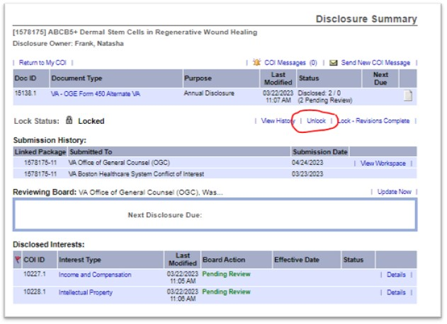

Slide 13
Technical Review Steps
Page 2: Is everything filled out? If not, send back to the Investigator.
Pages 3-4 (Section I): Are there “yes” answers? If not, then you can certify the form. If yes, go to Section II.

Slide 14
Notes:
This is page 2 of the form, which is the first page that contains information provided by the investigator. Note in the red lettering in the first paragraph that the investigator is required to complete all fields in Sections 1 and 3, and they should also complete all of the fields on this cover page.
These first few fields are self-explanatory.
In case you are unaware, there is a difference between the sponsor of the study and the funding source of the study. The funding source is the entity funding the study, but the sponsor, while it could be the funding source, is the individual or entity that is responsible for the conduct of the study. If the same entity is the sponsor and the funding source, the entity should be listed twice. If the study is not funded, the funding source field should say N/A or unfunded.
At the bottom is where the investigator indicates whether they have an affiliate appointment. They must select one of these boxes. This is important because it helps us determine whether the investigator is employed by the affiliate, in which case there may be 208 concerns, or whether they have a non-employee position at the affiliate, in which case there may be 502 concerns.
This is a good time to mention that, under the regulations concerning 450 and 278e review, we take the information provided on a form at face value, unless we have reason to believe that something reported is incorrect. You should do the same here. For example, if the investigator notes that they have no appointment at the affiliate, but you know that they do, then you should reach out to the investigator for clarification and possibly to amend the form.

Slide 15
Notes:
Let’s move on to Pages 3 and 4, which is section 1 on the form. Section 1 asks a series of yes or no questions. The investigator must answer every question. If every answer in Section 1 is no, then the investigator is not reporting any potential conflicts and you can certify the Alt-450 in Section 3. If the investigator has at least one yes answer, the investigator needs to explain every yes answer in section 2.
Again, in Section 1 all the investigator does is check yes or no for each question. So you must ensure that there is an answer checked for each question.
I also wanted to point out the wording found in all of these questions. We do not ask whether there is some outside interest that could affect the study. We ask whether the study could affect an outside interest. For example, in question 1, we ask whether the investigator receives income from an entity whose financial interests could be affected by the study. In 2c, we ask whether the investigator has had a relationship, in the past year, with a company whose interests could be affected by the study. In question 3 we ask whether the investigator or an outside employer has as an interest in intellectual property that could be affected by the study. We ask the question this way because the statute—208—prohibits working on matters that could affect certain financial interests.
You need to ensure that the investigator explains how the study could affect the reported interest.

Slide 16
Technical Review
Section II:
Ensure that every “yes” from Section I is addressed.
Ensure that every answer is complete in Section II.
Things to look for:
Values
How the study can affect the interest
Speculation of future interests
Date relationship ended
Notes:
When the investigator gives a “yes” answer in Section 1, you must ensure that the investigator explained that yes answer in section 2. So your first task is to simply ensure that all section 1 yes answers are addressed in section 2.
But when doing so, you must ensure that the explanation given by the investigator is complete. For example, question 1 requires the investigator to explain the source, value, and reason for the compensation. It is not sufficient for the investigator to say, “I’m a consultant” or “I’m a consultant for Merck.” The investigator must name the entity providing the compensation, provide the value of the compensation, and explain the reason for the compensation. Each question in Section 2 asks the investigator to provide certain details or explain the relationship or financial interest and how the study affects it, and you must ensure that the investigator provides all of the required details.

Slide 17
Notes:
This is the first page of Section 2. I want to point out that each question in section 2 tells you and the investigator what information should be provided in response to the question. For example, question 1 requires source, value and reason for the compensation. And the question also requires the investigator to explain the source, value, and reason. So they should explain what it is that they or their spouse or child or partner do for the entity. I’m not going through each question today because they are self-explanatory, but each question is clear about what answers must be provided.

Slide 18
Technical Review
Section II:
Ensure that every “yes” from Section I is addressed.
Ensure that every answer is complete.
Things to look for:
Values
How the study can affect the interest
Speculation of future interests
Date relationship ended
Notes:
Regarding things to look for:
1) Values. If the question requires the investigator reveal the value of their interest, ensure that they do. This is especially important on the second page of part 2.

Slide 19
Notes:
If the investigator owns stock in a publicly traded company that could be affected by the study, the investigator must report the value of their investment here. And even though the sector mutual fund field below that does not mention values, we do need to know the value of the sector fund investments, so ask the investigator to provide that information if they do not.

Slide 20
Technical Review
Section II:
Ensure that every “yes” from Section I is addressed.
Ensure that every answer is complete.
Things to look for:
Values
How the study can affect the interest
Speculation of future interests
Date relationship ended
Notes:
Other things to look for:
It’s vital that the investigator not merely mention a company that they have a relationship with. The investigator must also explain how the study will affect that entity’s financial interest. If the entity is funding the study or providing equipment or personnel or pharmaceuticals, the investigator must state that. If the study examines intellectual property owned or licensed by the entity, the investigator must state that. The investigator must clearly explain what the nexus is between the study and the financial interest noted on the form.
Same for intellectual property. The investigator must explain the IP’s role in the study. If the aim of the study is to examine the IP, the study could affect the value of the IP. But perhaps the IP will not be examined, and it is only used as a tool. In that case, we may determine that the study will not affect the value of the IP. So the investigator needs to explain how the study and the IP interact.

Slide 21
Technical Review
Section II:
Ensure that every “yes” from Section I is addressed.
Ensure that every answer is complete.
Things to look for:
Values
How the study can affect the interest
Speculation of future interests
Date relationship ended
Notes:
Other things to look for:
We frequently see investigators who report an interest that doesn’t currently exist. For example, an investigator may write that if their research is successful, it may lead to a job offer, or it may lead to the awarding of future grants. But those interests do not currently exist, so they cannot create a conflict of interest issue. Please ensure that the reported financial interest actually exists.
I’ll note that when it comes to inventions, it is not speculation to state that the study may affect the value of the invention. Because in that case the invention already exists. But the investigator should not say that the study may result in a discovery that becomes an invention—there can be no conflict in that situation because the invention does not yet exist.

Slide 22
Technical Review
Section II:
Ensure that every “yes” from Section I is addressed.
Ensure that every answer is complete.
Things to look for:
Values
How the study can affect the interest
Speculation of future interests
Date relationship ended
Notes:
Other things to look for:
Finally, if the potential conflict is due to the investigator’s relationship with an entity, they need to explain if the relationship is current or, if the relationship is in the past, when it ended. This is important, particularly, for consultant relationships and former employment. If an investigator has a past relationship with a company, the investigator has a covered relationship under the impartiality regulation for one year. This is an important fact when we determine whether a conflict exists.

Slide 23
Next Step
Remember that the goal of the technical review is to ensure that everything required to be reported on the form is reported, and that potential conflicts are clear.
Once that is complete, the next step is to perform a conflicts review to determine if you can certify the form or if you must send it to the EST.

Slide 24
When Can I Certify an Alt-450?
All “no” answers
Report only discloses speculation of future interests (interests that do not exist)
An annual report that discloses no new potential conflicts when compared to the initial, certified report
Investigator received a 208 waiver or 502 authorization that covers this study
Over-reporting
Notes:
First, if in Section 1 the investigator answers “no” to every question and there are no potential conflicts disclosed in Section 2, and you have no reason to think that the investigator is omitting information, then no potential conflict is reported and you can certify the form. Remember that you take the information at face value unless you have reason to believe that something is being omitted or is incorrect.
Second, if the investigator only reports an interest that doesn’t yet exist, you can certify the report. If you have questions about this, please ask us. For example, if the investigator says, “If the research is successful, it may lead to a better paying job or to new research funding,” that is not a conflict because the better paying job and new research funding do not exist. One point of clarification: if an investigator has a royalty interest in an invention that is being examined in the study, that is an interest that DOES exist now, even if the investigator is not receiving royalties. So if the investigator reports an interest in an existing invention, and the study will affect the value of that invention, that Alt-450 should be referred to the EST.
Third, you may certify an Alt-450 if it is an annual report and it is identical to the prior, certified report for that study. For example, if you or the EST properly certified the initial Alt-450, which means that no conflict existed or if it existed it was managed, if the next annual report submitted by that investigator for that study reveals no new potential conflicts, there is nothing for the EST to examine and you may certify the Alt-450. But how do they compare?
Fourth, if the investigator received a 208 waiver or a 502 authorization that permits them to participate in the study, you can certify the Alt-450. Now, sometimes it’s difficult to determine if a waiver or authorization covers a study, because we try to draft waivers and authorizations broadly, so that they cover more studies than just the study for which the waiver or authorization was issued.
Finally, some investigators report things that cannot be affected by the study. For example, an investigator may report all of the individual stocks that they own “just to be safe,” even when the study is not funded by any of the companies and does not examine a drug or device. If the investigator over-reports, you should have them edit the Alt-450 appropriately, and if that results in no reported potential conflicts, you can certify the form.

Slide 25
When Can I Certify an Alt-450?
If you review an Alt-450 and are unsure about certifying it. Submit to the VA Office of General Counsel (OGC) workspace in IRBNet. See next two slides.
It’s important that you certify Alt-450s that you’re able to certify, so that the process can be as expeditious as possible
When a study involves a CRADA administered by the NPC, please forward the determination email (not the Alt-450) to the NPC contact managing the CRADA.

Slide 26
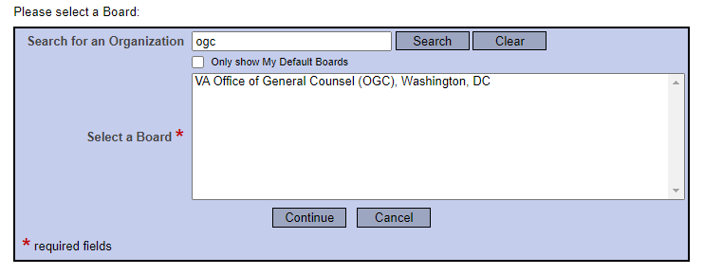

Slide 27
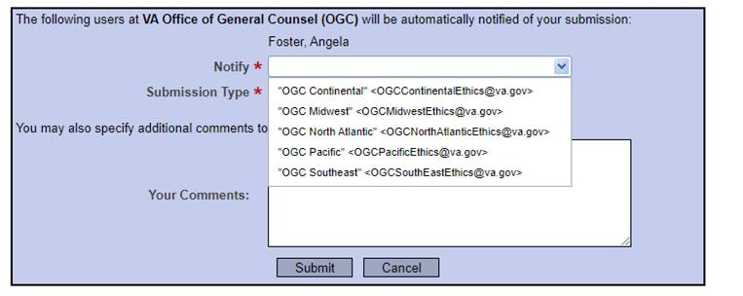

Slide 28
Conflicts Review?
Diversified funds: S&P 500, Small Cap, Large Cap
Sector funds:
Primary diversified v. sector opinion
Real estate opinion
IT opinion
Mutual funds: Disregard all diversified funds. For sector funds, it’s only an issue if the fund holdings in that sector exceed $50k and a company affected by the study is held by a fund.
What you’re really looking for are health-care funds.
Examples:
Biotech
Health Care
Pharma
Medical Devices
When in doubt – send it to EST

Slide 29
Other Issues
What if the potential conflict is IP? Check with the PI to see if an Invention Disclosure has been filed and if a Determination of Rights has been issued.
If a 208 waiver or authorization (502) was previously granted, include a copy of the 208 waiver or the authorization when sending to EST.
Notes:
NOTE: If FCOIA is n Research Office – contact Tech Transfer. If the FCOIA is outside the Research Office, then contact the Research Office

Slide 30
Alt-450 Review
Invention disclosed
“Confirm if the invention is affected by the Study?”
Stock ownership disclosed
“How does this Study affect the company?”
Position with company disclosed
“How does this Study affect the financial interests of yourself and any imputed interests of the company?”
Totally speculative future occurrences
You can sign these.

Slide 31
Alt-450 Review
Practice tip:
If an investigator discloses IP, confirm 1) how the IP relates to the Study (i.e., how it is used in or affected by the Study) and 2) who owns the IP or otherwise has an interest in the IP.

Slide 32
Alt-450 Review
Practice tip:
If you think you can certify the form but are unsure forward the Alt-450 to the EST for review.

Slide 33
Scenarios
“I own stocks.”
Make sure the company name and amount are listed.
Does the Study affect the company?
“I was a consultant for Merck.”
Is Merck a sponsor or funding source of the Study?
If so, then did the consultancy end? Has it been over a year?
“I’m the inventor of a device that does X and Z.”
Check with the PI to see if an Invention Disclosure has been filed and if a Determination of Rights has been issued.
Check with the researcher to see whether the invention ahs been license or commercialized?

Slide 34
How to Contact EST:
https://www.va.gov/OGC/docs/Ethics/VA_Ethics_Officials_Contacts.pdf for general questions about this guidance.
Notes:
Explain the inboxes

