Slide 1
Welcome to the ePROS Webinar.
We will begin shortly.
Check the chat box for handouts that may have been uploaded by the presenters.
Please mute your mic and use the chat box or raise your hand to ask questions. Reactions are also encouraged.
Please complete the post-webinar evaluation survey, available here after the webinar. The presenter will post the link in chat.
If you experience sound issues– call in using the number included on the TEAMs calendar invitation.
Notes:
Presenters – Please do not make changes to this slide.
HOSTING THE WEBINAR
Join the webinar 10 minutes early
Start with a sound check of all speakers
Share the PowerPoint slides- ask if other speakers can see it
Begin Recording
At the end of the meeting, remind audience to fill out the survey. Add survey link to chat.
Q&A ASSISTANT ROLE
When questions are submitted, please respond in the chat “Thank you for your question.”
Copy and paste submitted questions into a PowerPoint document to share at the end during the last 15-ish minutes of the webinar. You will only need to share your screen. The presenter will read the questions aloud and answer the question.
Download attendance list of meeting. Send reminder to fill out survey if they haven't already, providing survey link. Test link before sending.

Slide 2
VA Innovation and Research Review System (VAIRRS)
Webinar
July 16, 2024

Slide 3
Webinar Housekeeping
Webinar Housekeeping
Presentation - Slides are shared in the TEAMs chat at the beginning of the meeting.
Recording - This session is recorded, and the associated handouts will be available on ePROS Education and Training website within a week after the webinar.
Close Captioning – Available on Teams. To access, select “More” in the top menu bar, then “Record and transcribe,” and finally “Transcript.”
Q&A - Please use the chat feature to submit questions.
Questions will be addressed at the end of the webinar
Webinar Archive - Most ePROS webinars can be found here: https://www.research.va.gov/programs/epros/education/webinars/archives.cfm
Survey - Please complete the post-webinar evaluation survey available here: ePROS Webinar Survey. We will also post this link in the chat.

Slide 4
Contents
01 IRBNet Conflict of Interest (COI) Module
04 COI Module for Investigators Submission Process Overview
05 COI Module Live Demo

Slide 5
VAIRRS Webinar Series: Conflict of Interest (COI) Module for Investigators
Presenter:
Angela Foster, ePROS Program Manager

Slide 6
IRBNet COI Module
Presented by
Angie Foster, ePROS Program Manager

Slide 7
IRBNet COI Module
Key Points:
Today’s training will focus on the COI submission process in IRBNet. FCOI administrator training will be provided by IRBNet upon notification that the research office is ready to begin using the module.
Always defer to your local COI standard operation procedures (SOP) or program requirements for specific guidance.
Previous training provided by ORD Regulatory is available on the ePROS webinar archive.
The COI module cannot be accessed until your research office activates the module.
The OGE Form 450 Alt VA, which was previously a PDF, has now been converted to a wizard.
All OGE 450 Alt VA forms must be submitted via IRBNet (VAIRRS) utilizing the COI wizard.

Slide 8
COI Module for Investigators
Submission Process Overview
Create a New COI Disclosure
Link Disclosure Forms for Submission
Submit Disclosure Forms
View the Status of a Disclosure

Slide 9
COI Module for Investigators
Create a New COI Disclosure

Slide 10
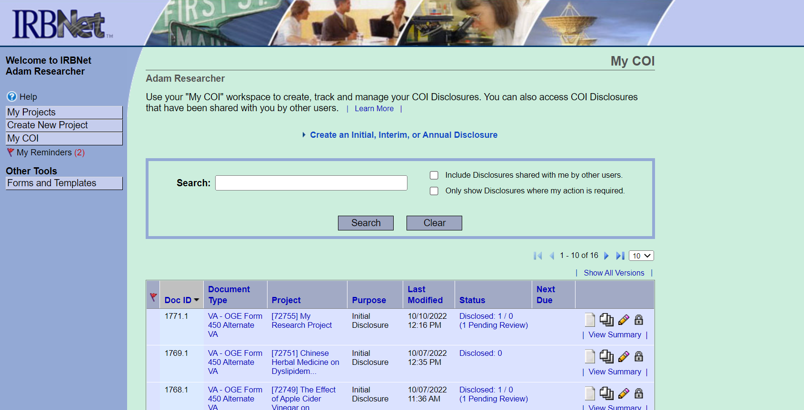
Create a New COI Disclosure
To create your COI disclosure, simply click “Create an Initial, Interim, or Annual Disclosure” from the “My COI” workspace.

Slide 11
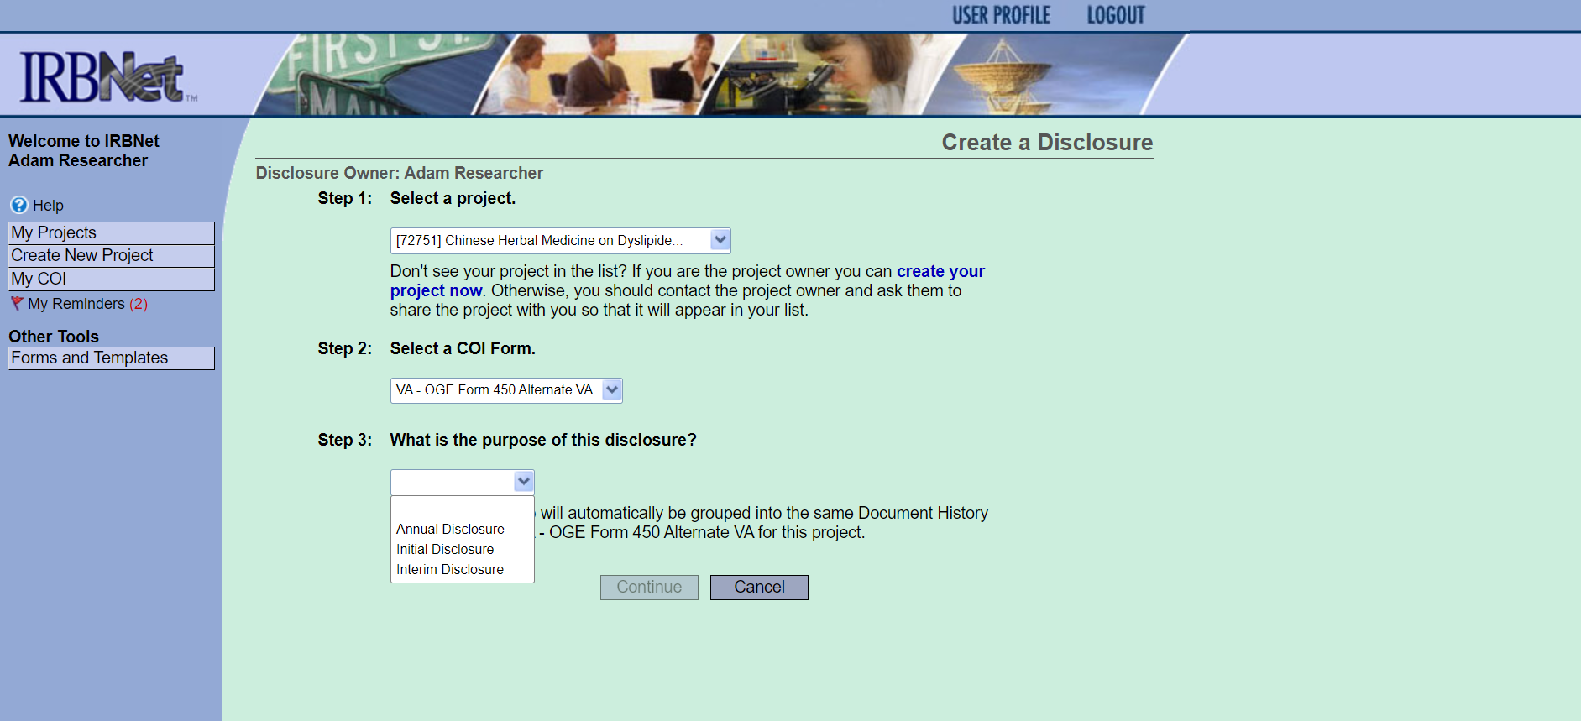
Create a New COI Disclosure
Once you click the “Create an Initial, Interim, or Annual Disclosure” and “Continue,” you are routed to the VA – OGE Form 450 Alternate VA Wizard.

Slide 12
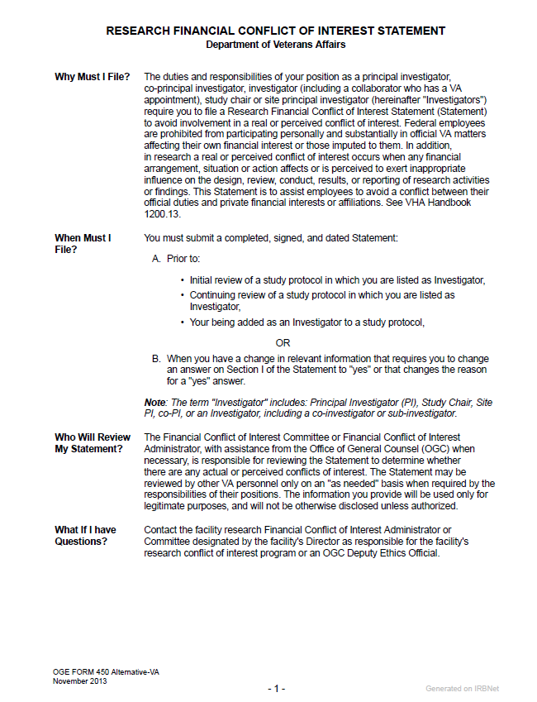
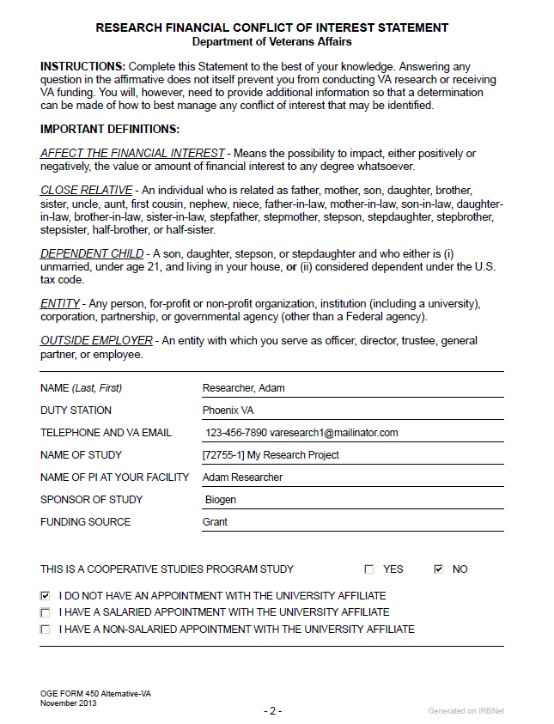
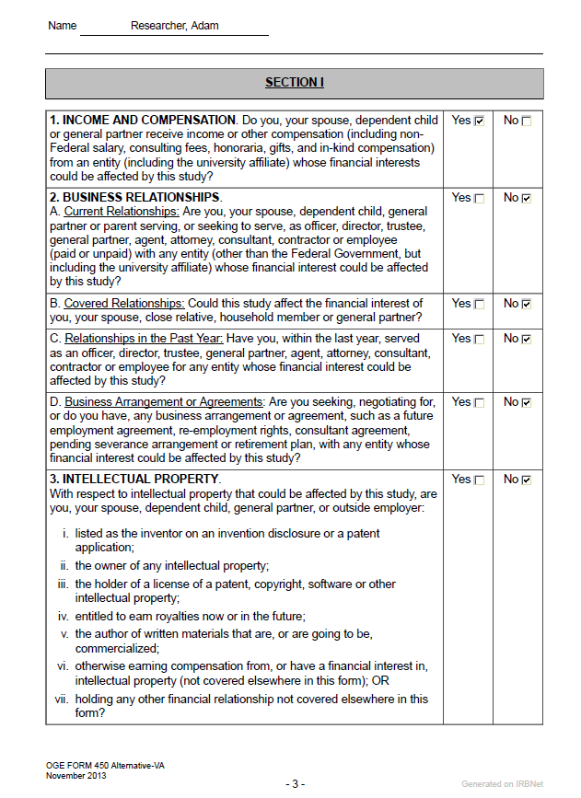
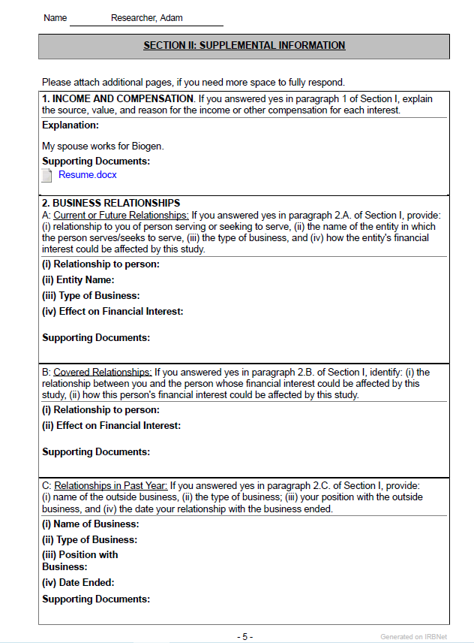
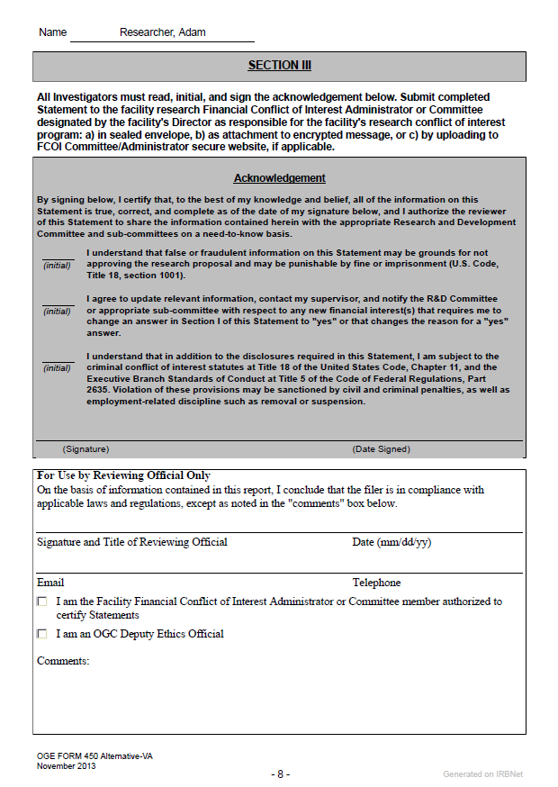
Create a New COI Disclosure
Comparison of OGE Form 450 Alt VA Wizard to PDF Version
General Information (PDF – Page 1)
Instructions (PDF – Page 2)
Disclosure Information (PDF – Page 2)
Income and Compensation (PDF – Section II, #1)
Supporting Documents
Business Relationships (PDF – Section II, #2)
Current Relationships
Covered Relationships
Relationships in Past Year
Business Arrangements or Agreements
Current or Future Relationships 1
Relationship to you of Person Serving
Entity Name
Type of Business
Effect on Entity’s Financial Interest
Supporting Documentation
Intellectual Property (PDF – Section II, #3)
Non-Publicly Traded Companies (PDF – Section II, #4)
Specific Types of Financial Interest (PDF – Section II, #5)
Acknowledgment (PDF – Section III)
Privacy Act Statement (PDF – Section III)
VA - OGE Form 450 Alternate VA
PDF Example
*The OGE Form 450 Alternate VA Wizard is an exact copy of the existing PDF version of the form.
This Photo by Unknown Author is licensed under CC BY

Slide 13
Create a New COI Disclosure
This is the confirmation page you will receive once your disclosures are completed.

Slide 14
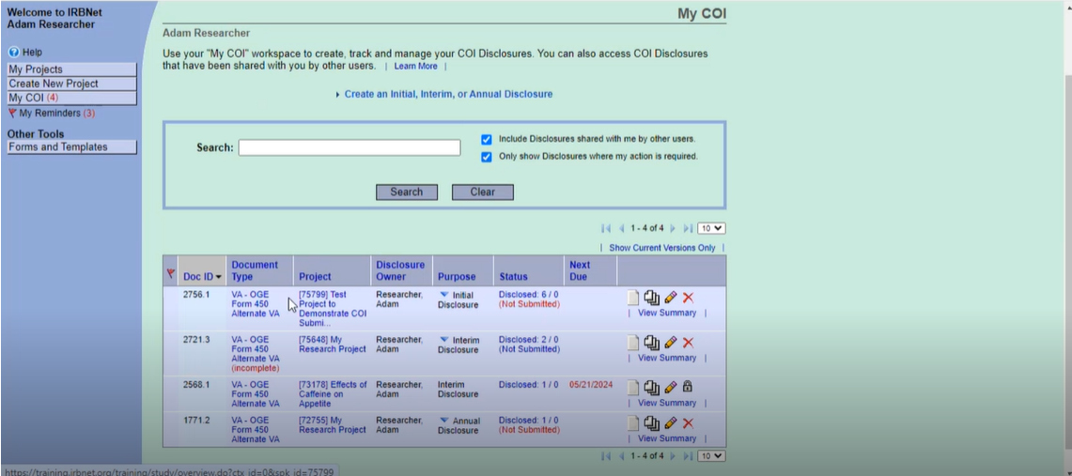
Create a New COI Disclosure
After you complete the wizard, you are taken back to the “My COI” page.

Slide 15
COI Module for Investigators
Create a New COI Disclosure
Link Disclosure Forms for Submission

Slide 16
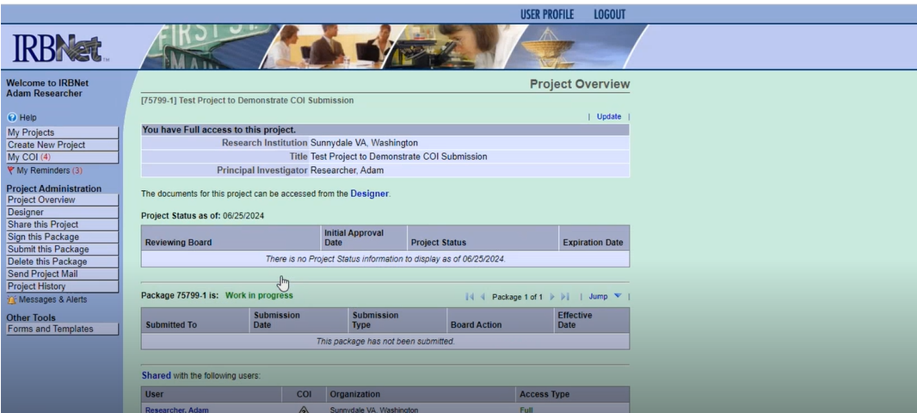
Link Disclosure Forms for Submission
Select your package from the “Project Overview” page and go to the “Designer” page to link your COI disclosures.

Slide 17
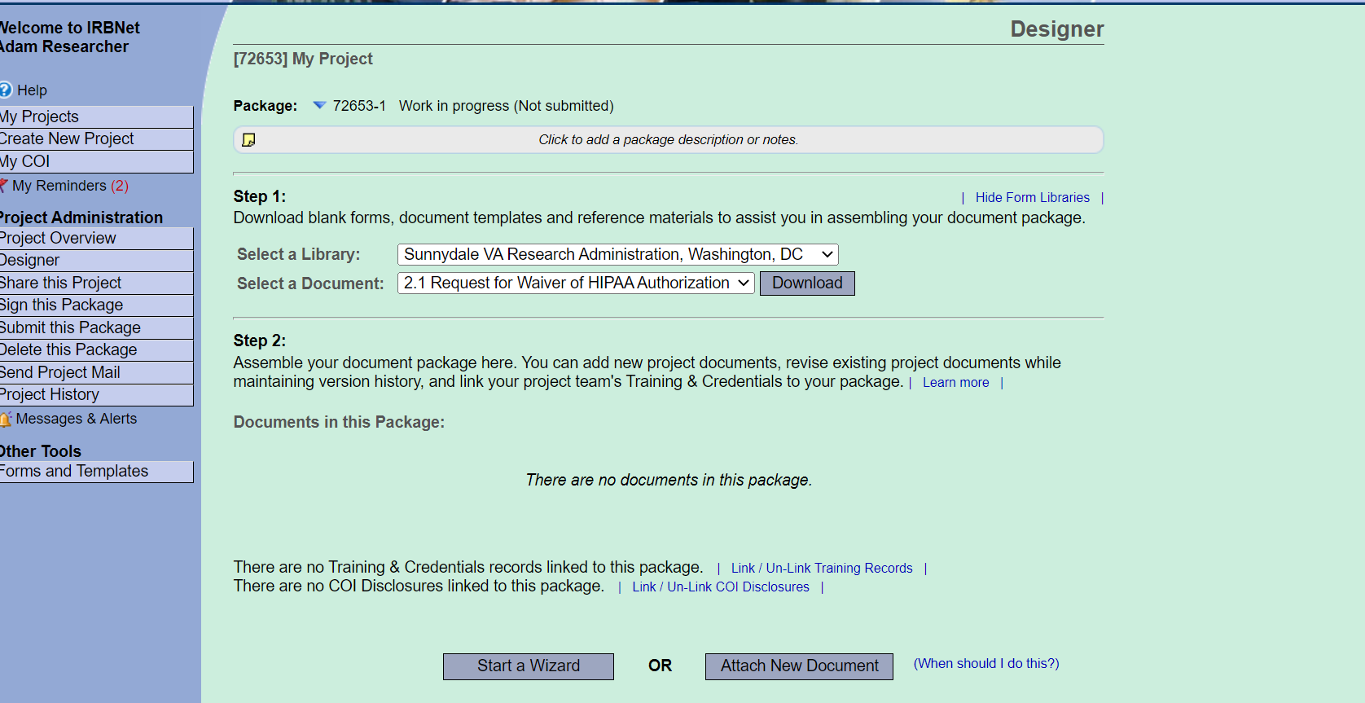
Link Disclosure Forms for Submission
Once you have navigated to the “Designer” page, click on the “Link / Un-link COI Disclosures” hyperlink at the bottom of the form. You will link the COI disclosures that are associated with this package.
The package is the carrier that will take your COI disclosures through IRBNet.

Slide 18
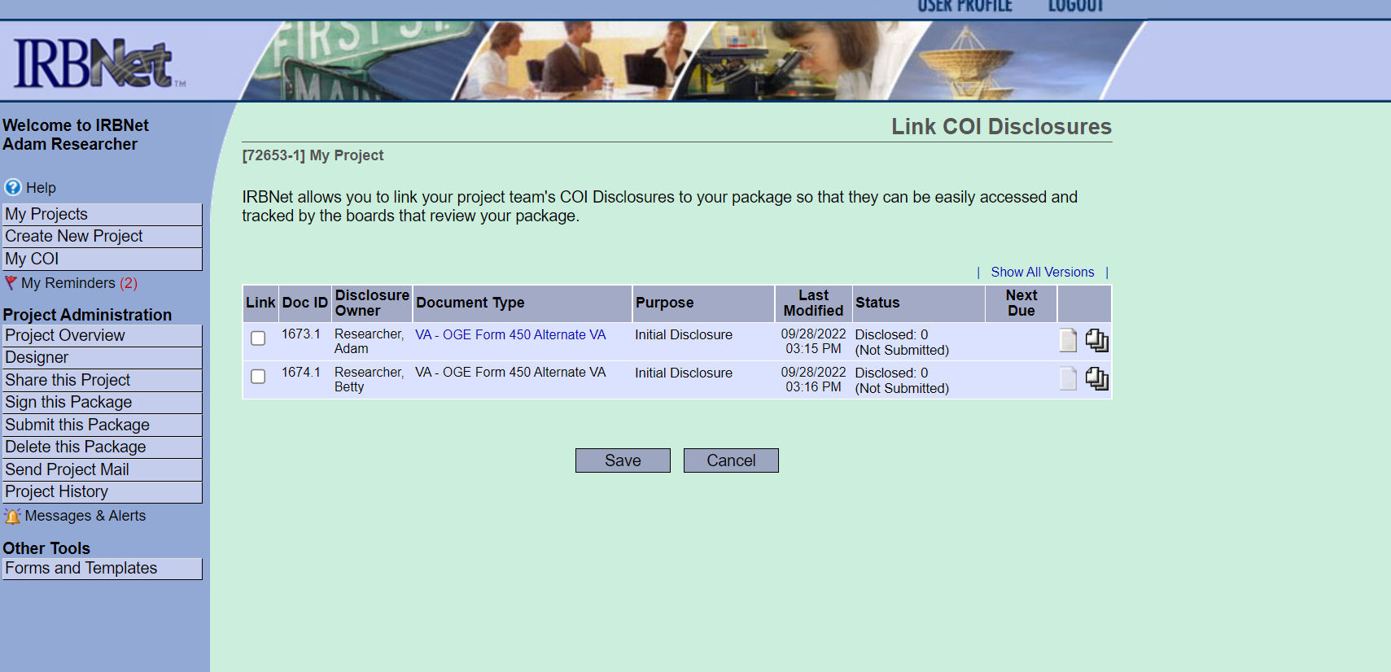
Link Disclosure Forms for Submission
Once you click “Link/Un-link COI Disclosures”, you will be presented with a list of disclosures for every study team member with access to the project. Select the OGE 450 Alt VA forms that you want to submit and click “Save”.

Slide 19
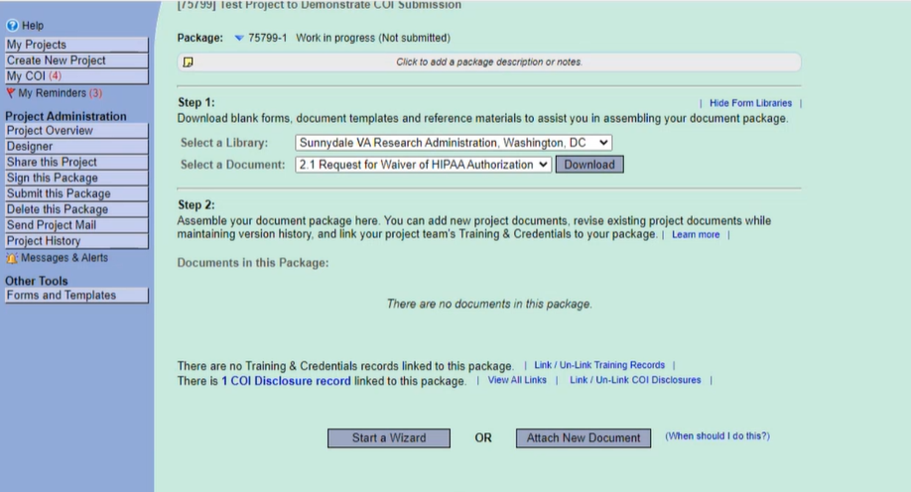
Link Disclosure Forms for Submission
If you have other investigators on your project, then you can also attach their COI Disclosures on this page to keep all disclosures together in one package.

Slide 20
COI Module for Investigators
Create a New COI Disclosure
Link Disclosure Forms for Submission
Submit Disclosure Forms

Slide 21
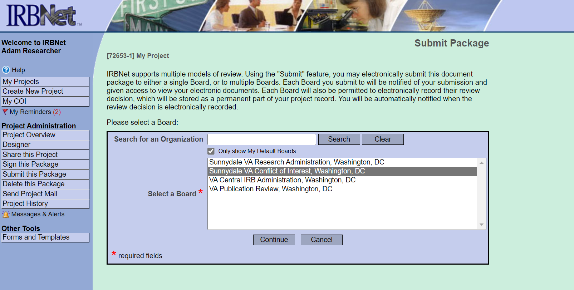
Submit Disclosure Forms
After all required disclosure forms are linked to the package, click the “Submit this Package” button, and select your facility’s COI workspace. Packages containing disclosure forms should only be submitted to the COI workspace. It is the responsibility of the project owner (someone with “Full” access) to submit the package. Always follow local COI SOPs.

Slide 22
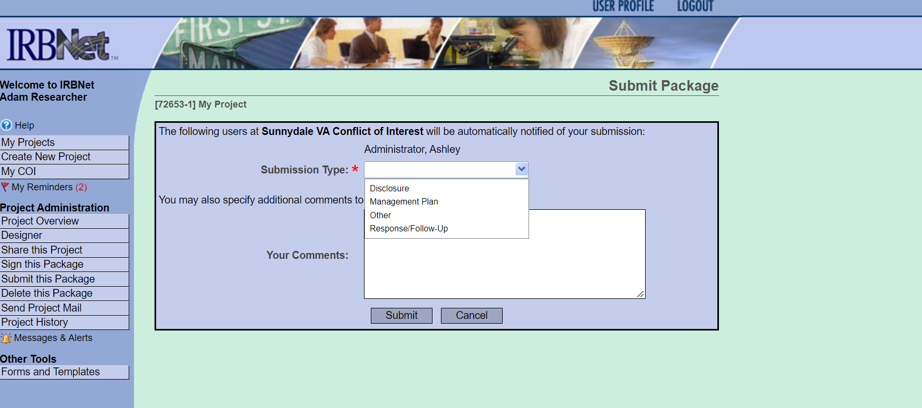
Submit Disclosure Forms
While submitting the disclosure, you can select the submission type as “Disclosure” and add comments.

Slide 23
COI Module for Investigators
Create a New COI Disclosure
Link Disclosure Forms for Submission
Submit Disclosure Forms
View the Status of a Disclosure

Slide 24
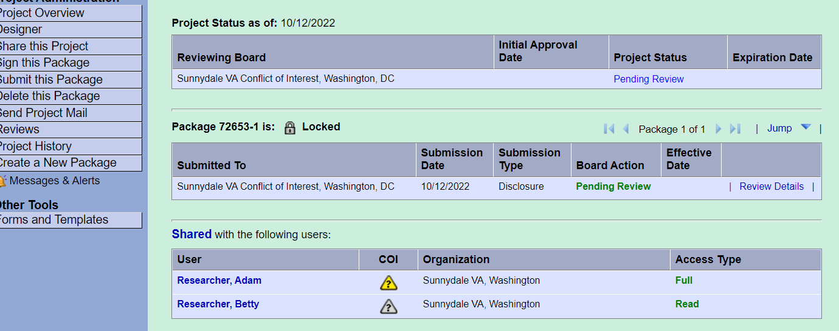
View the Status of a Disclosure
Project Overview Page
View status of COI submission package.
View status of each study team member’s COI review.
My COI Page
View status and details of your COI submission.

Slide 25
View the Status of a Disclosure
The oversight committee(s) can view the COI status on the “Project Overview” page or on the “Submission Detail” page under “Project Team Tracking.”

Slide 26
COI Module for Investigators
Create a New COI Disclosure
Link Disclosure Forms for Submission
Submit Disclosure Forms
View the Status of a Disclosure

Slide 27
COI Module Live Demo

Slide 28
Frequently Asked Questions
Q. What if my project isn't listed when I try to create my new COI disclosure?
The list includes all the projects that you have access to in IRBNet. These are the same projects that are listed on your “My Projects” page. If you don't see your project listed, then there are two things you can do:
• If you are the project owner, but have not yet created your project, do so before proceeding. To create a project, click the "Create New Project" option on the left menu.
• If you are not the project owner, contact the project owner (typically the study coordinator or principal investigator) and ask them to share the project with you in IRBNet. The project owner may need to create the project if they haven't already done so.
Q. What if a study team member isn’t listed when I try to link their disclosure?
Either they have not been shared on the project, or they have not completed their disclosure form.
Q. Where can I get help with questions about a disclosure or how to submit a disclosure?
A. Contact your local facility’s COI administrator.

Slide 29
References
VHA Directive 1200.13 Financial Conflicts of Interest and Outside Compensation for Performance in VA Research (May 2, 2024): VHA Publications
Research Financial Conflict of Interest Statement – OGE Form 450 Alternative VA: conflict_of_interest.pdf (va.gov)
IRBNet Notes – Submitting COI Disclosures:
ePROS Webinar Archive: https://www.research.va.gov/programs/epros/education/webinars/archives.cfm
VAIRRS University: https://www.research.va.gov/programs/epros/vairrs/training/vaiirs_university.cfm
IRBNet Notes - Submitting COI Disclosures.pdf

Slide 30
Questions?

Slide 31
Survey
Please take 3 minutes to let us know how we did today.
ePROS Webinar Survey

Slide 32
Thank you for joining!
If you have any questions, please contact the VAIRRS Support Team at VAIRRS@va.gov.

