Slide 1
Training IRB Members and Conducting Annual Evaluations
Estela Hamblen, MHA – VA Central IRB Administrator
Christie O'Brien – VA Central IRB Administrator

Slide 2
Overview
Training IRB Members
New IRB Members
Continuing Education
Suggested Tools and Resources
Annual Evaluation of Member Performance
Performance Evaluation
How to conduct
Tools and Reports

Slide 3
HRPP Responsibilities
IRB members to be trained on :
Policies and Procedures
Applicable federal regulations and ethical codes
SOPs
Directives

Slide 4
Regulatory Framework
Belmont Report Beneficence Justice Respect for Persons | Common Rule – 38 CFR 16 Food and Drug Regulations 21 CFR 56 21 CFR 50
VHA Directive 1200.05 Relative SOPs | State and Local Requirements California Bill of Rights Age of Majority

Slide 5
Initial Training Considerations
Observe IRB Meetings
Assess member’s experience
Clear expectations as a Member
Have an orientation meeting
Have a post meeting for observations
IRB Member Mentorship
Consider partnering with an experienced member
Consider a training period

Slide 6
Ongoing Education Considerations
Types of Research Reviewed
Changes to Regulations
Changes to Policies and SOPs
INDs, IND Exemptions, IDEs
Exemptions/Limited IRB Review
Electronic Platform
Standardization of Reviews

Slide 7
Resources
Office of Human Research Protections (OHRP) -educational events and OHRP’s website (Training Checklist for Those Working with IRBs - PDF)
Collaborative Institutional Training Initiative Program (CITI): Research, Ethics, and Compliance Training - Training Requirements for Human Subjects Protection (va.gov)
Public Responsibility in Medicine and Research (PRIM&R)
Annual Conference - December 2023 Washington DC
Annual Conference – November 2024 Seattle WA
ORD Sponsored Trainings (ORPP&E Webinar Archive (va.gov) )
IRB Member Toolbox

Slide 8
Program Assessment
Purpose of the Assessment -
Assess Board Member needs
Assess program needs
Assess expertise needs based on ORD’s research initiatives
Assess needed resources

Slide 9
Performance Factors
Attendance at convened IRB meetings – in-person or remote
Active participation in meeting discussions
Knowledge of local polices and federal regulations
Accurately complete checklists and required forms for review
Reviewing all materials in depth and provide comments in organized fashion
Processing all actions in a timely manner within established timeframes

Slide 10
Program Assessment
IRB Chairs and Leadership (IO)
Self-Evaluations and /or 360 Evaluations
IRB Administrative Support
Leadership

Slide 11
Example of a Tool
 | Element 1 | Element 2 | Element 3 | Element 4 | Element 5 | Element 1 | Element 2 | Element 3 | Element 4 | Element 5 | Element 1 | Element 2 | Element 3 | Element 4 | Element 5 | Element 1 | Element 2 | Element 3 | Element 4 | Element 5 | Element 1 | Element 2 | Element 3 | Element 4 | Element 5 | Element 1 | Element 2 | Element 3 | Element 4 | Element 5
Board Member | Survey Particpant #1 |  |  |  |  | Survey Particpant #2 |  |  |  |  | Survey Particpant #3 |  |  |  |  | Survey Particpant #4 |  |  |  |  | Survey Particpant #5 |  |  |  |  | Survey Particpant #6 |  |  |  |  | Average Score
 | Element 1: |  | Knowledge and application of federal regulations and ethical principles for the protection of human subjects in research.
 | Element 2: |  | Knowledge and application of VA – directives and policies in the review of research.
 | Element 3: |  | Meeting Preparedness: Members are expected to be prepared for meetings for discussion and/or presenting to the Board.
 |  |  | Members present clearly aspects of the research and regulatory requirements in order to apply approval criteria.

Slide 12
Program Assessment
Internal Tracking / IRBNet Reports
Attendance
Number of Assigned Reviews

Slide 13
Viewing Turnaround Time (TAT) Standardizing Member Reviews to Support TAT
Jessica Kroll, MA, CIP, VA Central IRB Administrator

Slide 14
Standardizing Member Reviews
Research Administrations have an opportunity to develop a standardized process for documenting committee member reviews in IRBNet to be able to generate member turnaround times (TAT).
Why create a standardized process?
Ensure all members use are using IRBNet the same way
Allow for data to be captured in IRBNet consistently and reliably
Ability to utilize IRBNet reports and dashboards (i.e., capture TAT)
Support staff responsible for processing member reviews
Streamline training of new members

Slide 15
What should we standardize?
IRBNet allows for some flexibility when it comes to documenting committee member reviews in the system. This provides the Research Administration with an opportunity to use the system in a way that best fits the local process and aligns with their standard operating procedures.
What should we standardize?
Define terms in IRBNet
Outline steps and order of actions to document a review in IRBNet
Establish review TAT for members

Slide 16
Define Terms in IRBNet
The Research Administration can define terms within IRBNet according to their local process and standard operating procedures. This will support consistency when a member provides a reviewer recommendation or determination.
For example, defining Approve with Conditions vs. Modifications Required
Approve with Conditions: Determination that can be made during expedited review or a vote will be taken during a convened IRB meeting where minor modifications are required to secure approval.
Modifications Required: Member identified that modifications are required from the Investigator for the submission to be considered complete. When the Investigator responds and the package is complete, the RECOMMENDATION should be updated (i.e., Approve, Acknowledge, etc.)

Slide 17
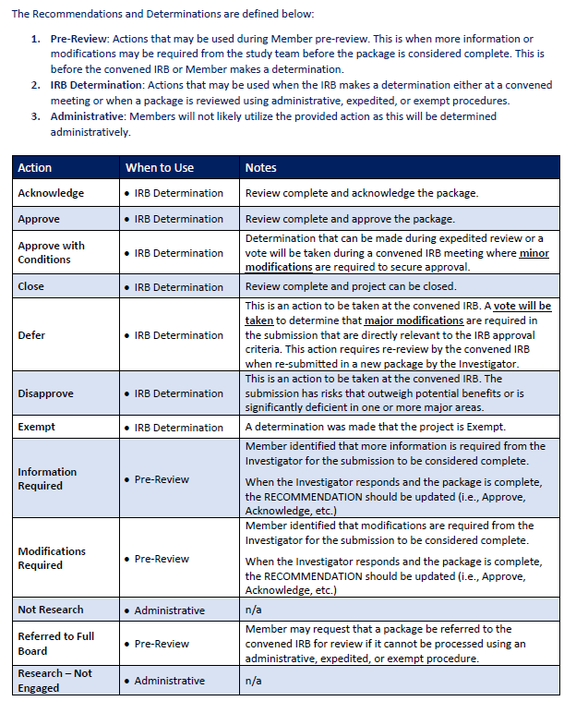
CIRB Sample
SAMPLE handout created by the VA Central IRB for members and staff to refer to when making a recommendation or determination.

Slide 18
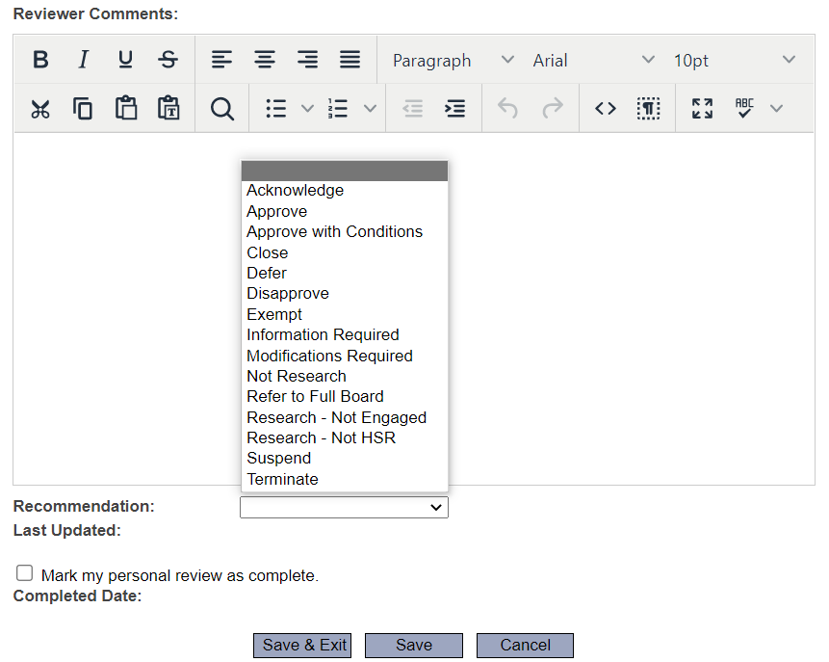
When should I…?
Should I make a recommendation before it goes to the convened board for review?
Can I change my recommendation?
When should I mark my review complete?

Slide 19
Do my actions in IRBNet matter?
Your actions matter!
Actions taken in IRBNet are captured behind the scenes and made available in IRBNet Insight Reports.
IRBNet Insight Reports provide timepoints based on specific reviewer actions that can be used to calculate TAT for a member’s review.

Slide 20
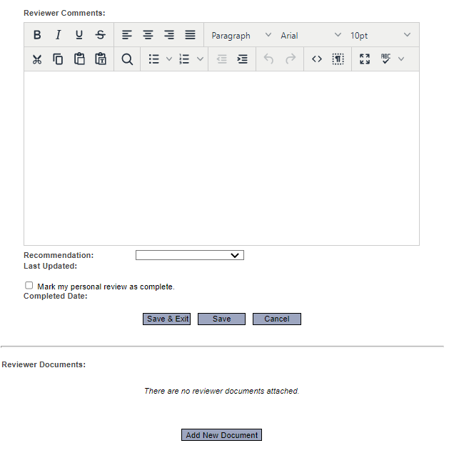
Documenting a Review
The Research Administration can create instructions and order of actions a member needs to take to document their review in IRBNet. It is important to take into consideration how each of the actions will relate to capturing member TAT in IRBNet Insight Reports.
Staff assigning reviewer a designation (i.e., Primary, Secondary, or Expedited)
Adding comments at first review
When to check the box and “Mark personal review as complete.”
Uploading reviewer checklists and worksheets
Adding comments at final review

Slide 21
Establish Review TAT
Establishing reviewer TAT expectations is key to measuring member performance and setting the framework for collecting metrics.
Sample Reviewer TAT:
TAT starts when staff assign a member as a reviewer
John is assigned an Amendment package as a Primary Reviewer
Member expectations are to complete first review within 7 days of assignment
Member expectations are to complete subsequent reviews (i.e., responses from study team) within 5 days

Slide 22
Viewing TAT
Once you have established a standardized process for members to document their reviews in IRBNet and have set expectations for review TAT, you can begin utilizing IRBNet Insight Reports with confidence.
How many days does it take reviewer John to complete their first review?
IRBNet Insight Report - Reviewer Activity
Date Member Assigned Review to Date First Reviewer Comment
January 10, 2023 to January 15, 2023
Equals 5 days to first review
Reviewer met the 7 TAT requirement for first review

Slide 23
Collecting Additional Metrics
Additional metrics can be collected by using IRBNet Insight Reports such as the Reviewer Activity Report.
The Reviewer Activity Report allows for basic TAT to be calculated along with number of reviews completed.
This data can easily be turned in to a pivot table and utilized when evaluating member workload and performance.

Slide 24
VAIRRS Data Overview
Angela Foster
Program Manager, Enterprise Data Research Systems
Updated: July 19, 2019

Slide 25
Discussion Topics
VAIRRS Data Availability
How to obtain VAIRRS Data
IRBNet Reports
VAIRRS Dashboards

Slide 26
VAIRRS Data Availability
IRBNet Insight Reports
VAIRRS Dashboards

Slide 27
IRBNet Insight Reports
Review Process
All packages and key dates
Pending Review
All packages pending review
Reviewer Activity
Detailed activity report for each reviewer
Meeting Attendance
Detailed listing of meeting attendees
Submission date
Effective date
Share Dates
Review completion dates
Agenda date
Only includes packages pending review
Submission date
Share date
Agenda date
Share date
Reviewer comment date
Reviewer completion date
Agenda date
Attendee list

Slide 28
IRBNet Insight Reports
Insight Reports are formatted a .csv files
Viewable in Microsoft Excel and other data manipulation tools (MS Access)
Requested by local IRBNet Power User
Available at any cadence (nightly, weekly, monthly)

Slide 29
VAIRRS Dashboards

Slide 30
VAIRRS Dashboards

Slide 31
VAIRRS Dashboards
Available for all sites
Request access to your site’s dashboard at: https://dvagov.sharepoint.com/sites/VHAORPPE/VAIRRS/SitePages/Dashboards.aspx
Data driven by IRBNet Insight Reports
Opportunity to build Committee Chair dashboard
Average reviewer turnaround times
Submission turnaround times
Number of projects reviewed

Slide 32
Thank You!

