Slide 1
VHA Privacy Issues and Privacy Reviews
Stephania Griffin, JD, RHIA Michelle Christiano, CCRC, CIP
Director, Information Access and Privacy Privacy Officer
Veterans Health Administration Veterans Health Administration
Office of Health Informatics Office of Research & Development
February 2023

Slide 2
Privacy Topics
Data Types and their Interactions
Privacy Officers Roles/Responsibilities
Privacy Officer Review Documentation
Privacy Officers Process for Research Protocol Reviews with Commercial IRBs
Central Privacy Reviews

Slide 3
Data Relationships
SPI/PII
III
IIHI
PHI*
LDS
De-identified Data
Notes:
Let’s take a minute to discuss the relationships between different types of information.
Sensitive Personal Information and Personally Identifiable Information are synonymous and encompass Individually Identifiable Information, Individually Identifiable Health Information and Protected Health Information.
Individually Identifiable Information encompasses Individually-identifiable Health Information. It may or may not be Protected health Information.
Individually Identified Health Information is maintained by VHA and is protected by the HIPAA Privacy Rule, as well as the Privacy Act and the Title 38 confidentiality statutes 5701 and 7332. IIHI will always be Protected Health Information or PHI.
PHI includes Limited Data Sets and Non-identifiable information. Also, PHI may encompass any of these data types, except when de-identified. This is why PHI is a bad descriptor of information when trying to understand which laws apply to the information based on the information type.
For example, PHI may be III and as a result the Privacy Act, 38 USC 5701 and the HIPAA Privacy Rule apply. However, PHI may be a LDS and only the HIPAA Privacy Rule applies to it.

Slide 4
Sensitive Personal Information (SPI)/ Personally Identifiable Information (PII)
SPI with respect to an individual means any information about the individual maintained by an agency, including the following:
Education, financial transactions, medical history, and criminal or employment history
Information that can be used to distinguish or trace the individual’s identity, including name, social security number, date and place of birth, mother’s maiden name, or biometric records

Slide 5
Sensitive Personal Information (SPI)/ Personally Identifiable Information (PII)
SPI/PII is a subset of VA Sensitive Information/Data and may also include:
Individually Identifiable Information (III)
Individually Identifiable Health Information (IIHI)
Protected Health Information (PHI)
Limited Data Set (LDS)
Non-Identifiable Information (NII)

Slide 6
Individually-Identifiable Information (III)
III is any information pertaining to an individual that is retrieved by the individual’s name or other unique identifier
It is a subset of Personally Identifiable Information (PII) that is always protected by the Privacy Act and does not have to be health information.

Slide 7
Individually Identifiable Health Information
Individually-identifiable health information (IIHI) is a subset of health information, including demographic information collected from an individual, that: (1) is created or received by a health care provider, health plan, or health care clearinghouse (e.g., a HIPAA-covered entity, such as VHA); (2) relates to the past, present, or future physical or mental condition of an individual, or provision of or payment for health care to an individual; and (3) identifies the individual or where a reasonable basis exists to believe the information can be used to identify the individual.

Slide 8
Individually-Identifiable Information (III)
IIHI is a subset of health information and a form of Individually Identifiable Information (III) in the possession of VHA and protected by the HIPAA Privacy Rule, Privacy Act, 38 U.S.C. §5701 and, when applicable, 38 U.S.C. § 7332

Slide 9
Protected Health Information (PHI)
PHI is IIHI transmitted or maintained in any form or medium by VHA, as a health plan or covered health care provider, that has not been de-identified in accordance with the HIPAA Privacy Rule.
38 U.S.C. § 7332-protected information is a subset off IIHI that is health information related to:
HIV;
Sickle cell anemia; and/or
the treatment of drug abuse, alcoholism or alcohol abuse.

Slide 10
Limited Data Set (LDS)
LDS is a subset of PHI from which certain specified direct identifiers of the individuals and their relatives, household members and employers have been removed, but is not “de-identified.”
Includes name, address (other than town or city, state, or zip code), phone number, fax number, email address, Social Security Number (SSN), medical record number, health plan number, account number, certificate or license numbers, vehicle identification, device identifiers, web universal resource locators (URL), internet protocol (IP) address numbers, biometric identifiers, and full-face photographic images
The two identifiers that can be used are dates and postal address information that is limited to town or city, State, or zip code.

Slide 11
Non-Identifiable Information (NII)
Non-identifiable information is III from which all unique identifiers have been removed so that the information is no longer protected under the Privacy Act, 38 U.S.C. §§ 5701 or 7332.
Non-identifiable information that is health information is still protected under the HIPAA Privacy Rule as it is not “de-identified” by either Safe Harbor or Expert Determination.

Slide 12
De-identified Information
De-identified information is not considered Sensitive Personal Information
It is health information that is presumed not to identify an individual and there is no reasonable basis to believe that the information can be used to identify an individual, because the 18 patient identifiers described in the HIPAA Privacy Rule have been removed by one of the following two methods:
Safe Harbor, or
Expert Determination

Slide 13
De-identification Methods
HIPAA Privacy Rule
De-identification Methods
Expert
Safe
Harbor
Determination
§
§
164.514(b)(1)
164.514(b)2
Apply statistical or
Removal of 18 types of
scientific principles
identifiers
Very small risk that
No actual knowledge
anticipated recipient
residual information can
could identify individual
identify individual

Slide 14
De-identified Information
De-identified information is no longer covered by the Privacy Act, 38 U.S.C. §§ 5701 or 7332, the HIPAA Privacy Rule and is no longer considered personally identifiable information.
FOIA may apply to requests for the disclosure of de-identified data. (NOTE: FOIA is not a data protection law but a date disclosure law.)

Slide 15
Coded Data
Coded Data means a random or arbitrary alphanumeric code or symbol used in place of unique identifiers.
Coded data is NOT generally de-identified.
The “code” is often used to segregate one record from another. However, when that “code” is used to link data on a research subject through time, it becomes a unique identifier, and the data is not de-identified.
For example, Study ID.
The coded data would still be protected health information under the HIPAA Privacy Rule.
Notes:
Many studies use codes assigned to either a subject or tissue sample.
Coded Data means that collected samples or data are unidentified for research purposes by use of a random or arbitrary alphanumeric code or symbol but the samples may still be linked to their sources through use of a key to the code available to an investigator or those collaborating with the research study.

Slide 16
Coded Data
Even when coded data does not use a “code” to link multiple data collections to a subject’s record, the information may still be a Limited Data Set (LDS) as opposed to de-identified data.
All dates associated with the subject or the subject’s family and address information limited to city, state and zip code are permitted.
A LDS is still protected health information that must be protected under the HIPAA Privacy Rule.

Slide 17
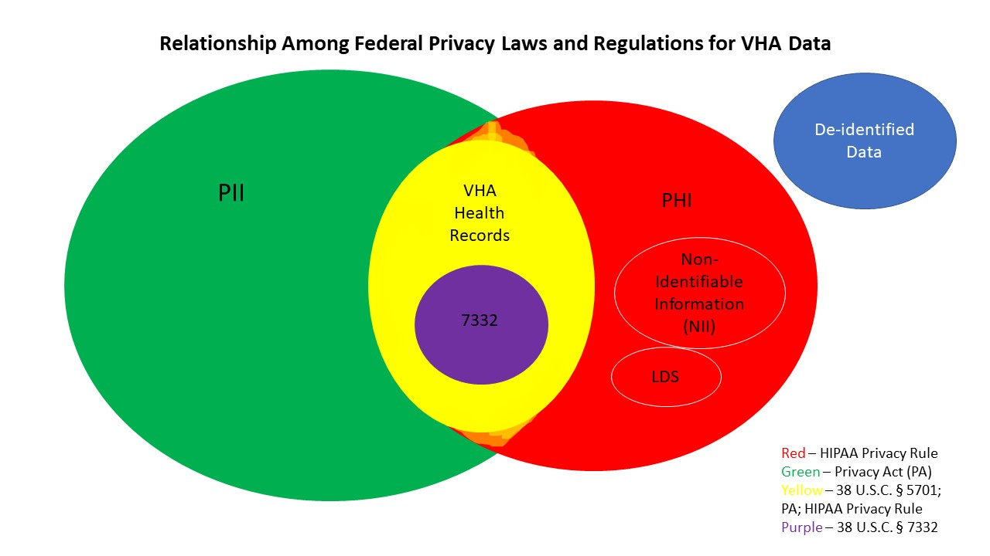
VHA Data Type Interactions

Slide 18
Documenting Privacy Reviews
CIRB Privacy reviews are documented via the Form 123
Field Privacy Reviews are documented by the VA Form 10-250, VHA Research Protocol Privacy Review Checklist, is required by VHA Directive 1605.03
Both the Preliminary and Final review sections must be completed.
Must incorporate applicable completed form into the protocol documents. May be maintained in facility protocol documentation, if using Affiliate IRB.

Slide 19
Why Not Use the Same Form?
The processes for PO interaction with the research team is different at the Central level than it is at the facility level.
Multiple sites require a higher level review.

Slide 20
Completing VA Form 10-250
Privacy Officer Preliminary review begins on pg. 2
Conducted to ensure that all privacy concerns are addressed prior to approval
Privacy Officer Final Review begins on pg. 5
Conduct a final review after the IRB (or R&D Committee when acting as Privacy Board) has approved the study to see if any changes were made that would affect the privacy interest of the subjects
Did the approval documents include all the necessary components

Slide 21
VA Form 10-250
When should this form be initiated by the Principal Investigator?
New submission
Continuing Review or Amendment/Modification that have a privacy impact (e.g., changes to the VA Form 10-0493, change in data sources, etc.)

Slide 22
VA Studies Permitted to Use Commercial IRBs
Courtesy of Dr. Karen Jeans, Office of Research Protections, Policy, and Education (ORPP&E), VHA Office of Research & Development
Use of a commercial IRB is not appropriate for all VA studies, and VA policy does not allow the use of a commercial IRB for all studies.
VA Facilities are not permitted to use commercial IRBs as their primary IRBs of Record.
VA studies may use a commercial IRB if it meets all of the following requirements:
Multi-site research
At least one VA is participating as a site in the study
Neither VA nor the VA Nonprofit Corporation (NPC) is not contracting directly for use of the commercial IRB for the study (e.g., another party is paying for the use of the commercial IRB).
ORD has approved the use of the commercial IRB for applicable VA studies.

Slide 23
Commercial IRBs Permitted to be Used by VA Facilities
Courtesy of Dr. Don Workman, Office of Research Protections, Policy, and Education (ORPP&E), VHA Office of Research & Development
VA has agreements with three commercial IRBs at the present time
Advarra IRB:
82 VA Facilities
Western Institutional Review Board (WIRB)-Copernicus Group (WCG)
76 VA Facilities
Sterling IRB
12 VA Facilities
VA anticipates that additional commercial IRBs will be approved in the future if they meet VA’s requirements.

Slide 24
Local PO Process for Commercial IRB Submissions
Local PO is to review the submission the same as for any external IRB submission
The PO may have to reach out to the research team for questions via email or Project Mail in VAIRRS as each of the commercial IRBs have different forms
E.g., Advarra does not ask for the identifiers

Slide 25
Central Privacy Reviews
Central Privacy Reviews are only conducted by the ORD, Privacy Officer for projects that are multi-site, reviewed by a single commercial IRB and that are managed by the:
Partnered Research Program (PRP)
ACTIV Network
There are currently five studies with a combined total of 34 VA facilities.

Slide 26
FAQ
What statutes apply when VHA employees (providers, nurses, etc.) are research subjects?
Who confirms that the data are de-identified before the data is disclosed?

Slide 27
Q&A Discussion

Slide 28
Additional Information
Stephania Griffin, Director Information Access and Privacy (105HIG)
704-245-2492
Stephania.griffin@va.gov
VHA Privacy Office email contact:
VHAPrivIssues@va.gov

Slide 29
Additional Information
Michelle Christiano, ORD Privacy Officer
706-399-7980
Michelle.Christiano@va.gov

