Slide 1
General Research Administration – Combined Program Reviews
Cynthia Boudreaux, M.Ed.

Slide 2
Conference Content Copyright
All content included in this session is the property of the presenter(s), and is protected by United States and international copyright laws. Certain materials are used by permission of their respective owners. The course content may not be reproduced, transmitted, or shared in any way without the prior written permission of the presenter(s). Access to this presentation should not be construed as a license or right under any copyright, patent, trademark or other proprietary interest of PRIM&R or third parties.

Slide 3
Disclosure: Cynthia Boudreaux
I have no relevant personal/professional/financial relationship(s) with respect to this educational activity

Slide 4
Learning Objective
Describe the approach to assessing the General Research Administration during a Combined Program Review

Slide 5
Combined Program Reviews (CPRs)
Combined Program Reviews
Overview of the VA facility’s research oversight program
Review of 3-5 areas of the research program
Designed to identify research oversight program areas that require strengthening

Slide 6
Areas of Review
Resources and Infrastructure
Research and Development Committee
Communication
Research Compliance Officers
Program Oversight
Subcommittees and external committees
R&D Committee Operations
Standard Operating Procedures

Slide 7
Resources and Infrastructure
Is the research program getting the support it needs to be successful?
Support from: Facility Director
OI&T
Human Resources
Engineering/Plant Dept
(Maintaining physical infrastructure)
Support for: Committee Members and Staffing
Computers/Hardware/Software
Space
Other

Slide 8
Research and Development Committee (R&DC)
Own
Another VA

Slide 9
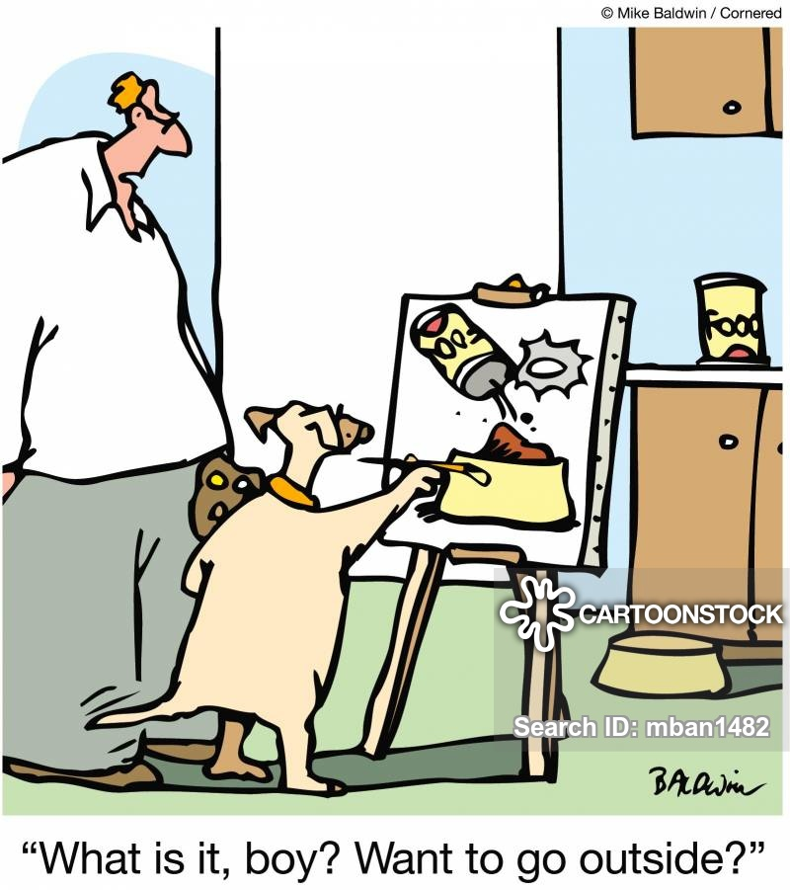
Communication

Slide 10
Research Compliance Officers
Audit Plan
Relationships with
Facility Director
Research Office
Review Committees
Investigators/coordinators

Slide 11
Program Oversight
Tracking Systems
Access to and Maintenance of Required Documents
Appointments/Credentials/Privileges of Research Staff

Slide 12
R&DC Operations
Research Oversight
Research overseen by subcommittees and external committees
Research for which R&DC is only oversight committee
Review of Subcommittees and External Committees
Subcommittees – QI/QA
External Committees - MOU

Slide 13
R&D Committee SOPs
Recurring Processes

Slide 14
References
VHA Directive 1200.01
VHA Directive 1200.02
VHA Directive 1200.05
VHA Handbook 1058.01
VHA Handbook 1058.03
RCS 10-01 Code 8300

Slide 15
Questions?

Slide 16
Thank You

