Slide 1
Direct Care Inpatient Admissions (SIDR)
Veronika Pav
Kennell & Associates, Inc.

Slide 2
Objectives
Describe a Standard Inpatient Data Record (SIDR)
  What is a record?
  How are records coded?
  How are TRICARE MS-DRGs different from Medicare?
  Highlight important data fields

Slide 3
Common Terms
National Provider ID Tmt DMIS ID
HIPAA Taxonomy Code MEPRS Code
ICD Diagnosis Code ICD Procedure Code
CPT/HCPCS Code CCS Category
MDC MS-DRG
APC Service Dates
Basic Workload Weighted Workload
Person IDs Demographics
Bencat/Bencat Common HCDP, ACV & ACV Group, Enrollment Group
PCM ID Enrollment Site
Enrollment MEPRS Code Special HCDP
Deployment Information Raw vs Total
Geography Record ID
Case Manager ID Case Manager DMISID

Slide 4
Standard Inpatient Data (SIDR) Record
  Each record represents the most recent version of a record for a patient dispositioned from an MTF.
  MTFs are considered Acute Care Facilities
    Includes both those records where the electronic record has been closed out (complete) and those still open (incomplete) – but the patient has been discharged
      More later
    Long Stay patients included in the file once discharged from the hospital (inconsistent with Purchased Care data)
    Includes Observation Stays
      If DX1 = V719 (for FY15 and back) or Z049 (for FY16 forward) and DMISDAYS <= 2 then OBSFLAG = Y; otherwise OBSFLAG = N (Populated FY12+)

Slide 5
Reported vs. Inferred SIDRs
Timeliness: For MTFs, the requirement is to complete SIDR within 30 business days of patient discharge
Completeness: Some records slow getting submitted
  More like 30-90 days depending on Treatment DMIS ID
For patients that have been discharged, both electronically closed out records and those that have not been closed out are received from the sites
  Identified using Compliance Status (INFFLAG)
    I = Inferred (record has not been closed out)
    R = Reported (record closed out)

Slide 6
Inferred SIDRs
Diagnosis and Procedure Code fields on inferred records do not have complete information
  Diagnosis 1 has temporary placeholders:
    FY15 and back: B200 (live birth), B700 (Disease), B900 (Injury)
    FY16 and forward: DOD0010 (live birth), DOD0011 (Injury), DOD0012 (Other)
Workload measures (e.g., MS-DRG RWP) are averaged by Tmt DMIS ID and MEPRS Code for inferred records
MHS GENESIS IOC: No SIDRs as of these dates for these sites:
  Oak Harbor: 7/15/17
  Bremerton: 9/23/17
  Madigan: 10/21/17

Slide 7
Reported vs. Inferred SIDRs
FY17:
  Varies by Tmt DMIS ID: Guam – 194 (10% of their total), San Antinio (SAMMC) - 18
FY18:
  At the beginning of a new FY, there’s a lag in loading new MS-DRG weights at MTFs, so see a backlog that has to be worked through
*As of 7/18/18

Slide 8
What’s on a SIDR record?

Slide 9
Identifying Unique Records
Record ID: CHCS Patient Register Number (PRN)
  Essentially a chronological counter at each MTF, 7 characters
  Use with Tmt DMIS ID for unique record (MTF)
Patient Information:
  Patient SSN & DoD EDIPN, patient demographics (age, dob, gender, marital status), Sponsor SSN, Enrollment Group, Beneficiary Category, etc.

Slide 10
Date Fields
Admission Date: (ADMDATE)
  Use to stratify admissions
Disposition Date: (DISPDATE)
  Disposition date is used to allocate records to each FY file
FY/FM and CY/CM: year and month of disposition date

Slide 11
Provider Information
Tmt DMIS ID and Attributes (Treatment Service, Command, etc.)
MEPRS Code of MTF department providing care
  Up to 4 MEPRS Codes -- Admitting, Dispositioning, Up to 2 Interim
      MEPRS3 Code, Admitting
      MEPRS3 Code, Dispositioning
      MEPRS3 Code, Second Service
      MEPRS3 Code, Third Service
  If patient in more work centers, info not available
Admitting and Attending Providers: NPI, EDIPN, HIPAA Specialty
  Provider Assignment information comes from DMHRSi.

Slide 12
Diagnosis Codes
Diagnosis 1 – Diagnosis 20:
  Diagnosis 1 is the principle diagnosis
  No decimal points
  FY15 and back ICD-9-CM
  FY16 and forward ICD-10-CM
  Both ICD-9-CM and ICD-10-CM have MHS Unique Codes
Present on Admission (POA)
  Per diagnosis code

Slide 13
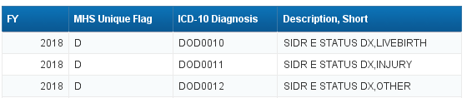
MHS Unique Diagnosis Codes
There are
  36 MHS Unique Codes in ICD-10 (FY 16+)
  535 MHS Unique Codes in ICD-9 (through FY 15)
We already saw some of these on the Inferred Inpatient Records

Slide 14
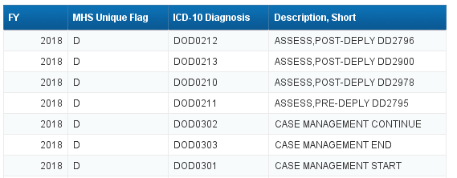
MHS Unique Diagnosis Codes
Most MHS Unique Codes will refer to care specific to the MHS, for example: pre- and post- deployment health assessments

Slide 15
Procedure Codes
Procedure 1 – Procedure 20:
  Left justified; no decimal points
  FY15 and back ICD-9-CM
  FY16 and forward ICD-10-PCS

Slide 16
MDC and MS-DRG
MDC: Major Diagnostic Category
  Based on Diagnosis 1 (primary diagnosis)
  ~25 groupings typically related to a diagnosis involving a body system (e.g., 14 Mothers; 15 Newborns; 04 Respiratory)
MS-DRG: TRICARE Diagnosis Related Group
  825+ MS-DRGs
  Based on Medicare with refinements made by TRICARE
Not available on inferred SIDRs
    Remember, no diagnosis or procedure codes on inferred records!

Slide 17
MDC’s
Code | Description
14 | Pregnancy, Childbirth, and the Puerperium
15 | Newborns & Other Neonates with Conditions Originating in Perinatal Period
16 | Diseases and Disorders of the Blood, Blood Forming Organs, Immunological Disorders
17 | Myeloproliferative Diseases and Disorders, Poorly Differentiated Neoplasm
18 | Infectious and Parasitic Diseases, Systemic or Unspecified Sites
19 | Mental Diseases and Disorders
20 | Alcohol/Drug Use and Alcohol/Drug Induced Organic Mental Disorders
21 | Injuries, Poisonings and Toxic Effects of Drugs
22 | Burns
23 | Factors Influencing Health Status and Other Contacts with Health Services
24 | Multiple Significant Trauma
25 | Human Immunodeficiency Virus Infections
28 | Outpatient Drug and Adjunctive Dental (HCSR Only, not valid in SIDR)
29 | Not Classifiable
98 | Diseases and Disorders of the Reproductive System
PR | Pre-Major Diagnostic Category, DRG May Occur in 1 or More MDC
DO | DoD Unique Codes (used only in CAPER) which are unique attributes
Code | Description
Blank | Not Associated with any Specific MDC
00 | Unknown
01 | Diseases and Disorders of the Nervous System
02 | Diseases and Disorders of the Eye
03 | Diseases and Disorders of the Ear, Nose, Mouth, and Throat
04 | Diseases and Disorders of the Respiratory System
05 | Diseases and Disorders of the Circulatory System
06 | Diseases and Disorders of the Digestive System
07 | Diseases and Disorders of the Hepatobiliary System and Pancreas
08 | Diseases and Disorders of the Musculoskeletal System and Connective Tissue
09 | Diseases and Disorders of the Skin, Subcutaneous Tissue and Breast
10 | Endocrine, Nutritional and Metabolic Diseases and Disorders
11 | Diseases and Disorders of the Kidney and Urinary Tract
12 | Diseases and Disorders of the Male Reproductive System
13 | Diseases and Disorders of the Female Reproductive System

Slide 18
TRICARE vs MEDICARE MS-DRGs
Direct Care and Purchased Care have TRICARE MS-DRGs
  Exception is MHS GENESIS, which has Medicare MS-DRGs
Major Differences:
  TRICARE has more Neonate MS-DRGs
  TRICARE has age specific MS-DRGs
    Alcohol, Allergic Reactions, Leukemia, etc.

Slide 19
TRICARE vs MEDICARE MS-DRGs
Examples of Differences
TRICARE MS-DRG | TRICARE Description
266 | ACUTE LEUKEMIA W/O MAJOR O.R. PROCEDURE AGE 0-17
834 | ACUTE LEUKEMIA W/O MAJOR O.R. PROCEDURE AGE >17 W MCC
835 | ACUTE LEUKEMIA W/O MAJOR O.R. PROCEDURE AGE >17 W CC
836 | ACUTE LEUKEMIA W/O MAJOR O.R. PROCEDURE AGE >17 W/O CC/MCC
Medicare MS-DRG | Medicare Description
834 | ACUTE LEUKEMIA W/O MAJOR O.R. PROCEDURE W MCC
835 | ACUTE LEUKEMIA W/O MAJOR O.R. PROCEDURE W CC
836 | ACUTE LEUKEMIA W/O MAJOR O.R. PROCEDURE W/O CC/MCC
TRICARE MS-DRG | TRICARE Description
898 | ALCOHOL/DRUG ABUSE OR DEPENDENCE W/O REHABILITATION THERAPY AGE >21 W/O MCC
899 | ALCOHOL/DRUG ABUSE OR DEPENDENCE W/O REHABILITATION THERAPY AGE <=21 W/O MCC
Medicare MS-DRG | Medicare Description
897 | ALCOHOL/DRUG ABUSE OR DEPENDENCE W/O REHABILITATION THERAPY W/O MCC

Slide 20
TRICARE vs MEDICARE MS-DRGs
Examples of Differences
TRICARE MS-DRG | Description
789 | NEONATE, BIRTHWT >2499G, W/O SIGNIF O.R. PROC, W MULT MAJOR PROB
790 | NEONATE, BIRTHWT >2499G, W/O SIGNIF O.R. PROC, W MAJOR PROB
791 | NEONATE, BIRTHWT >2499G, W/O SIGNIF O.R. PROC, W MINOR PROB
792 | NEONATE, BIRTHWT >2499G, W/O SIGNIF O.R. PROC, W OTHER PROB
793 | NEONATAL AFTERCARE FOR WEIGHT GAIN
794 | NEONATAL DIAGNOSIS, AGE > 28 DAYS

Slide 21
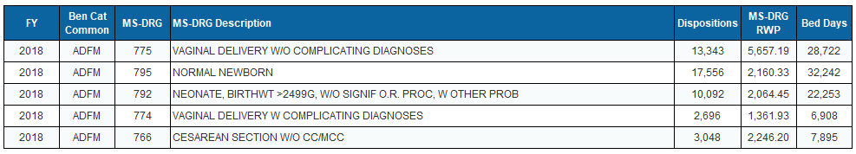
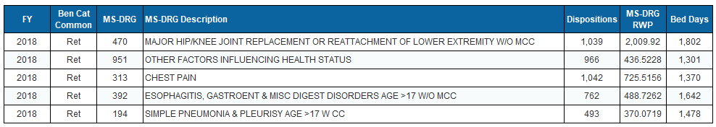
Top MS-DRG by Beneficiary Category

Slide 22

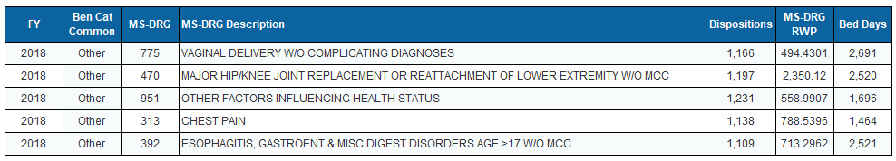
Top MS-DRG by Beneficiary Category

Slide 23
What to use?
MDC 14 (Pregnancy, Childbirth, & the Puerperium)
  MS-DRG 766 (C-Section w/o CC)
    ICD-9 Diagnosis 65420 (Scar from Previous Cesarean Delivery)
    or
    ICD-10 Diagnosis O3421 (Maternal Care for Scar from Previous Cesarean Delivery)
****************************************************
All OB care, not just deliveries? MDC
Just deliveries? MS-DRG
Specific kind of delivery? Diagnosis Code

Slide 24
Admission and Discharge Status
*As of 7/18/18

Slide 25
Workload Measures
Dispositions:
  Each record is a disposition
  To count dispositions, can count MTF +PRNs, so set to 1
Bed Days: days as reported from MTF
  Bed Days have 0 (zero) days changed to 1 bed day
  Bed Days of Record: zero bed days not changed
  Bed Days in ICU: bed days spent in any intensive care unit
  Summing by FY and/or FM puts all the bed days in the month of discharge
MS-DRG RWP
Remember – these measures include inferred unless
Compliance Status is filtered/conditioned!

Slide 26
MS-DRG RWP
Relative Weighted Product (RWP)
  Intensity adjusted workload measure
  Based on MS-DRG weight (i.e., relative costliness of that MS-DRG, hospital costs only), LOS, and other factors
  Does not include provider’s costliness
  MS-RWP = MS-DRG weight for most cases.
    Long Stay Outliers receive a little more for each day over the threshold; Short Stay Outliers receive a little less
  BEST WORKLOAD MEASURE!
  Inferred records have averages
Let’s look at the MS DRG Relative Wegiht

Slide 27
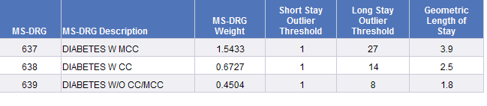
MS DRG Relative Weights
Relative weights are the basis of payment in TRICARE for acute care hospitals.
All MTFs are acute care, only some private sector providers are (acute care hospital indicator can be used to discern)
Annually, billed amounts from acute care hospitals are examined on TRICARE claims and compared by MS-DRG.
Relative weights represent the relative billed amount for one MS-DRG vs. all others.
An MS-DRG weight of 2 means the care was billed at twice the rate of an MS-DRG with a weight of 1.
“Inlier” patients (within short and long stay thresholds) receive the relative weight as the RWP. Adjustments are made for LOS outliers and transfers.
The RWP for DRG 637 is the same whether the LOS is 26 days or 2 days.

Slide 28
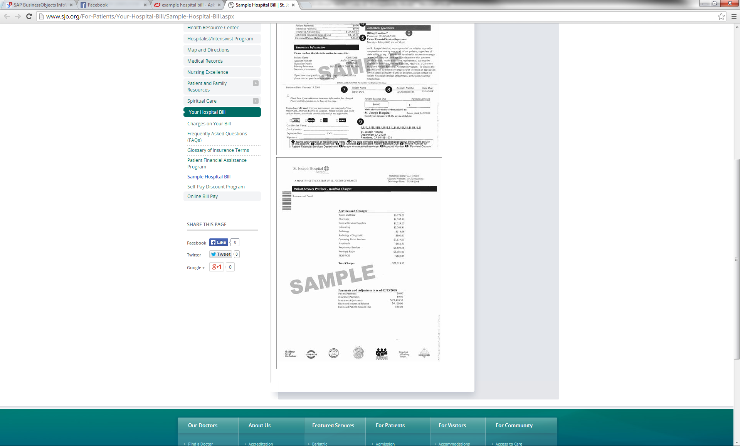
MS-DRG Relative Weights
The relative weight reflects the relative billed amount in TRICARE for that MS-DRGs vs. all others.
  Remember these are inpatient hospital bills. The weights do not consider provider costliness.
Note that there are no physician charges on hospital bills.

Slide 29
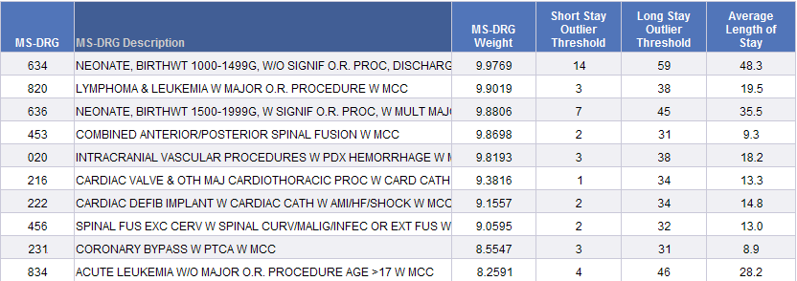
MS-DRG Relative Weights
Highest Weight MS-DRGs – FY2017

Slide 30
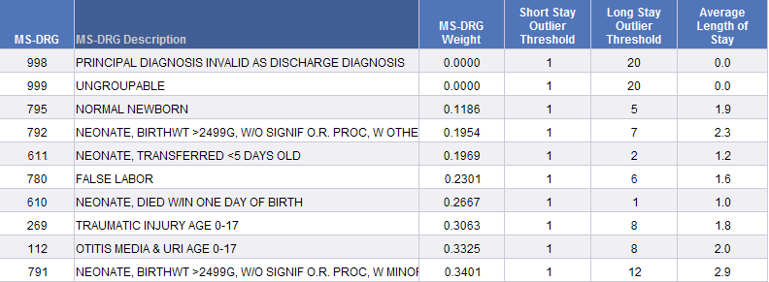
MS-DRG Relative Weights
Lowest Weight MS-DRGs – FY2017

Slide 31
MS-DRG RWP
Relative Weighted Products (RWP)
  Inpatient Case Mix = MS-DRG RWP / DISP
    Note: Additional filters have to be applied in purchased care (TED-I) so that only acute facilities (use Acute Care Hospital Indicator) are included and partial stays (use Discharge Status) are excluded.

Slide 32
Inpatient Workload Example
Create a query to look at workload measures by Tmt DMIS ID for FY17:
  Dispositions
  Bed Days
  MS-DRG RWP
Compute Average LOS (ALOS) and CMI.
Look at the top 15 Tmt DMIS ID based on CMI.
What do we know about these facilities:
  Population mix, medical specialties, etc.?

Slide 33
Workload Measures – FY17
WRNMMC: Trauma, Ortho, and Circulatory (looked by MDC)
SAMMC: trauma center for the city of San Antonio, Burn Unit
Eisenhower: deliveries sent downtown
San Diego: 35% of workload for MDC 14 and 15 (moms and babies)
Portsmouth: 40% of workload for MDC 14 and 15 (moms and babies)
Keller: Sports Medicine residency
Don’t just look at “how many” as “what kind” tells more of the story!
*As of 7/18/18

Slide 34
Workload Measures – FY17
Omitting MS-DRGs 765-768, 774-775, 791-792, 795
(Deliveries and Newborns with low MSDRG weights)
“All”: no records omitted
“Omit”: MS-DRGs listed above omitted
0079 Nellis and 0086 Keller dropped out of top 15
0123 Ft Belvoir and 0621 Okinawa are now in top 15
*As of 7/18/18

Slide 35
Questions
vpav@kennellinc.com

