Slide 1
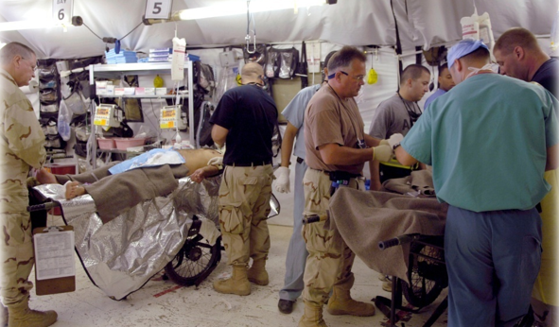
DaVINCI:
Theater Medical Data Store (TMDS) and Designated Provider (USFHP) Data

Slide 2
Objectives
Describe the Designated Provider table characteristics
Describe the TMDS table characteristics
Highlight important fields and consider how this data can be used in analyses

Slide 3
What’s in the Designated Provider Table
Designated Provider Claims:
Claims associated with the Designated Provider Program
Content: Medical and Pharmacy Claims; Person Identifiers, Types of Care, Diagnosis, Payment Amounts, Dates, etc.
Potential Uses: To study the Designated Provider program. To complete the health history of beneficiaries enrolled in DP
Refresh Frequency: Monthly in MDR; Quarterly in DaVINCI
Comment: These patients do not use MTFs or purchased care (ACV=Desig Prov)

Slide 4
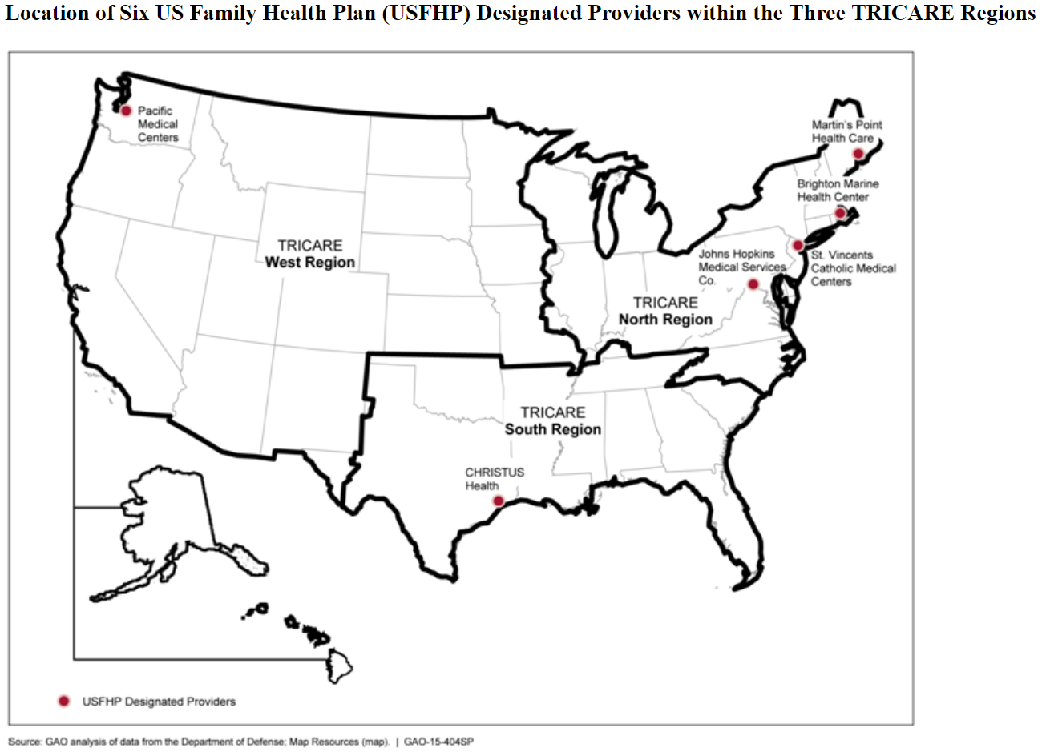
Designated Provider (USFHP) locations

Slide 5
Designated Provider patients, setting
Program mostly used by family members (dependents) and military Retirees, which are part of the DaVINCI cohort
Combines institutional and non-institutional claims
Beneficiary Category | Claims
Active Duty | 183
Dependents of Active Duty | 1,272,155
Dependent of Guard/Reserve | 255,788
Dependents of Retiree | 3,933,993
Dependent Survivor | 1,182,644
Guard/Reserve on Active Duty | 306
Dependent of Inactive Guard/Reserve | 15,632
Inactive Guard/Reserve | 5,210
Other | 8,668
Retirees | 4,025,898
Encounter Setting | Claims
H = Hospital Services | 229,767
I = Inpatient Professional | 908,106
O = Outpatient Professional | 10,709,266

Slide 6
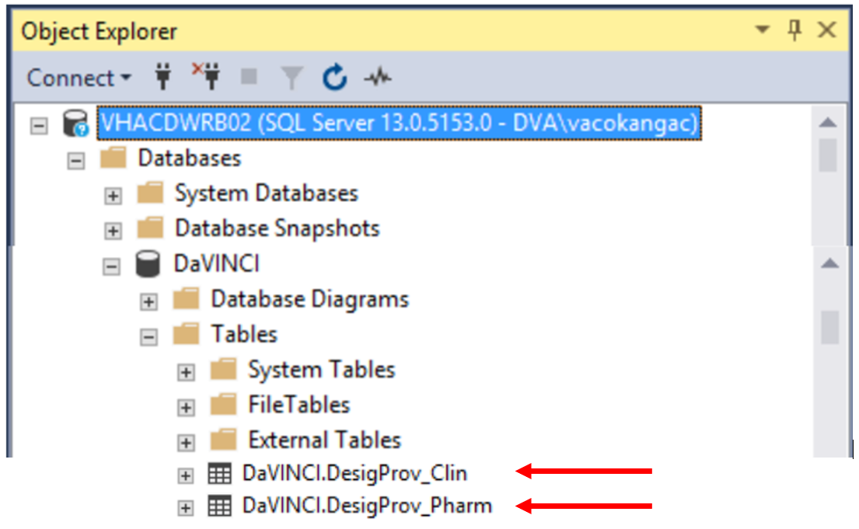
Table Location in DaVINCI
Location of Designated Provider Tables in DaVINCI:
VHACDWRB02 \ Databases \ DaVINCI \ Tables \ DaVINCI.DesigProv_Clin & DaVINCI.DesigProv_Pharm

Slide 7
Designated Provider pharmacy
Claims for medications are also in DaVINCI, with common pharmacy related fields available including:
NDC (National Drug Code)
Quantity Dispensed
Days Supply
Prescribing Provider

Slide 8
What’s in the TMDS Tables
Theater Medical Data Store
TMDS is a relational database with separate tables for encounters, diagnoses, medications, symptoms, vitals signs, services, etc.
MDR processing combines many of the tables into two tables:
Encounter level
Medication level
Fields: EDIPI, Name, Dates of Care, Procedure and Diagnosis Codes, Service, Theater location, vitals (BP, pulse ox, temperature, etc.)
Potential Uses: To complete the health history of ADSM who have deployed.
Refresh Frequency: Monthly on the MDR; Quarterly on DaVINCI
Comment: An important component to understand the full healthcare of Active Duty service members.

Slide 9
Table Location in DaVINCI
Location of Theater Medical Data Store Tables in DaVINCI:
TMDS data is still ‘in the mail’; waiting for DoD to send it over to VINCI via the approved SFTP path

Slide 10
Theater data by source and Top Sites
Source System | Encounters
AHLTA-T | 1,582,285
CHCSTC2 | 10,605
JPTA | 9,663
SAMS8 | 4,641
TRAC2ES | 19,048
Site | Encounters
379TH EMDG AL UDEID | 164,940
380TH EMDG (AL DHAFRA) | 95,928
USMHK ROLE 3 | 83,489
386TH EMDG (ALI AL SALEM) | 64,380
CRAIG JOINT THEATER HOSPITAL (BAGRAM) | 57,604
TMC BUEHRING (21ST CSH) | 51,033
USS HARRY S. TRUMAN (CVN 75) | 50,800
USS CARL VINSON (CVN 70) | 44,641
USS DWIGHT D EISENHOWER | 37,796
USS GERALDFORD CVN78 | 34,061
USS STENNIS | 32,033
USS RONALD REAGAN | 30,494
ASG-KUWAIT TMC (ARIFJAN) | 27,729
USS THEODORE ROOSEVELT CVN-71 | 26,786
USS NIMITZ (CVN 68) | 26,416
CAMP AS SAYLIYAH TROOP MEDICAL CLINIC | 25,177

Slide 11
Top Diagnoses in TMDS
Dx Code | Description | Records
V705 9 | DoD Separation Exam | 172,282
7242 | Lumbago | 47,800
71946 | Unspecified knee pain | 39,345
DOD0212 | ASSESS,POST-DEPLY DD2796 | 30,466
71941 | Unspecified shoulder pain | 28,183
4659 | Acute upper respiratory infections of unspecified site | 25,912
Z0289 | Encounter for other administrative examinations | 18,017
5589 | Noninfectious gastroenteritis and colitis | 16,191
7295 | Pain in limb | 16,078
460 | Acute nasopharyngitis | 14,928
7048 | Other specified diseases of hair and hair follicles | 14,811
78055 | Disruption of 24 hour sleep wake cycle, unspecified | 12,385
V7260 | Laboratory examination, unspecified | 11,224
7231 | Cervicalgia | 11,126
84500 | Sprains and strains of ankle and foot | 10,588

Slide 12
Procedure codes in TMDS
Unfortunately, CPT codes in theater data are very poorly populated (99.9% null)
There is virtually no data quality discipline for theater entry of these data
Navy seems to be doing better at data quality on shipboard care, and the data supports the Navy uses TMIP-maritime (their package for AHLTA-T and TMDS) for recording some clinical information

Slide 13
Questions

