Slide 1
Data Linkages for DaVINCI

Slide 2
Objectives
Describe patient identifier linkages.
Identify linking methodologies for direct care data.
Describe

Slide 3
Patient Linkages

Slide 4
Patient Linkages
While the EDIPN is the official identifier for DoD beneficiaries, there are systems that were not built to rely upon EDIPN.
CHCS uses the CHCS Host + Patient IEN.
  This is the only patient identifier that is always populated in CHCS data.
  This field is not available outside of CHCS.
  CHCS also has an EDIPN and an SSN when the patient has one..
AHLTA/CDR uses the CDR Unit ID.
  This is based off of Sponsor Social SSN and the patient’s relationship to sponsor.
  This field is corrupt; it not unique.
  This is the only field that is always populated in AHLTA/CDR
  AHLTA/CDR has an EDIPN but is also corrupt. Usually only one of a person’s duplicate CDR Unit IDs will have the EDIPN.
  SSN is also available, if the patient has one.

Slide 5
Patient Linkages
Newer systems are usually built with EDIPN as the foundational person identifier.

Slide 6
Patient Linkages
MHS Genesis and Patient Identifiers
  During registration, MHS Genesis assigns person identifiers.
  Data are exchanged with DEERS so that EDIPN can be provided.
  MHS Genesis is built around the person key.
  There is a person table that contains the person key and maps to EDIPN and SSN.
  (Be sure you have a good policy on how test persons will be entered into the system prior to implementation)
  In MHS Genesis, this file is updated whenever a patient has an encounter.
    Attributes of a patient can be “stale” in the person file.
    The MHS uses DEERS to enhance the data provided from Genesis.

Slide 7
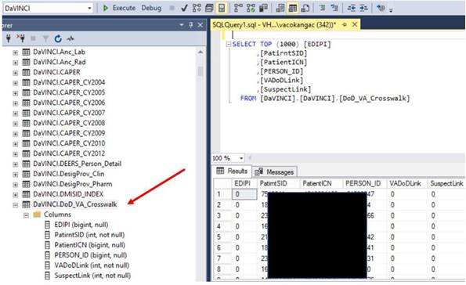
Patient Linkages
There is a DoD – VA person identifier crosswalk that is used to combine records for DaVINCI.
  EDIPN
  Patient ICN
  OMOP Person ID

Slide 8
Direct Care Linkages

Slide 9
CHCS-Based Linkages
Each CHCS Host uses sequential counters to identify individual records.
CHCS Host + Sequential Counter = Unique identifier for a record
Two very important record IDs are the:
  Appointment ID Number: Uniquely identifies a professional encounter record.
  Patient Registry Number: Uniquely identifies an inpatient admission record.
CHCS links events associated with an encounter or an inpatient admission with these identifiers.
  Lab
  Rad
  Pharmacy
  Referral
  Vitals
  Appointments
Enables analysts to track services associated with a visit or a stay

Slide 10

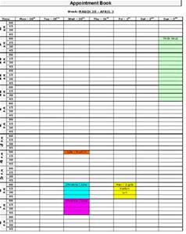







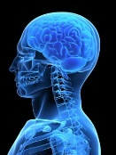
CHCS
Mom makes appointment
CHCS Appt file entry
Example: Data files prepared from operational process
CAPER
Provider sees patient
Provider orders ancillaries and documents care
Lab
Rad
Information in CHCS is generally collected in the course of doing business
Rx

Slide 11
Direct Care Linking Matrix

Slide 12
Ambulatory Events – Linking CAPERs to Other Services
General approach to retrieving CAPERs and related services:
  Retrieve CAPERs of interest, including Tmt DMIS ID and Appointment IEN.
  Query ancillary data for matching records, including only records where the Ordering DMIS ID (orddmis) and Appt record ID (apptno) from ancillary match the Tmt DMIS ID (dmisid) and appointment ID number (apptidno) from CAPER
CAPER
Ancillary
=

Slide 13
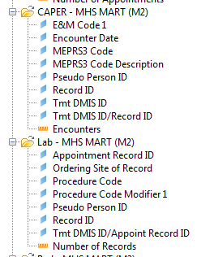

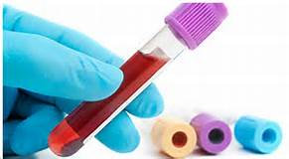

Ambulatory Events – Linking CAPER to Labs
Record ID = Appt IEN
Appointment Record ID = Appt IEN where lab was ordered

Slide 14
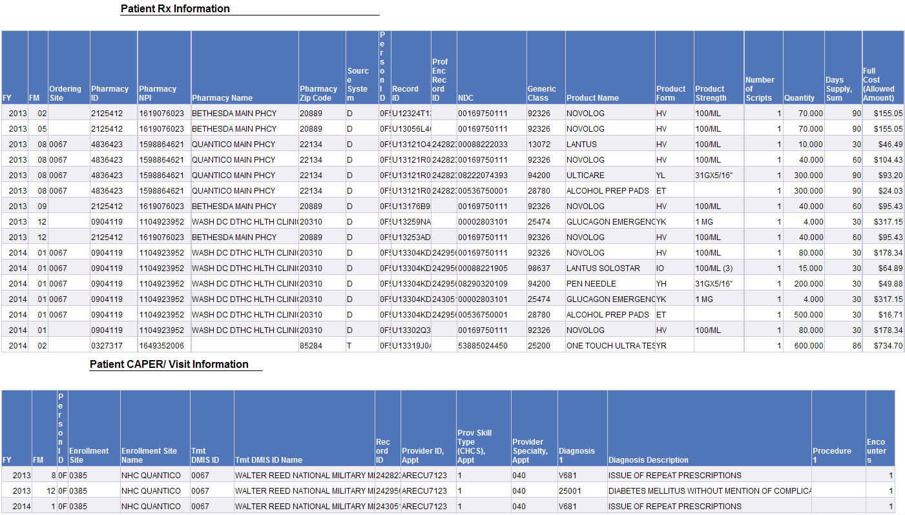
CAPER and PDTS Link

Slide 15
Example of Linked Data
Newborn at an MTF
SIDR
MSDRG | Description | Admission Date | Disposition Date
792 | NEONATE, BIRTHWT >2499G, W/O SIGNIF O.R. PROC, W OTHER PROB | 4/5/16 | 4/6/16
CAPER
DX1 | Description | CPT_4 | Description | MEPRS Code | Description | Encounter Date
Z3800 | SINGLE LIVEBORN INFANT, DELIVERED VAGINALLY | 54150 | CIRCUMCISION, CLAMP/DEVICE/RING BLOCK | AGHA | FAMILY PRACTICE NEWBORN NURSERY | 4/6/16

Slide 16
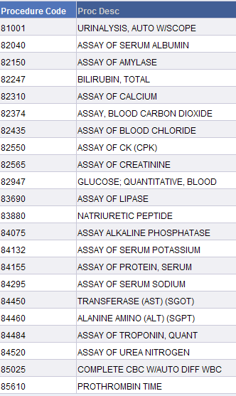



Example of Linked Data
Linked Labs
Emergency Room Visit at an MTF
CAPER
Linked Rads

Slide 17
CDR Linkages

Slide 18
CDR Linkages
Besides linking the CDR data to other MTF files, there are various linkages between the CDR data types
Two main “helper” files are the CDR Patient and CDR Appointment files which allow CDR data to be linked to data from CHCS and other systems
The Patient file can be merged by the Unit Number, called CDR_PATIENT_ID in the MDR
  For the most part, this merge has already been done in the files available in MDR PUB
There are lots of complicated linkages within the CDR, but in the MDR, most of the linking has already been done for you

Slide 19
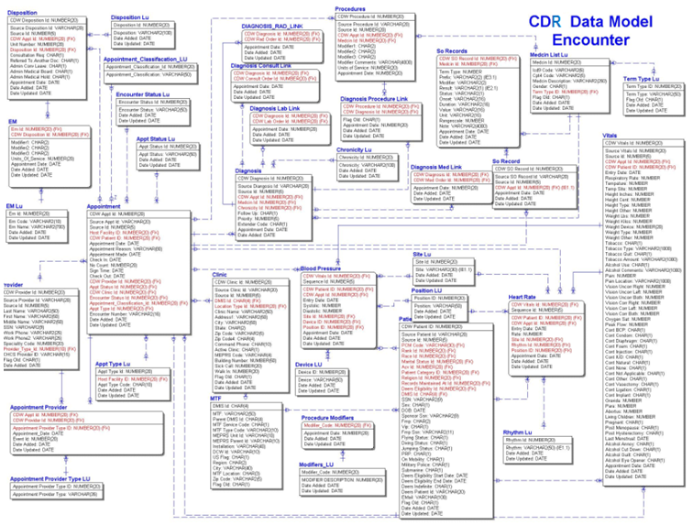
CDR Data Model

Slide 20
CDR Linkages
All three lab files (Chemistry, Microbiology, Pathology) have a LAB_ORDER_ID, but information from the CDR Lab Orders file has already been appended to these files
Microbiology can be linked to the Susceptibility results using the MICRO_EVENT_ID
Pathology can be linked to additional CPT codes using the PATH_EVENT_ID
Medication Orders and Fills can be linked using the MED_ORDER_ID
There is also a CDR_PROVIDER_ID on many of the files, but it does not link to anything

Slide 21
Example of Linked Data
Metabolic Panel and Other Labs
Chemistry Results
Ancillary File
Lab Test Name | Result LOINC | Result LOINC Name | Result Numeric | Result Text
CMP W/GFR | 1751-7 | ALBUMIN:MCNC:PT:SER/PLAS:QN: | 2.8 | 2.8
CMP W/GFR | 1975-2 | BILIRUBIN:MCNC:PT:SER/PLAS:QN: | 0.2 | 0.2
CMP W/GFR | 17861-6 | CALCIUM:MCNC:PT:SER/PLAS:QN: | 8.2 | 8.2
CMP W/GFR | 2028-9 | CARBON DIOXIDE:SCNC:PT:SER/PLAS:QN: | 27 | 27
CMP W/GFR | 2075-0 | CHLORIDE:SCNC:PT:SER/PLAS:QN: | 100 | 100
CARDIAC PANEL | 2157-6 | CREATINE KINASE:CCNC:PT:SER/PLAS:QN: | 341 | 341
CARDIAC PANEL | 13969-1 | CREATINE KINASE.MB:MCNC:PT:SER/PLAS:QN: | 1.4 | 1.4
CARDIAC PANEL | 20569-0 | CREATINE KINASE.MB/CREATINE KINASE.TOTAL:CFR:PT:SER/PLAS:QN: | 0.4 | 0.4
CMP W/GFR | 2160-0 | CREATININE:MCNC:PT:SER/PLAS:QN: | 2.1 | 2.1
CMP W/GFR | 2345-7 | GLUCOSE:MCNC:PT:SER/PLAS:QN: | 218 | 218
MAGNESIUM | 19123-9 | MAGNESIUM:MCNC:PT:SER/PLAS:QN: | 2.4 | 2.4
CMP W/GFR | 6768-6 | ALKALINE PHOSPHATASE:CCNC:PT:SER/PLAS:QN: | 74 | 74
PHOSPHORUS | 2777-1 | PHOSPHATE:MCNC:PT:SER/PLAS:QN: | 3.2 | 3.2
CMP W/GFR | 2823-3 | POTASSIUM:SCNC:PT:SER/PLAS:QN: | 4.7 | 4.7
CMP W/GFR | 2885-2 | PROTEIN:MCNC:PT:SER/PLAS:QN: | 6 | 6
CMP W/GFR | 2951-2 | SODIUM:SCNC:PT:SER/PLAS:QN: | 133 | 133
CMP W/GFR | 1920-8 | ASPARTATE AMINOTRANSFERASE:CCNC:PT:SER/PLAS:QN: | 33 | 33
CMP W/GFR | 1742-6 | ALANINE AMINOTRANSFERASE:CCNC:PT:SER/PLAS:QN: | 44 | 44
CARDIAC PANEL | 10839-9 | TROPONIN I.CARDIAC:MCNC:PT:SER/PLAS:QN: | . | <0.015
CMP W/GFR | 3094-0 | UREA NITROGEN:MCNC:PT:SER/PLAS:QN: | 35 | 35
CMP W/GFR | 3097-3 | UREA NITROGEN/CREATININE:MCRTO:PT:SER/PLAS:QN: | 16.7 | 16.7
CMP W/GFR | 1863-0 | ANION GAP 4:SCNC:PT:SER/PLAS:QN: | 11 | 11
CMP W/GFR | 18182-6 | OSMOLALITY:OSMOL:PT:SER/PLAS:QN:CALCULATED | 281 | 281
CMP W/GFR | 33914-3 | GLOMERULAR FILTRATION RATE/1.73 SQ M.PREDICTED:ARVRAT:PT:SER/PLAS:QN:C | 25 | 25
CPT | Description
82040 | ASSAY OF ADP & AMP
82247 | BILIRUBIN, TOTAL
82310 | ASSAY OF CALCIUM
82374 | ASSAY, BLOOD CARBON DIOXIDE
82435 | ASSAY OF BLOOD CHLORIDE
82550 | ASSAY OF CK (CPK)
82553 | CREATINE, MB FRACTION
82565 | ASSAY OF CREATININE
82947 | GLUCOSE; QUANTITATIVE, BLOOD
83735 | ASSAY OF MAGNESIUM
84075 | ASSAY ALKALINE PHOSPHATASE
84100 | ASSAY OF PHOSPHORUS
84132 | ASSAY OF SERUM POTASSIUM
84155 | ASSAY OF PROTEIN, SERUM
84295 | ASSAY OF SERUM SODIUM
84450 | TRANSFERASE (AST) (SGOT)
84460 | ALANINE AMINO (ALT) (SGPT)
84484 | ASSAY OF TROPONIN, QUANT
84520 | ASSAY OF UREA NITROGEN

Slide 22
Example of Linked Data
Urinalysis
Ancillary File
CPT | Description
81001 | URINALYSIS, AUTO W/SCOPE
Chemistry Results
Lab Test Name | Result LOINC | Result LOINC Name | Result Name HDD | Result Numeric | Result Text
URINALYSIS W/MICROSCOPIC | 5803-2 | PH:LSCNC:PT:URINE:QN:TEST STRIP | PH | 5.5 | 5.5
URINALYSIS W/MICROSCOPIC | 2965-2 | SPECIFIC GRAVITY:RDEN:PT:URINE:QN: | SPECIFIC GRAVITY | 1.012 | 1.012
URINALYSIS W/MICROSCOPIC | 25145-4 | BACTERIA:ACNC:PT:URINE SED:ORD:MICROSCOPY.LIGHT | BACTERIA | . | NONE
URINALYSIS W/MICROSCOPIC | 5778-6 | COLOR:TYPE:PT:URINE:NOM: | COLOR | . | LIGHT-YELLOW
URINALYSIS W/MICROSCOPIC | 5792-7 | GLUCOSE:MCNC:PT:URINE:QN:TEST STRIP | GLUCOSE | . | NEGATIVE
URINALYSIS W/MICROSCOPIC | 5797-6 | KETONES:MCNC:PT:URINE:QN:TEST STRIP | KETONES | . | NEGATIVE
URINALYSIS W/MICROSCOPIC | 5799-2 | LEUKOCYTE ESTERASE:ACNC:PT:URINE:ORD:TEST STRIP | LEUKOCYTE ESTERASE | . | NEGATIVE
URINALYSIS W/MICROSCOPIC | 5804-0 | PROTEIN:MCNC:PT:URINE:QN:TEST STRIP | PROTEIN | . | NEGATIVE
URINALYSIS W/MICROSCOPIC | 5802-4 | NITRITE:ACNC:PT:URINE:ORD:TEST STRIP | NITRITE | . | NEGATIVE
URINALYSIS W/MICROSCOPIC | 11277-1 | EPITHELIAL CELLS.SQUAMOUS:NARIC:PT:URINE SED:QN:MICROSCOPY.LIGHT.HPF | EPITHELIAL CELLS SQUAMOUS | . | NONE
URINALYSIS W/MICROSCOPIC | 13945-1 | ERYTHROCYTES:NARIC:PT:URINE SED:QN:MICROSCOPY.LIGHT.HPF | RBC | 1 | 1
URINALYSIS W/MICROSCOPIC | 5821-4 | LEUKOCYTES:NARIC:PT:URINE SED:QN:MICROSCOPY.LIGHT.HPF | WBC | . | <1
URINALYSIS W/MICROSCOPIC | 20505-4 | BILIRUBIN:MCNC:PT:URINE:QN:TEST STRIP | BILIRUBIN | . | NEGATIVE
URINALYSIS W/MICROSCOPIC | 20405-7 | UROBILINOGEN:MCNC:PT:URINE:QN:TEST STRIP | UROBILINOGEN | . | <2.0
URINALYSIS W/MICROSCOPIC | 32167-9 | CLARITY:TYPE:PT:URINE:NOM: | CLARITY | . | CLEAR
URINALYSIS W/MICROSCOPIC |  |  | BLOOD | . | NEGATIVE

Slide 23
Example of Linked Data
Chest X-Ray
Ancillary File
CPT | Description
71010 | CHEST X-RAY
Radiology Results
Rad Type | Result Text
CHEST (PA VIEW) SERIES REPORT | PA CHEST ^COMPARISON: NONE AVAILABLE ^FINDINGS: THE LUNGS AND PLEURAL ARE CLEAR. THE HEART, MEDIASTINUM, AND BONY THORAX ARE A… (truncated)

Slide 24
Example of Linked Data
Visit to Primary Care Clinic for Anxiety
CAPER
DX1 | Description | CPT_4 | Description | MEPRS Code | Encounter Date
F419 | ANXIETY DISORDER, UNSPECIFIED | 90836 | PSYCHOTHERA,45MIN,PAT&/FAM,E&M | BHA2 | 2/15/16
Vitals
Temperature (°F) | Height (in.) | Weight (lbs.) | Systolic BP (mm Hg) | Diastolic BP (mm Hg) | Heart Rate (/min.) | Appointment Date
98.0 | 64 | 133 | 115 | 77 | 73 | 2/15/16
PDTS
Product Name (use) | NDC | Product Strength | Days Supply | Date Dispensed
EFFEXOR XR (antidepressant) | 00008083302 | 75 MG | 45 | 2/15/16
BUSPIRONE HCL (anti-anxiety) | 00378115005 | 10 MG | 30 | 2/15/16
PROPRANOLOL HCL (beta blocker) | 00591555510 | 20 MG | 45 | 2/15/16
CDR Medication
Orders
NDC | Give Amount | Units | Duration | Medication Order Date | Order ID
00008083302 | 75 | MG | 45 | 2/15/16 | XXX
00378115005 | 10 | MG | 30 | 2/15/16 | YYY
00591555510 | 20 | MG | 45 | 2/15/16 | ZZZ
CDR Medication Fills
Order ID | Dispense Date
XXX | 2/15/16
YYY | 2/15/16
ZZZ | 2/15/16

Slide 25
Purchased Care Linkages

Slide 26
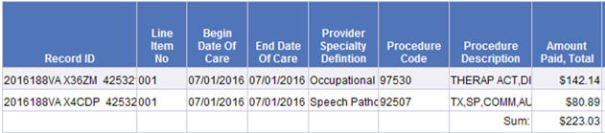
Purchased Care
Purchased care records come in as claims.
When more than one provider of care is involved in an event, each provider is paid separately and there is no indication that the claims when together to form an event.
Building episodes of care is an art rather than a science.
The only episode building the MHS does is inpatient acute care episodes.

Slide 27
Inpatient Purchased Care
Purchased Care:
  Data element “Admitting TED Number” can be used to link all claims related to an acute care stay
TED Institutional contains the facility bill(s)
  There can be more than one record per stay. Rare with acute care.
  Diagnosis, procedures, etc. from hospital perspective.
TED Non-Institutional contains other bills.
  Lab and pharmacy information usually N/A because part of DRG payments.
Admitting TED Number contains the “TED Number” of the admission record.

Slide 28
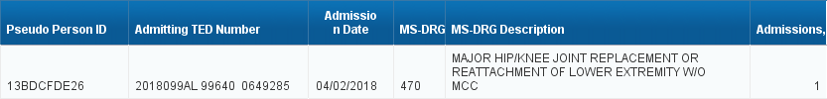
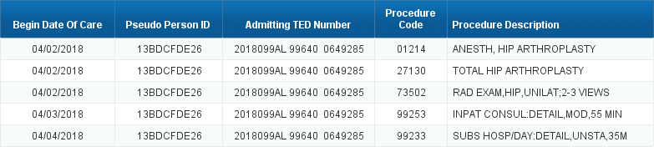
Admitting TED Number

Slide 29
Caveats
Sometimes an acute stay will have a non-acute component to it.
  The Admitting TED Number will not incorporate that part of a stay.
  Example: Patient is treated for a stroke, then goes to a rehab facility.
  This information could be obtained by retrieving records for persons with inpatient stays beyond the period of stay.
There are also entirely non-acute stays which the admitting TED number does not address.
  i.e. mental health institutions
Resource Sharing stays are not included. For those, there will be an institutional TED record but a CAPER to indicate the professional service.

