Slide 1
Pharmacy Data
Veronika Pav
Kennell & Associates, Inc

Slide 2
Objectives
Describe the data source of Pharmacy Data Transaction Service (PDTS).
Properly use common terms in PDTS.
Properly use pharmacy specific terms in PDTS.
Describe other sources of pharmacy data available.

Slide 3
TRICARE Pharmacy
Pharmacy is one of the most important product lines in the MHS.
Information about the TRICARE pharmacy benefit can be found at:
  http://www.tricare.mil/pharmacycosts.
Almost all of the pharmacy data in PDTS represents care that was paid for by the MHS.
  The VA uses PDTS for Drug Utilization Review for dual VA/DoD eligible beneficiaries. (This care is not funded by the DHP.)
  VA Pharmacies reported more than 6.6 million prescriptions to date in FY18.
  Best guess at finding DoD/VA Dual Eligibles.
PDTS is an operational centralized database system that provides a comprehensive patient medication profile for each DoD beneficiary from multiple sources system that does a drug utilization review.
  Provides a weekly data feed to MDR

Slide 4
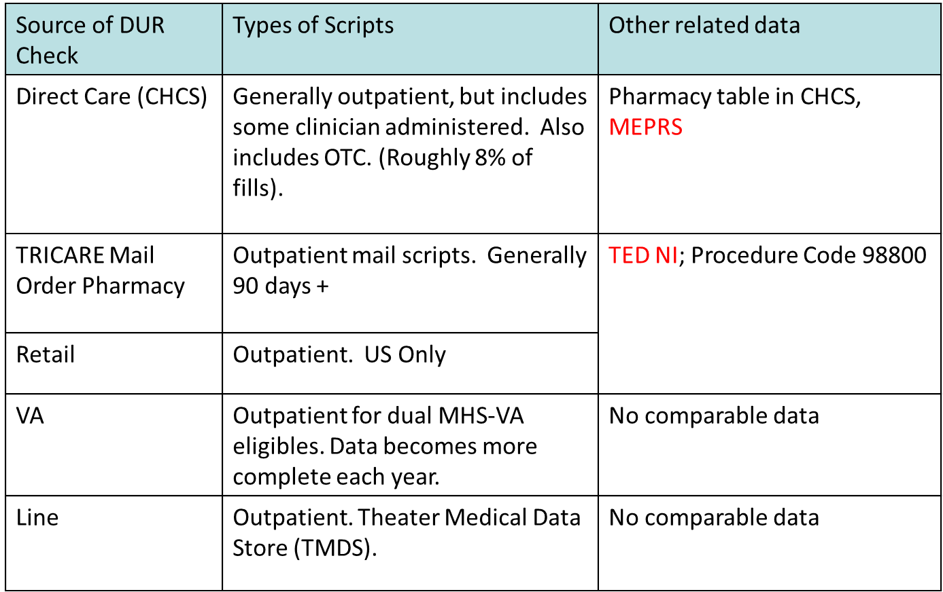
Data Sources in PDTS

Slide 5
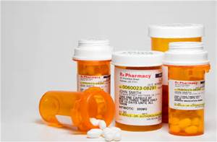
PDTS File
Pharmacy Data Transaction Service (PDTS)
  Record: Each record represents a filled outpatient prescription.
    Record ID: Authorization Number (AUTHNUM)

Slide 6
PDTS Data Elements
Robust set of common terms in PDTS data
Record ID: PDTS Authorization Number (AUTHNUM)
Issue Date (DATEDISP):
  Represents date of PDTS DUR query. This is usually the date of issue, but may not be for refills.
  FY/FM and CY/CM are based on Issue Date.
Geography available for patient, pharmacy and provider (prescriber)
  Catchment Area, PRISM Area, etc.

Slide 7
PDTS Data Elements
Source System:
  Indicates fill location
  D: Direct Care
  M: Retail Pharmacy (MCSC)
  T: Mail Order Pharmacy
  V: Veterans Health Administration (since FY 2006)
  C: Direct Care, clinician administered, but not an outpatient prescription.
  R: Theater Medical Data Store (TMDS)/Line Unit (since FY 2011)
Will be used often! Remember this one!

Slide 8
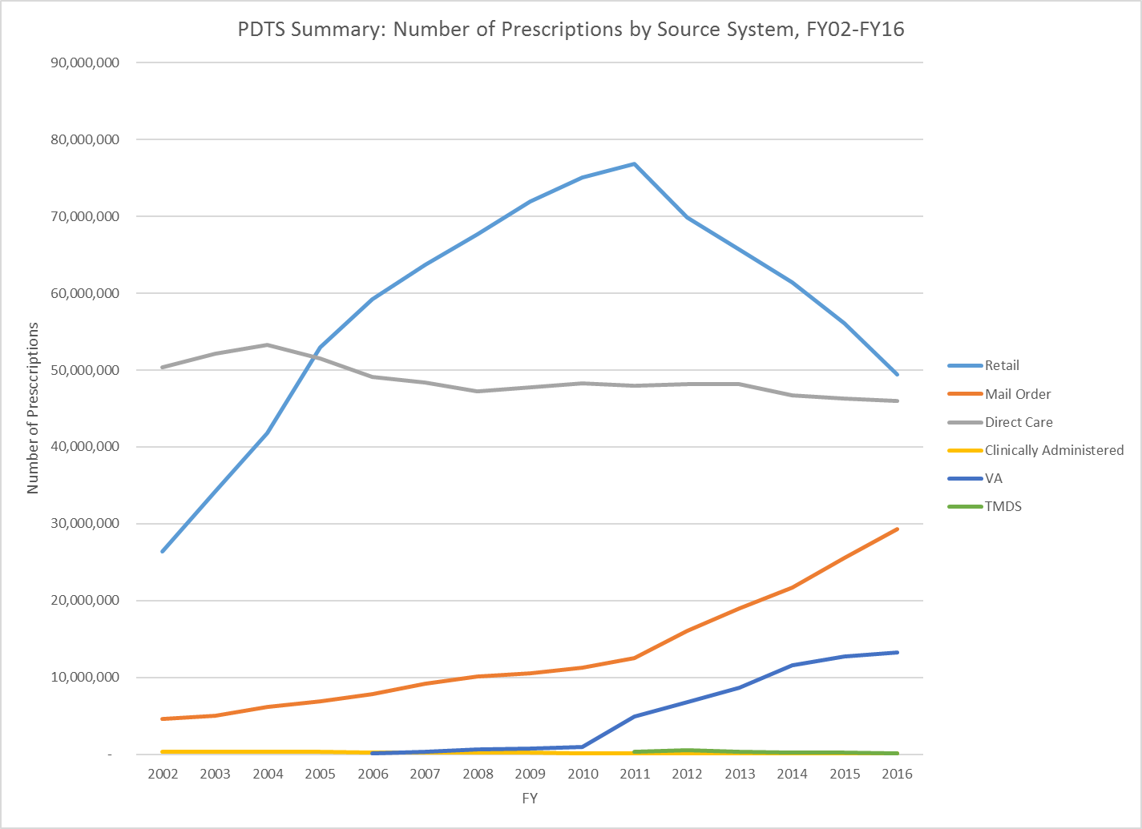
Number of Prescriptions by Year and Source
Retail (M) is by far the most expensive fill location

Slide 9
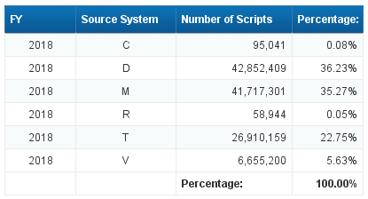
PDTS Source System: Number of Scripts

Slide 10
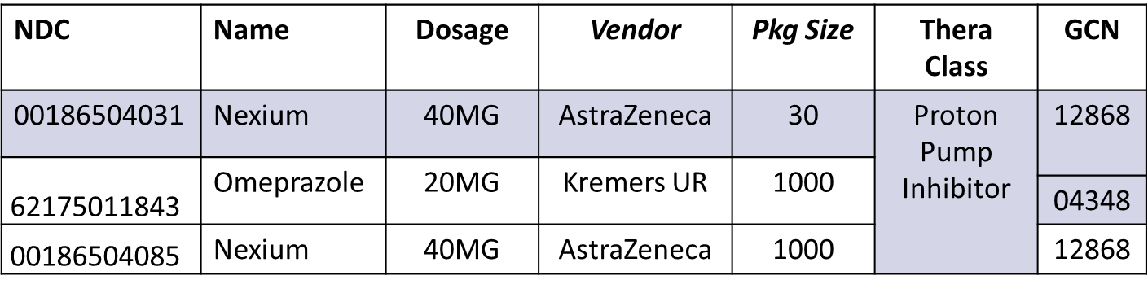
Data About the Drug Dispensed
National Drug Code (NDC):
  Most granular; no ref table!
  Indicates drug, dosage, package size and vendor.
Generic Class (GCN):
  Grouping into category of all drugs that are of the same generic equivalent
    No Reference Table Available!
Therapeutic Class (THERCLSS):
  Grouping based on therapeutic effect; DD Appendix

Slide 11
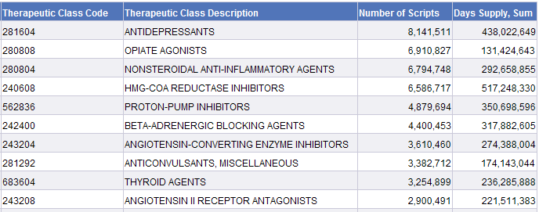
Top 10 Therapeutic Class Codes (all sources)
Notes:
Top ANTIDEPRESSANT is SERTRALINE HCL (Zoloft)
Top OPIATE AGONIST is HYDROCODONE-ACETAMINOPHEN (Vicodin)
Top NONSTEROIDAL ANTI-INFLAMMATORY AGENT is IBUPROFEN (Advil)
Top HMG-COA REDUCTASE INHIBITOR is ATORVASTATIN CALCIUM (Lipitor)
Top PROTON-PUMP INHIBITOR is OMEPRAZOLE (Prilosec)
Top BETA-ADRENERGIC BLOCKING AGENT is METOPROLOL SUCCINATE (Toprol)
Top ANGIOTENSIN-CONVERTING ENZYME INHIBITOR is LISINOPRIL (Prinivil)
Top ANTICONVULSANT, MISCELLANEOUS is GABAPENTIN (Neurontin)
Top THYROID AGENT is LEVOTHYROXINE SODIUM (Synthroid)
Top ANGIOTENSIN II RECEPTOR ANTAGONIST is LOSARTAN POTASSIUM (Cozaar)

Slide 12

PDTS Data Elements
Product Name: Name of drug (all caps)
Quantity: # Units Dispensed
Days Supply:
  Doesn’t make sense for all medications. (i.e. take as needed)
  Sometimes unreliable for direct care; depends on how the prescription is ordered. (may default to 30 days)
Product Form: Tablet, Inhalant, etc.
Product Strength: Dosage
Refill Number:
  00=Initial Fill; 01=First Refill, etc

Slide 13
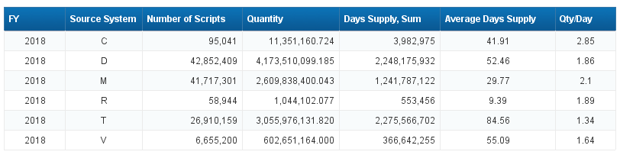
Days Supply and Quantity by Source System
Note the differences in number of days per script in the different fill locations
Mail order prescriptions tend to be more long term fills.
Let’s look at VA Source System a little bit more….

Slide 14
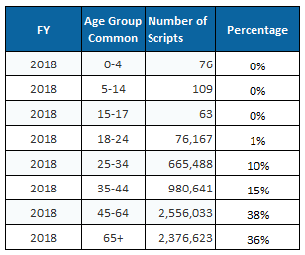
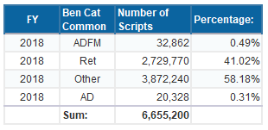
Source System: VA

Slide 15
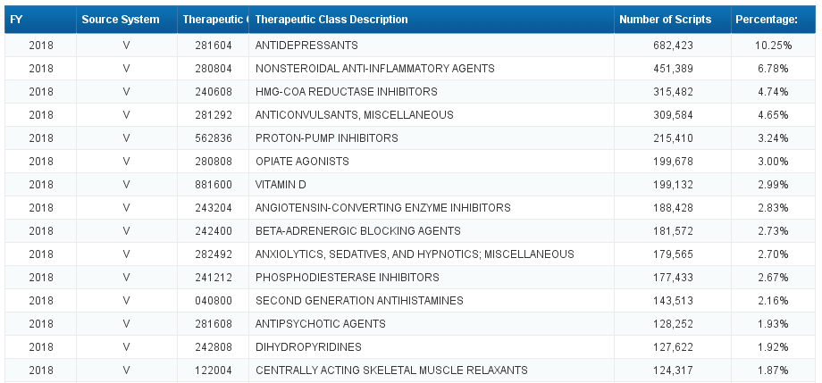
Source System: VA

Slide 16
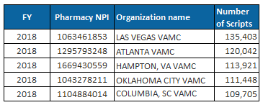
Source System: VA
Top Pharmacy NPIs

Slide 17
PDTS Data Elements
Generic Indicator (GENIND):
  Tells whether or not a generic equivalent was available.
  Values :
    M = Multi source brand
    N = Single source brand
    O = Originator brand
  (only on claims prior to 5/1/15)
    Y = Generic
    X = Non-drug items
      (only on claims prior to 5/1/15)
    blank = undetermined.
Dispensed as Written Indicator (DAW):
  Indicates that the pharmacy cannot make substitutions.
Number of Scripts
  Include this element to count prescriptions. Is 1 on all records.

Slide 18
PDTS Data Elements
Data about the pharmacy
Treatment DMISID: Just for direct care.
Pharmacy ID (NCPDPNUM):
  National Council for Prescription Drug Plan Identifier
  Sometimes useful in identifying smaller entities within a DMISID (MTF Only).
Pharmacy Name
  Only populated for MTFs.
    Not Populated for Source System VA
Pharmacy National Provider ID (SITENPI):
    Populated for Source System VA

Slide 19
PDTS Data Elements
Data about the prescriber:
DEA Number:
  This data element historically contained DEA Number, but now generally contains the prescriber’s NPI.
  Populated for both direct and purchased care fills.
  Can look up at in NPPES File.
  Particularly helpful if trying to link fills to orders in the purchased care.

Slide 20
PDTS Data Elements
Data about the prescriber:
Ordering Information (Direct care only)
  Information from CHCS, added to PDTS file in MDR processing.
  Only populated when prescription is ordered and filled at the same CHCS host.
  Not populated on average 26% of the time for initial fills, 46% for refills.
  Ordering Site: DMISID where the prescription was ordered.
  Ordering MEPRS Code
  Prof Enc Record ID (APPTIEN): Contains Record ID of CAPER where prescription was ordered.

Slide 21
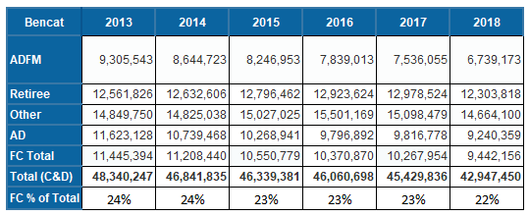
Ordering MEPRS Code
If Ordering MEPRS2 Code = “FC” then the prescription was ordered by a provider external to the MTF that issued the product.
About 62% of these prescriptions are for patients who are 65 and older.
Direct Care Prescriptions Filled By MTFs But Ordered Externally, FY 2018

Slide 22
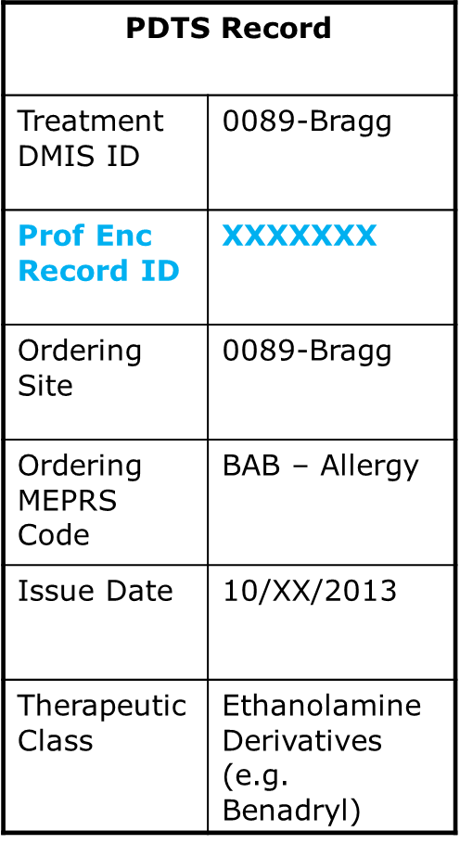
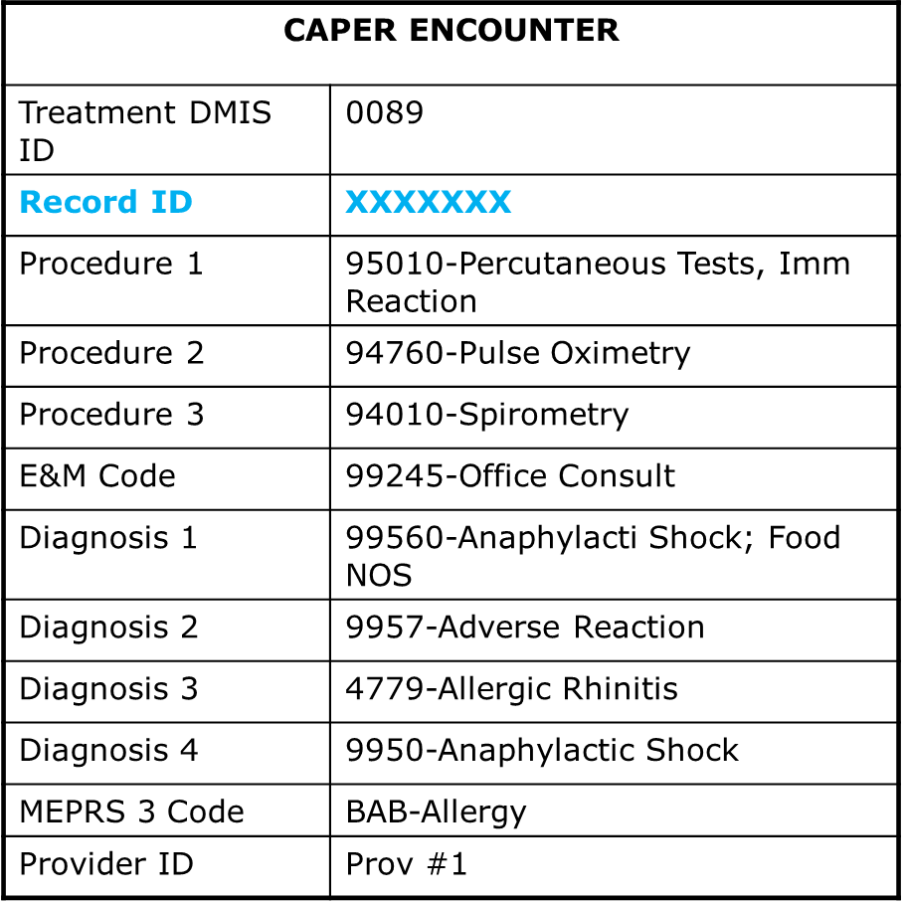
CAPER and PDTS Link

Slide 23
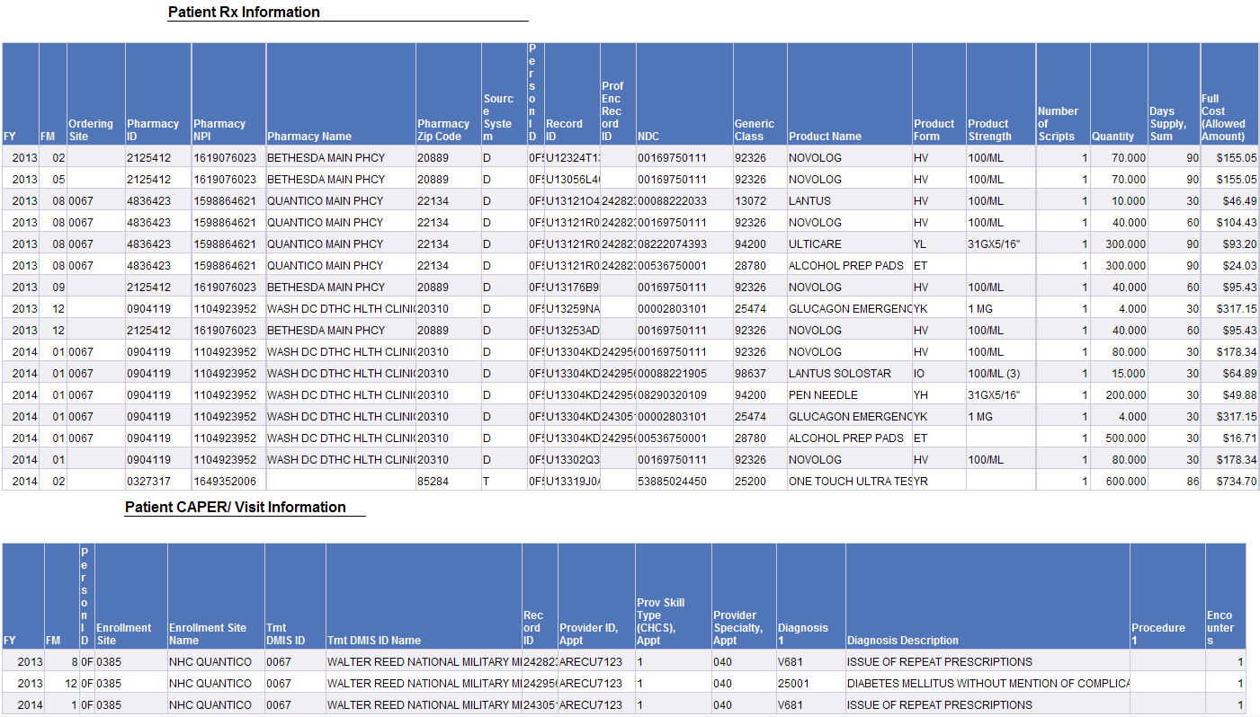
CAPER and PDTS Link
Results…

Slide 24
Caveats and Other Things to Remember
MTF Data Issues
  The NDC can sometimes be incorrect on direct care fills.
    The drug itself will usually be correct, as will the strength and product form
    Therefore, the therapeutic class and generic class will also usually be correct
    This can also cause the generic indicator to be incorrect
  Sometimes quantities are incorrect – CHCS Pharmacy Table errors.
  Sometimes days supply are incorrect – depends on the way that the scripts are ordered.

Slide 25
Pharmacy Examples
Effects of Formulary & Benefit Changes

Slide 26
Formulary Changes Example - LIPITOR
When a drug’s patent runs out, generic versions usually become available at a much lower cost and the cost of the previously brand name product also declines.
Lipitor is a good example of that.
Almost 2 million MHS Lipitor scripts in 2011.
When generic became available, Lipitor itself became much cheaper, but the generic version is even cheaper still.
Saved the MHS a considerable amount of money given the prominence of this medication.
Changed ordering patterns for providers throughout the MHS.

Slide 27
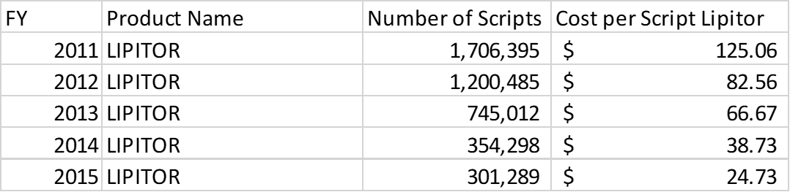
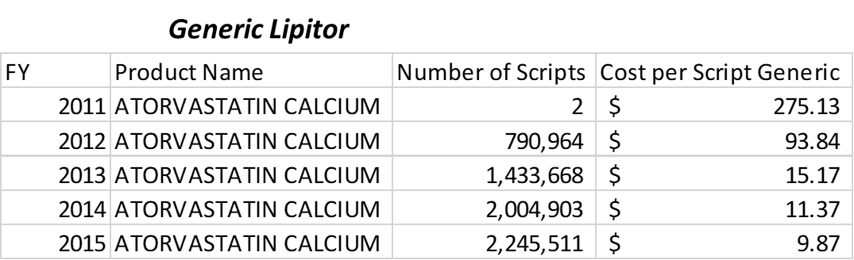
LIPITOR Example
The MHS saved nearly $200 million dollars on this one medication when it became available as a generic in FY 2012

Slide 28
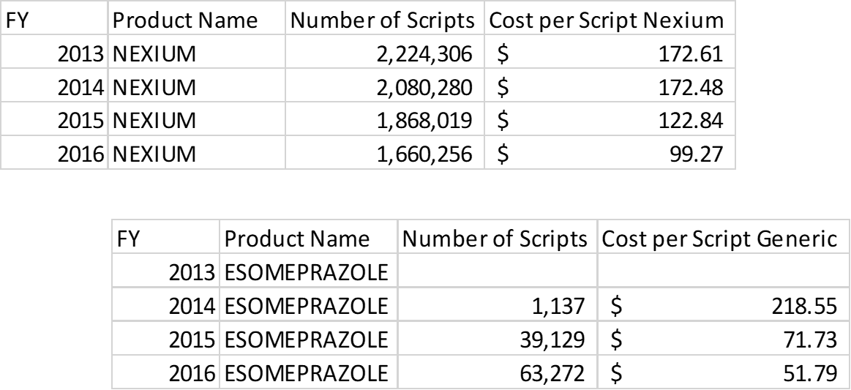
NEXIUM Example
This trend is starting to repeat itself with Nexium, another common brand name drug.
Generic Nexium

Slide 29
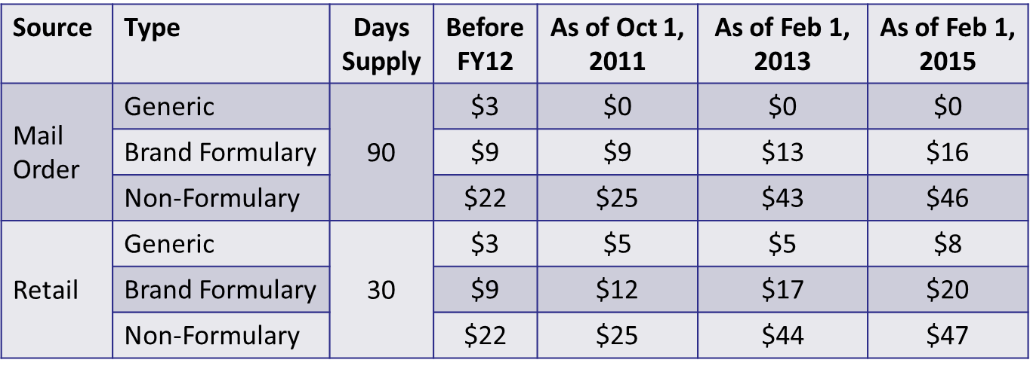
Benefit Changes
DHA has made some benefit changes with respect to pharmacy copays.
  There is no copay for direct care scripts, or for generic scripts filled through Mail Order.
  Copays for retail and for brand name drugs in mail order have increased, encouraging patients to switch to cheaper source systems
Notes:
Notice how generic fills became free in TMOP in FY12. This caused a huge shift from retail to mail order. Also, note how brand name drugs become more and more expensive compared to generic drugs.

Slide 30
Select Maintenance Drugs
Maintenance drugs make up nearly three quarters of total pharmacy spending
  Drugs taken regularly for a long time (e.g. blood pressure and cholesterol drugs)
In March 2014, DHA instituted a pilot for TFL beneficiaries, where they would be required to fill brand name maintenance drugs in TMOP or MTFs
  Patients can fill first two fills in retail before switching
  Patients with OHI with a prescription benefit, personal hardships, who live in a nursing home, or who live outside the US are excluded
  Many drugs are excluded, including those that require refrigeration, and many cancer and mental health drugs
As of October 1, 2015 (FY16), this pilot was extended to all non-ADSM beneficiaries

Slide 31
Compound Pharmacy
Compound drugs are:
  A combination of two or more drugs
  Prepared by a pharmacist (not mass produced)
  For a specific patient’s individual needs
In FY12, compound drugs made up 0.4% of total pharmacy spending
Compound drugs are typically reimbursed at billed amounts, which led to rampant abuse peaking in FY15, costing TRICARE over $1.6 billion (16% of total pharmacy spending).
The gov’t has begun prosecuting those who defrauded the system:
  http://www.wsj.com/articles/u-s-targets-pharmacies-over-soaring-claims-to-military-health-program-1447032619
  http://www.usatoday.com/story/news/nation-now/2017/01/01/phoenix-doctor-indicted-100-million-fraud-case/96072826/

Slide 32
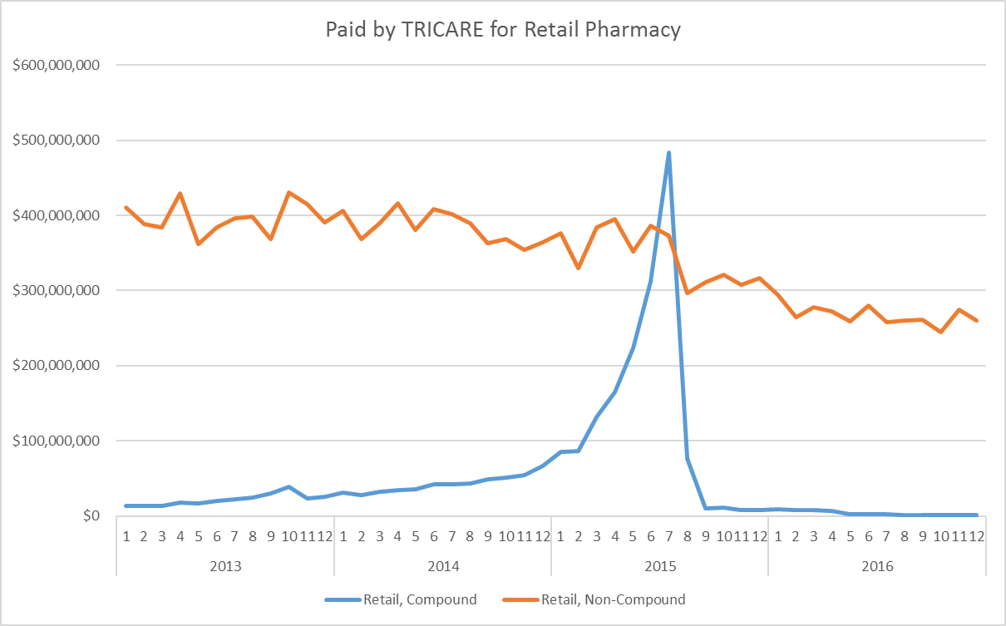
Compound Pharmacy Retail

Slide 33
Takeaways
PDTS contains only outpatient dispensed prescriptions
Contains data from many sources:
  M = Retail: most expensive, use Paid by TRICARE
  T = TMOP: often 90-day scripts, fastest growing, use Paid by TRICARE
  D = Direct Care: cheapest, use Full Cost (Allowed Amount)
  V = VA: Not paid for by DoD
  C = Clinically Administered
  R = Theater/Line
Don’t double-count when combining with other sources
Use Therapeutic Class and Product Name to identify drugs
Linkages to Ordering Information
  Direct care: Prof Enc Record ID; Ordering Site; MEPRS Code, Ordering
  DEA Number = Prescriber’s NPI

Slide 34
Questions
vpav@kennellinc.com

