Slide 1
DocuSign – ORD TPOXX Study Job aid
Last Updated: October 2022

Slide 2
CONTENTS
LOGGING IN TO DOCUSIGN
SENDING DOCUMENTS FOR SIGNATURE USING THE TEMPLATE
DELETING A WORKFLOW
21 CFR PART 11 COMPLIANT FORM COMPLETION AND SIGNING
RETRIEVING DOCUMENT

Slide 3
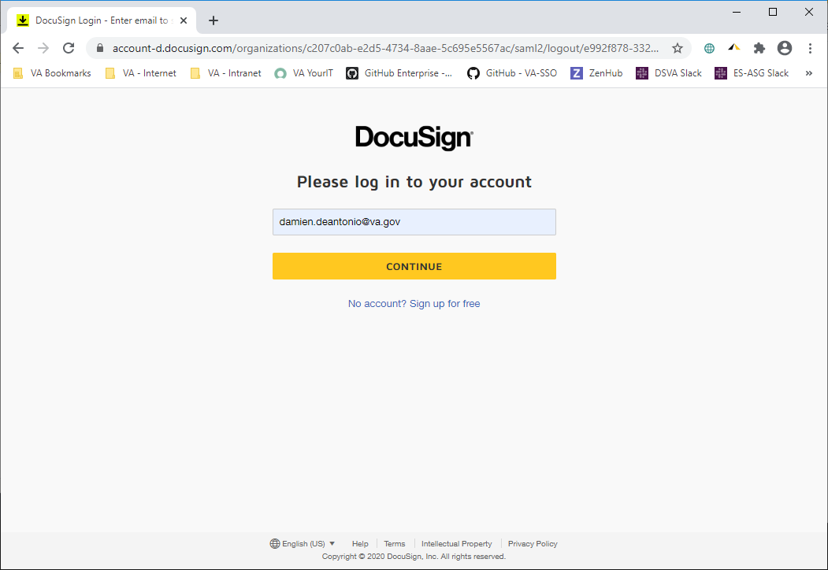
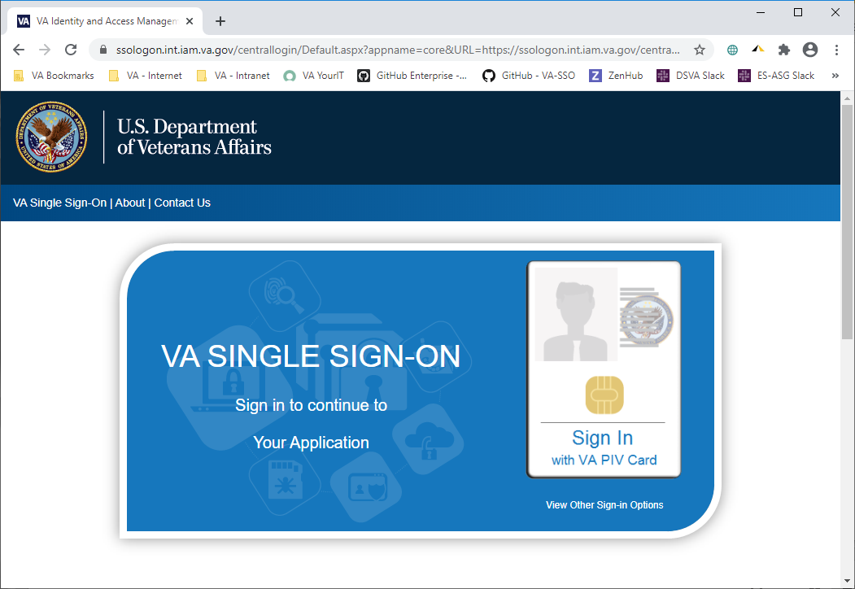
LOGGING IN TO DOCUSIGN
DocuSign Production URL: https://app.docusign.com/documents
Enter your VA email address
Click CONTINUE
You will be redirected to IAM SSOi to login with your PIV card

Slide 4
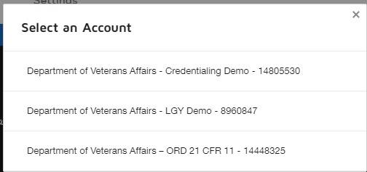
Switching your account to 21 CFR PART 11 COMPLIANT (Only if you have 2 DocuSign accounts)
Go to your Profile in the upper right corner and click the gray circle.
Click Switch Account.
Click on the “Manage” Tab to get to your inbox

Slide 5
SENDING DOCUMENTS FOR SIGNATURE USING THE TEMPLATE
Complete the steps below to send a new document for signature using a previously created template:
Go the DocuSign URL https://app.docusign.com/documents
and login
2. Click NEW on the upper left corner
3. Click Use a Template
4. Click Shared with Me, select the appropriate template and click ADD SELECTED
5. Provide the Name (first name and last name) and Email address for all recipients.
6. Click Send.

Slide 6
Sending Documents for Signature URLs
Once you have logged in successfully using the URL below:
Production URL: https://app.docusign.com/documents
You will see the DocuSign Home Screen as seen on the next slide.
YOUR DOCUSIGN ACCOUNT IS SET UP AS A 21 CFR PART 11 COMPLIANT ACCOUNT.
IF YOU ALREADY HAVE A DOCUSIGN ACCOUNT AND USE IT FOR OTHER RESEARCH STUDIES, YOU WILL HAVE TWO ACCOUNTS:
ONE IS A REGULAR ACCOUNT
THE OTHER IS THE 21 CFR PART 11 COMPLIANT ACCOUNT. *** YOU WILL NEED TO SWITCH ACCOUNTS TO SEE THE MONKEYPOX TEMPLATE FOR THE TPOXX STUDY***

Slide 7
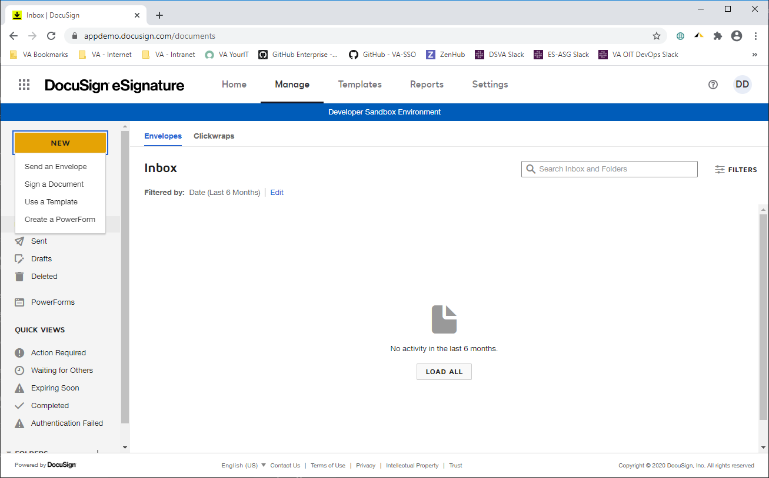
Click on the Yellow button that says ‘NEW’
Then Click on ‘Use a Template’

Slide 8
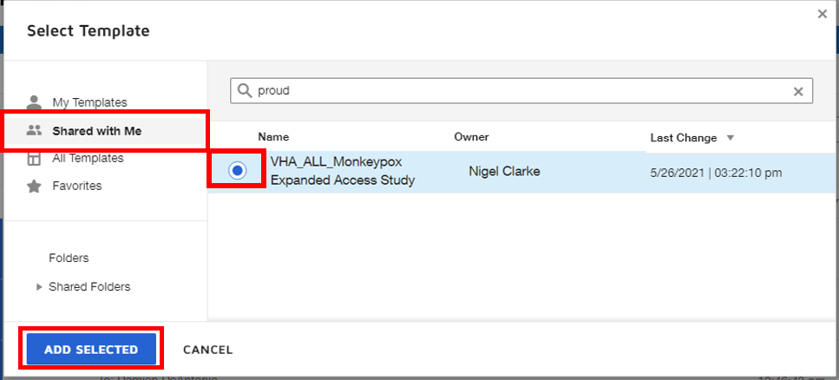
You will see the box below pop up
Select ‘Shared with me’, you will see the MonkeyPox template, select the template and they click on the ‘ADD SELECTED’

Slide 9
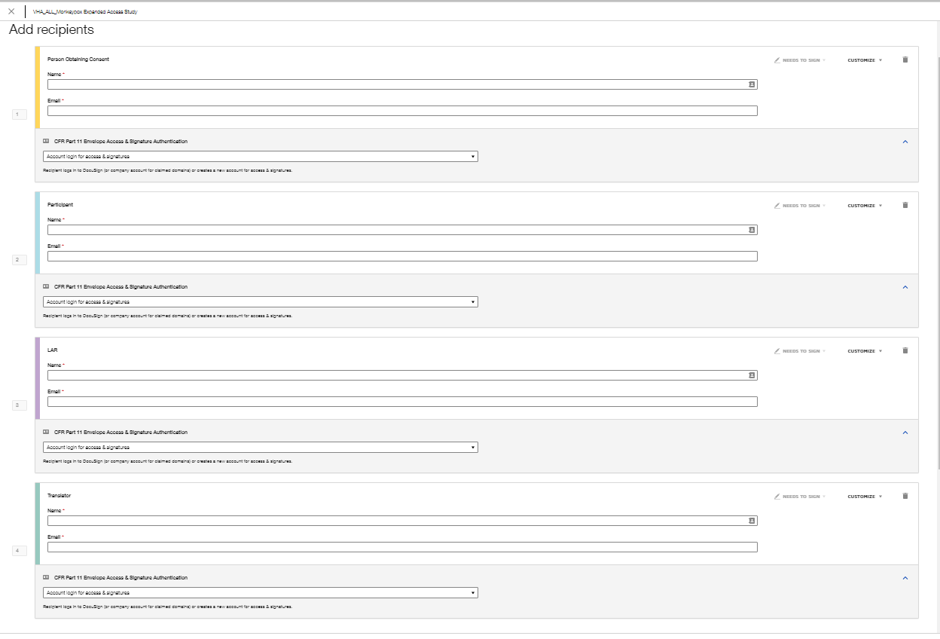
OVERVIEW OF SELECTION OPTIONS
Person Obtaining Consent (i.e. Researcher)
Participant (i.e. Veteran)
LAR (DELETE THIS OPTION IF NOT NEEDED)
Translator (DELETE THIS OPTION IF NOT NEEDED)

Slide 10
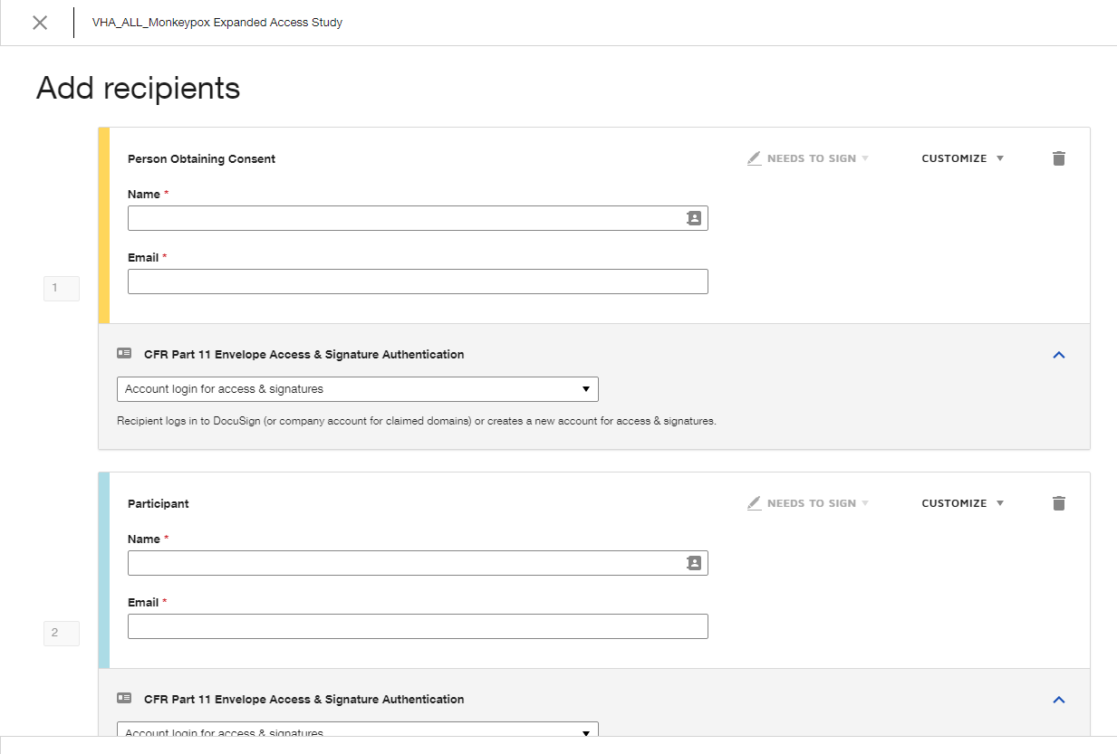
Enter Legal First Name and Last Name (of Person Obtaining Consent)
Enter Email address (of Person Obtaining Consent)
Enter Legal First Name and Last Name (of Participant)
Enter Email address (of Participant)
***NOTE: IF you will be using an LAR ROLE, DELETE THE PARTICIPANT ROLE****

Slide 11
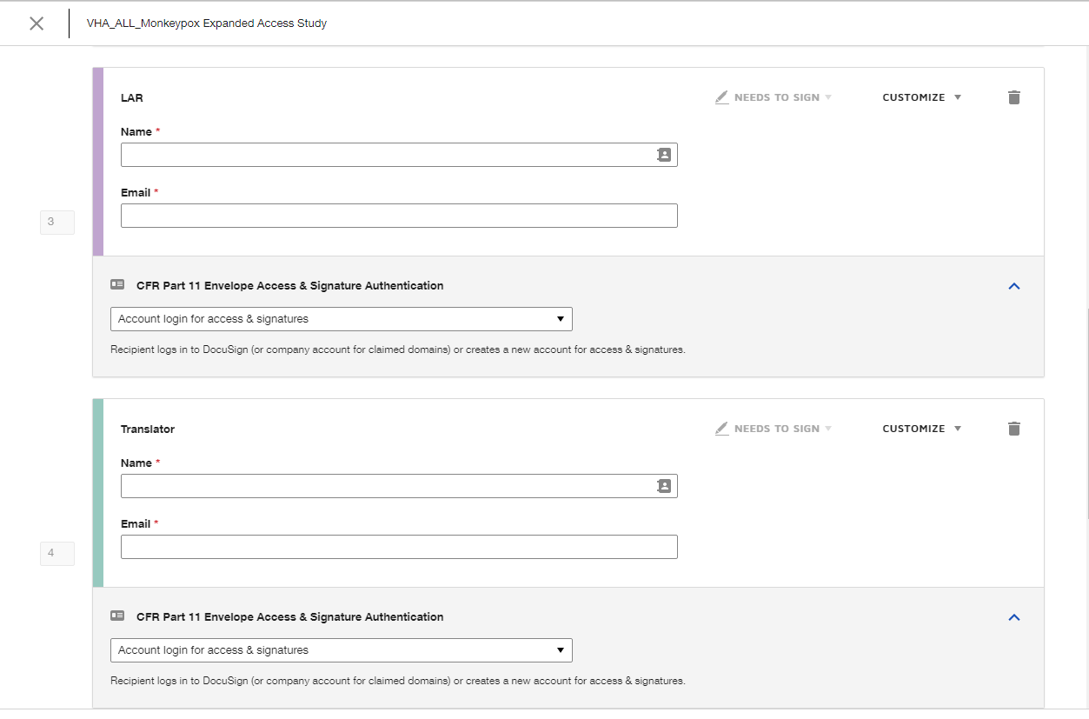
Enter Legal First Name and Last Name (of LAR)
Enter Email address (of LAR)
***NOTE: IF you will be using PARTICIPANT ROLE, DELETE THE LAR ROLE****
Enter Legal First Name and Last Name (of Translator)
Enter Email address (of Translator)
***NOTE: IF you don’t need a TRANSLATOR ROLE, DELETE THIS ROLE****

Slide 12
***For this example… we will use the PARTICIPANT ROLE
and will DELETE the LAR ROLE and the Translator Role, there should ALWAYS be a PERSON OBTAINING CONSENT ROLE****
Nigel Clarke (EXAMPLE PERSON OBTAINING CONSENT)
Nigel.Clarke@va.gov
April Primous (EXAMPLE PARTICIPANT)
April.Primous@va.gov

Slide 13
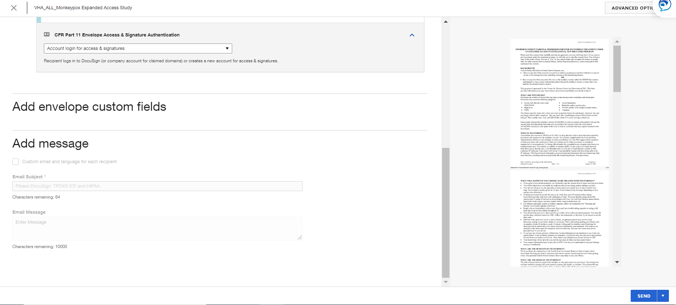
Click Send

Slide 14
MANAGE TAB:
Once the TEMPLATE is sent, the DocuSign application will take you back to the Manage tab, Sent Items folder of your DocuSign account
It will show that the Template was sent and that the current Status is waiting for other to obtain their signature(s).

Slide 15
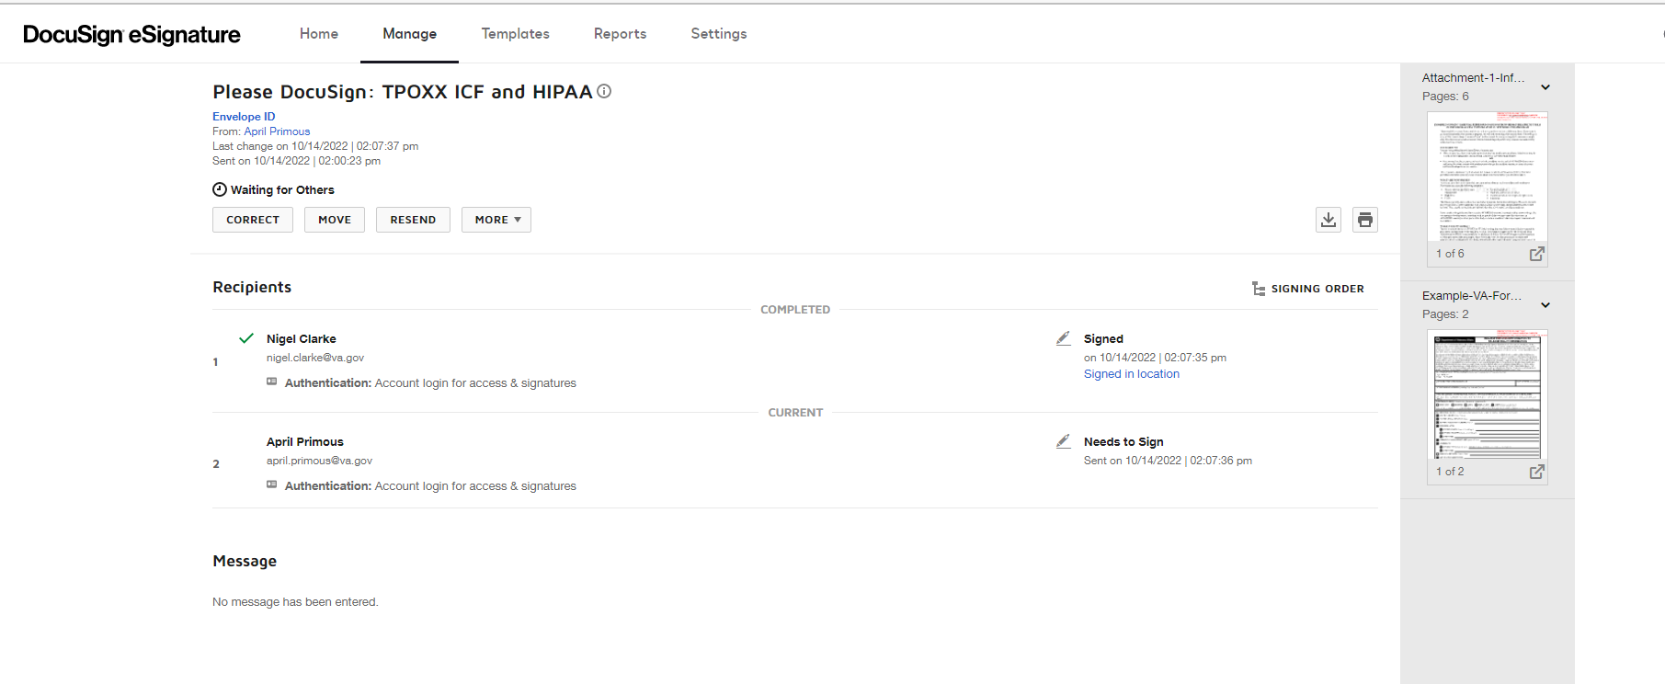
MANAGE Tab:
Click on the sent email and it will show the details of the email to include status and other information
Status of who has signed and who has not signed via the DocuSign application

Slide 16
Form Completion and Signing
All recipients receive an email to the email address(es) provided by the person obtaining informed consent that notifies the recipient that a document requires their signature.
When the recipient(s) click the link in the email, they will be presented with the forms in the DocuSign user interface:
They must complete all required fields
Sign the document and
Click FINISH.
***IMPORTANT – ALL SIGNATURES REQUIRE THE SIGNER TO ‘SIGN IN TO THE DOCUSIGN ACCOUNT’ AND MAKE A SELECTION BEFORE THEY CAN CLICK FINISH FOR 21 CFR PART 11 COMPLIANT SIGNATURES
Once all recipients sign, the participant and the person obtaining informed consent who sent the document for signature will receive an email with a link to the completed and signed forms.

Slide 17
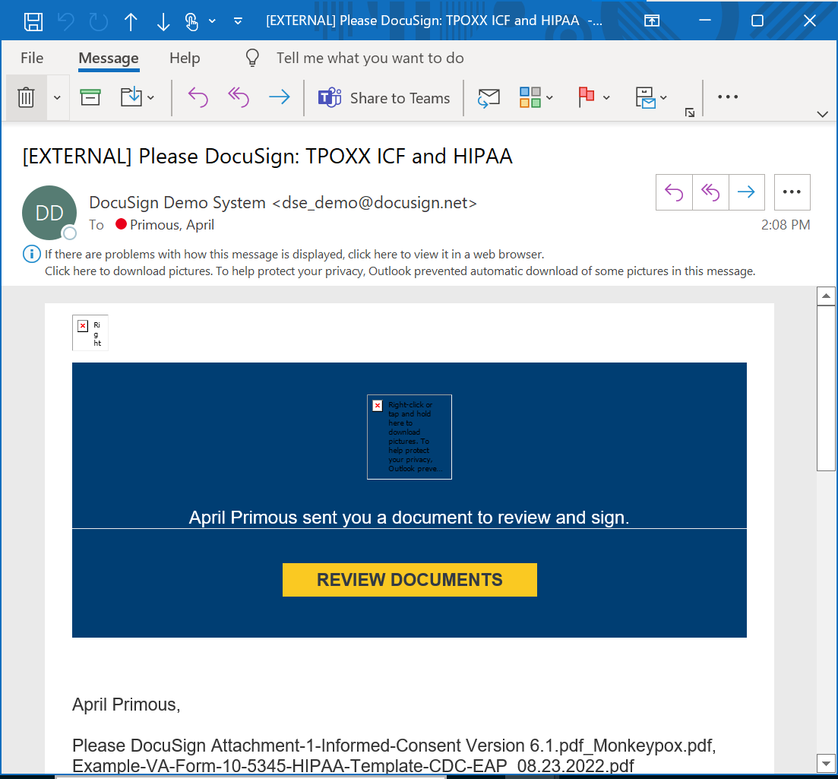

Slide 18
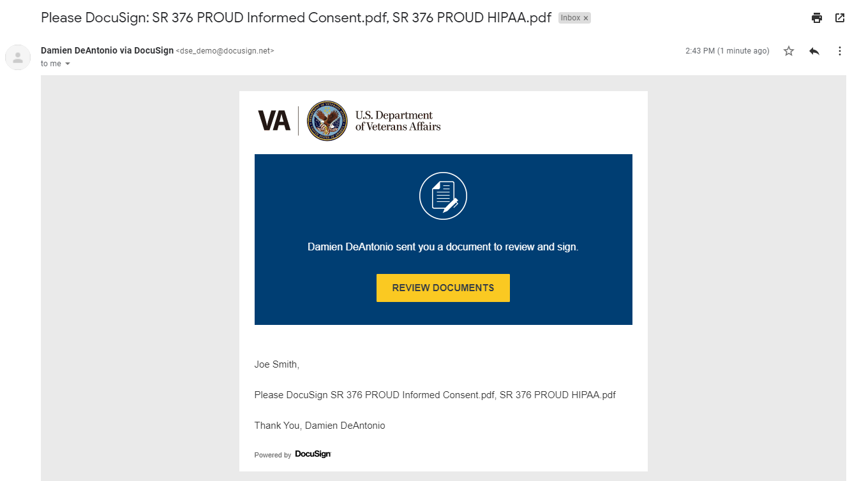

Slide 19
If Participant does not have a Docusign account, they will be prompted to create one.

Slide 20
PARTICIPANT :
On the left side, click the checkbox ‘I agree to use electronic records and signatures’
Then click on the yellow ‘Continue’ button on the right side

Slide 21
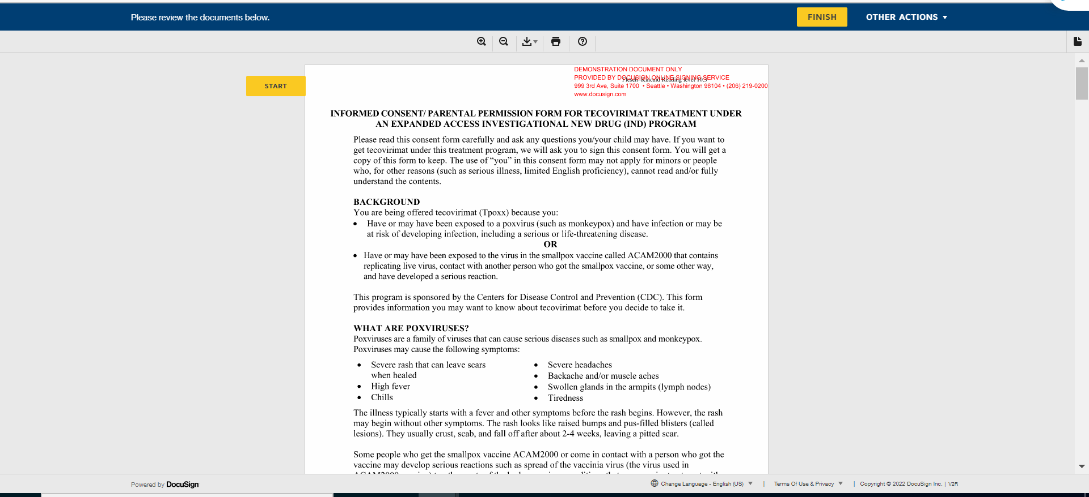
PARTICIPANT :
On the left click the Start button
At any time, use the scroll vertical bar on the right to review the whole document.

Slide 22
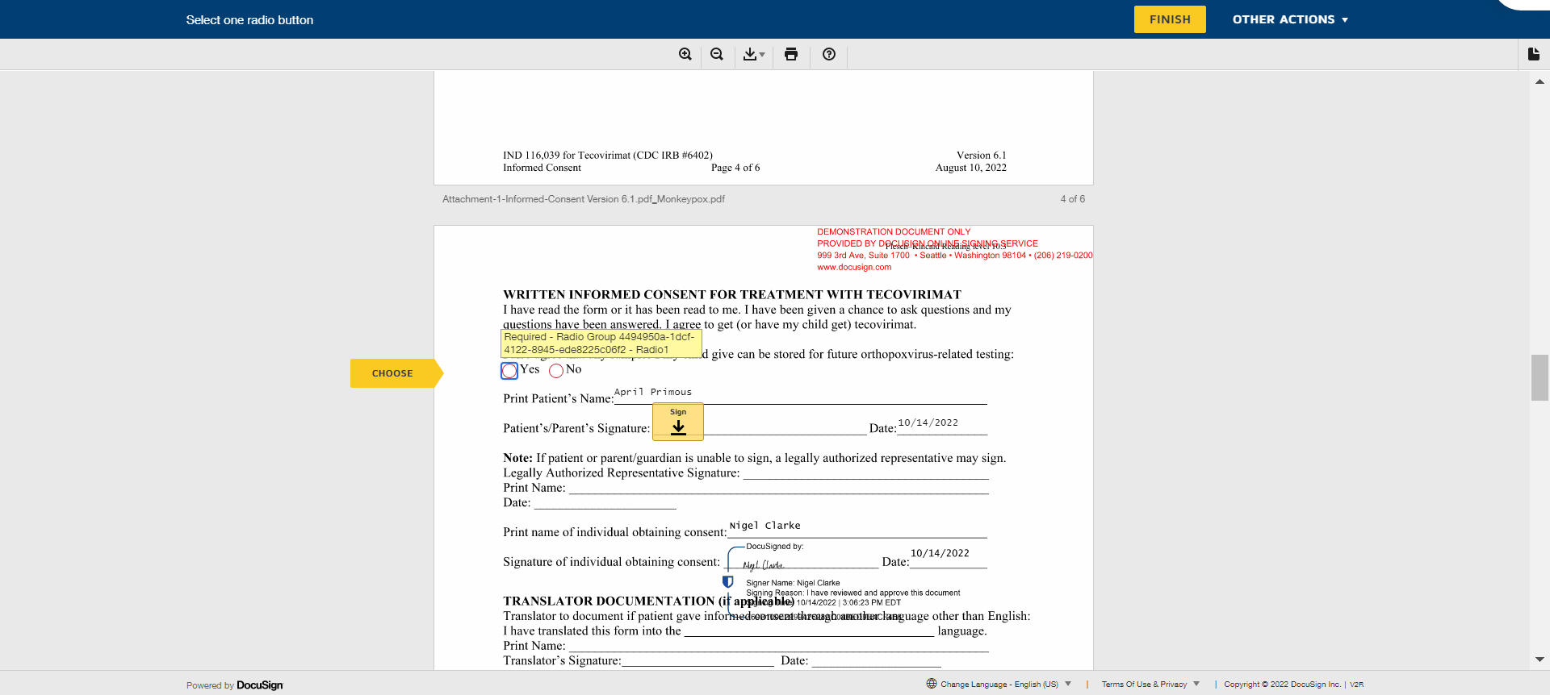
PARTICIPANT :
You will be taken to the FIRST spot to enter the required information. NOTE: There are three total spots for you to enter the required information.
Choose either YES or NO
Then click the yellow ‘SIGN’ button
Notice: Your name is pre-populated on the Participant’s Name entry and the date has been added automatically (IF this is not correct, please contact the Research Study POC)

Slide 23
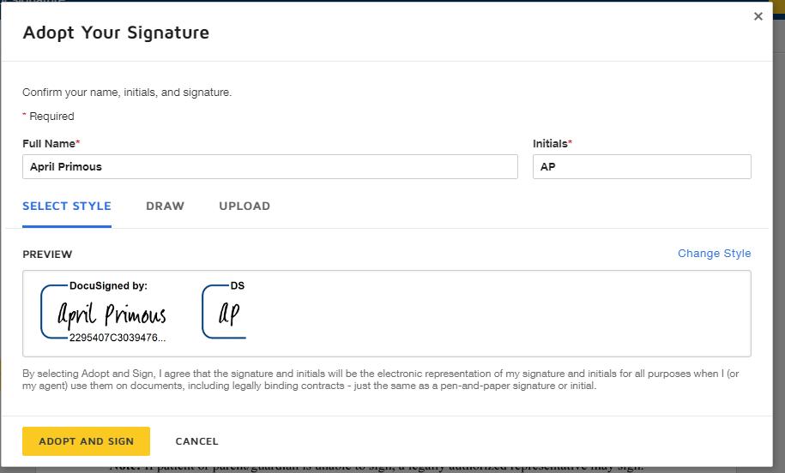

Slide 24
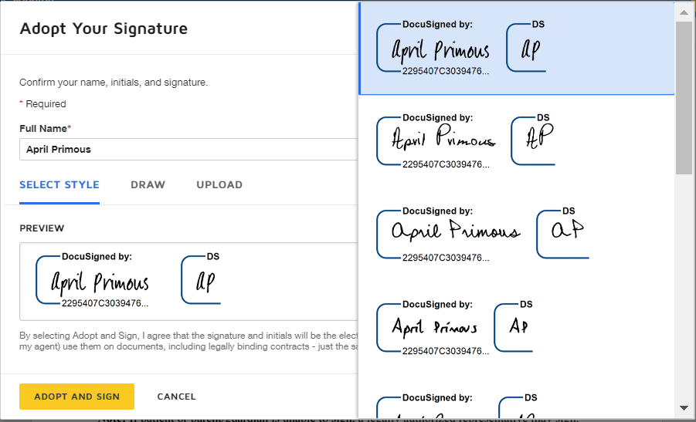

Slide 25
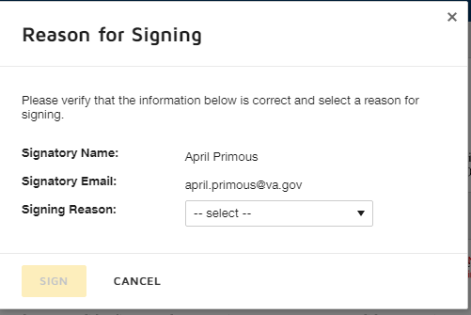
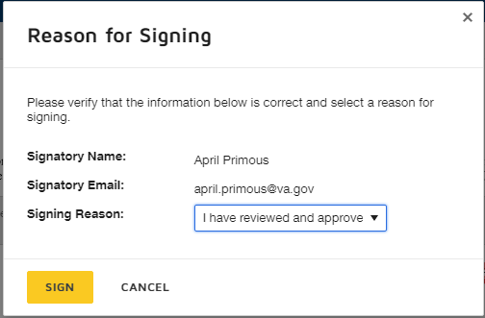
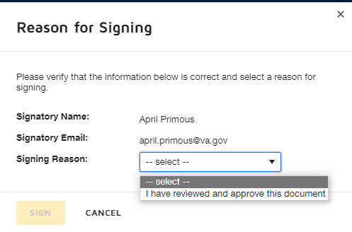
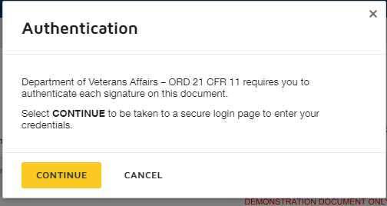
Login again….email and password for Participant. SSOi for VA staff (va.gov emails)
1
3
2
4

Slide 26
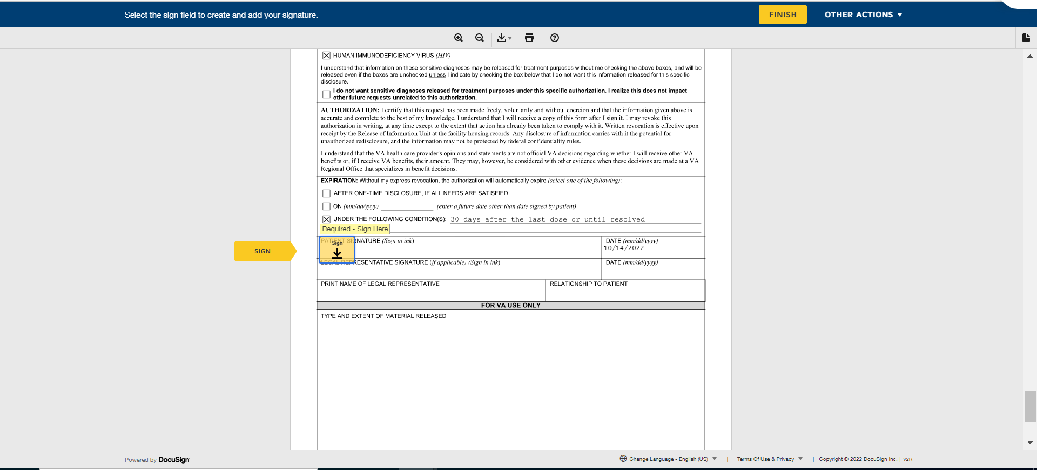
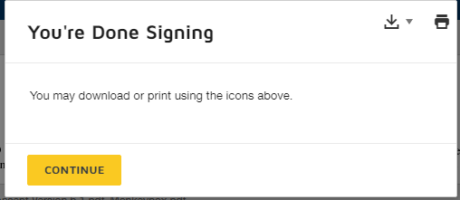

Slide 27
Login again….email and password for Participant. SSOi for VA staff (va.gov emails)
1
3
2
4

Slide 28
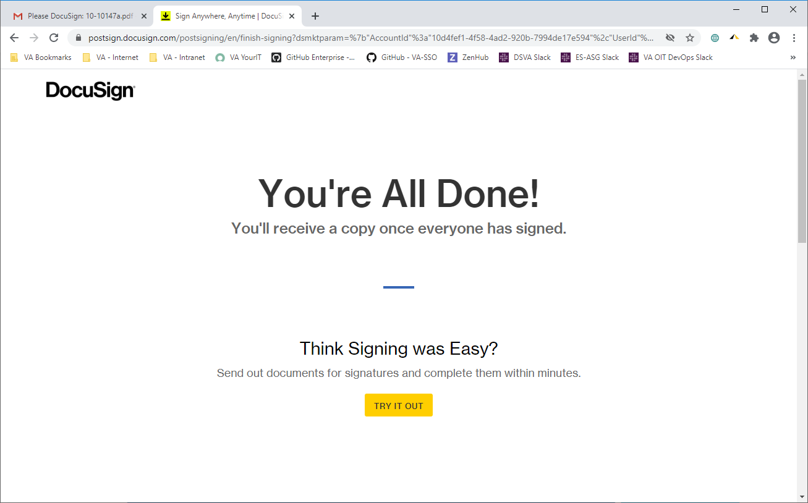

Slide 29
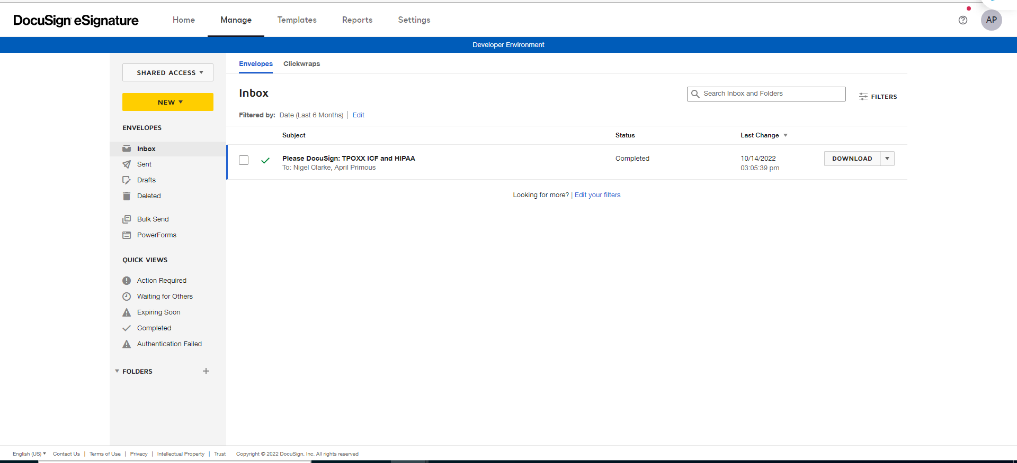
PERSON OBTAINING CONSENT:
You will receive an email that all signatures are complete.
All signers receive an email that shows the completed documents which can be downloaded and saved to any document repository (i.e., Server or desktop) as approved by the IRB.
Log into your DocuSign account inbox to see the signed and completed Informed Consent Forms and VA Form 10-5345.

Slide 30
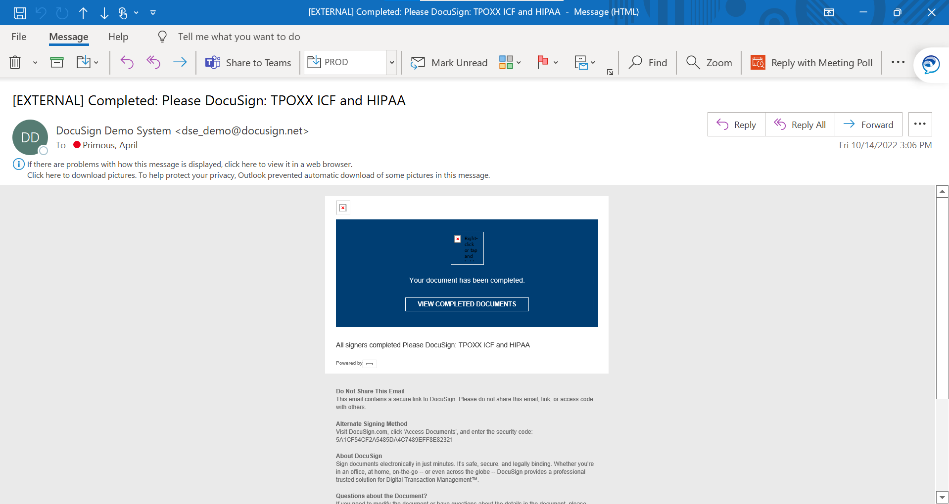

Slide 31
PERSON OBTAINING INFORMED CONSENT: Retrieve Signed Documents (Informed Consent Form and VA Form 10-5345)
The completed and signed Informed Consent Form and VA Form 10-5345 can be retrieved from DocuSign using the steps below or by clicking the link in the completion notification email.
Go to https://app.docusign.com/documents and select login
Click Sent from the left side
Find the desired envelope/document (the search box on the upper right can be used to locate the envelope as well)
Click on the documents to view the Informed Consent Form and VA Form 10-5345 and its associated data.

Slide 32
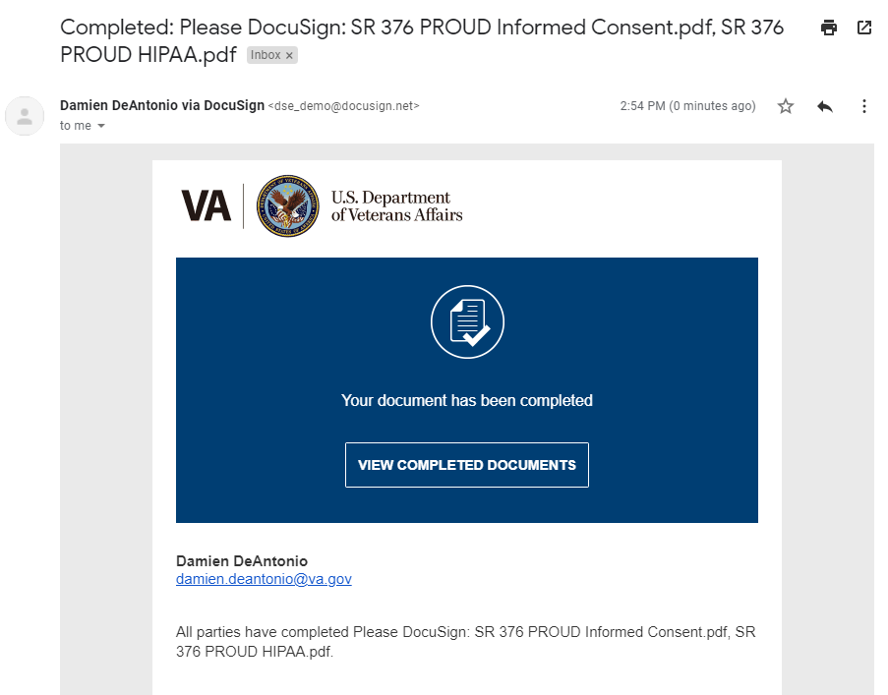
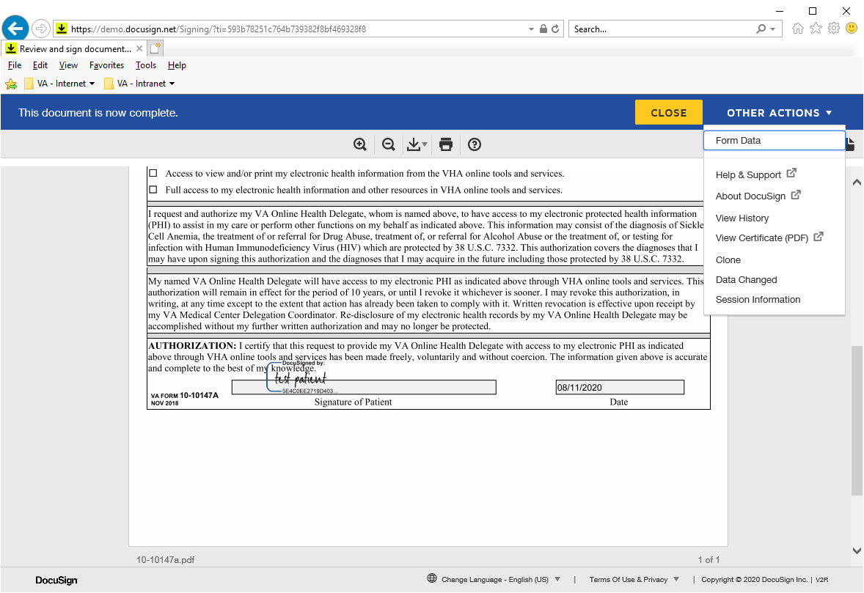

Slide 33
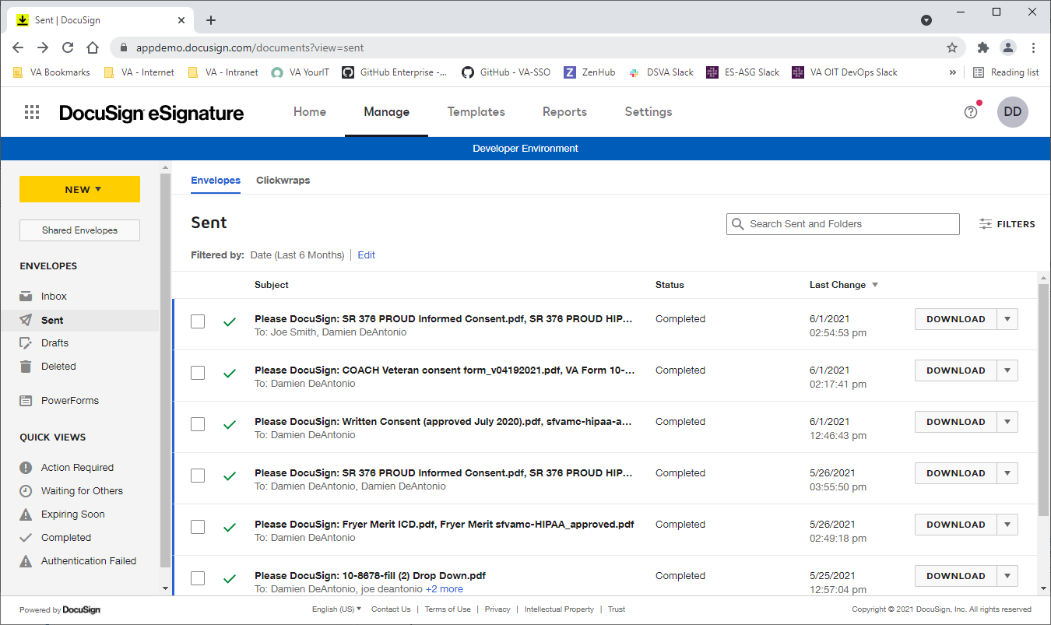

Slide 34
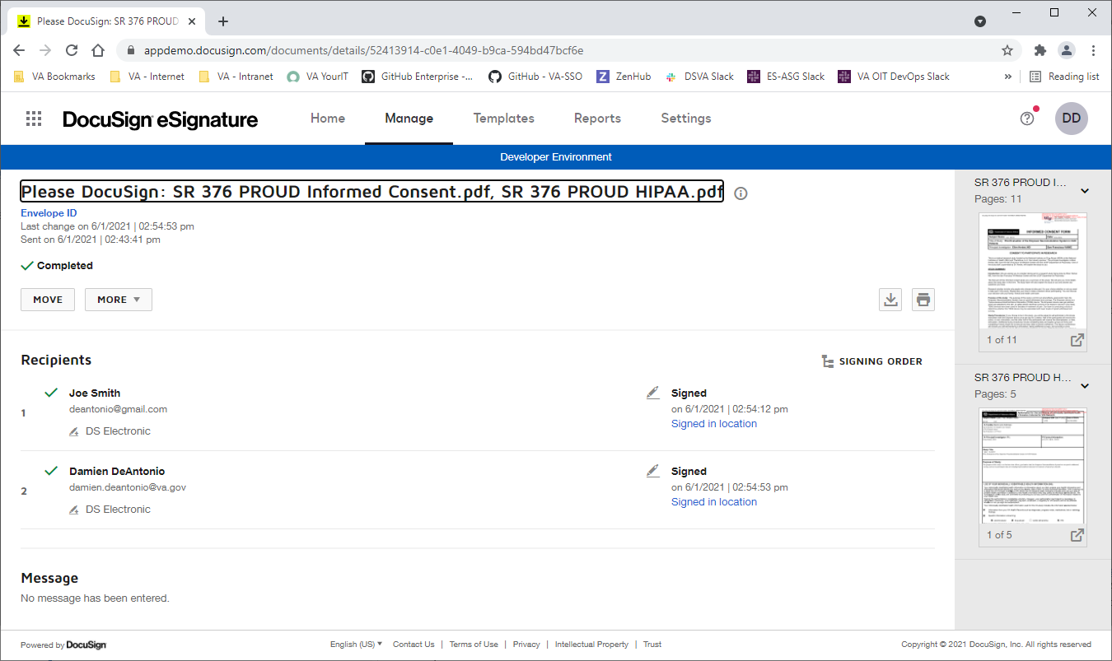

Slide 35
QUESTIONS?

