Slide 1
Key Issues Involving Use of Data and Biospecimens in VA and Collaborative Research and Related Issues
C. Karen Jeans, PhD, CCRN, CIP
VHA Office of Research and Development (ORD)
2023 IRB and R&D Committee Chair Workshop
February 9, 2023

Slide 2
Discussion Topics
Selected key misconceptions and areas of confusion about VA data.
Status required to access “VA data”
Role of IRB and R&D Committee in review of Data Use Agreements (DUAs)
CRADAs and R&D Committee approvals
Key questions an IRB and VA Facility Research & Development (R&D) Committee need to ask when an investigator wants to start a biobank.
Abandoned biobanks

Slide 3
Common Misconception about “VA Data” #1:
If VA sends VA data to the University, the person receiving it at the University MUST have a VA status.

Slide 4
Does Joint Data Exist?
VA Facility
University

Slide 5
Common Misconception about “VA Data” #2:
IRBs MUST Review Data Use Agreements

Slide 6
Common Misconception about “VA Data”:
But What About VA Facility Research and Development
Committees?
IRBs MUST Review Data Use Agreements

Slide 7
Common Areas of Confusion: Order of Approvals
VA Facility R&D Committee
CRADA

Slide 8
Common Confusion about “VA Agreements/Data #3:
The R&D Committee should approve the study AFTER the study’s Cooperative Research and Development Agreement (CRADA) is executed.

Slide 9
Moving on to Biospecimens ----

Slide 10
Key Initials Questions: Proposed Transfer of Biospecimen Bank – Ethical Aspects (not Privacy)
How were the biospecimens obtained?
What is the type of biospecimens (e.g., blood, spinal cords)?
3. If consented cohort, what did the IRB-approved informed consent document state where the biospecimens would reside?
Who is allowed access?
How they will be used and distributed (e.g., to whom and for what purposes)?
4. Is any data associated with the biospecimens also proposed to be transferred?
5. Has the institution in possession of the biospecimens (and any associated data) confirmed that they will agree to transfer the biospecimens?

Slide 11
Key Initials Questions: Proposed Transfer of Biospecimen Bank – Infrastructure Aspects
How big is the collection?
Are biospecimens still being collected?
What are the conditions of storage for the biospecimens?
How many freezers will be needed for the current collection?
Does the facility have the appropriate space for the biospecimens?
What was the prior distribution (if any) and projected distribution for requests?
How will requests for biospecimens and/or data be evaluated?
Does the proposed investigator have prior experience with biobanks?

Slide 12
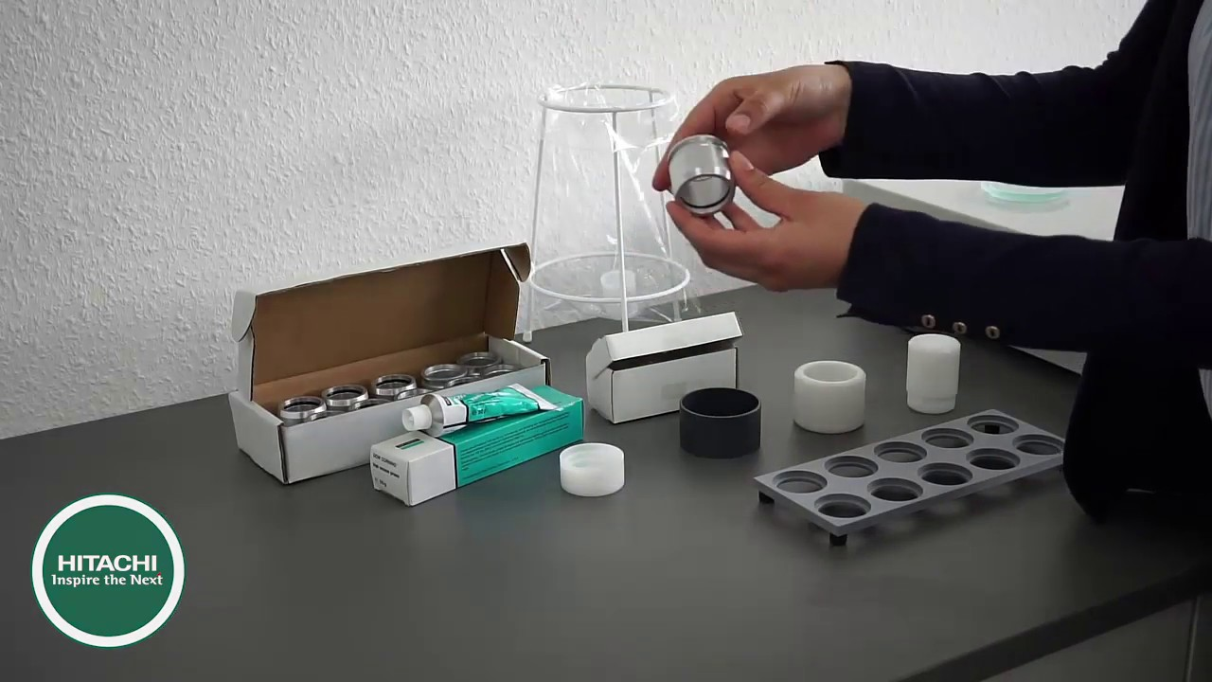
One of the Most Important Questions When a Biobank is Proposed: Succession Planning Vs. Destruction
Destruction

Slide 13
To be Avoided with Any Biobank: Abandonment

Slide 14
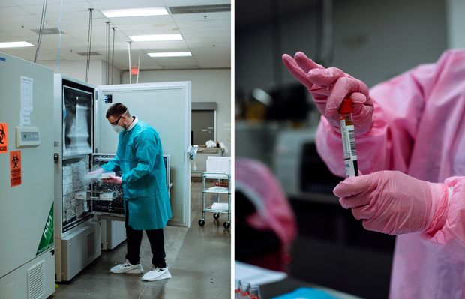
What Happens with Abandoned Biobanks?

Slide 15
Issues for Consideration Before Destruction of a Biobank:
Is it a Unique Collection?

Slide 16
Summary

