Slide 1
Assignment Agreement Title IV of the Intergovernmental Personnel Act of 1970 (5 United States Code (U.S.C.) 3371 – 3376)
Completion of Optional Form 69/IPA
Nonprofit Program Office – 2013
Office of Research and Development

Slide 2
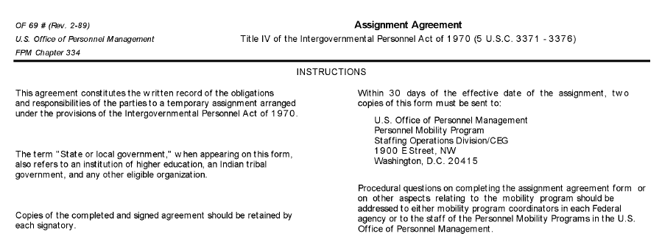
Instructions

Slide 3
Part 1-3 Nature of Assignment
New Agreement
Modification
Extension
The nature of the assignment is determined by:
New Agreement
Modification
Extension

Slide 4
Part 1-3 Nature of Assignment – new agreement
Part 2 – Block 5A NO
(Employee has not been on an IPA previously)
New
Agreement
Part 2 – Block 5B Dates are left Blank
(employee has not been on an IPA previously)

Slide 5
Part 1-3 Nature of Assignment - MODIFICATION
Modification
Time period covered on all previous IPA (s)

Slide 6
Part 1-3 Nature of Assignment - EXTENSION
Extension
Date (s) vary based on IPA History

Slide 7
Part 1-3 Parties to the Agreement
Part 3 - Block 6
An IPA is NEVER between the University and the NPC
The IPA is ALWAYS with a Federal Agency
Part 3 - Block 7
This block will always be the local NPC
Part 3 - Block 8
This is an Unusual Occurrence for the NPC

Slide 8
Part 4 – Position data –Position Currently Held
Part 4 - Block 10 Must Be Completed.
Examples of hard-to-fill positions: Statistician, Chemist, Nurse Coordinator, Scientist
Best Practice:
Part 4 - Block 12
Matthew McConaughey, PI
Actual Signature
Notes:
Note that the PI should sign someplace in either location to acknowledge responsibility. Sign one of the two places

Slide 9
Part 4 – Position data - Type of current appointment
This is an unusual occurrence for the NPC

Slide 10
Part 4 – Position data –Type of current appointment
At least 90 Days prior to the start of IPA
How do we arrive at $31,200 annually?
$15hr X 80hr bi-weekly X 26 pay periods = $31,200

Slide 11
Part 4 – Position data – position to which assignment will be made
Part 4 - Block 16 Must Be Completed.
Examples of hard-to-fill positions: Statistician, Chemist, Nurse Coordinator, Scientist
Part 4 - Block 18
Matthew McConaughey, PI
and Original Signature

Slide 12
Part 5 type of assignment
Individuals on IPAs will not be given WOC appointments as liability issues are covered in the IPA legislation (5 U.S.C. 3374)
Varies based on appointment

Slide 13
Part 5 type of assignment
This Date should be at least 90 days after the date entered in Part 4 - Block 14
The IPA can NEVER exceed two years

Slide 14
Part 6 Reason for mobility assignment

Slide 15
Part 7 – Position description

Slide 16
Part 8 – Employee benefits
Part 8 – Block 23 Indicate hourly, bi-weekly or annual salary
NPC NURSE
IPA NURSE
NPC CHEMIST
IPA CHEMIST

Slide 17
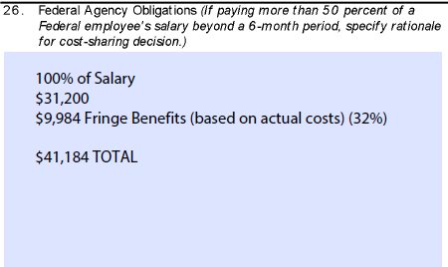
Part 9 – Fiscal obligations
Fringe Benefits
(based on actual costs)
The NPC will always calculate including all leave.
Part 9 - Block 26 State the specific percentage of employees salary

Slide 18
Part 9 – Fiscal obligations
Fringe Benefits
(based on actual costs) The NPC should consider all costs including retirement, health insurance, worker’s compensation insurance, annual leave, etc..

Slide 19
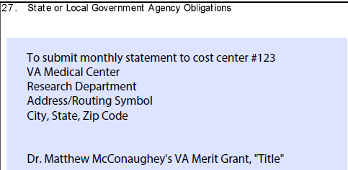
Part 9 – Fiscal obligations
Part 9 – Block 27 The NPC will submit (monthly or quarterly)
the invoice to cost center #123
The cost center is a sub-organization where costs are incurred and responsibility is fixed on the organizations management. These cost centers are distinguished by area of responsibility and are symbolized by a four-to-six digit code used to identify the organizational elements throughout the VA.
Notes:
Slide 19, can we split this into two slides?
26. This always states the specific percentage of employee’s salary
Fringe Benefits (based on actual costs) The NPC will calculate this.
25. The NPC will submit monthly (quarterly, annually) an invoice to cost center #123 (These are VA’s cost center that associate with the specific grant or project covered in this IPA)
Always include the entire mailing address.

Slide 20
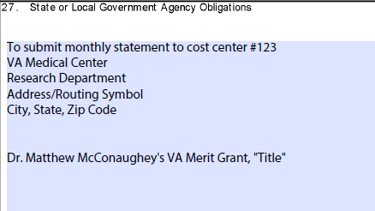
Part 9 - Fiscal obligations
Always include the entire mailing address
Notes:
Slide 19, can we split this into two slides?
26. This always states the specific percentage of employee’s salary
Fringe Benefits (based on actual costs) The NPC will calculate this.
25. The NPC will submit monthly (quarterly, annually) an invoice to cost center #123 (These are VA’s cost center that associate with the specific grant or project covered in this IPA)
Always include the entire mailing address.

Slide 21
Part 10 – Conflicts of interest and employee conduct
Self-Explanatory

Slide 22
Part 11 – options
IPA employees do not receive federal benefits
Nurse
Nurse

Slide 23
Part 12 – Travel and transportation expenses and allowances
In the Event of Travel
Standard NPC Travel Policy Applies

Slide 24
Part 13 – Applicability of rules, regulations and policies
A – B – C - D
Apply to the IPA
E
Not normally part of IPA agreements between VA and NPC

Slide 25
Part 14 – Certification of assigned employee
Part 14 - Block 35
Local NPC
Part 14 - Block 36
Same Date as
Part 5 - Block 20
Employee Signs and Date

Slide 26
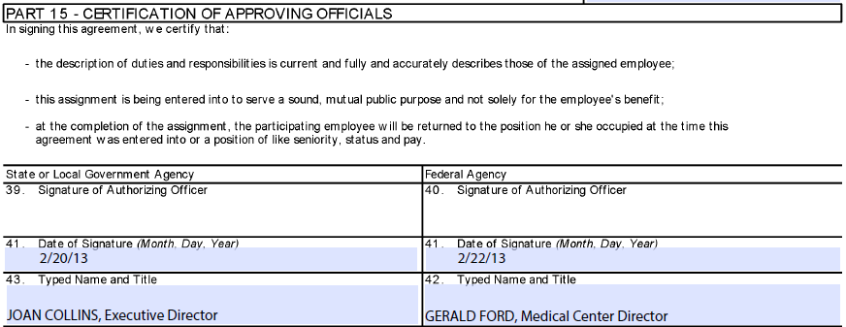
Part 15 – Certification of approving officials
Sign and Date Prior to from Date identified in Part 5 Block 20

Slide 27
Privacy act statement
TITLE 5--ADMINISTRATIVE PERSONNEL CHAPTER I--OFFICE OF PERSONNEL MANAGEMENT PART 334 TEMPORARY ASSIGNMENTS UNDER THE INTERGOVERNMENTAL _{PERSONNEL ACT (IPA)}

