Slide 1
69th AALAS National Meeting AVAVMO/VMU Supervisors Business Meeting
30 October 2018
12:00-2:00 pm

Slide 2
Responsible Transparency
Alice Huang
Office of the CVMO
Deputy for IACUC Guidance

Slide 3
Children:
Messy
Inconvenient
Expensive

Slide 4
Children:
Messy
Inconvenient
Expensive

Slide 5
Research with Animals:
The
Whole
Story
Part
of the Story

Slide 6
Why Aren’t We Making Sure that the Public Knows the Whole Story?
Assume it’s obvious, common knowledge
We’re too busy doing the work
It’s not in our nature or training
Expect it will be enough to answer questions
Fear

Slide 7
Groups Working to Address the Gaps
Pro-Test
Americans for Medical Progress (AMP)
Speaking of Research
Understanding Animal Research (UAR)
European Animal Research Association (EARA)

Slide 8
How These Groups Are Helping
Assume it’s obvious, common knowledge
We’re too busy doing the work
It’s not in our nature or training
Expect it will be enough to answer questions
Fear
Fill in the gaps in
Support so we can do
Contribute communications expertise

Slide 9
Concordat on Openness on Animal Research in the UK
1 – We will be clear about when, how and why we use animals in research
2 – We will enhance our communications with the media and the public about our research using animals
3 – We will be proactive in providing opportunities for the public to find out about research using animals
4 – We will report on progress annually and share our experiences

Slide 10
Dangers
of Transparency
Dangers of Secrecy

Slide 11
Concordat on Openness on Animal Research in the UK
1 – We will be clear about when, how and why we use animals in research
2 – We will enhance our communications with the media and the public about our research using animals
3 – We will be proactive in providing opportunities for the public to find out about research using animals
4 – We will report on progress annually and share our experiences

Slide 12
Looking Out for the Animals | Why We Do What We Do | FAQs | The Rules
Numbers of Animals | VA is committed to doing the research that we need to do, to improve the medical care that we can offer our Veterans. When that means that we must do research with animals, we make sure that the animals experience as little pain or distress as possible, as we work toward reducing the pain and distress that Veterans experience. |  | The People
Adoptions |  |  | Current Efforts
VA Money | For Researchers | For Administrators | Other Voices

Slide 14
Looking Out for the Animals | Why We Do What We Do | FAQs | The Rules
Numbers of Animals | VA is committed to doing the research that we need to do, to improve the medical care that we can offer our Veterans. When that means that we must do research with animals, we make sure that the animals experience as little pain or distress as possible, as we work toward reducing the pain and distress that Veterans experience. |  | The People
Adoptions |  |  | Current Efforts
VA Money | For Researchers | For Administrators | Other Voices

Slide 15
Who Looks Out for the Animals?
Role | How Many?
VA Veterinarians | ~ 70
VMU Supervisors | ~ 70
Vet Techs / Animal Techs | hundreds
IACUC members | >350
IACUC administrators | ~ 70
Researchers | hundreds
Research staff | thousands
CVMO Office | 4
ORO/Animal Research | 3

Slide 16
Looking Out for the Animals | Why We Do What We Do | FAQs | The Rules
Numbers of Animals | VA is committed to doing the research that we need to do, to improve the medical care that we can offer our Veterans. When that means that we must do research with animals, we make sure that the animals experience as little pain or distress as possible, as we work toward reducing the pain and distress that Veterans experience. |  | The People
Adoptions |  |  | Current Efforts
VA Money | For Researchers | For Administrators | Other Voices

Slide 17
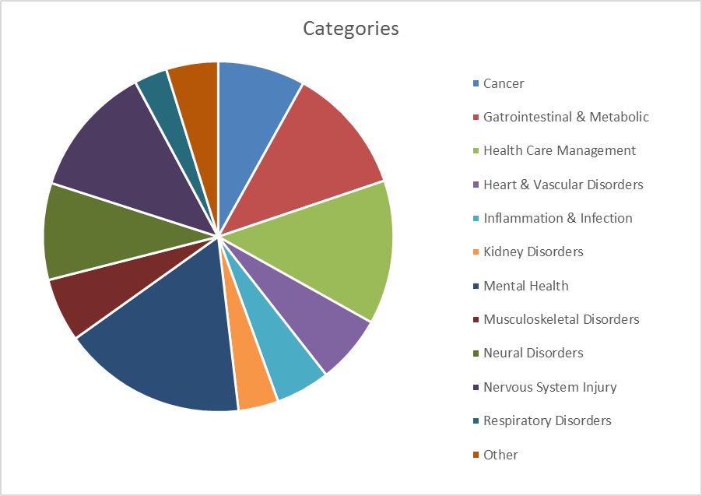
Projects from
FY17-FY18 review cycles funded
so far

Slide 18
Research on Mental Health
Includes projects addressing PTSD, substance use disorders, depression, suicide
Research is conducted with
Humans (60)
Mice (10)
Rats (7)
No subjects (4)
Pigs (1)

Slide 19
Projects from
FY17-FY18 review cycles funded
so far

Slide 20
Research on Heart and Vascular Disorders
Includes projects addressing cardiac failure, myocardial infarction, deep vein thrombosis
Research is conducted with
Mice (16)
Humans (11)
Rats (3)
Guinea Pigs (1)
Rabbits (1)
Zebrafish (1)
No subjects (1)

Slide 21
Looking Out for the Animals | Why We Do What We Do | FAQs | The Rules
Numbers of Animals | VA is committed to doing the research that we need to do, to improve the medical care that we can offer our Veterans. When that means that we must do research with animals, we make sure that the animals experience as little pain or distress as possible, as we work toward reducing the pain and distress that Veterans experience. |  | The People
Adoptions |  |  | Current Efforts
VA Money | For Researchers | For Administrators | Other Voices

Slide 22
Follow the Money
Veterans Benefits Administration | Veterans Health Administration
 | NCA and Admin

Slide 23
Looking Out for the Animals | Why We Do What We Do | FAQs | The Rules
Numbers of Animals | VA is committed to doing the research that we need to do, to improve the medical care that we can offer our Veterans. When that means that we must do research with animals, we make sure that the animals experience as little pain or distress as possible, as we work toward reducing the pain and distress that Veterans experience. |  | The People
Adoptions |  |  | Current Efforts
VA Money | For Researchers | For Administrators | Other Voices

Slide 24
Numbers of Animals

Slide 25
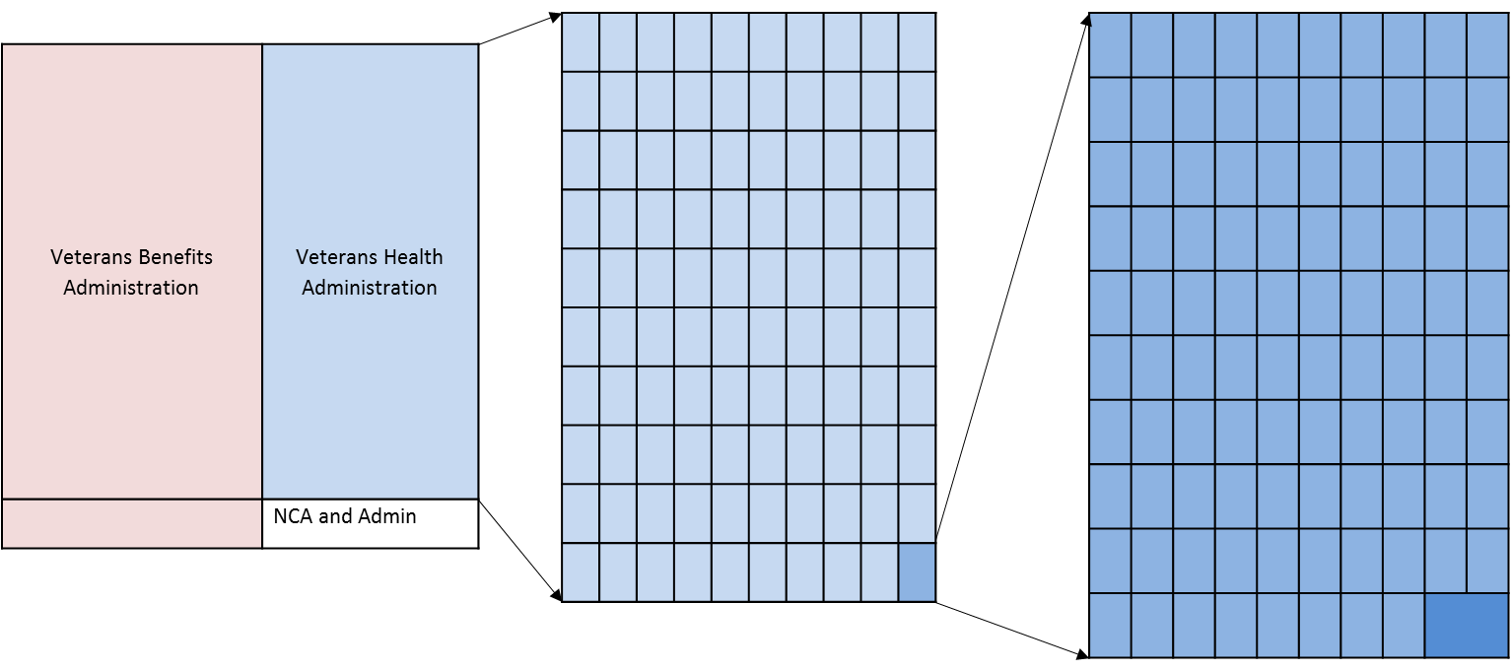
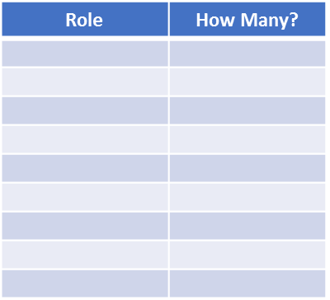
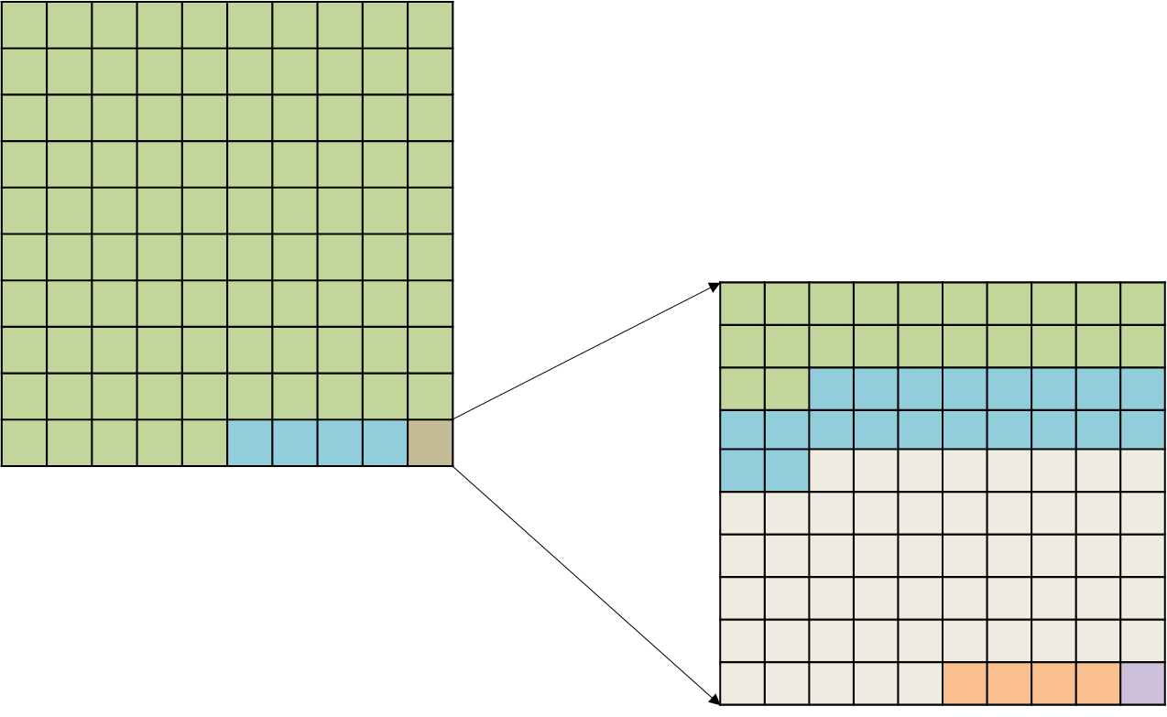
Research with Animals:
 | VA is committed

Slide 26
Thank You!

