Slide 1
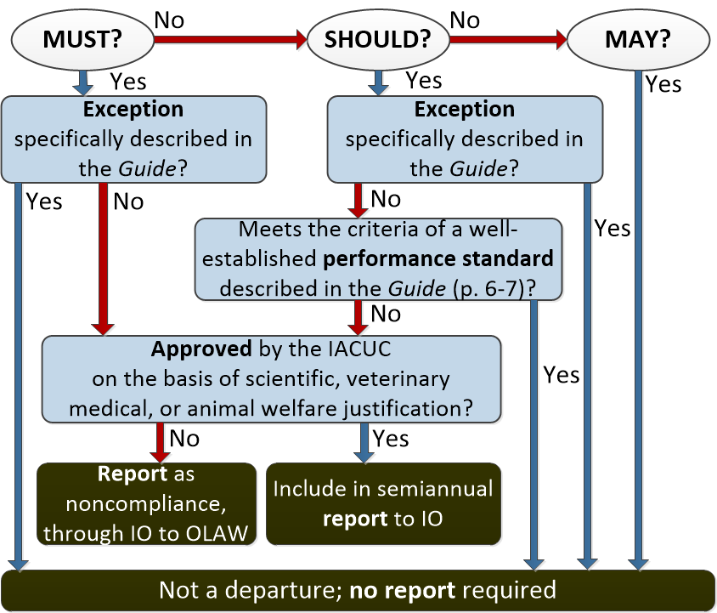
IACUC Departure Decision Tree
Prepared by VA Office of the CVMO; reviewed by OLAW for consistency with The PHS Policy (2015).
Notes:
OFFICE OF RESEARCH AND DEVELOPMENT VETERANS HEALTH ADMINISTRATION
Departure Decision Tree
(Flowchart prepared by the Office of the CVMO)
Date: March 12, 2015 Guidance Document: AR2015-001

